Slide 1
Founding Team
E - LAB
BUSINESS PLAN
Prachi Singh (20DM153) Rashi Arora (20DM169) Ritika Gupta (20DM176)
Sangeet Khandelwal (20DM186) Sanya Arora (20DM188) Saransh Neerad (20DM189)

Slide 2

BinClean
“Removing Waste for a better Nest”

Slide 3
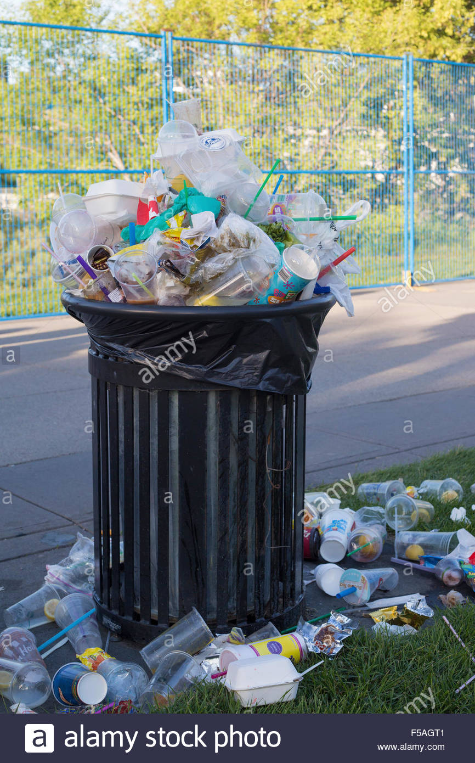

Genesis of the Idea
Traditional overflowing Dustbins (often without lids).
No routine clean up of dustbins.
Lack of synchronisation between sanitation workers.
Concern for hygiene and cleanliness.

Slide 4
Options before Founders
Campaign (Educational / Psychological )
Set-up a Non-Profit Organisation / NGO
Collaborate with Government Campaign like “Swachh Bharat Mission”
Educate people on cleanliness and hygiene.
Working with local bodies.
Product based Solution
Design and implement an advanced set-up to remove the waste disposal bottlenecks
Modern Dustbins
Sensors in bins to predict overflow levels (press garbage) and detect overflow status (send SoS)
Using IoT to connect bins and Central Station ; Station alerts Garbage Trucks and bins cleared.

Slide 5
Why BinClean ?
Already existing ; No Novelty in NGO approach
Campaign is a long term idea
Use of founder teams’ technical knowhow
Scalable Model (Technology and Target wise)

Slide 6
Problem Statement
Problem
Waste spillover on roads and other areas due to overflow from dustbins and lack of timely clean-up by local authorities.
Who has it ?
Common Public
Why is it Pressing ?
Leaves surrounding dirty and makes environment unhygienic. Spillover from bins will also lead to air/water/land pollution.
How do you know ?
It is seen everywhere. Interaction with people.
Survey done online.

Slide 7
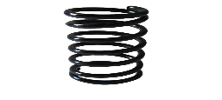
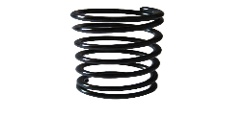
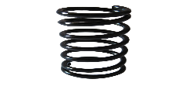
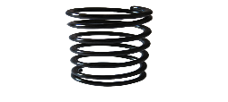

Solution
Push Plates
Spring Motor Mechanism
Product
Smart Dustbin with multiple sensors.
One set of sensors to detect garbage level in the bin and press them.
Second set of sensors sends information to nearest control centre which is then forwarded to nearest waste collection van.
Few other sensors give information about health of dustbin or any damage caused.
Service
Installation of bins
Setting Up the Control Centre
6 Months after sales service (Free)
Hinge
Sensors

Slide 8
Market and Product Positioning
Target Customer
Government (Local Municipal Bodies, Municipal Corporations etc)
Pvt Entities (IT Parks, SEZ, Industrial Parks etc)
Malls, Shopping Complexes etc
Why ?
Upcoming Smart city projects.
Government in dire need of technology solutions for waste management.
To invest 2 Lakh crores.
Go to Market Strategy
Demo at various Trade fairs was a huge success.
Reach out to various Govt Bodies, Local authorities and SPVs (in case of Smart cities)
Partnership with Private Waste Management Companies.

Slide 9
Industry Trends
Waste Management Industry is presently valued at $12-$14 bn.
By 2025, it is projected to reach $15 bn.
------------------------------------------------------------------------------------
Government spending for Smart Cities and Upgrading City Infrastructure pegged around ₹ 2 Trillion.
------------------------------------------------------------------------------------
No. of waste management players in India now: A2Z Green Waste Management, BVG India ltd, Antony Waste Handlers etc.
None of them currently employing this technology.
Companies do want to make the process more efficient.

Slide 10
PESTE Analysis of Business Environment
 | POLITICAL (Govt. Policy/ Regulatory) | ECONOMIC (Growth, Inflation, interest rates etc.) | SOCIAL ( Behavior changes, Buying patterns) | TECHNICAL (R&D, Automation, Digitization) | ENVIRONMENTAL (Ecological & Environmental changes)
Favourable | Positive Intent ; Willing to spend in Infrastructure | Post-COVID Economic recovery is fast. Demand up from all quarters. | Awareness for hygiene and cleanliness. | Latest Technological trends in line with our product | Increasing pollution levels, pandemic etc. incentive for our business.
Unfavourable | Red Tapism ; Lack of cohesion between centre and states. | Although interest rates are low but fund raising is difficult. Banks unwilling to give loans. | - | - | -

Slide 11
Competition Analysis
 | Traditional Dustbins | BinClean
Strength | # No formal installation # Easy to use | # Variety of sensors to detect garbage overflow and Bin Health # Fixed
Weakness | # Garbage Overflow # Can be easily stolen # Bad quality of body material | # Repaired only by technicians. # Immobile
Price Point | 3000-4000 | 5000-5300
UVP | Mobile Garbage Dustbin | Garbage Bin with waste compressor and overflow Sos indicator.

Slide 12
Operational Plan
Key Resources
Physical : Dustbins, Sensors, Solar Panels, Machinery, Storage Facilities, Transportation Vehicles
Human : Engineers, Factory Workers, Marketing Team, Other Office Staffs.
Intellectual : Brand, Partnerships, Patents
Technological : Software
Key Activities
Manufacturing Smart Dustbins
Installation and Control Centre Set-up.
After sales service.
Key Milestones
From Local Bodies -> SEZ, IT/Industrial Parks -> Malls, Shopping Centres -> Rural Areas

Slide 13
Legal Identity
Company Incorporation Year
2019
Key Compliance
Statutory Auditor Appointed
Board Meeting held within 30 days of incorporation.
Directors Appointed
AGM held in April,2020
Financial Reports circulated amongst members of the company.

Slide 14
Organizational Plan - Team
Founding team comprises of Engineers (Computer Science & Mechanical) , Commerce, Economics and Management Graduates.
Team Members have experience of working with various MNCs and executing several projects along similar lines.
Initial Funding in the business came from the founders.
For further growth, they are planning to part some stake in their company and raise funds.

Slide 15
Milestones
Successfully implemented the project across 12 Municipalities across 3 states.
Supplied around 5000 dustbins and established the control centres.
Only 50 dustbins were replaced post installation due to manufacturing defects, thus, keeping the defect rate at a meagre 1 %
Revenues - ₹ 26 Mn in first year of operation ; Profit - ₹ 2.34 Mn

Slide 16
Risk Analysis
Financial Risk
  Investor withdrawing their investment.
  Volatile Profit Margins may lead to higher product cost.
  Strategic Risk
  Idea may sometime not look feasible to our target customer.
  Partners adopting the same technology in near future.
  Operational Risk
  Inefficient Workforce

Slide 17
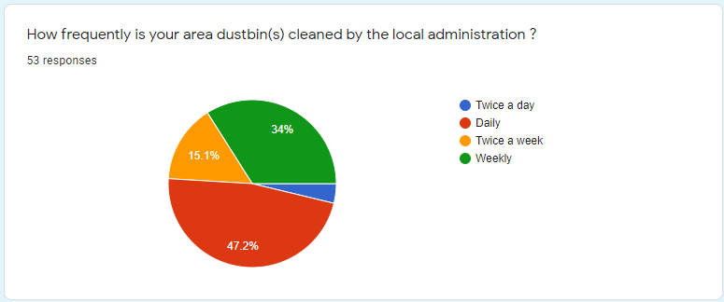
Market Survey Screenshots

Slide 18
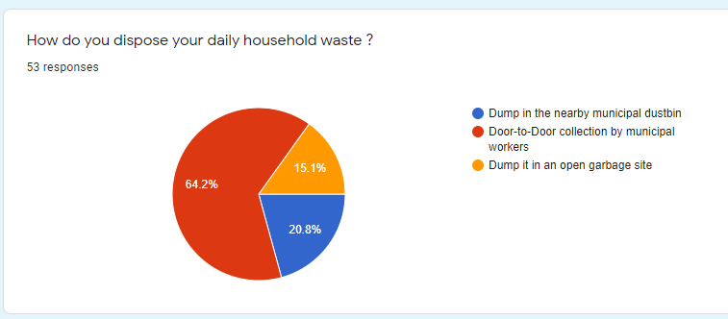

Slide 19
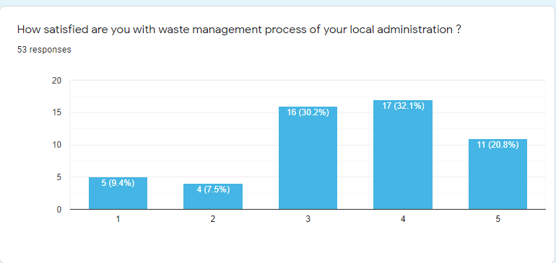

Slide 20
Thank you..

