Slide 1

E-LAB
& Business Models
PROJECT
GROUP 3

Slide 2

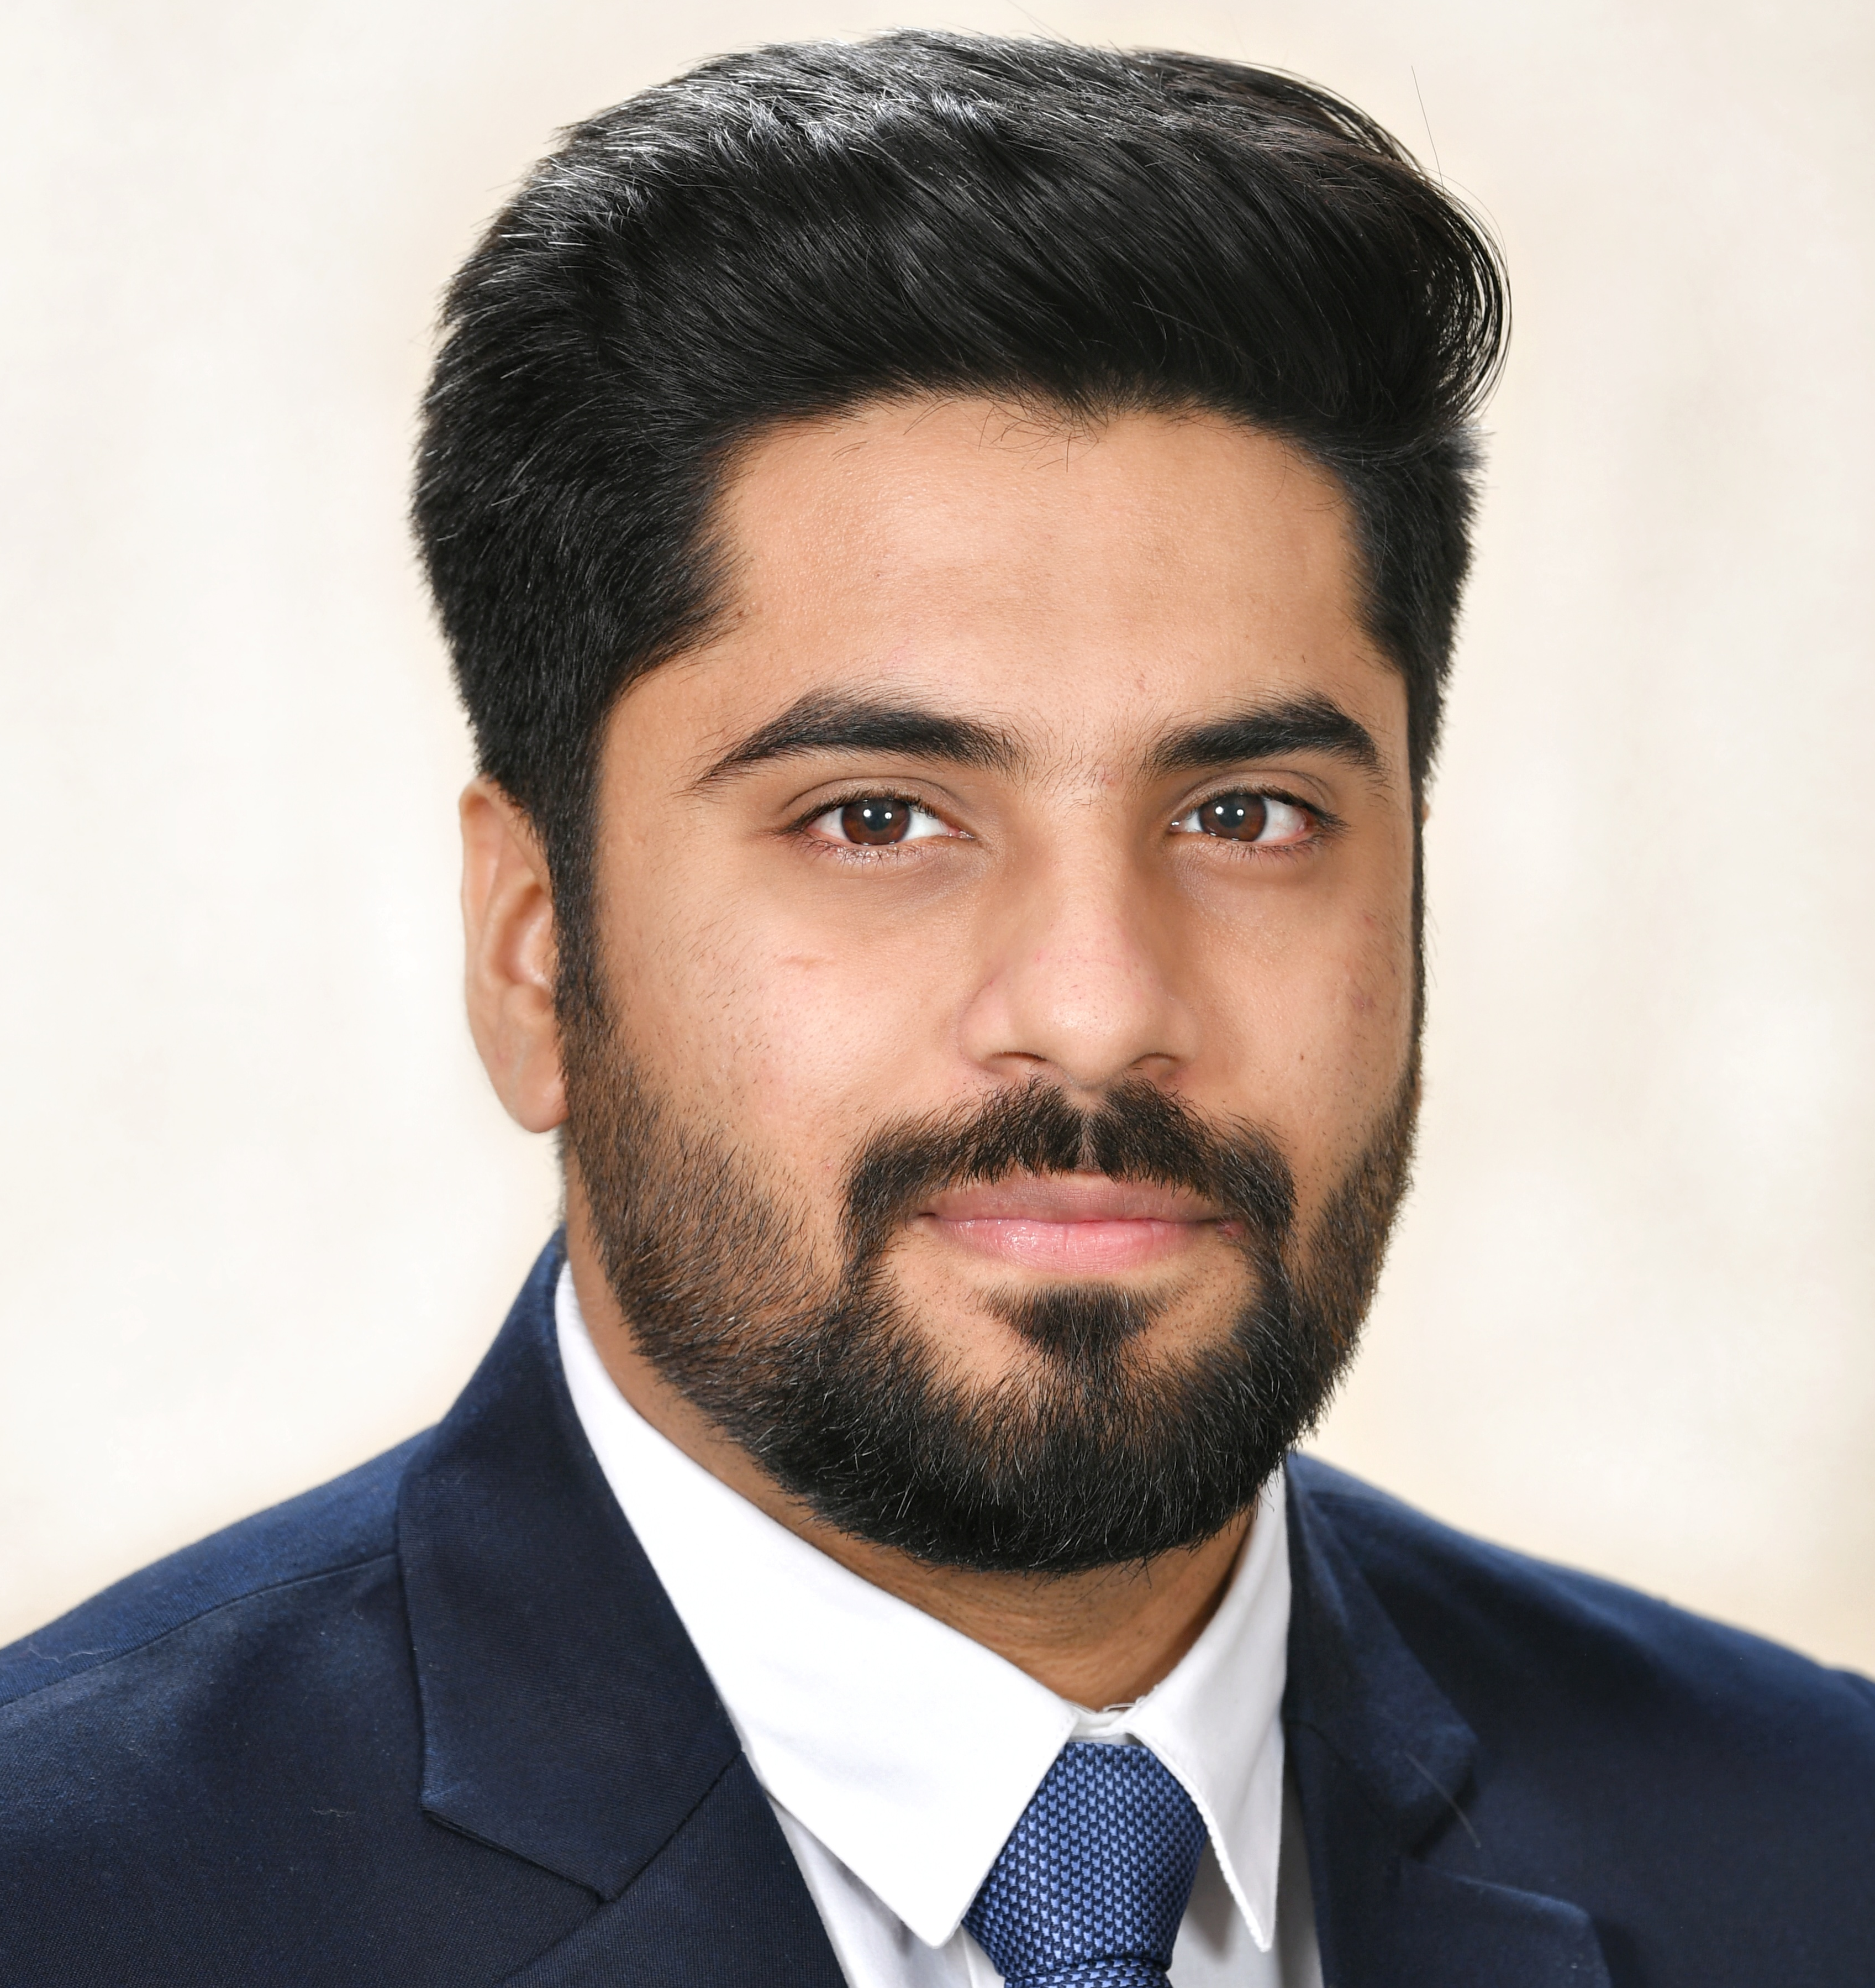

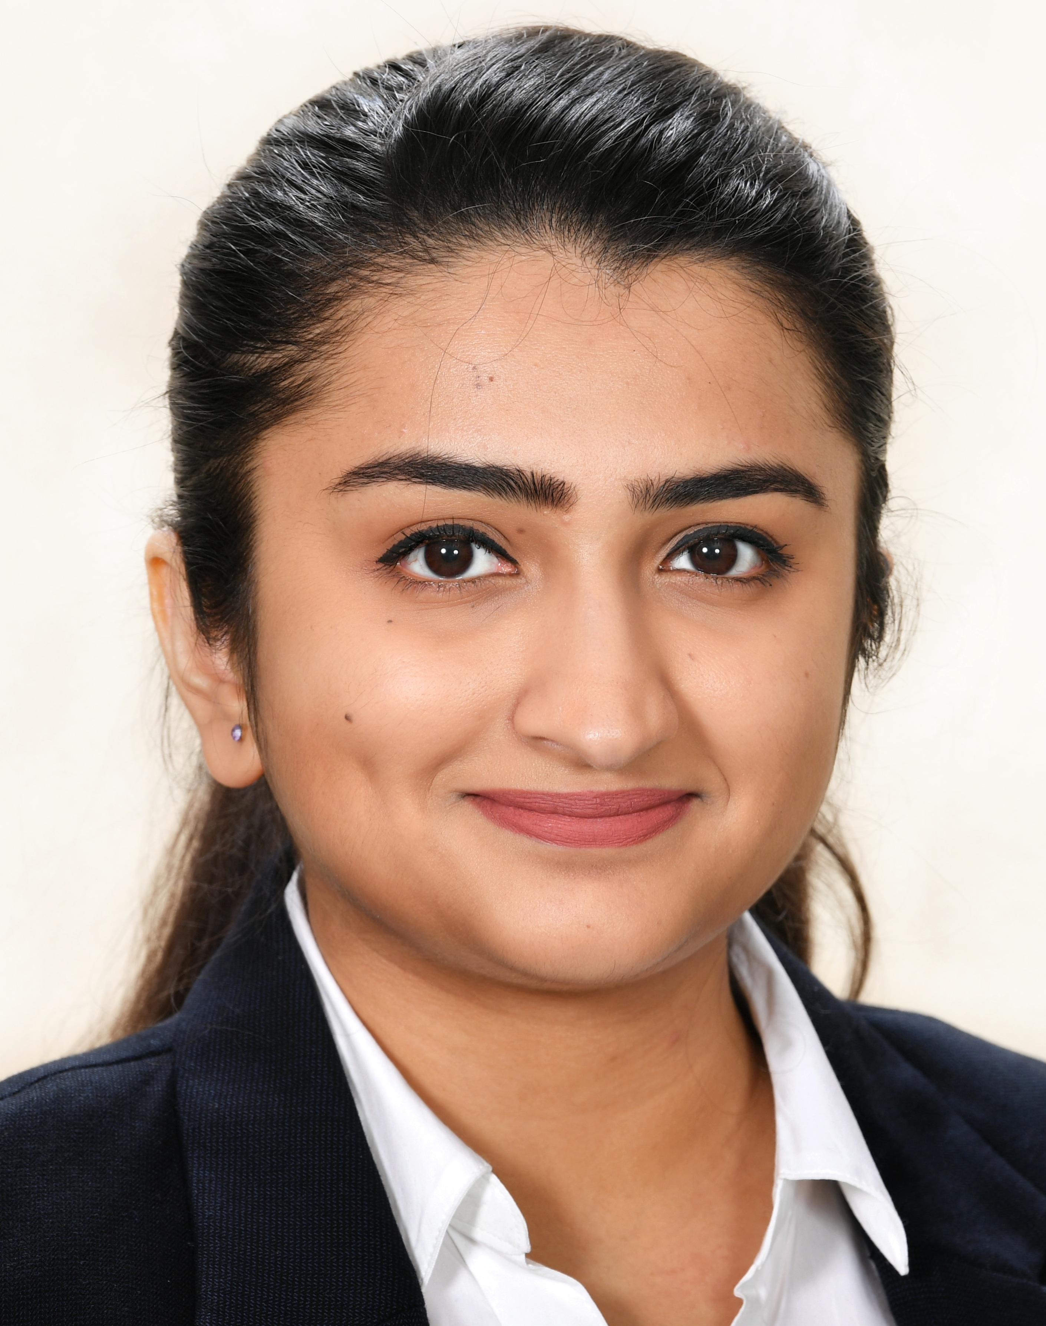
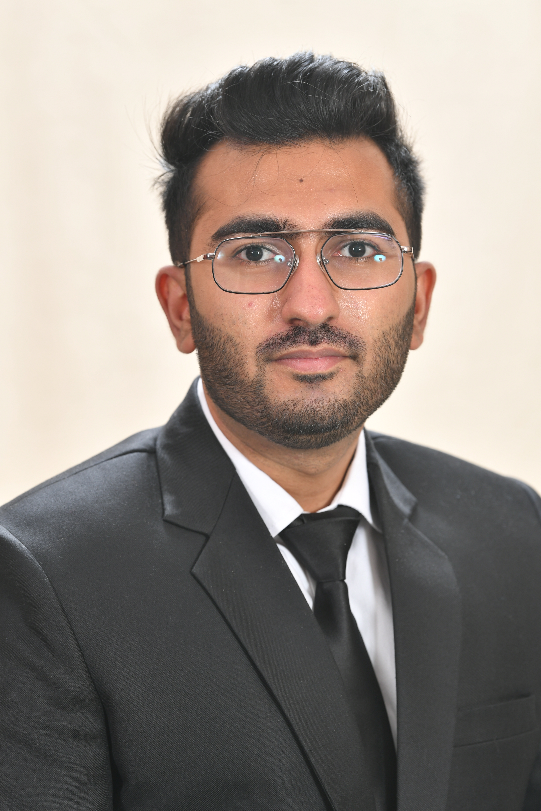
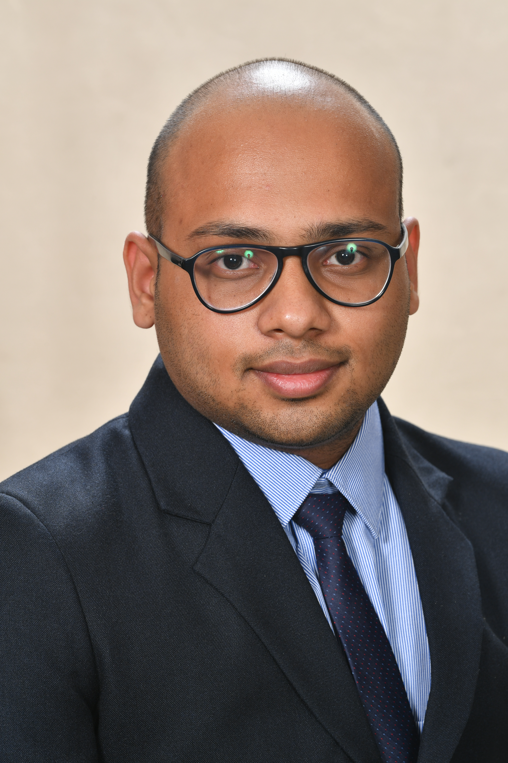
MEET THE FOUNDERS
We Believe
The secret of getting ahead is getting started.
Our Team’s Diverse Portfolio
Adarsh Agarwal
Sales Dealership
Ex HYUNDAI
Vaibhav Arora
Management Consultant
Ex KPMG EX EY
Vrinda Maheshwari
Software Developer
Ex NTT DATA
Tarannum Aurora
EX PR Professional
Pranav Bharti
Sales
Consumer Electronics
V. Soumith Reddy
Software Testing
Ex ACCENTURE

Slide 3


MISSION-
We rent homes for easy, practical and affordable living
VISION-
We make newcomers feel they belong
ABOUT
THE
COMPANY
As you go out, You are a stand-alone person in this massive crowd.
No worries! We are there for you, with a Home alike (Acco in Comfortable Flats) experience, Security, personal assistant and solving all your problems.
We would set up clusters with Institution as the center, All Peerozo in the cluster are within 1 Km distance.
We provide 2-level security optimization especially for students, a security guard, and a personal attendant, especially for students
PEEROZO

Slide 4

GENESIS OF THE IDEA
Studying & Working millennials have laid back attitude .
Customer has to roam around city to physically check for the space.
Stay with strangers (request for room, accommodation changes is always denied)
Poor Infrastructure
Unhygienic mess conditions (no meal service in many cases)
No transparency in utility bills
Brokerage (hidden charges) are a huge problem
Privacy is not respected by many owners

Slide 5
ROAD MAP & MILESTONE
1
2
3
IDEA Brainstorming +
Documentation + Database
Peerozo Basics
Online Presence + Blogs + Surveys !
FoodOzo Strategy &
Financial Modeling
7
6
5
4
Final Launch & Expansión !
On-Ground Setup + Team Expansion
Collaboration & Investment
Technical Task [ Current ]
UI/UX Design + Web/App Launch

Slide 6
PROBLEM STATEMENT
PG/Hostel are providing the worst standard of living for the Students, as well as the working community
Lots of effort, money and time is required to search for a good hostel, rental house or a PG. Both students and working professionals have their own problems in PGs/ Hostels which need to be solved
STUDENTS
Bad quality, unhygienic or tasteless food.
Frequent complications with the property owner/ landlord.
Poor room cleanliness and maintenance issues of furniture.
Security not provided, and Lack Personal assistance.
Complaints registered aren’t taken into account.
Parent-child meetings are also not well managed.
WORKING PROFESSIONALS
Finding a new place near your working place
A positive environment along with your peer group in a new city is a daunting task.
Finding and purchasing the furniture.
Setting up laundry,
Maintenance of the new property
Security issues
Mainly the food supply (you won’t survive on junk :P).

Slide 7
PROBLEMS WE SOLVE !
SEARCHING IN NEW CITY
Finding a new place near your working place with a positive environment along with your peer group in a new city is a daunting task.
FOOD PROBLEMS
HYGIENE
Bad quality, unhygienic or tasteless food.
Poor room cleanliness and maintenance issues of furniture.
PGs and HOSTELS
OTHER COMPLICATIONS
Currently, PGs/Hostels are providing the worst standard of living for the Students, as well as the working community.
Frequent complications with the property owner/ landlord.
Security not provided, and Lack Personal assistance.

Slide 8
Renovation Budget + Kitchen ownership
HOW
WE
WILL
FUNCTION
Quality Checks
Profit Share
Infrastructure
Kitchen Partners
Digital Exposure/ Customer Base
Delivery Network
Our Company
Best Quality
Business Mission - Remove the Customer - Kitchen Interaction
Revenue
Customers
Digital Portal
Meal Plans, Add-ons

Slide 9
HOMELY EXPERIENCE
Bringing out the best experience, away from home. Digital solutions using 3-level centralised system
Solution Prototype
Standard Amenities
Complaint Portal
We provide a home-like environment with semi-furnished spaces, water/ electricity for our youth
A regulatory body to resolve the complaints of Student/Security/PA including PeerOzo maintenance complaints.
FACILITIES
WE PROMISE
AT AFFORDABLE
PRICE
Foodozo - Cloud Kitchen
Clusters
Food is also an issue for students living in other cities. So we provide good quality food with good packaging and home delivery.
All Education institutes (College, School, Coaching) work as a Cluster Point.
Help Desk and Security
Parent Connect
Parent connect platform gives regular update of students' attendance and health. Moreover, the PA will solve the issues of the student
A 24 X 7 monitoring body for multiple clusters, Checks on the PA & looks upon the feedback from students and parents.

Slide 10
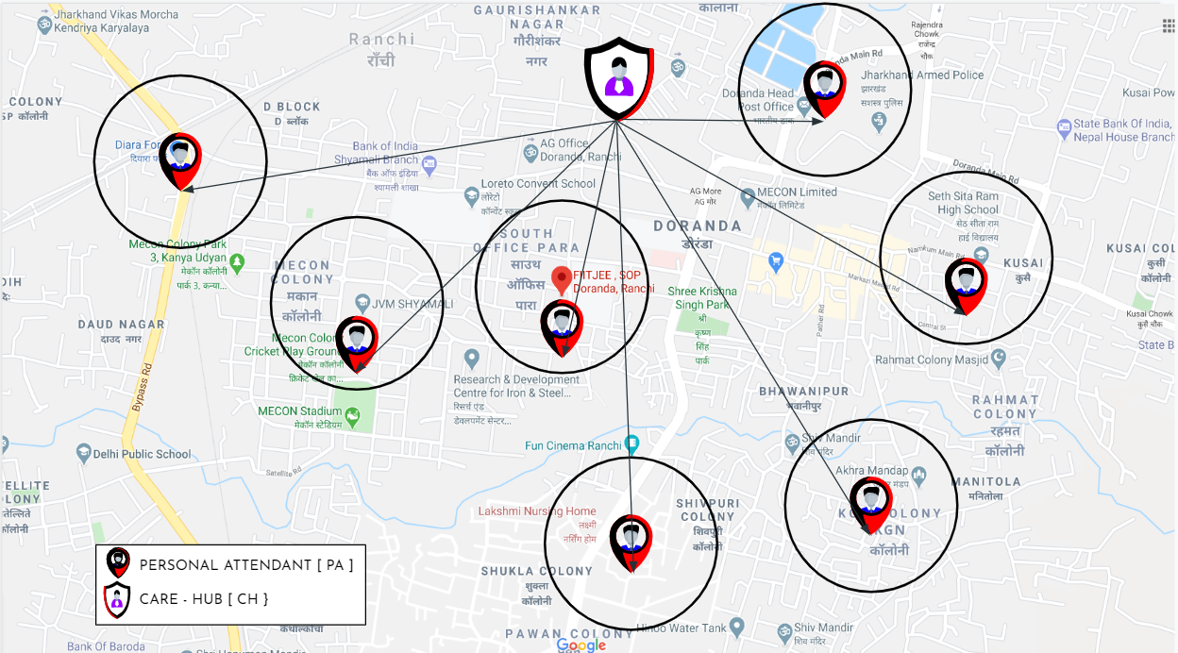

CLUSTER MAPPING
TESTED CITY – RANCHI (TIER 3)

Slide 11
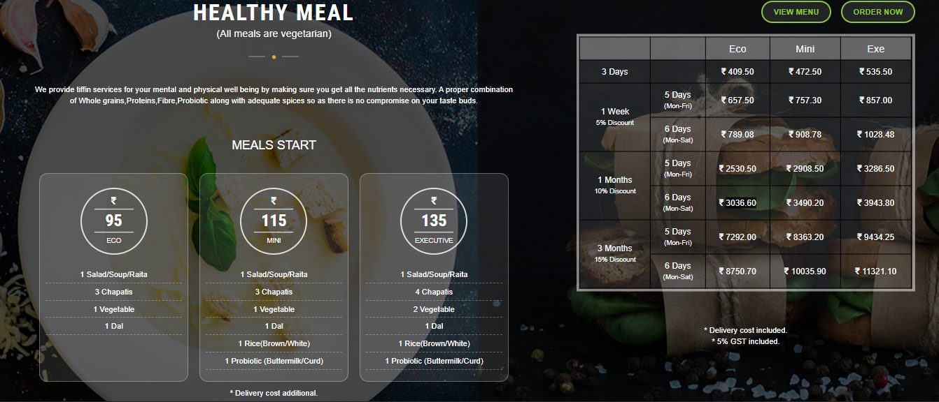
MEAL PLANS OFFERING

Slide 12
Market Positioning
Early Adopter - Students going out from hometown for further studies looking for good stay and hygienic food. Who want to find a stay without much of hustle.
Next Home for Student →
No more terrible Hostel Experience [ No Ragging, Bad Food, Bad Hygiene ]
No more issues with apartment owners
Customized Peer Group
Most comfortable & Homelike Experience
Customized Messing based on consensus
2 Level Security - Guard & Personal Attendant
Student Monthly report on health and attendance for Parent Satisfaction
Next to your Educational Hub - 1 km Policy
24 X 7 Help Desk with Quick Response Team
2 Days Parents’ Stay on Booking Basis
Next Home for Professional →
No more hassle in finding Next Home
Most comfortable & Homelike Experience
Customized Messing
Next to your Company Hub - 1 km Policy
24 X 7 Help Desk with Quick Response Team

Slide 13
Go to Market Strategy
Enter from the city where the need of this service is more i.e. tier two cities
Start Food Service three months prior to aware people & promote
Launch Hostel Business in Tier 2 & 3 cities
Hiring Campus Ambassadors to spread awareness in colleges & institution campuses.
Setting up kiosks in corporate offices and spaces.
Initial Market Potential as per competition basis (Nestaway)

Slide 14
What is the recent in the Industry?
The rate of growth of students going out of their hometown are increasing day by day. Same goes for working professionals as they are going to nearby developed cities for work. They all require good stay and good food.
No major competitors providing all in one facility.
Industry and Ecosystem
Positioning
Key connections that founders already have?
Key connections they need to establish?
Property Owners
Investors
Kitchen Services at respective cities.

Slide 15


























Commercial facilitys/ Property buy and sell
Renting Network
Student Housing
Foreign Startups
MAJOR
PLAYERS

Slide 16
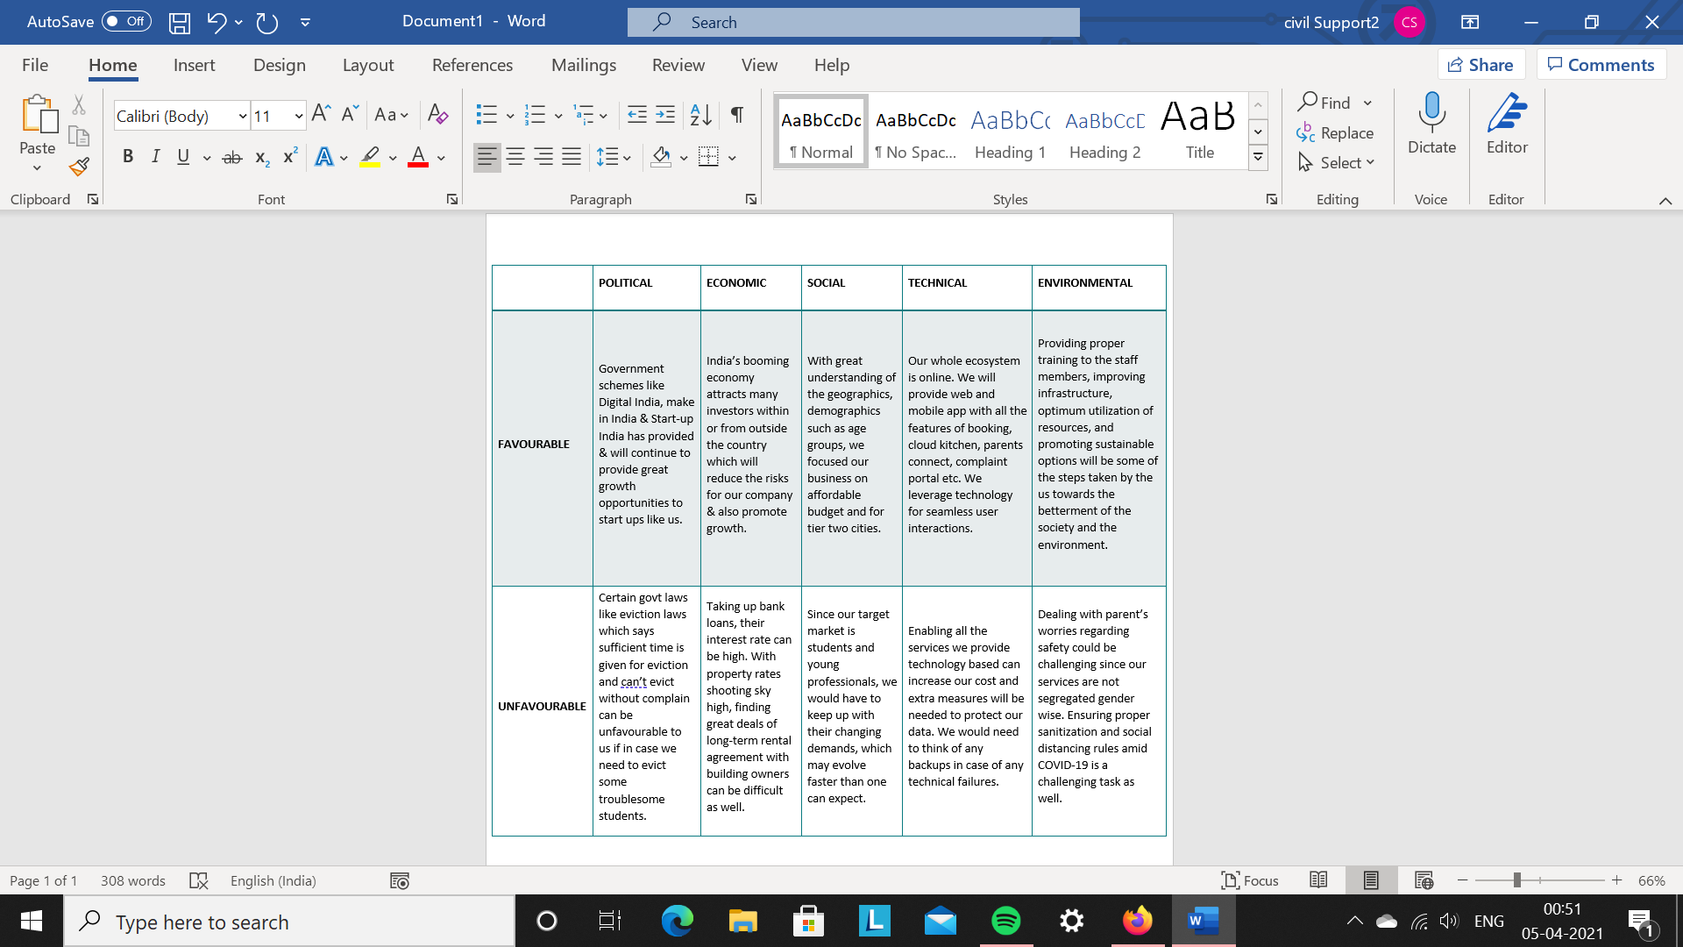
PESTE Analysis of Business Environment

Slide 17
Competition Analysis
 | CoHo | Nestaway | OYO Life | You
Strengths | 250 residents across Delhi NCR which includes both students and working professionals. | It has over 1800 homes in Bangalore. App has over 500k downloads. Cities: Bangalore, Delhi NCR, Hyderabad, Pune. | OYO Brand name. They provide rental furnished rooms with attached bathroom and free wifi. | Rental spaces focused for only students and young professionals. Easy living at affordable price points.
Weakness | Prepaid electricity meter and not based on how much usage. | They are trying to create a network of nesties i.e. the singles who accommodate the rooms by parties and get-togethers. | No electricity back up, hassle to get hold of drinking water. Poor management, bad customer reviews. | Medium-High entrance barrier.
Price Point |  | Rent starts from 6000 per month. |  | Rents: 10K Meal plan starts from: 3K
UVP | Introduction of latest technology products like smart locks, virtual reality. | They help you find, book and move. Every nestaway home is equipped with a TV, wifi, sofa, fridge etc. | Only 1 month security deposit. | Customised meal plans, peer to peer interactions, cluster of your own choice, house keeping, semi-furnished.

Slide 18
FINANCIAL PROJECTIONS
Target Population and Revenue
Ranchi Population (2019) → 15 lakhs (Source: indiapopulation2019.com)
15-59 year Population → 61% (Source: http://censusindia.gov.in)
Dividing Equally: 18-23 year population in Ranchi → 45000
If we capture 3% market share in first year:
Customer Number is approx: 675
Let’s say 50% opt for hostels (the population coming from other towns included here
EXPECTATION / FIXED PRICE
Rs 10000 (rent) + Rs 5000 (food)
=> Target Population → 22500 students
Total Revenue generated in a year:
Rs 121,500,000

Slide 19
Price for the facilities (all prices in INR)
Let 20 OZOs for first year → 34 students per OZO → 6 students per facility → 6 facility per OZO
Food Caterers
Security
Cleaning
Managers
3000 (per month) x 34 students per OZO x 20 OZOs x 12 months
2 shifts x 6 facilities per OZO x 20 OZOs x 12 months x 5000 per month
6 facilities per OZO x 7000 per month for one facility x 20 OZOs x 12 months
12 months x 10000 per month x 20 OZOs x 1 person per OZO
Manager will be responsible for marketing, complaint registration, expanding business in OZO
24,480,000
14,400,000
10,080,000
2,400,000
Rs 121,500,000 - Rs 51,360,000
= Rs 70,140,000

Slide 20
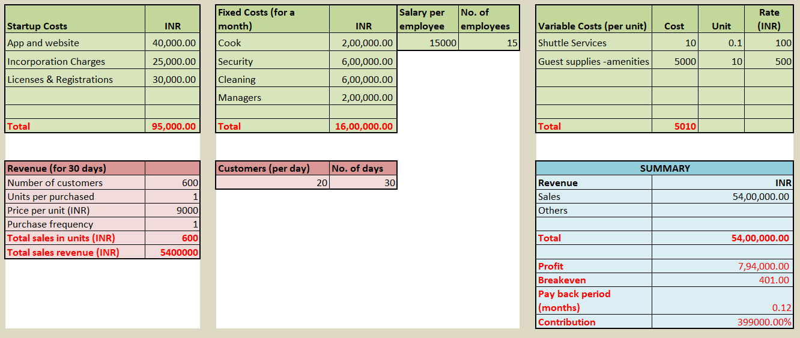
BASIC FINANCIAL PLAN

Slide 21
Implementation Plan / Milestones
How convincing is the implementation?
Implementation is easy, as our plan is ‘lean’ and are not rushing with the idea.
Product Development & Business Strategy
App and website to be fully functional
Start with the mess service three months prior the launch of hostel service
Get the Hostels ready for delivery
Make clusters and set up kitchen
Tie up with landlords and not so famous hostels.
Milestones Achieved
Customer survey going, what students wants
App and website in prototyping phase
11

Slide 22
OPERATIONAL PLAN
Technical Requirement →
User Specific Mobile Application & Web Portal: Enabling User to find PeerOzo via, Education Hub, Company location or Locality
Student Monitoring System: For digital Surveillance [ OPT-IN Optional*], knowing student daily check-in & check-out timing, Health & Wellness Status.
FoodOzo Mobile application and web portal: connected with Peerozo login credentials.
Mess Consensus & Feedback System: Students to decide Mess menu based on Voting consensus, EOM Mess & PA feedback for Happiness Index.
Complain & Support Dashboard: Online System to manage any requirement or Complain resolution via Care - Hub.
Attendant to Parent feedback System: Parents can Book time with PA to know about their Children’s issues or to provide any additional support. PA gives an update to Parents on a monthly basis.
Operation Requirement →
PeerOzo Acquisition: Analytical survey to decide cluster & Acquiring agreement with AO, with freeship of PeerOzo branding.
PeerOzo Setup: Renovation & arranging all amenities for the student settlement. Setting up a Messing facility for the Cluster.
Messing & Cleaning Chain: Regulating Mess staff, cleaning staff (Fixed timing system) by PA.
Security Regulation: Maintaining updates on check-in & check-out with Security Guard / AO.
PA assistance Session: Daily PA visit to all PeerOzo in the assigned cluster, updating the parent portal on a monthly basis. Providing any further assistance to students if required.
Care-Hub Watch: Assessing Mess, cleaning, PA feedback, resolving maintenance problems or Complains.
Training session: for all the employees who join us in various teams.
Maintenance backbone: The contacts of the maintenance community who can be called immediately when a situation arises.

Slide 23
LEGAL IDENTITY
Company Incorporation
Business Registration
Service Tax
GST registration
PESO License
Key Legal Compliances
    facility Permit
    FSSAI licence
    ESI Registration
    Pollution Clearance
    Labour Law Registration

Slide 24
RISK ANALYSIS
Financial – Loosing Investment if targets are not met
Strategic – Market, Tech/Product, Regulatory
Operational – Hiring, Retaining Talent

Slide 25
LETS TALK BUSINESS
Broad usage of funds
Fixed cost incurred on expansion
Extra facilities(To new customer segment)
What stake we are giving ?
HYGIENE
13%
Poor room cleanliness and maintenance issues of furniture.
What we Demand ?
Exit strategy ?
INR 5 Cr
(As seed Investment)
Collaboration with colleges to provide outsourced hostel facilities
With companies to provide accommodation facilities to employees for business trips

Slide 26
Annexure
Lean Canvas
Financial Plan
Customer Feedback and Industry Review Documents

Slide 27





THANKS
Any queries? Drop us a mail
support@peerozo.com
www.peerozo.com
/peerozo
/peerozo
/peerozo
/peerozo

