Slide 1


E-Lab
Business Plan
Group 5:
Ishita Dewan (20DM085)
Joydeep Chakraborty (20DM091)
Juhi Srivastava (20DM093)
Riddhima Singh (20DM171)

Slide 2
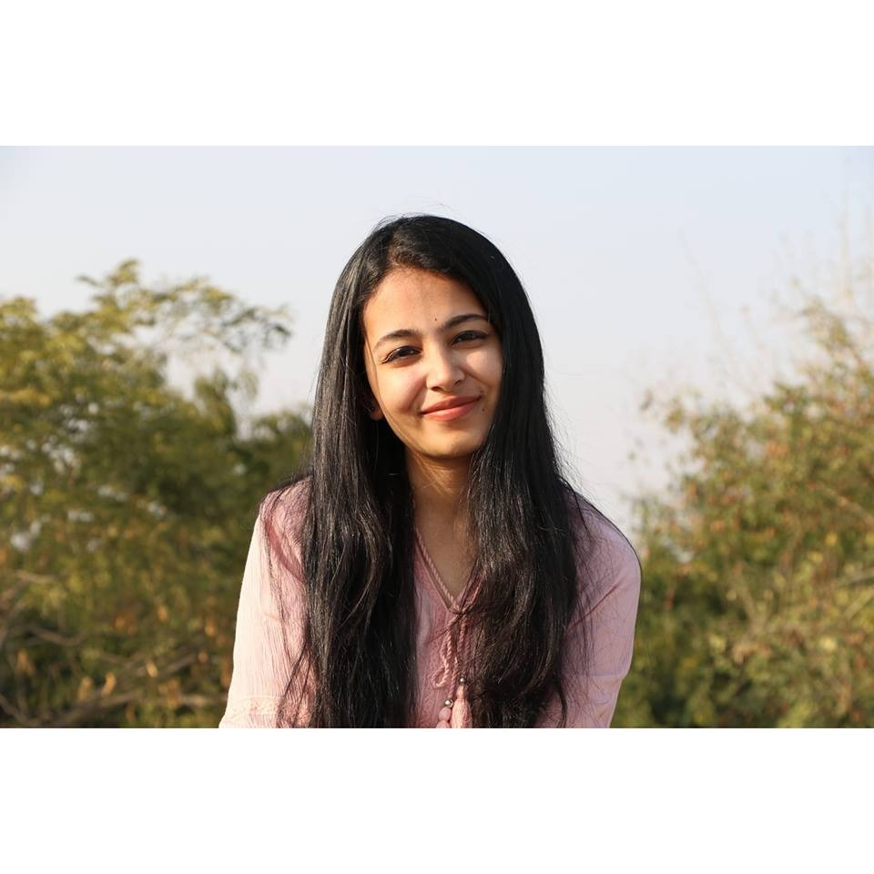
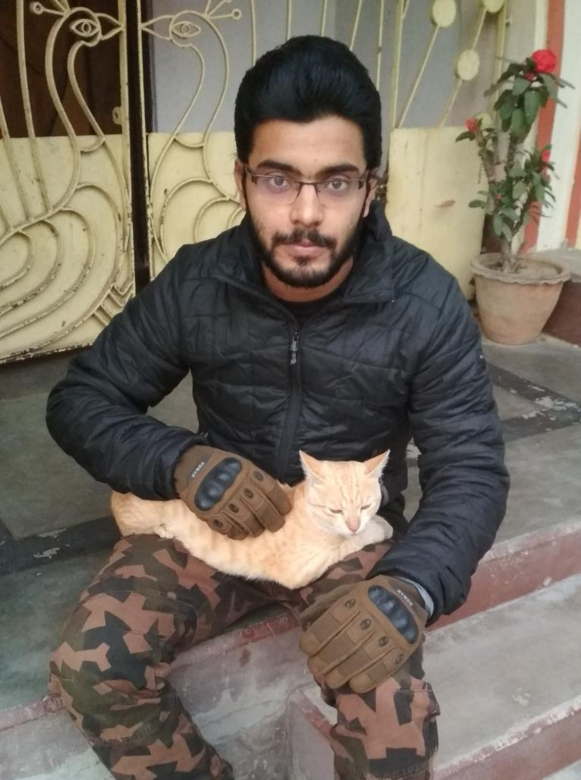
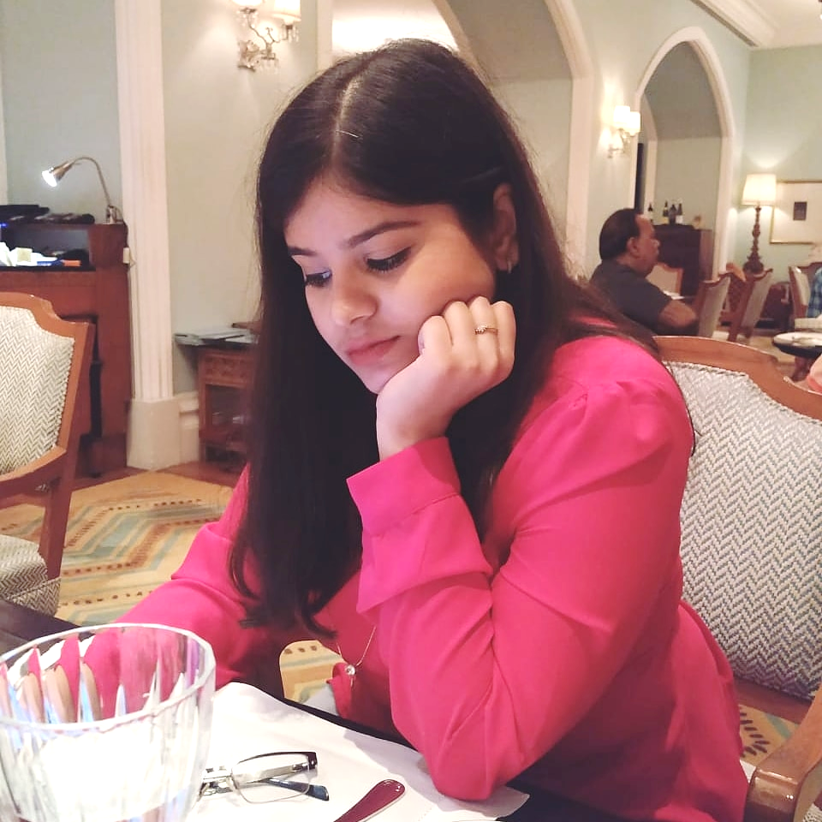
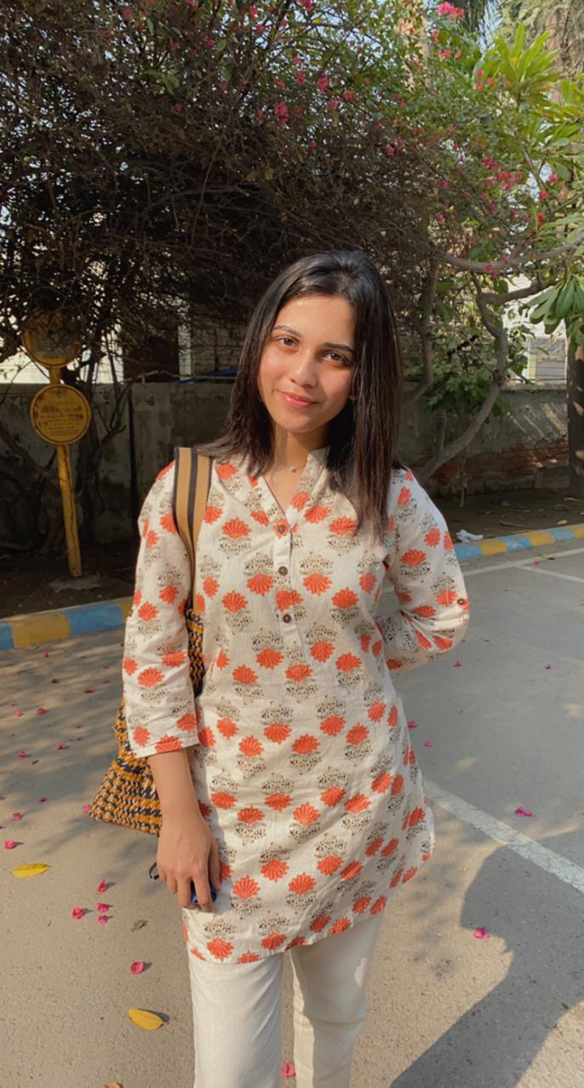
Our Team
Ishita Dewan
Joydeep Chakraborty
Juhi Srivastava
Riddhima Singh

Slide 3

INTRODUCTION
Set up in March 2020, Safer aims to revolutionize periods by providing natural, affordable and effective sanitary napkins that are gentle to your skin and kind to the planet.
Let’s keep plastics and chemicals as far away from your body and the environment as possible.
Your “that time of the month” is nothing to be ashamed of.
In fact, period is an essential part of all human life as it marks the beginning of womanhood.

Slide 4
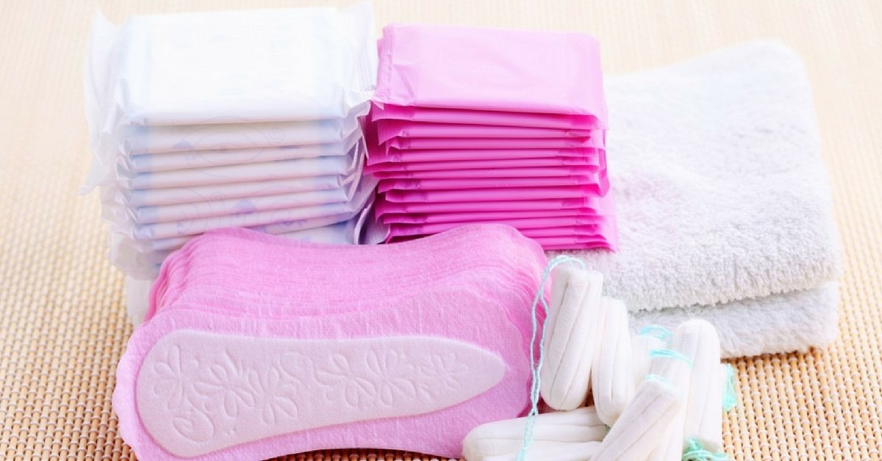
GENESIS OF THE IDEA
In India, there are over 355 million menstruating women and girls in India of them, of which 36% use disposable sanitary napkins.
Using ash, coconut husk, sand, cow dung, or simply cotton cloth during menstruation has been the practice for majority since ages and it continues.
India has approximately 12.3 billion disposable sanitary napkins to be discarded, and a majority of these are non-biodegradable.
This amount of waste is usually dumped in landfills, thrown in open spaces and water bodies, burnt, buried (shallow burial) or flushed down toilets.
Thus, we wanted to create a reusable sanitary napkin that is hygienic, sustainable, and comfortable allowing an easy green switch.

Slide 5
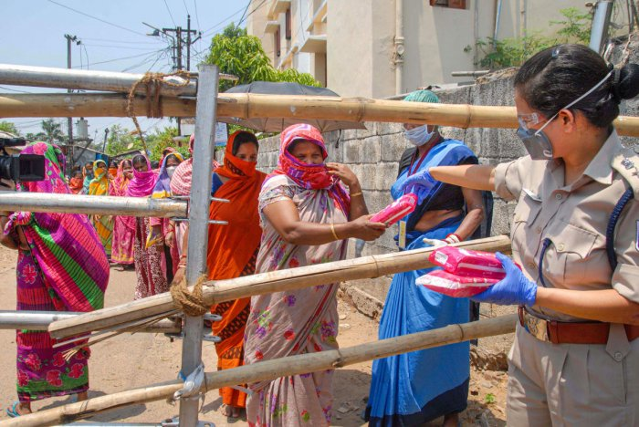

PROBLEM STATEMENT
Women in India still face significant barriers to comfortable and dignified experience with menstrual health. Majority of women do not have proper access to sanitary napkins.
Regular sanitary napkins are still too expensive for a large segment of the population. They also contribute highly to the increasing non-biodegradable waste which may take years to decompose. This creates a hazard for the environment.

Slide 6
SOLUTION
“We provide natural products for natural processes”
We provide an affordable, reusable and biodegradable sanitary napkin made of banana fibre that can last for up to 120 washes or two years.
Disposable sanitary napkins are mostly made of synthetic materials and plastic, which can take more than 50-60 years to decompose.
Providing two product variants – targeted to rural woman and targeted to urban woman.
Hitting two targets at the same time - availability and sustainability.

Slide 7
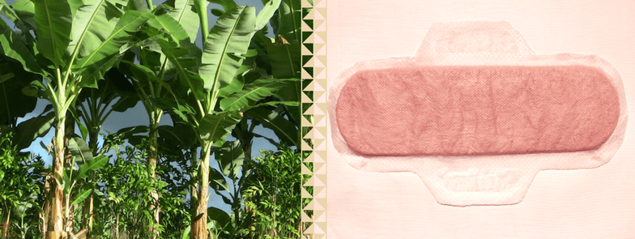
SOLUTION PROTOTYPE
From plastic to banana fibre,
From banana fibre to sanitary napkin.
Instead of importing low-cost pads from China or other countries and simply repackaging, rebranding or marketing them as “premium” pads with very high margins, we believe in supporting circular economy. Safer pads are made in India using locally sourced banana fibre. Besides reducing Agro-waste, Safer pads also provide extra income to banana farmers and help local economy.

Slide 8






SOLUTION PROTOTYPE
REGULAR FLOW
MEDIUM FLOW
HEAVY FLOW
“Pick your comfort”

Slide 9
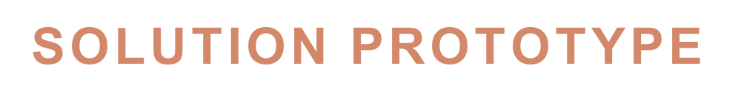
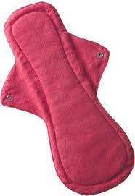
PACK OF 3 PADS
Rupees 90
PACK OF 10 PADS
Rupees (180,200,250)
“Pick your quantity”

Slide 10
MARKET & PRODUCT
POSITIONING
Projections on how market will evolve over time?
The market has a lot of potential because none of the companies are offering the product which we are offering and with time people will be aware of the side effects of the currently available sanitary pads and will look for an alternative.
Early adaptors?
Educated women who are aware of the harmful effects of using the sanitary pads which are currently available in the market.
Women who have encountered problems while using the pads available in the markets.
NGO's distributing the sanitary pads in the rural and semi-rural areas and slums.
Government creating awareness about the sanitary hygiene.
Why will they pay?
They will pay because they are getting a much better product and at a cost which will be lesser than the one which they are currently using.

Slide 11
MARKET & PRODUCT
POSITIONING
How do you plan to reach out and sell to early adopters?
Survey
Problems being faced by our potential customers
Pitching of our products
Distributing at lower rate
Gradually increasing cost
What is the initial market potential of the solution?
355 million menstruating women in India.
Only 12% of them have access to sanitary pads.
Make sanitary pads available to all of them.
How and where will you sell your products and/or services?
Medical shops and in convenience stores.
Hospitals, clinics and schools.
NGO’s and governmental organizations.

Slide 12
INDUSTRY & ECOSYSTEM POSITIONING
  What is the recent trend in the industry?
  Synthetic pads made of plastics, dioxins, and other harmful chemicals.
  Absorbent gel is carcinogenic.
  Chances of cervical cancer.
  Problems in the embryonic development of foetus.
  What are the key growth trends?
  Doubling of revenues in each year.
  Key connections they need to establish?
  Create awareness about the use of synthetic pads.
  Tie up with schools.
  Hospitals.
  Doctors.
  Clinics.
  Who are the major players and key suppliers?
  The major players are Johnson and Johnson, P&G, Unicharm India Private Limited, etc.
  Key connections that founders already have?
  Tie-up with NGO's, partnered with the government.

Slide 13
PESTE ANALYSIS
 | POLITICAL | ECONOMIC | SOCIAL | TECHNICAL | ENVIRONMENTAL
FAVOURABLE | N/A | Highly economic product. You can save upto 94% of what you would have spent on disposables over your lifetime. | Breaking the stereotypes and making the world a better world for woman. Changing the mindset of woman by making them aware that safety and hygiene matters more than the cost. | Dedicated website to place orders for wider reach. Product also available on Amazon | The product is made of banana fiber, banana fiber and corn starch making it reusable and biodegradable on disposal. A perfect substitute to plastic which is non biodegradable. A perfect substitute to cotton which consumes a lot of water as a crop.
UNFAVOURABLE | N/A | Banana fiber as a crop is expensive. (Rs. 250/ kg) | Mindset cannot be changed overnight hence it will require effort and time to absorb the changes. | Cost involved for a dedicated team to handle orders online. | N/A

Slide 14
COMPETITOR ANALYSIS
 | COMPETITOR 1 STAYFREE | COMPETITOR 2 KOTEX | COMPETITOR 3 HEYDAY | COMPETITOR 4 PEE SAFE (TAMPONS)
STRENGHTS | Good brand presence with J&J tag. Substantial market share. Available everywhere. | Creative and attractive packaging. Enjoys brand trust associated with Kimberly Clark. | Biodegradable pads within 2 years Made from organic material. | Eco-friendly and super soft product. Affordable.
WEAKNESS | No presence in rural areas. High brand switching. | Relies only on TV and print media for promotion Not much innovation. | Low brand visibility. No presence in rural areas. | Low brand awareness. Use of organic cotton.
PRICE POINT | Rs. 90 (7 pads) | Rs. 265 (7 pads) | Rs. 104 (7 pads) | Rs. 320 (16pcs)
UVP | Sanitary napkin that gives 24-hour protection. | An age-old brand with a wide range of products. | Biodegradable composition. | Chemical free and super convenient.

Slide 15
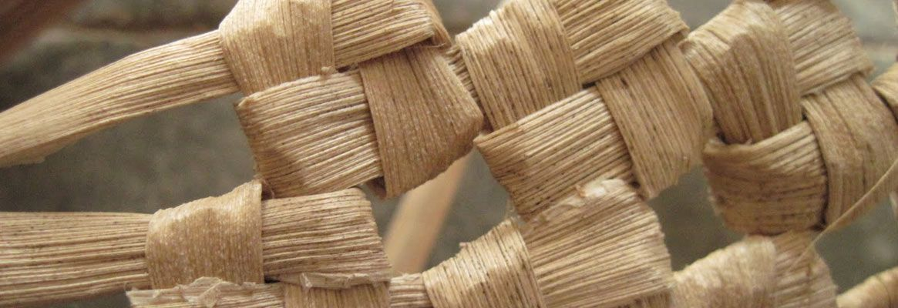
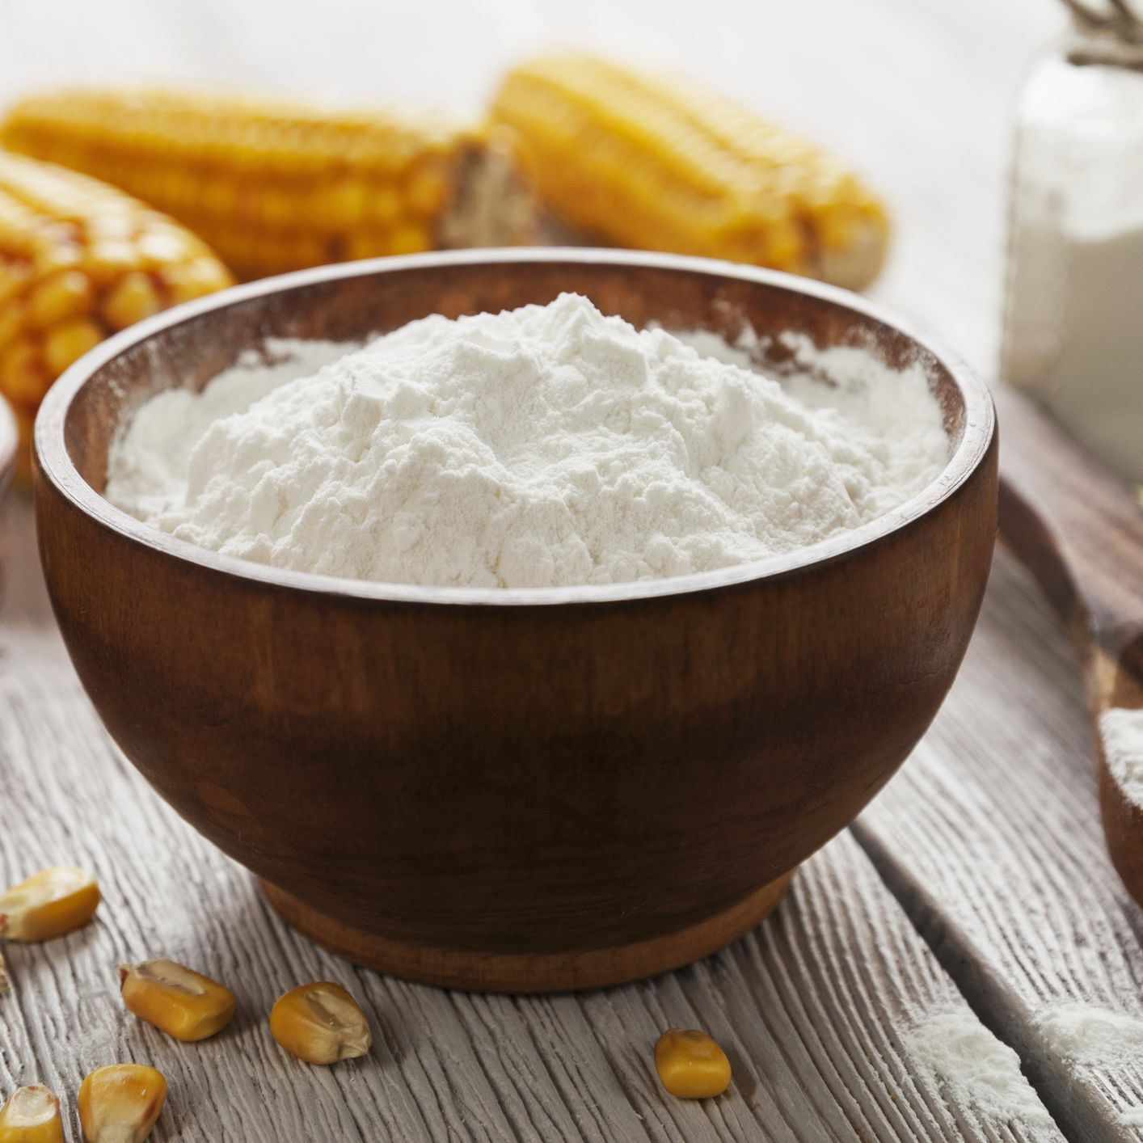

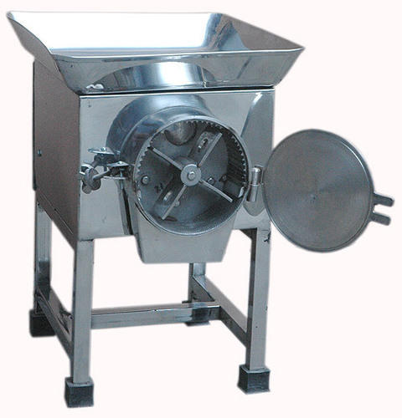
OPERATIONAL PLAN
Key Resources
Banana fibers, Corn Starch, De-fiberation Machine
Trained production team
Social media executive
Human resource
Intellectual resources

Slide 16

Key Milestones
Create awareness in the market.
Partner up with NGOs and schools to make our product accessible in the rural and semi-rural areas.
Tap into both rural and urban markets and devote our first two to three years in that areas, and make our products available in every convenience store, every clinic every hospital, also to create awareness we will be launching an event wherein we will be distributing our products.launching an event wherein we will be distributing our products.
Going global and shipping our products across the globe.

Slide 17
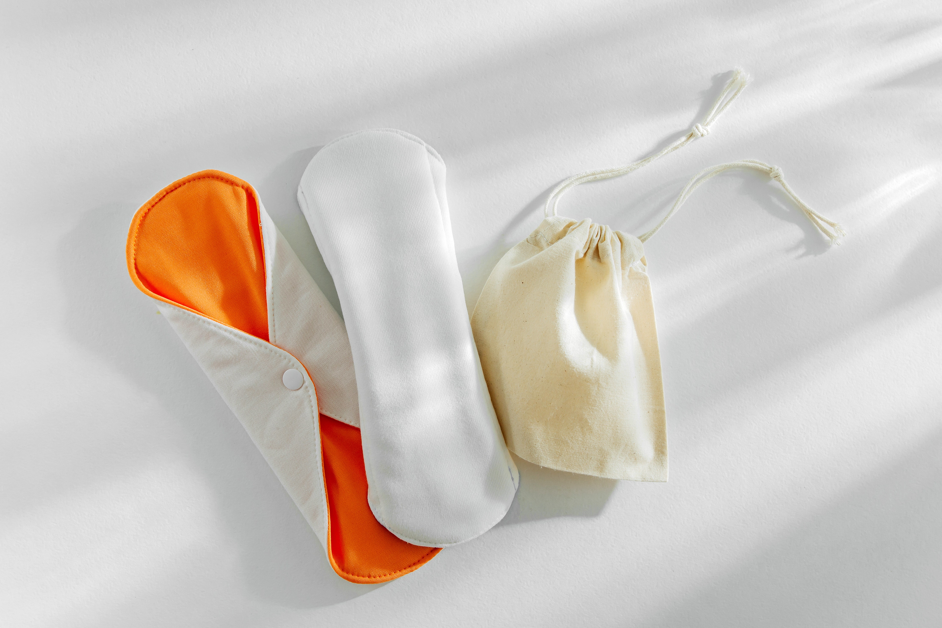
IMPLEMENTATION PLAN
How convincing is the implementation?
We have spoken with the customers and as per our survey, women use synthetic pads because they don’t have any other alternative.
They have shown their interest in using our pads, we now plan to create awareness, tie-ups with various NGO's and governmental organization.
Show us the targets for next 12 months and the plans for ‘product development’ and ‘business strategy’.
Our target for the next 12 months is reaching out to the early adaptors and increase the sales of the product.
We also plan to create awareness in the rural and semi rural areas as they are the ones who are deprived of the basic sanitary hygiene.

Slide 18
ORGANIZATIONAL PLAN
Our organization consists of 4 founders with diverse backgrounds.
We believe our different backgrounds and skills will help us establish and grow our business to provide women of all strata, comfortable and dignified experience with menstrual health.
Ishita Dewan
(B.Tech)
Riddhima Singh
(BBA)
Juhi Srivastava
(B.com)
Joydeep Chakraborty
(B.Sc. in Microbio)

Slide 19
RISK ANALYSIS
Strategic Risk
Target Market
Product Viability
Financial Risk
Return on Investment (ROI)
Operational Risk
Hiring
Retention of employees
Liquidity Risk

Slide 20
How much stake do you offer in the company?
As founders we own 20 percent stake each which makes a total of 80 percent and we are offering 20 percent stake in our company.
What is the exit strategy if this business goes sideways?
Our exit strategy will be an initial public offering. A portion of our company will be sold in the market.
Going public is our long-term major business milestone for us and if done correctly will make everyone wealthy.
The liquidity means investors can earn many times their initial investment. The risk of investing will also be mitigated by the return from the IPO.

Slide 21
Problem | Solution | Unique Value Proposition |  | Unfair Advantage | Customer Segments
Sanitary hygiene Inaccessibility Non-Biodegradable Price constraint | Providing environment friendly substitutes to plastic Making the product accessible to wider audience Taking care of sanitary hygiene Providing cheap product to enhance accessibility | Made with biodegradable and compostable banana fibre, bamboo fibre and corn starch, These can biodegrade in around 6 months of disposal. |  | Can’t be easily copied or bought | Urban Woman Rural Woman
Existing Alternatives | Key Metrics | High-Level Concept |  | Channels | Early Adopters
Stayfree Whisper Kotex Tampons Organyc Heyday Organic Pads | Number of areas explored Number of subscriptions sold Number of pieces sold | Use of bamboo fibre, banana fibre, and corn starch |  | Word of mouth Gradually make it available online Campaigns Tying up with NGO’s | Rural woman who don’t have access to sanitary pads due to price factor.
Cost Structure |  |  | Revenue Structure
Machine and equipment Other accessories Land and Capital Working capital requirements Man-power requirements Other fixed assets |  |  | Recurring Revenue Frequency – Twice every six months Cost of one product/ pack – 150 INR Life time value of a customer – 90,000 INR Estimated yearly revenue – 500 customers x X units x Y fees = Z Revenue INR.

Slide 22
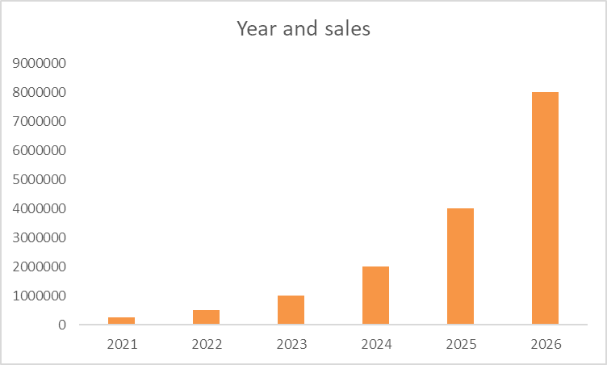
FINANCIAL
PROJECTIONS

Slide 23
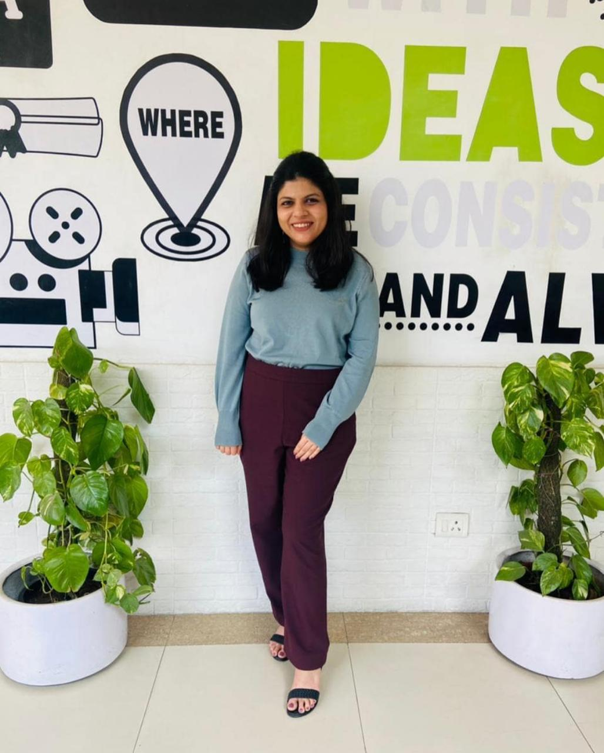
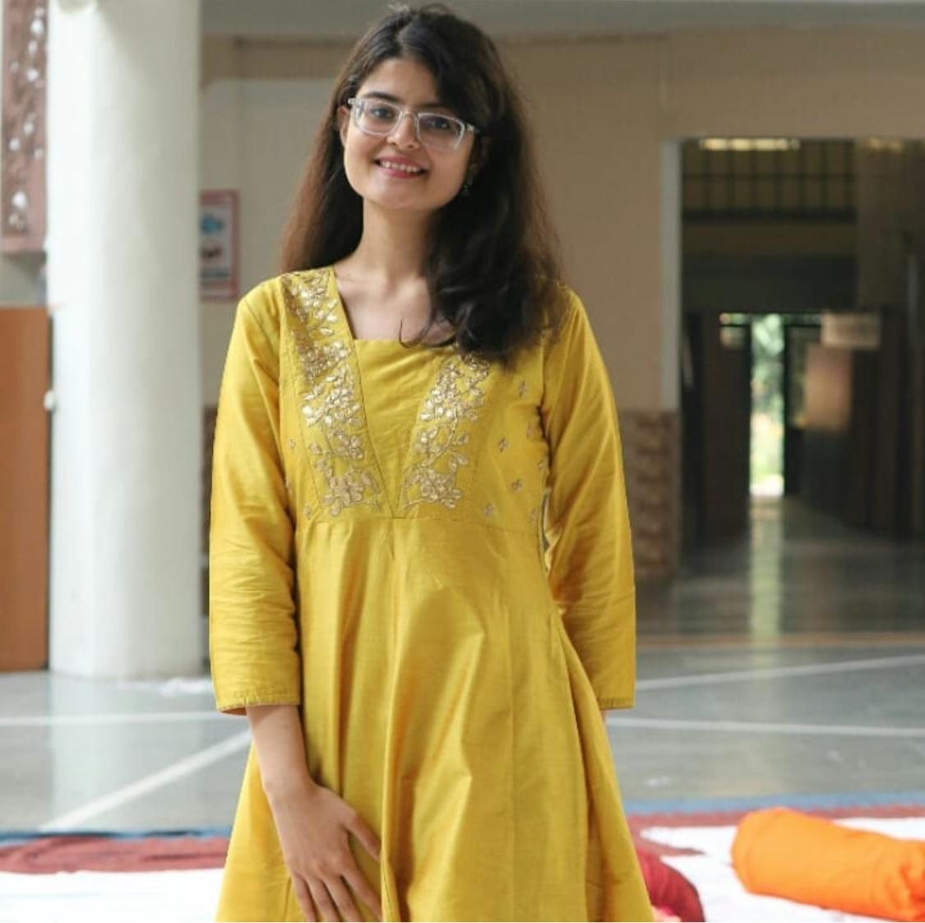
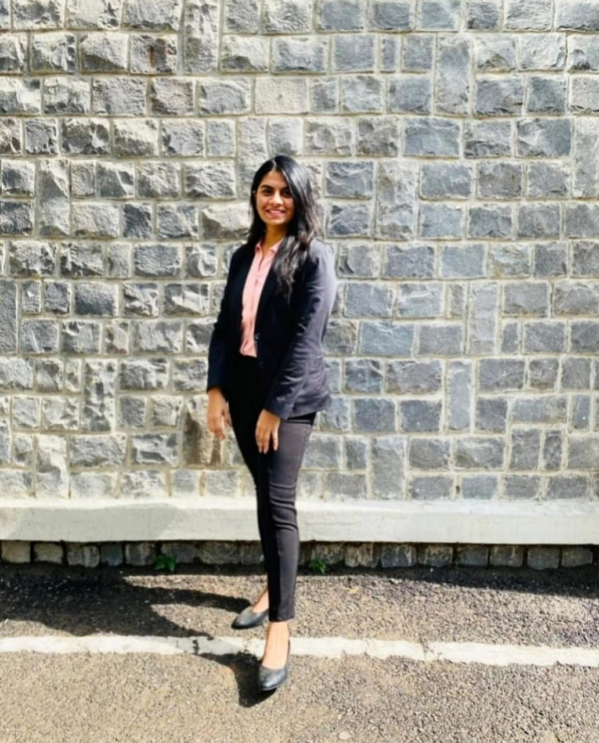
ANNEXURE- CUSTOMER REVIEWS
“Sanitary hygiene is of utmost importance”
“Switching to eco-friendly sanitary pads will be a game changer”
“Will definitely want to switch to organic pads”

Slide 24
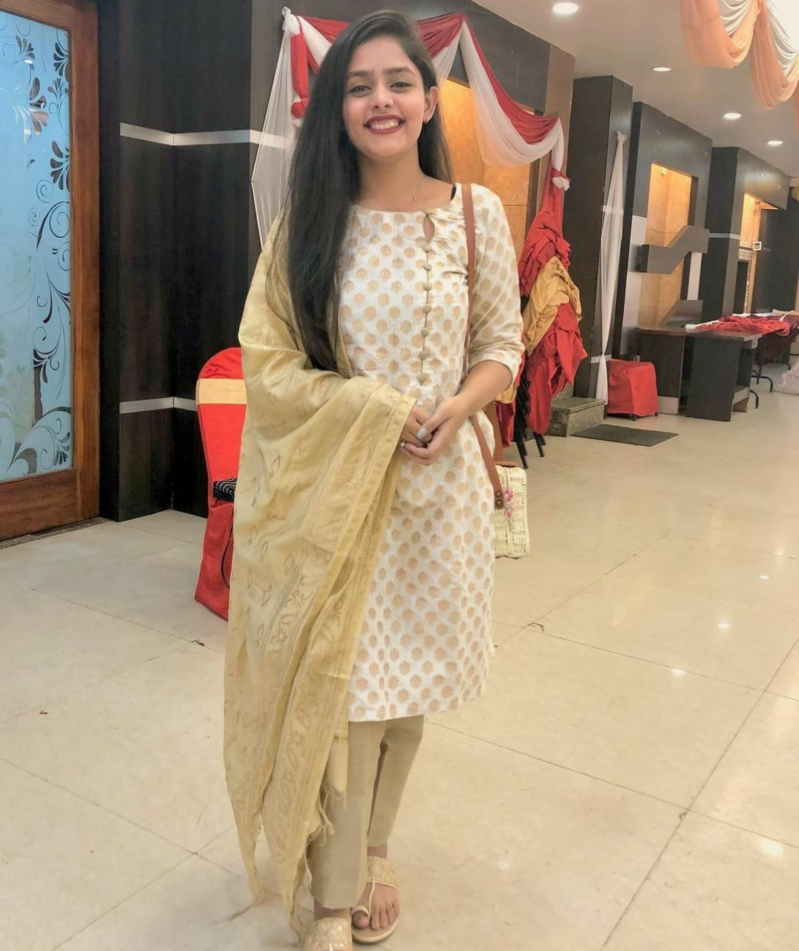
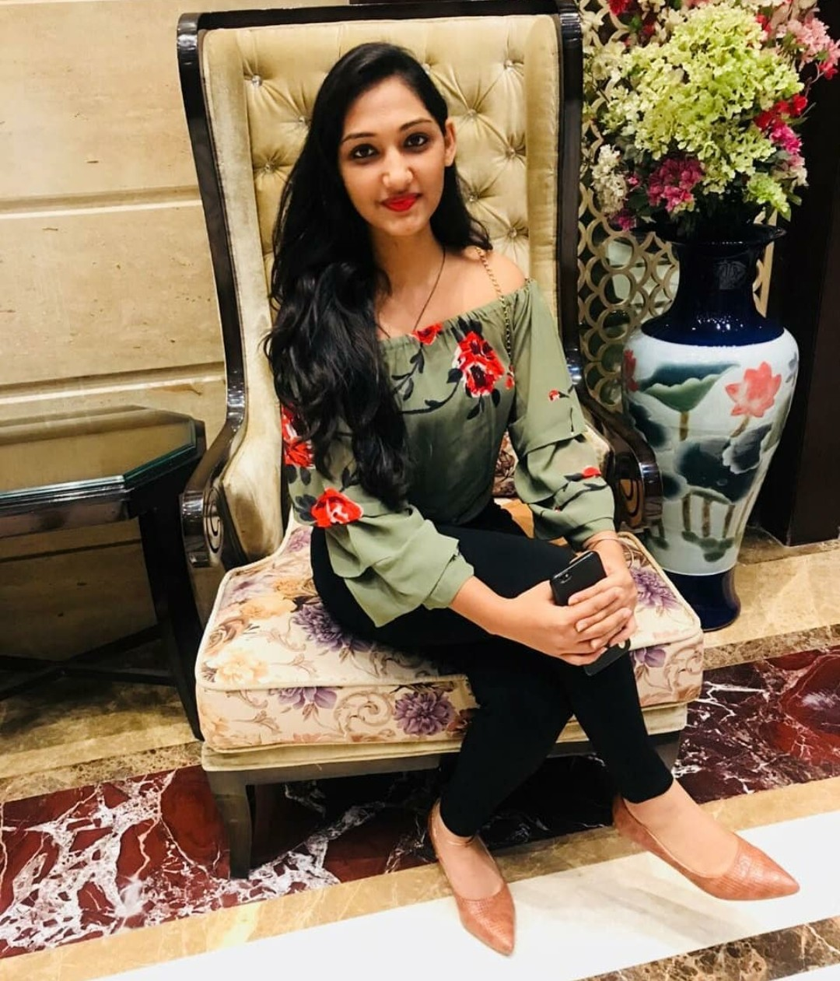
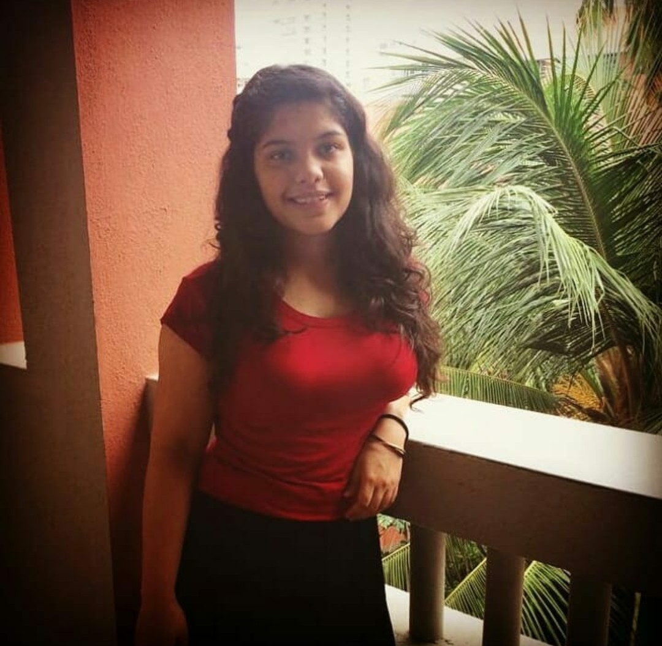
ANNEXURE- CUSTOMER REVIEWS
“The organic pads available in the market are too pricy”
“The extent of waste created by the currently available plastic sanitary pads is huge”
“Need something which is eco friendly as well as less pricy”

Slide 25
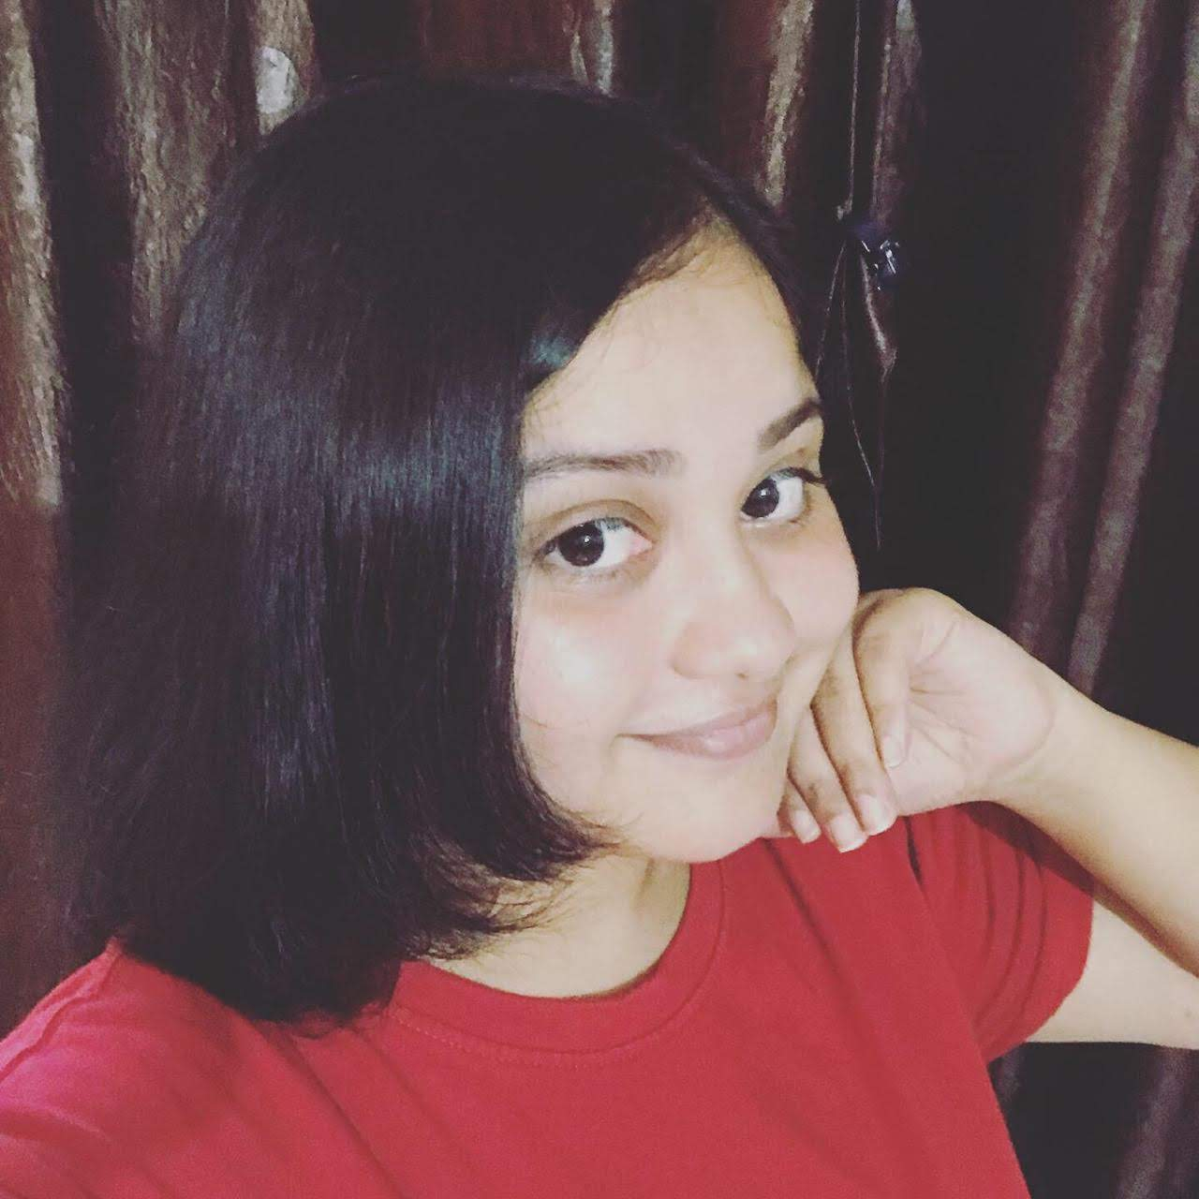
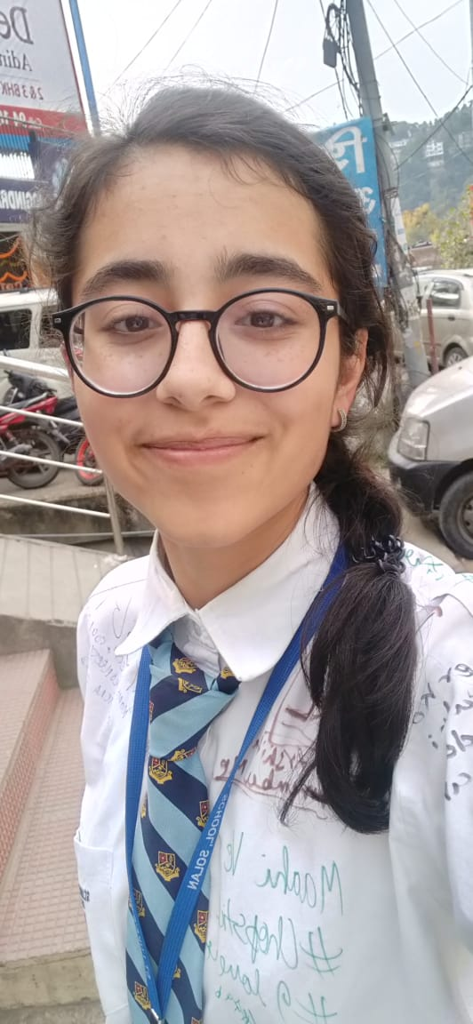
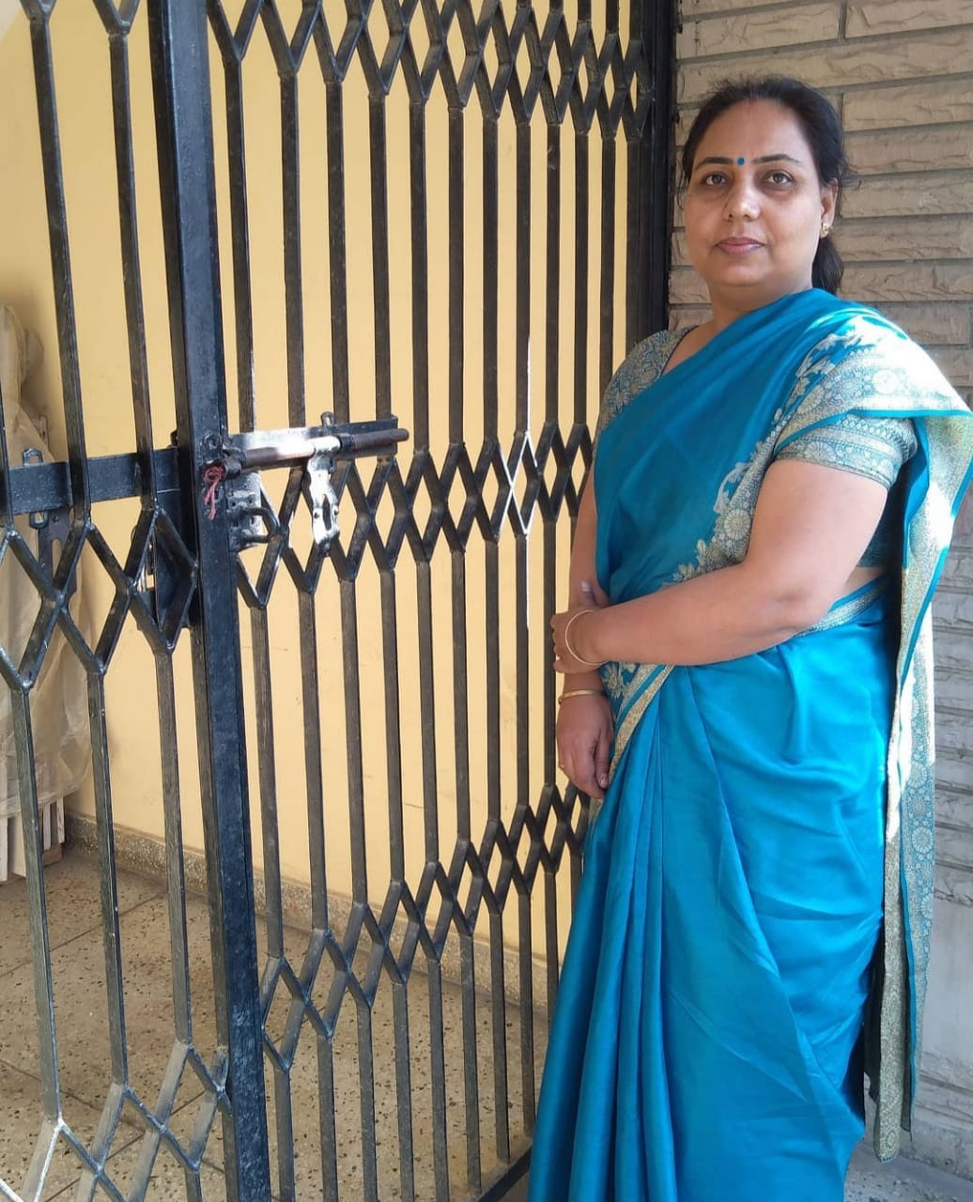
ANNEXURE- CUSTOMER REVIEWS
“The infections and other sanitary problems are common nowadays with every other woman”
“Every woman has the right to choose the type of menstrual product she wants to use”
“Eco-friendly menstrual products are imperative for a sustainable future.”

Slide 26
Thank You!!

