Slide 1
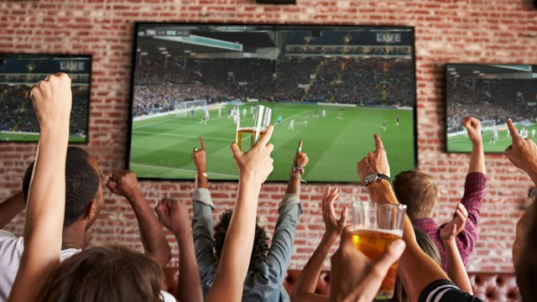

11 PINS DOWN
TURNING YOU INTO SPORTS LOVER
Group-13
Himanshu Talmale- 20DM084
Pramit Jain-20DM154
Prerna Agarwal-20DM159
Raghav Khandelwal-20DM165
Rahul Purthi- 20DM268
Shruta Kasliwal- 20DM204
Surbhi Daksh- 20Dm222

Slide 2
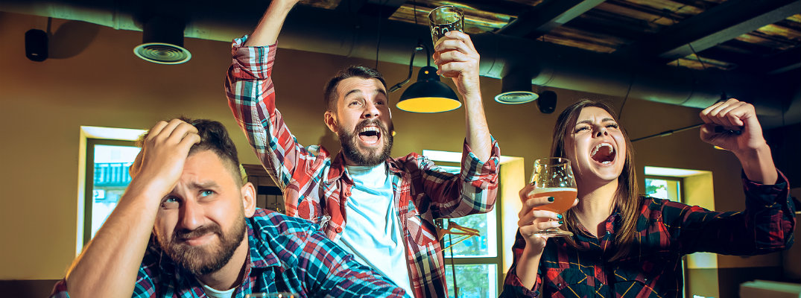
Genesis of the idea
Sports are becoming increasingly common in India, and people enjoy watching them with their friends and relatives. However, it is not always possible to visit each other's homes and drink.
As a result, we came up with the concept of a sports bar where family and friends could meet to watch sports and drink beverages.
The presence of sports bar café is very limited where people can enjoy drinks along with big sports screen.
Before our proposed idea these alternatives were available:
Sports Café (No bar)
Open air sports screening

Slide 3
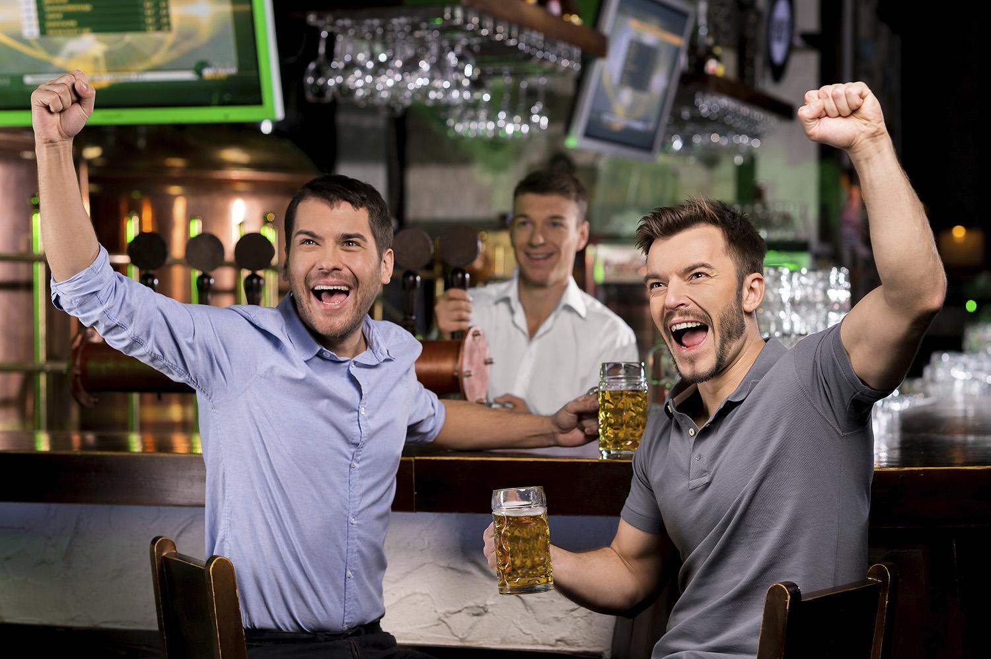
Product / Service / Solution
11 Pins Down – Sports bar & cafe
Gather with friends and family to enjoy.
Everything under one roof.
It's a great place to get alcoholic and non-alcoholic beverages.
People will hang out in different places depending on their preferences.
High-definition sound that brings the game to life.
Ambience that would bring sportsman out of you

Slide 4
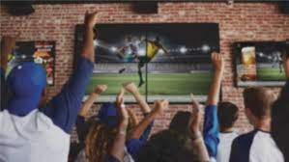
PITCH
Are you wondering where can you enjoy your favorite sports on big screen with your friends, lets end your waiting time and offer you want you want at 11 pins Down. We offer you big screen to watch sports with your friends. Your experience will be delighted with amazing food and drinks. Apart from this you will be enthralled with Bowling alley, VR games, Foosball and Pool Table.We have separate floors for family and youngsters to enjoy watching sports. So what are you waiting for, come and visit us and enjoy your sporty experience in Rs 500. Many big surprises await you.

Slide 5
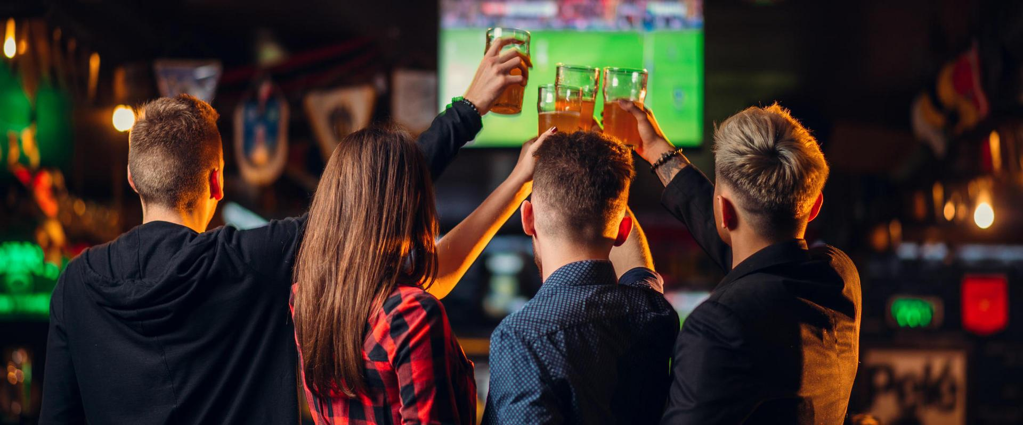
Problem Statement / Market Pain Point
We know because we can very well co relate when we want to hang out with friends & watch math there is no such place.
Watching sports is a group activity. Going to each other’s houses get tedious
Many upcoming matches like IPL, Football which attracts youngsters more
Students, Office professionals who can not drink at home

Slide 6
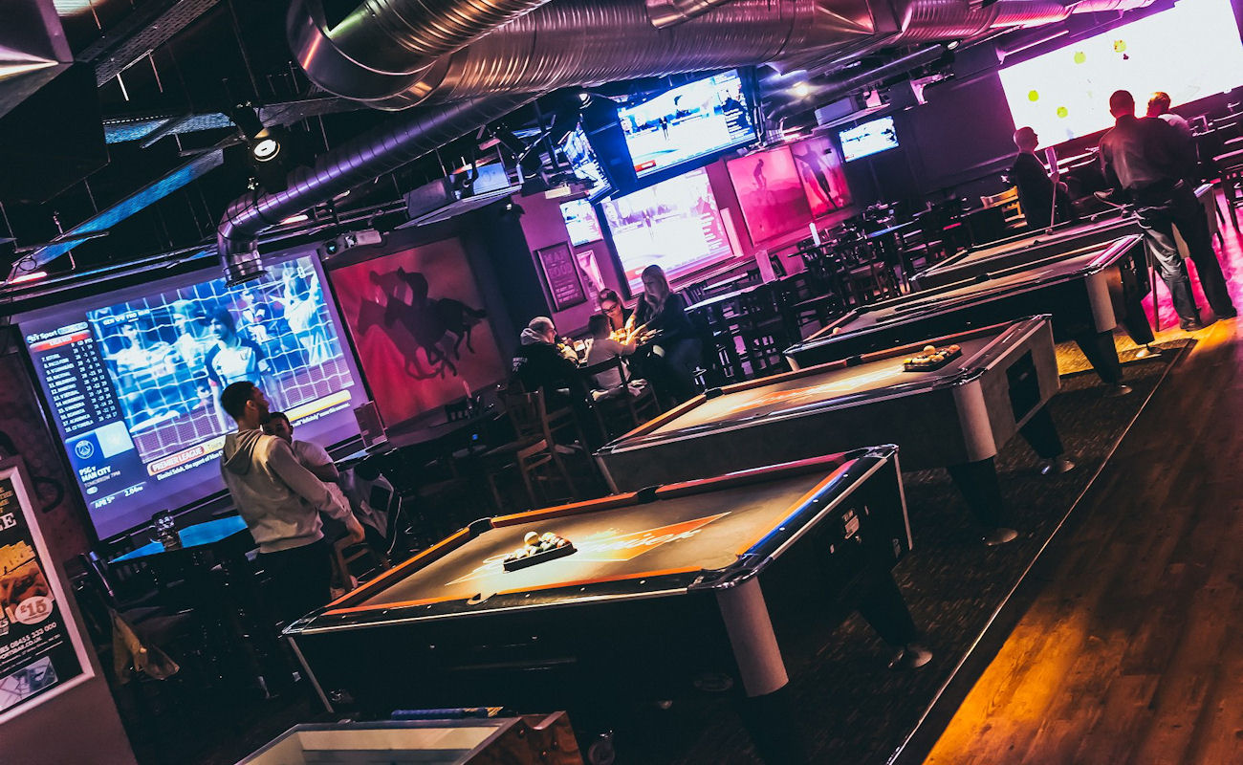
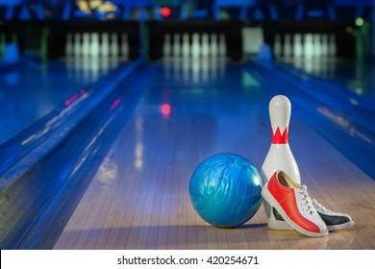
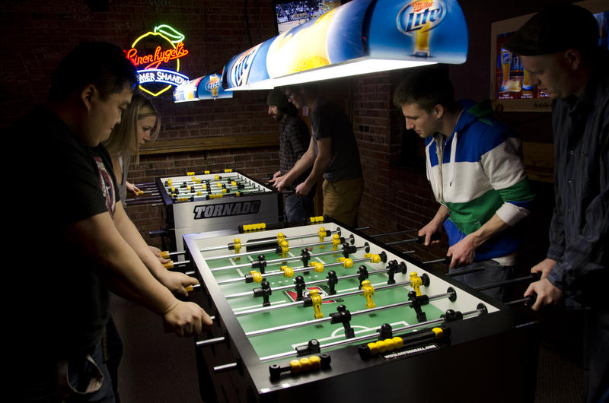
Prototype

Slide 7
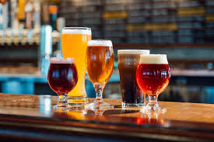
Value proposition for the client
Offer a boldly flavored menu with broad appeal.
Create an inviting, Sports Enthusiastic environment
Enable our guests to customize their dining experience.
VR games, foosball, pool table, bowling alley etc.
What is so unique/special about the product/solution?
Provides a rich experience of the 3D sound system with large projectors screen installed for better visuals
Special sitting that provides state of the table top, audio control which lets customer listen and watch game of their choice without interference from background noise
There are many pubs, cafés and restaurants in the town, but there is no sports bar like ours. We stand out in the city and therefore will have no difficulty in profiling ourselves.

Slide 8
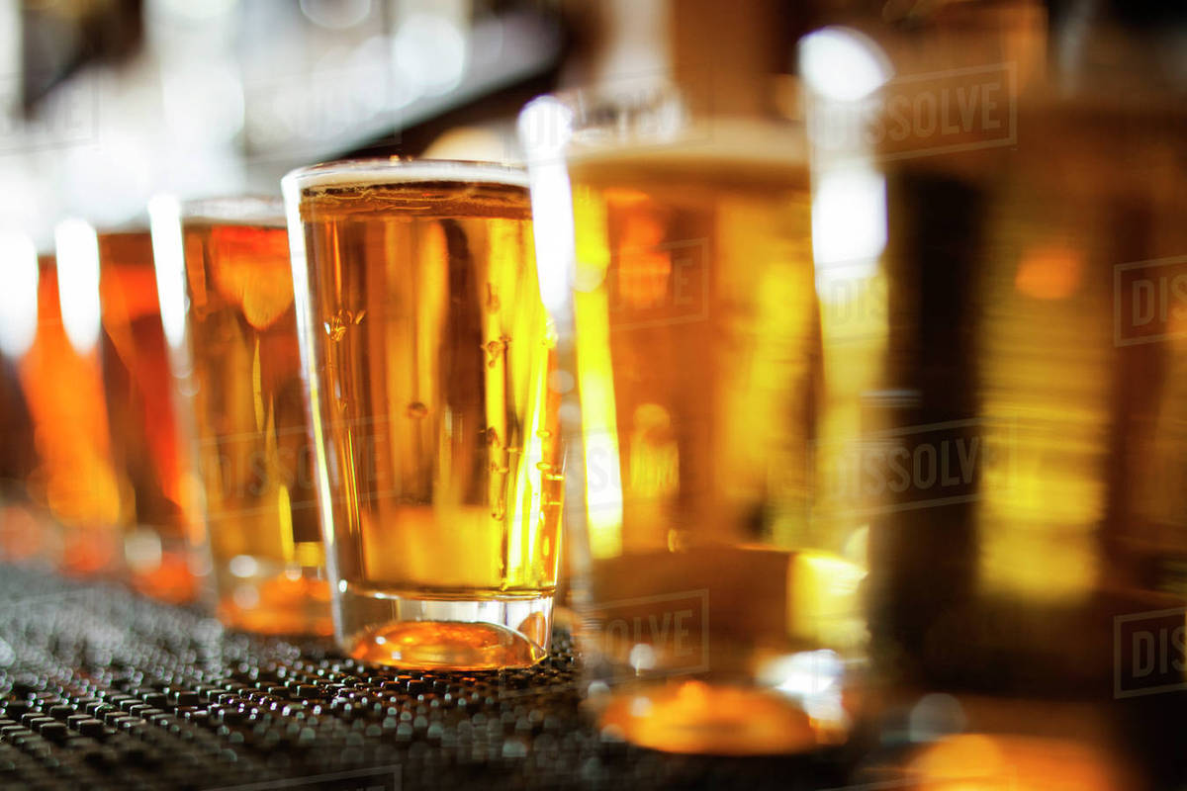
Market and Product Positioning
Target Customer
People who love to watch sport with there friends and family
Early adaptors
Sports Enthusiast, Business entertainers/ owners, tourism, local midnight crowd, families dining out.
Why will they pay?
For sport crazy environment/ quality of food & liquor and high definition sound system
Projections on how market will evolve over time?
Emergence of such type of business model, more awareness of such business model, increase in no of sports enthusiasts, party goers, any celebration or occasions , get together, people liking for alcohol

Slide 9
Go to Market Strategy
Plan to reach out and sell to early adopters?
Social media, happy hours, early bird, corporate celebratory events, sponsored post on social media account, tie-up with MNCs,
At events evenings/days/weeks will offer local cuisine and imported beers and souvenirs, contests with great prizes and live TV from the event.
Twice a year we will organize our own sporting event
Initial market potential of the solution?
On account IPL, Kabaadi Premier league, Football Club/ FIFA Festive seasons corporate celebrations Targeting Youngsters and midnight partygoers.
Products and/or services?
Offering quality food, alcohol, pool table, table tennis, foosball, live sports matches with lots of exciting prizes.

Slide 10
PEST Analysis of Business Environment
 | POLITICAL (Govt. Policy/ Regulatory) | ECONOMIC (Growth, Inflation, interest rates etc.) | SOCIAL ( Behavior changes, Buying patterns) | TECHNICAL (R&D, Automation, Digitization) | ENVIRONMENTAL (Ecological & Environmental changes)
FAVOURABLE | Relaxation of opening hours and late night opening | Increase in disposable income. | Foreign exposure and western media has changed the requirements and consumption habits of young Indians. Hanging out in bars has become a casual thing. Availability of more alcoholic drinks at reasonable price. | Developments in delivery of cold beers and chilled ale. Development of wide range of flavored alcoholic drinks. Local interest in nightlife promoted via multi media, websites, blogs and social networking
UNFAVOURABLE | Heavy duty on alcohol. | Rise in staff wages due to National Insurance and Minimum wage increase. Economic downturn can lead people to cut expenditure on entertainment. | Increased awareness of health concerns Increased advertising on mainstream media of consuming alcohol responsibly. Media concern with negative aspects of ‘binge drinking’ | Lack of advertisement on responsible drinking | Proper implementation of waste management policy.

Slide 11
Competition Analysis
 | Smaaash | Xtreme | Playground | 11 pins down
STRENGHTHS | Branches all over the country Bowling alley VR gaming | Live Sports Screening Pool Table Board Games | Live Sports Screening Pool Table | Highest surround sound quality VR gaming Bowling Alley Board games, Foosball, Pool table and Two Floors
WEAKNESS | Too crowded | Too crowded | Expensive Not able to attract more sports enthusiast customers | Less awareness
PRICE | Rs 1400 for two | Rs 1300 for two | Rs 1600 for two | Rs 1200 for two
UVP | A successful union between sports, virtual reality, music, and dining results in an interactive and energetic experience for all under one roof | From huge projector screens streaming the matches live to Food, Games, Drinks or Music, the bar sets the expectations high with an extremely lively ambience | Enjoy at the foosball or pool table while your favourite player or team is warming up for the match on the screen. Chill on the wall-side sofa seating, surrounded by sports logos and images, which set the mood for a boisterous sports screening | Delivering highest quality sound which creates the best experience for games, along with that three floors for different customers segment to suit their needs

Slide 12
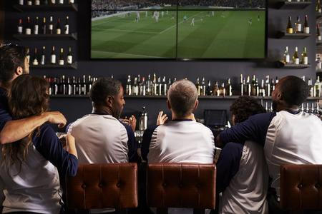
Industry and Ecosystem Positioning
Recent in the Industry
The India pub, bar, café and lounge (PBCL) market was valued at US$ 2.3 Billion in 2019.The primary factor driving the India pub, bar, café and lounge market is the growing disposable incomes across the country. This has led to an increasing indulgence of consumers in leisure activities and a rising preference for alcoholic beverage. Sports bars are bars where sports fans find an authentic sporting ambience with large LCD screens for watching live feeds of important international matches, pool tables, basketball courts and video games. Today there are close to 30 sports bars in India across various metros.
Major players and key suppliers
Xtreme Sports Bar
Smaaash
Sports Express
Key connections that founders already have?
We have connections with other nearby pubs which help keep a good relationship with your potential competitors.
Connections with various private investors
Deal with marketers.
Key connections they need to establish?
Food and Lifestyle Bloggers
Good relationships with regulatory authorities.
Good relations with sports persons

Slide 13
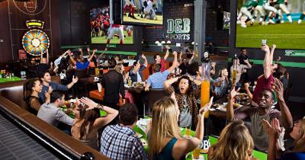
Operational Plan
Key Resources
Liquor, Staff, Screen, Space
Key Activities
Sports screening, Serving food and drinks, Organizing events, Customized dining
Key Milestones
Attracting large customer base, Gain huge popularity

Slide 14
Financial Projections
Pricing strategy: Relative pricing strategy.
OPEX & CAPEX: Our business model is not capital intensive, payroll expenses form majority of operating expenses.
Cashflow Projections: we are expecting to generate positive cashflow from 5 month. Currently we are generating cash inflows in the form of loan from banks and private investors.
Payback period: Our firm is expected to recover its investment in two and a half years.
Breakeven: We are expecting to arrive at breakeven within 10 months.
Basic Financial Projection: Please refer basic financial plan – 11 Pins Down

Slide 15
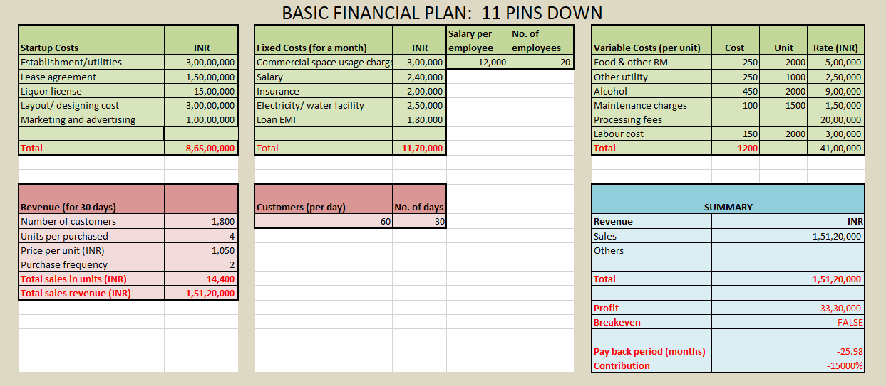

Slide 16
Implementation Plan / Milestones
Implementation
Our Implementation plan is quite convincing, we are getting good reviews from our target customers through survey form and interviews. Many of them are excited about visiting a sports bar café with their friends and family, we are expecting our Customer base to increase gradually through solid marketing and word of mouth.
Show us the targets for next 12 months
Aims to generate sales of 500 customers per week.
We expect to grow by 20%.
Product development
Combo offers for 4 persons
Continental Meal (veg/non veg)
exotic cuisines
exclusive liquor brands
Business Strategy
Offer loyalty coupons and discounts
Happy Hours
Corporate loyalty cards, Add on cards
Yearly Subscription
Any milestone achieved so far?
We have tied up with two music bands.
We have planned for organizing upcoming events.

Slide 17
Organizational Plan - Team
Prerna Agarwal
Owner
Shruta Kasliwal
Owner
Surbhi Daksh
Financial Management Expertise and Accounts head
Siddhartha Verma
Customer Relationship Manager
Pramit Jain
Marketing Head
Raghav Khandelwal
Business Advisor & Consultant
Himanshu Tamle
Sports bar Manager
Rahul Pruthi
Assistant Manager

Slide 18
Organizational Plan - Team
Show us your advisors / investors
Friends and family, Business Consultancy firm, Private Investors and banking institutions
Commitment:-
Not only we have the resources but also the have a laid out business plan which has made our idea into a reality. We commit to provide the best live streaming sports experience.

Slide 19
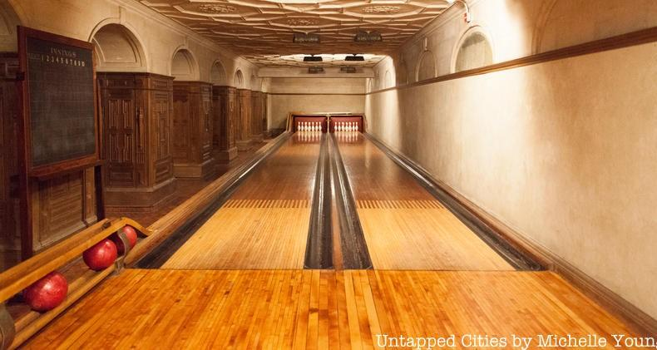
Legal Identity and Brand Name
Company Incorporation:
Registered as SPSR Private limited company under Companies Act, 2013
Key Legal Compliances:
Rules & Regulations of Companies Act, 2013,
Registered Branding under Brand Name- “11 PINS DOWN”
FASSAI registration for restaurant licensing
Liquor License and Bar License
Approval and NOC from Local Authority
License for playing music or videos
Pollution clearance
Lease Agreement, Trademarks
Fire Inspection & Safety
Insurance of Premises, exclusive equipment's, Fire, Health
Brand(s): 11 Pins Down
TAGLINE
TURNING YOU INTO SPORTS LOVER

Slide 20
Risk Involved
Financial Risk | Strategic Risk | Operational Risk
Availability of funds/ working capital Huge capital involved Decrease in revenue Increase in cost of borrowing Longer payback period due to footfall Owners degree of control | Entry of substitutes Stiff competition Losing of License Technical Glitches Off season | Huge operational cost Sluggish trends Increase in food, raw material and other consumables cost Governing Bodies intervention Inadequate manpower Inefficient management

Slide 21
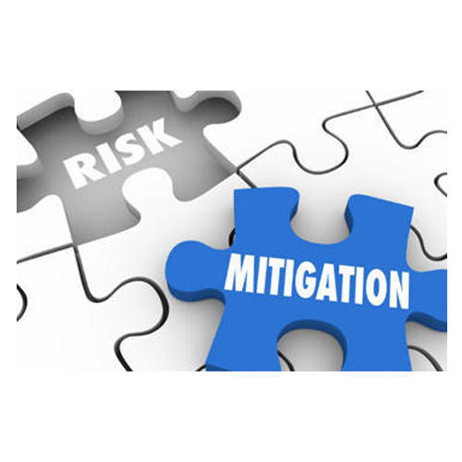
Risk Management Plan
Proper training of staff & workers
Follow the guidelines as per the governing body
Abiding legal norms
Investment in proper equipment and maintenance
Awareness of Food allergies and dietary information
Timely Insurance
Up-to -date technological support and security
Maintaining restaurants & bar facilities
Adherence to health and safety codes

Slide 22
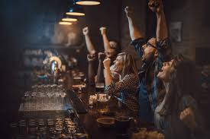
ASK
How much do you ask from the investor?
We have only asked for 45% of costs combined from all the investors and the rest 55% is funded ourselves.
From bank- 1.5crore loan and remaining from private investors and friends & family
How much stake do you offer in the company?
15% of stake to private investors, 20% to friends and family and the rest is kept with ourselves.
What is the exit strategy if this business goes sideways?
Liquidating the assets on time before they loose their value and making the debts clear. Or maybe just add some new additions to the bar which may spark up people’s interest.

Slide 23

Lean Canvas Model
Solution
Providing a common place to go to and watch sports ,enjoy favorite drinks, eat foods with your friends and family
Unique Value Proposition
3D sound system and large projector screens for better visuals
Customized Dining arrangements
First mover advantage
Unfair Advantages
Different sections for drinkers and non- drinkers
Customer segment
Bachelors
Couples
Families
Problem
Watching sports is a group activity. Going to each other’s houses get tedious.
No common place to watch sports and enjoy with drinks
Key Metrics
Growing customer base.
Retention of existing customers
Channels
Social media advertising
Word of mouth advertising
Contests and exciting prices
Cost Structure
Revenue Strems
Food and alcohol
Games charges
Special events charges
VIP lounge charges
Fixed cost
Salary
Rent
License charges
Electricity
Interest on loan
Variable cost
Food and alcohol
Event cost
Cutleries
Mis. Expenses

Slide 24
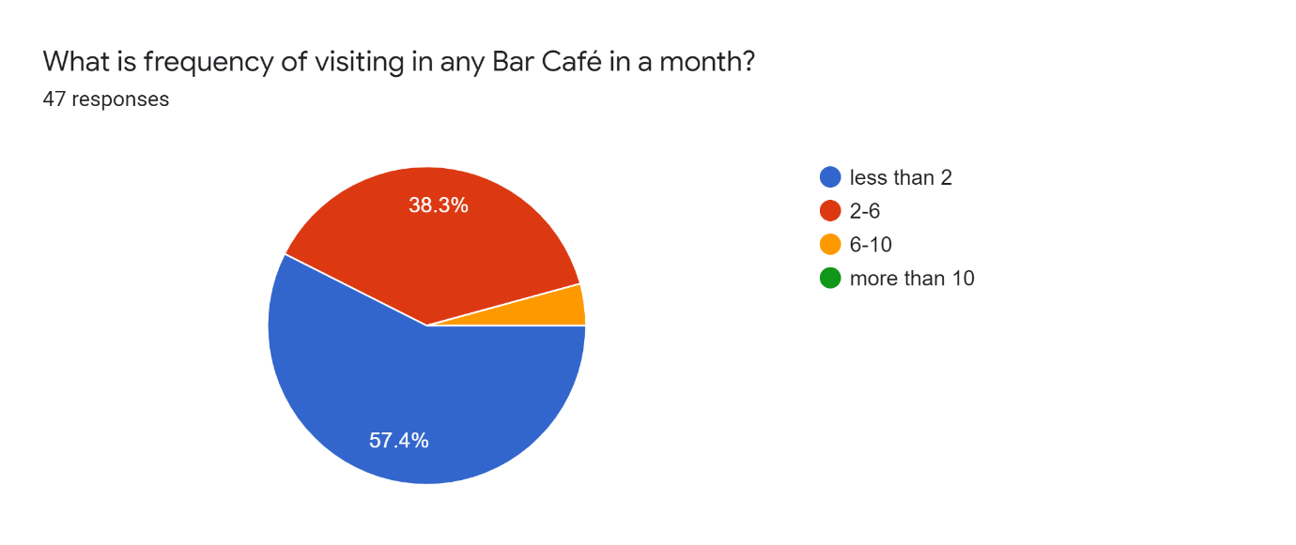
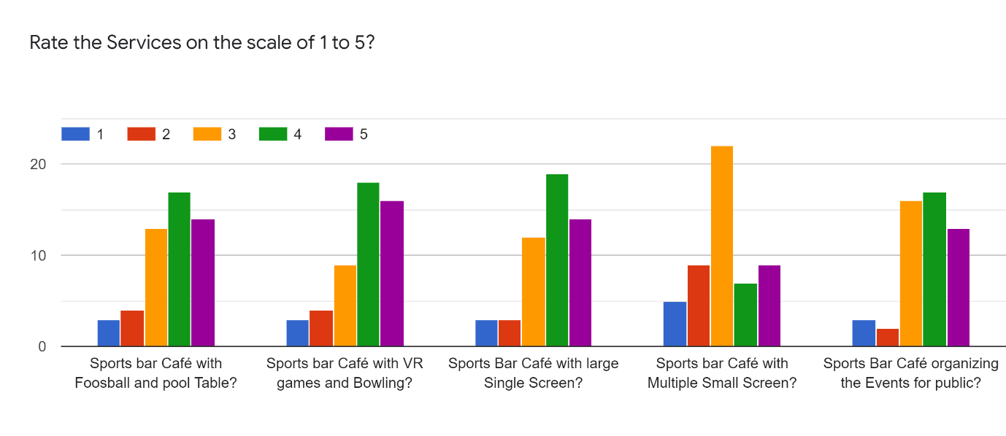
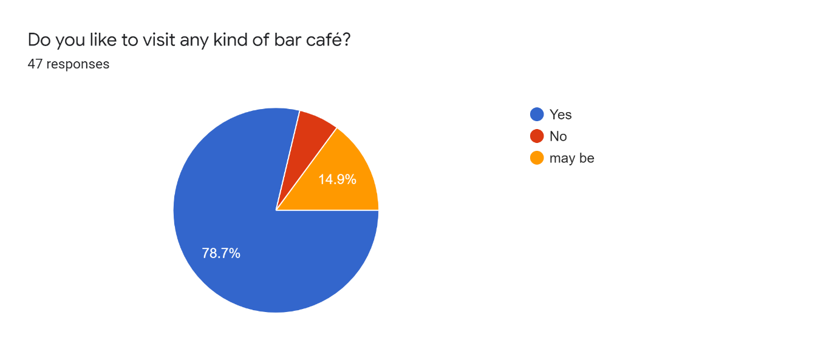
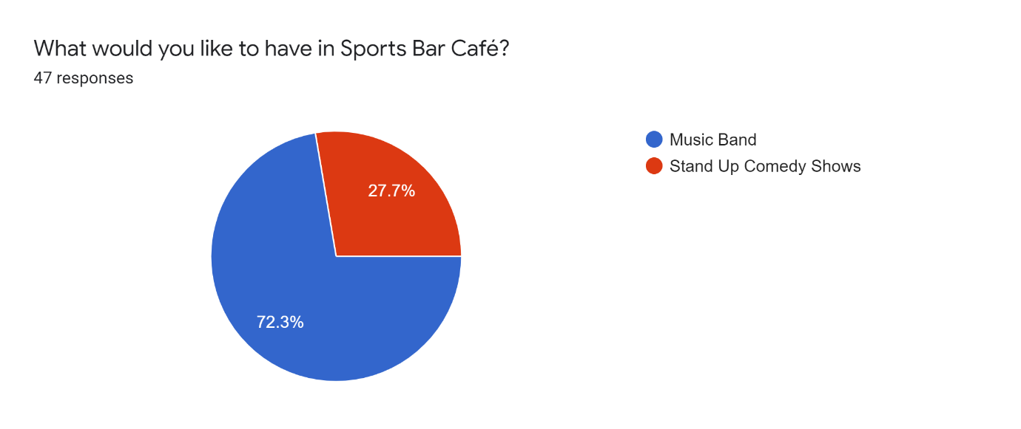
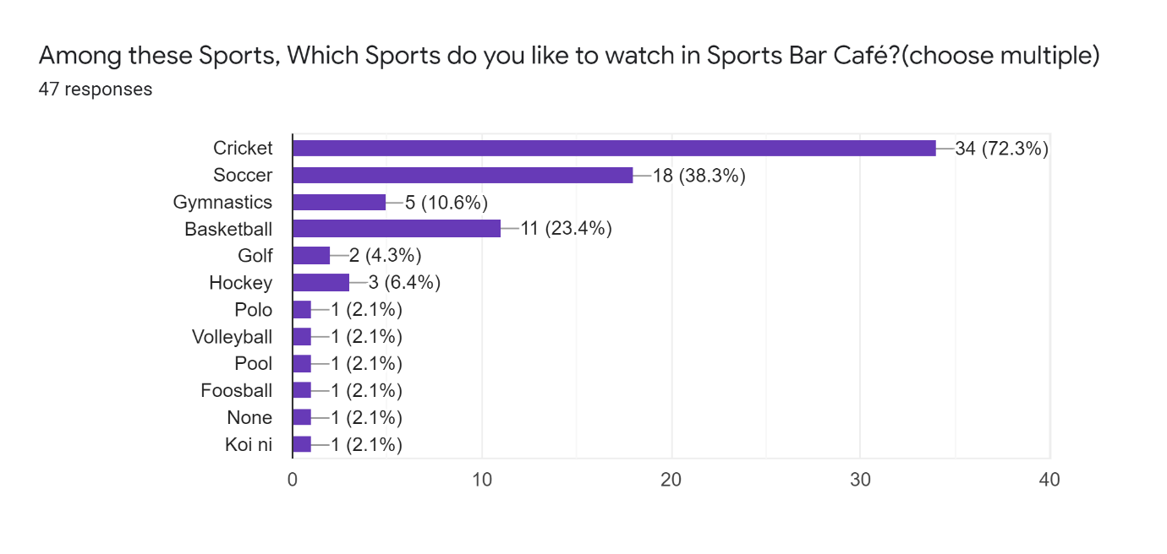
Customer feedback

Slide 25
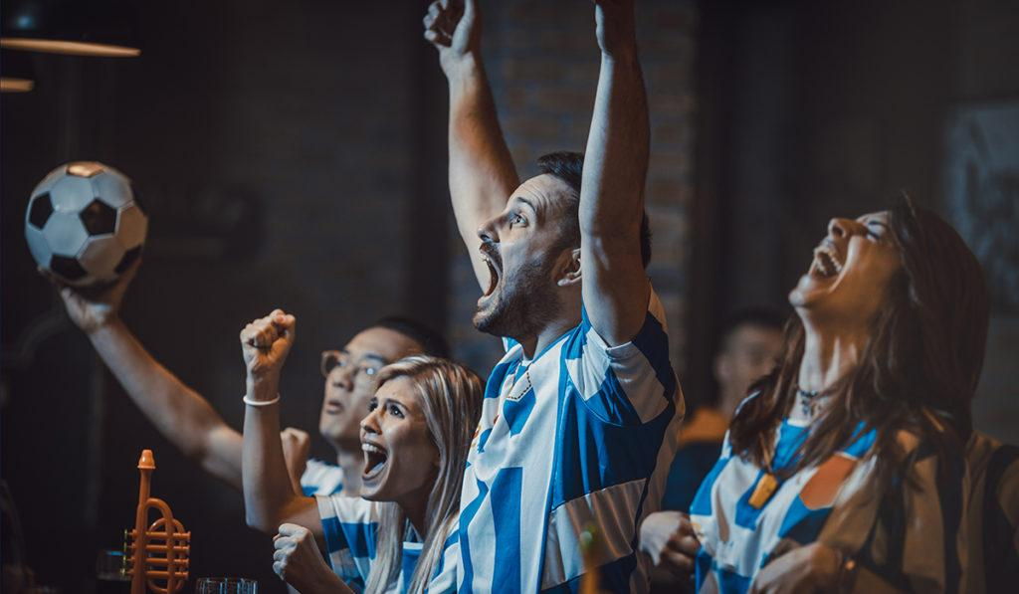
Customer Feedback and Industry Review
On the basis of our customer survey, our customer are more likely to visit bar café in less than a month.
Customers like the sports café with big screens than small multiple screen.
Customers prefer to have given more rating to the cafes which have more sports amenities.
According to our industry mentor Sports bar café offering big screens along with VR games, foosball, bowling alley are more likely to attract youngsters.
He said that this business will take time to gain popularity but in near future it will be a well established business.

Slide 26
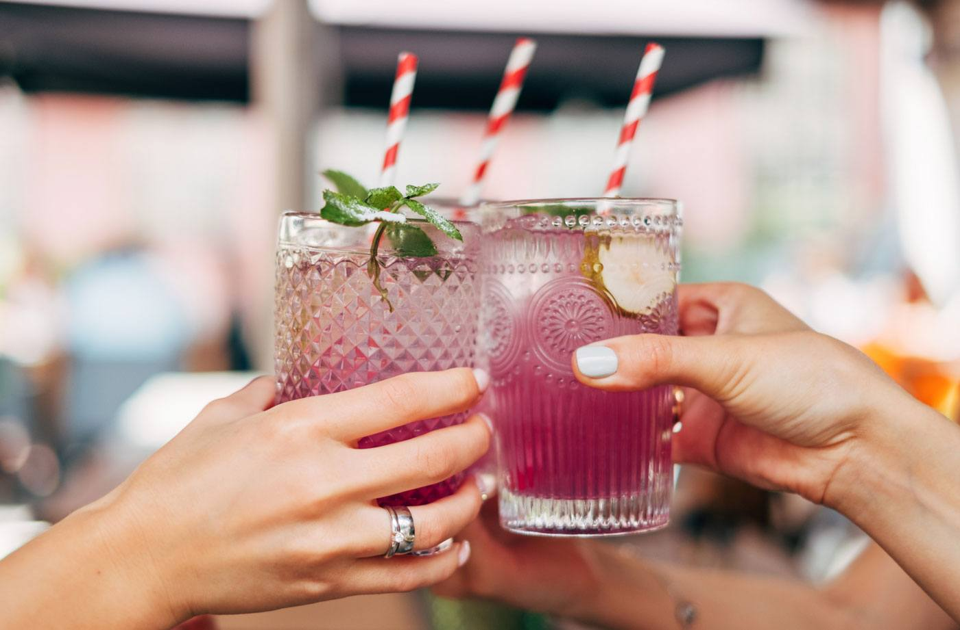
THANK YOU
Hope you enjoy your sporty experience

