Slide 1

Business plan

Slide 2

THE HOUSE OF MINIONS
OUR TEAM
Kamakshi Kaushik - Founder
Mahima Agarwal - Co Founder
Manish Jindal - Co Founder
Piyush Hirwani - Investor
Jaiks Eapen K - Investor
Mihir Manchanda - Employee
Mohammad Sohail - Employee
Kunal Jain - Employee
WE’RE BETTER…….
WE’RE FRESHER….
WE’RE TASTIER!!!!!!

Slide 3

ELEVATOR PITCH
“THE house of minion’s” restaurant for tots which is one of the unique concepts in india
CAGR of the gourmet food business in india is around 16%
Theme ambience according to different age group
Providing nutritious plus tasty food, In india 60% of kids suffer from folate, b12, iron and protein deficiency & our every menu has ADEQUATE AMOUNT OF NUTRITION
Eliminating boredom by ORGANISING stage performances like magic & stand up comedy
Annual membership PLAN
PRO

Slide 4
Genesis of the Idea
Making your restaurant "kid friendly" could increase traffic up to 25%. It's true - the youngest guests can become your best guests!
Kids strongly influence the habits of their parents because parents often decide to eat where their little ones feel comfortable and happy.
Families with children often do not stay for a long time in your restaurant or do not visit it at all if your restaurant is not kid friendly.
Restaurants are often used for celebrations such as kid’s birthday parties or for family gatherings.
Consequently, children and their spending power should not be underestimated. Children are some of the best consumers that can become your best guests if their parents consider that your catering facility appeals to the family as a whole.
Parents are searching online for ”kid and family friendly” restaurants when deciding to go out to eat for lunch - and will go there more often. Maybe this is the reason why the number of families who eat out has increased by 15% in the past 20 years.
ALTERNATIVES - Theme based restaurants and kids mania (Jungle Jamboree, Hang Out, Off The Leash - Dog Park and Hamoni Red: Play Café Hamoni: Cafe By The Greens.

Slide 5
PROBLEM STATEMENT
Why parents do not feel comfortable taking their kids to restaurants, clubs and cafes?

Slide 6
PROBLEM STATEMENT ABSTRACTION LADDER
Lack of perfect atmosphere and lack of fun/frolic activities for boosting them
Lack of enjoyment and entertainment based activities
Imbalance due to generational gaps creating boredom
Can’t handle tantrums and to avoid embarrassment
Outcomes of visiting restaurants and cafes will create further sub problems
Fear of junk food , unhealthy and unhygienic food consumption
Fear of observation of unethical practices like smoking, liquor consumption
Lack of availability of special zones for kids and no special menu is allotted to them
Lack of resources and improper customization

Slide 7

IDEATION
Effective catering facilities
Playing zone and separate kids wing
Emphasis on food presentation and quality
Kids friendly Restaurant
Customization
SECURED PLATFORM
Caretakers allotment
Animation, emojis,cartoon based backgrounds
Improvisation in Menu for balanced diet
Separate wings for adult and children
Special zones for cigarette/alcohol and warning signs
Promotional offers and attracting themes
Playful activities
Availability of necessary equipments like diapers/toddling chair
Variety of cuisines offering healthy and tasty food

Slide 8

PRODUCT DESCRIPTION
Specially curated Cafe/Restaurant for School-going Children & their families
Differentiation through theme-based ‘House of Minions’ Cafe
Linking knowledge with the sweetness of fun & taste, one of its own kind Techno food house
All food, menu, interiors & overall ambience specifically designed for school children

Slide 9

CORE VALUES
Intended Benefits
Online Delivery through Swiggy & Zomato
Special Play Area for entertainment purposes
Special promotional Discounts and
JoyBox
Special bookings for Birthday parties, Events

Slide 10

INTELLECTUAL PROPERTIES
Brand Logo
Patents relating to House of Minions themed desserts
Patents relating to some chef-specials & menu item names

Slide 11
Solution/PROTOTYPE
SOLUTION
UNIQUE PART
VALUE PROPOSITION
The unique part is an electronic globe on each table which is linked with the tab. On selecting any country on the globe the globe will tell a fun fact of that country and accordingly will display the special dish of that country.
We have created a themed restaurant meant especially for kids and families where the kids will enjoy as much as the adults.
Our unique Value proposition is:
Food-Learning-Fun

Slide 12
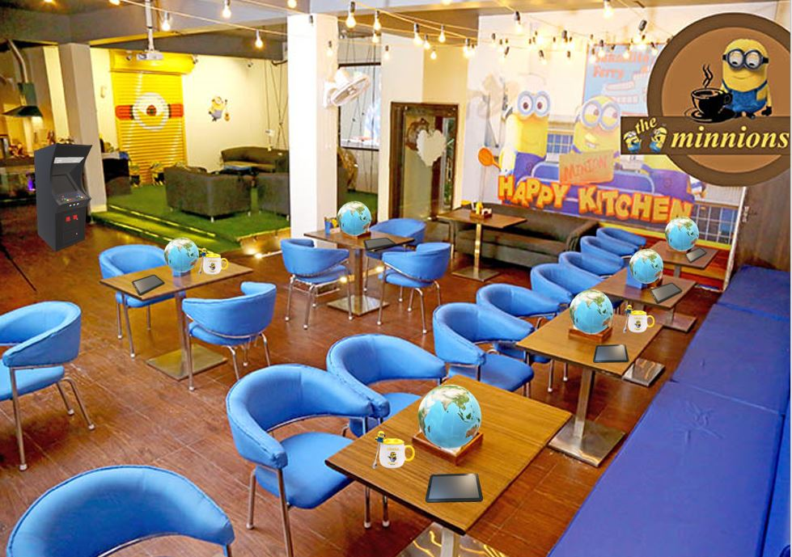
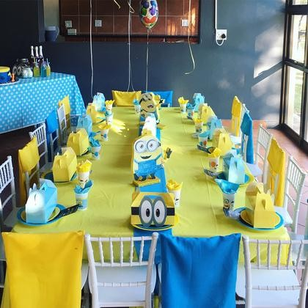
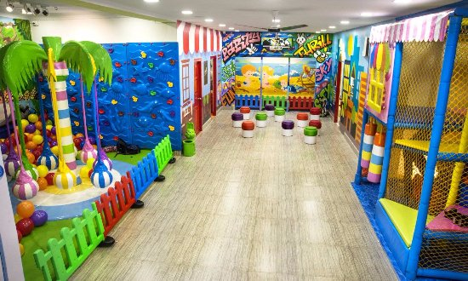
Birthday Celebration Lounge
Dining Area
Play Area
PLAY AREA

Slide 13

SELECT A COUNTRY
The first apple pie recipe was printed over 630 years ago in England in 1381.
What's special in USA?
Apple pie
The Hamburger
Drop biscuits & sausage gravy
Americans alone consume approximately 50-billion burgers a year.

Slide 14
Target Customer and MArket Size
Families which are not comfortable to go to café and family clubs with their children
Market size is about 70% and worth 75,000 crore and is growing at an annual rate of 7%.
Go To Market Strategy
Early Adopters
Early adopters are the families who are concerned to take their wards to café and family clubs.
We provide theme-based restaurants in which their children are not getting bored and there are so much fun activities.
We promote our campaign by Distribute pamphlets,social media, print media, develop our own website and strategic alliance with different partners and provides offers and discount.

Slide 15
Industry and Ecosystem positioning
Major Players and Suppliers
Recent Growth
Growth Trends
Restaurant menu trends
Delivery options
Ghost kitchens
Green kitchens and environmental concerns
Players-
Mc Donald’s
Dominos
Burger King
Suppliers-
Master Food Agency
KM Food Suppliers
Health consciousness
Sustainability
Innovative home delivery service

Slide 16



PESTE ANALYSIS OF BUSINESS ENVIRON-MENT
 | POLITICAL (Govt. Policy/ Regulatory) | ECONOMIC (Growth, Inflation, interest rates etc.) | SOCIAL ( Behavior changes, Buying patterns) | TECHNICAL (R&D, Automation, Digitization) | ENVIRONMENTAL (Ecological & Environmental changes)
FAVOURABLE | - Complying with all the health and safety standards and permissions like obtaining a certificate from FSSAI etc. | -Positive change in the consumer disposable income | -Increased preferences of consumers for a themed restaurants -Busy lifestyle of the people | -Installation of electronic globe on each table is our USP. -Adoption of Paperless technology | -Implementation of a proper food management system - Implementing water conservation procedures.
UNFAVOURABLE | -Change in Tax reforms could affect our restaurant business adversely | -Pandemic situation -Negative Change in consumer disposable income -Increase in inflation rate - | -Changing preferences towards being a health conscious person. - Due to the Pandemic, people might be suspicious about the hygiene and cleanliness | - Inappropriate and non working CCTV cameras. | N/A

Slide 17

COMPETITOR ANALYSIS
STRENGTHS
WEAKNESSES
The Funbox
Well-furnished for hosting Corporate events, School trips, etc also
Collaborating with retail brands for promotional efforts
No learning by doing activities which is preferred by parents nowadays
An outsourced food catering agency serving the needs.

Slide 18
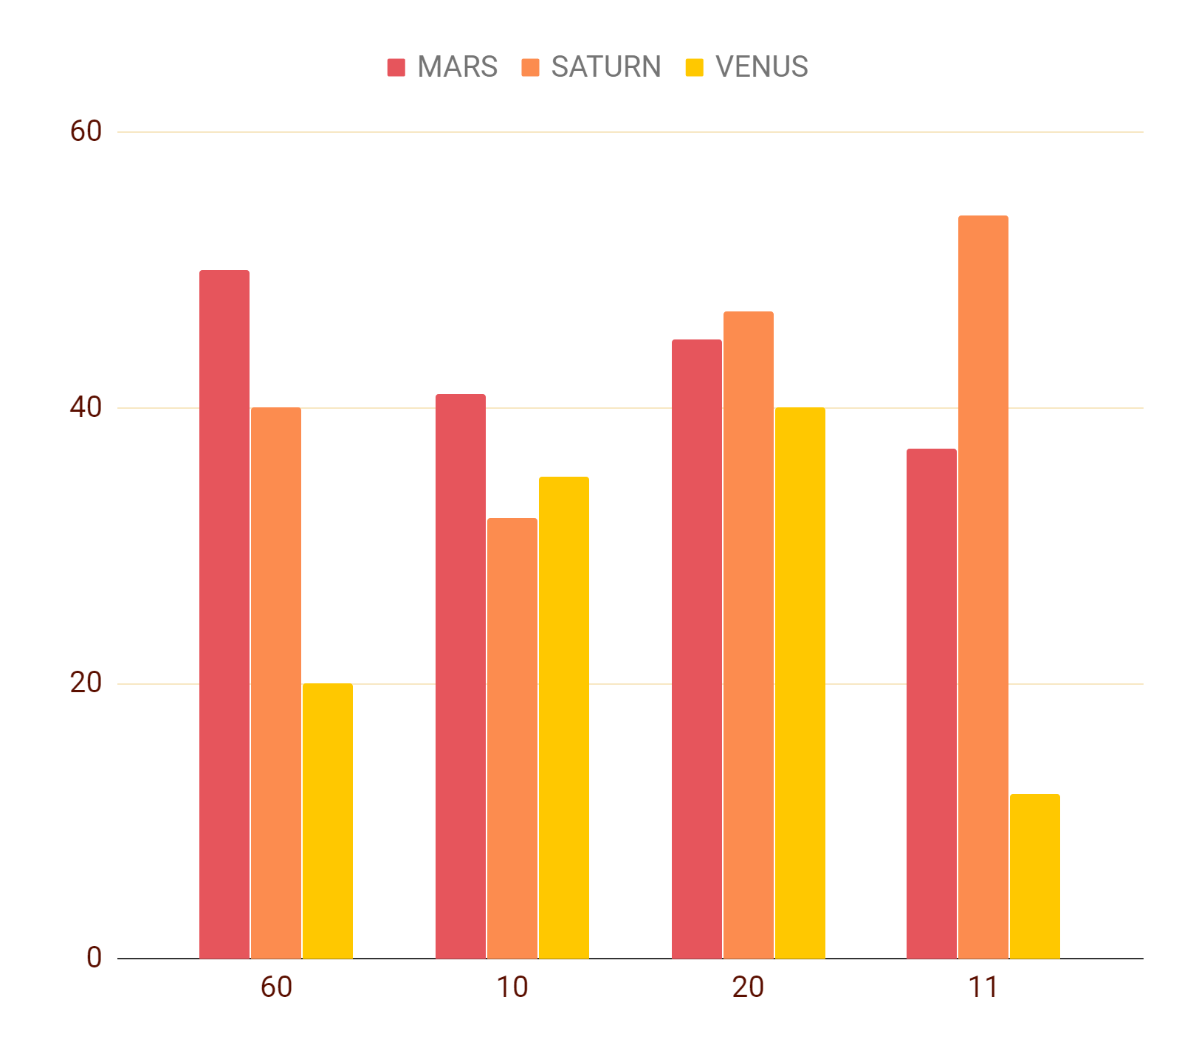
FINANCIAL PROJECTIONS
BREAK EVEN
FALSE
Relative pricing strategy
Country special
Focus on 99 rule
PAYBACK PERIOD
2.47
ESTIMATED CASHFLOW
45,00,000

Slide 19





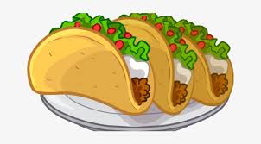


OPERATIONAL PLAN
KEY RESOURCES
KEY MILESTONES
Get into franchise business
Physical resources
Increase the services
Focus on different age group cafes
KEY ACTIVITIES
Human Capital
Intellectual Resources
AGE
Food , gaming and knowledge is what we offer to kids but in a new way

Slide 20

Implementation Plan
Convincing implementation
Product development and business strategy
Milestone Achieved
Regular updating and presentation
Social media reach
Customer centric approach
Performance measure
Good customer response
Pre booking service
Telephonic/Online ordering
Choosing form of business
Selecting location
Gathering team and assigning roles

Slide 21
Organization Plan (Team)
Founders
Advisors / Investors
Team Members
Diverse Fields
Technical Aspects And Expertise
Negotiations & Business Communications Skills
Funding
Angel Investors
Bank Loan
Right Personnel
Work Division
Performance Measure

Slide 22
Legal Identity
Licenses
Company incorporation
FSSAI Food Safety and Standards Authority License
Health/Trade License
Eating House License
Shop and Establishment Act
GST Registration
No Objection Certificate from The Fire Department
Music License
Certificate of Environmental Clearance
Signage License
Register your business under Companies Act 2003
Register the name and trademark it
Cost up to Rs.40,000

Slide 23



RISK Analysis
manpower
Getting fresh supply
Food safety
Equipment and maintenance
High fixed cost
Exposure to intense competition
Strategic
Licensing
location
inadequate marketing
Financial
Operational

Slide 24
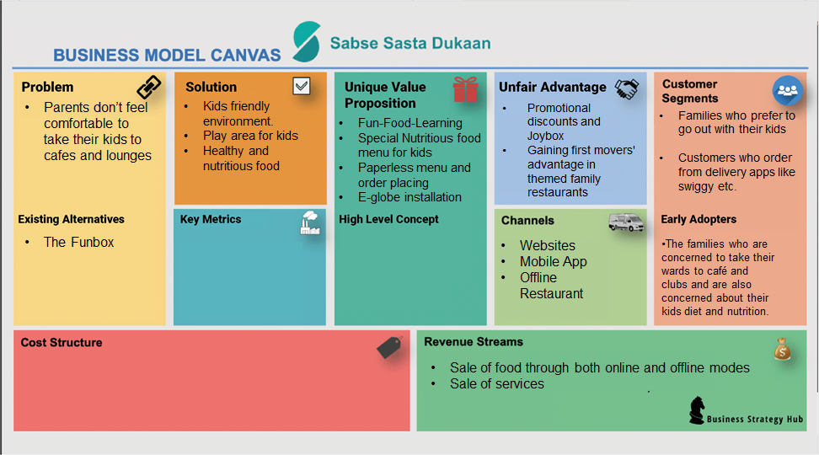



OPERATIONAL PLAN
MARS
JUPITER
SATURN
HOUSE OF MINIONS
LEAN CANVAS
Customer footfall
Online orders
Catering orders
New way with new technique and new technology
Despite being red, Mars is a cold place. The planet is full of iron oxide dust
Jupiter is a gas giant and the biggest planet in our Solar System
Saturn is the ringed one. It’s a gas giant, composed mostly of hydrogen
Start up cost , monthly payments to staff & other billings

Slide 25

THANKS YOU !
Please do visit House of minions

