Slide 1
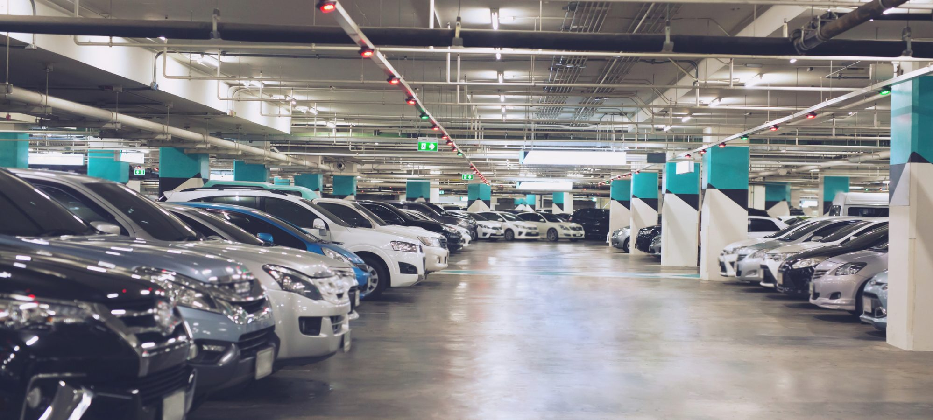
BUSINESS PLAN
By Group-10:
Arshraj Teotia (20DM045)
Barkha (20DM057)
Bhanu Pathak (20DM058)
Chirag Jaswal (20DM066)
Deepanshu Bansal (20DM070)
Deepanshu Pal Singh (20DM071)
Disha Bhatia (20DM074)
Satyam Bansal ( 20DM190)

Slide 2
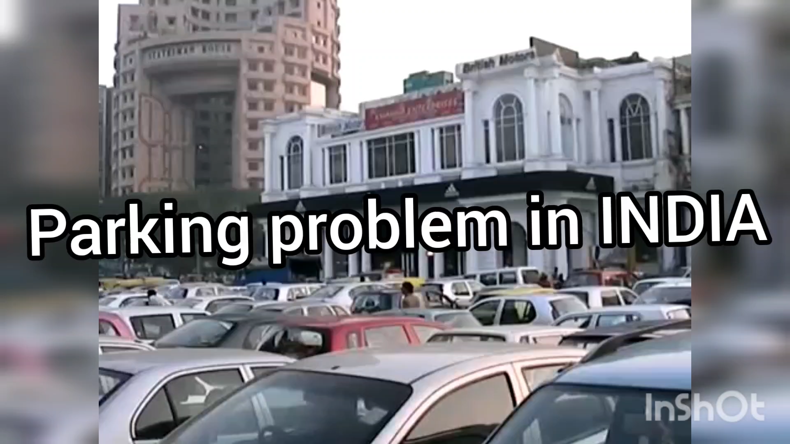

Slide 3


Business Overview
Parkey is here to cater to both.
Valet operations are best employed:
When an enhanced level of service is desired,
In parking operations in which an operator or facility owner needs to optimize use of limited or undesirable parking.

Slide 4

Parkey!
A simple, innovative, and helpful solution to all the parking woes.

Slide 5
How do the customers address the problem today?
Due to lack of time people park cars very inefficiently and at wrong places which cause traffic jams and chaos.
People also have to pay fines if they park at a wrong place.

Slide 6

Real-life Problem Validation
During events like The Grub Fest, Horn OK Please, the lil flea, or various shows, parking at Jawaharlal Nehru Stadium becomes extremely tedious. The provision of valet services at spots within and outside the stadium can ease the customer experience.
Running errands in markets like Bungalow Road and GK is preceded by a long waiting time to find a parking spot.
Students in private universities spend a lot of time looking for vacant parking spots before classes.

Slide 7
Problems
Traffic Jams
The increased number of vehicles on the roads causes traffic jams.
Unorganised parking
Careless and unorganised parking makes it difficult to utilise the parking space at the fullest.
Low parking space
Popular market areas and colleges have limited parking space but an increasing number of people visiting the places in cars and other vehicles.

Slide 8
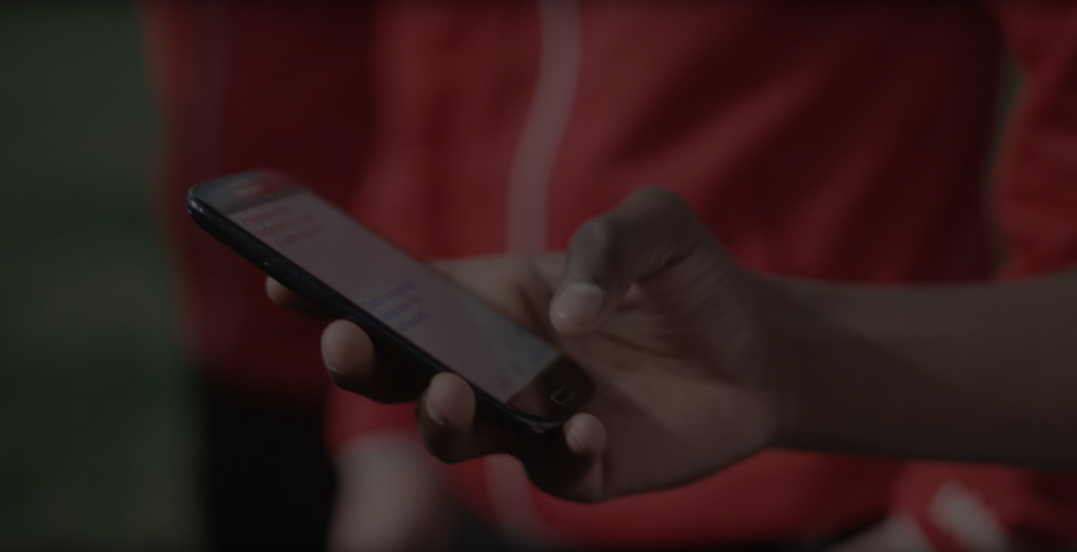
Problem Statement
Due to unorganized parking and increased traffic jams, valuable time is wasted in parking cars

Slide 9
Shortlisted Solutions
Employing valet drivers at various locations of high vehicle density parkings.
The customer can SMS the valet before he desires the car to himself, so as to save the waiting time usually taken.
Regular visitors can avail the benefits of the valet service through a monthly subscription.
Easy on the wallet of the customers and will ensure a proper, systematic parking environment.

Slide 10
Solution
Providing a solution to the growing parking problem at a minimal cost to the customers, saving up their time and effort wasted in finding the right parking spot for their car.

Slide 11
Benefits
Real-time occupancy: Real-time data about occupancy availability in a parking spot, vehicle details, customer sizing, data analysis for profiling.
Smart City & Smart Parking: Smart cities aiming to be greener, safer and efficient. Smart parking aids in reducing congestion, organizing parking on time, increasing productivity and easing mobility.
Analytics & Insights: Smart parking reports considerably reduce the manual efforts in analyzing the parking pattern and does an efficient forecast for further analysis.
Automated monitoring: Automated parking management through the mobile app reduces management costs and aids in easy monitoring.
Reserve & Pay: Drivers can reserve a parking spot in advance and make the payment digitally having a hassle-free parking experience.

Slide 12
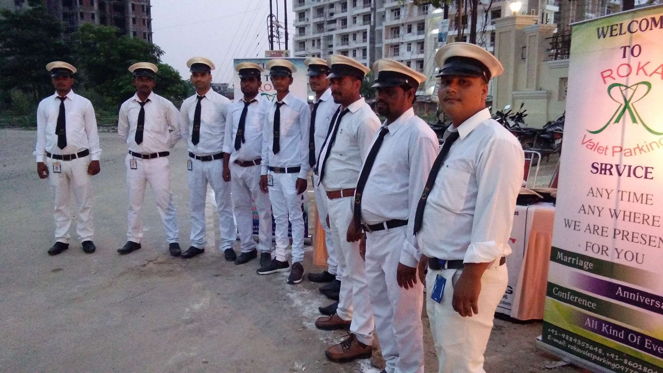
Strategy of Execution
● Visit the valet booth at the hotel or banquet hall
●Hand over the car to valet
●Once the valet tag is collected, the customer would get a pop SMS as acknowledgement
●The customer will reply to the message when he/she is about to leave
Hotels and Banquet Halls

Slide 13
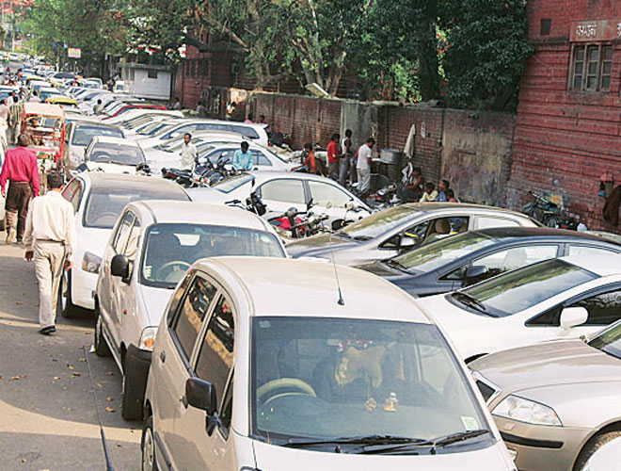
Strategy of Execution
●Get your car to the college gate
●Hand over the car to valet
●Take a mastercard as receipt of your service
●Text the valet when you are leaving the college
Private Universities

Slide 14
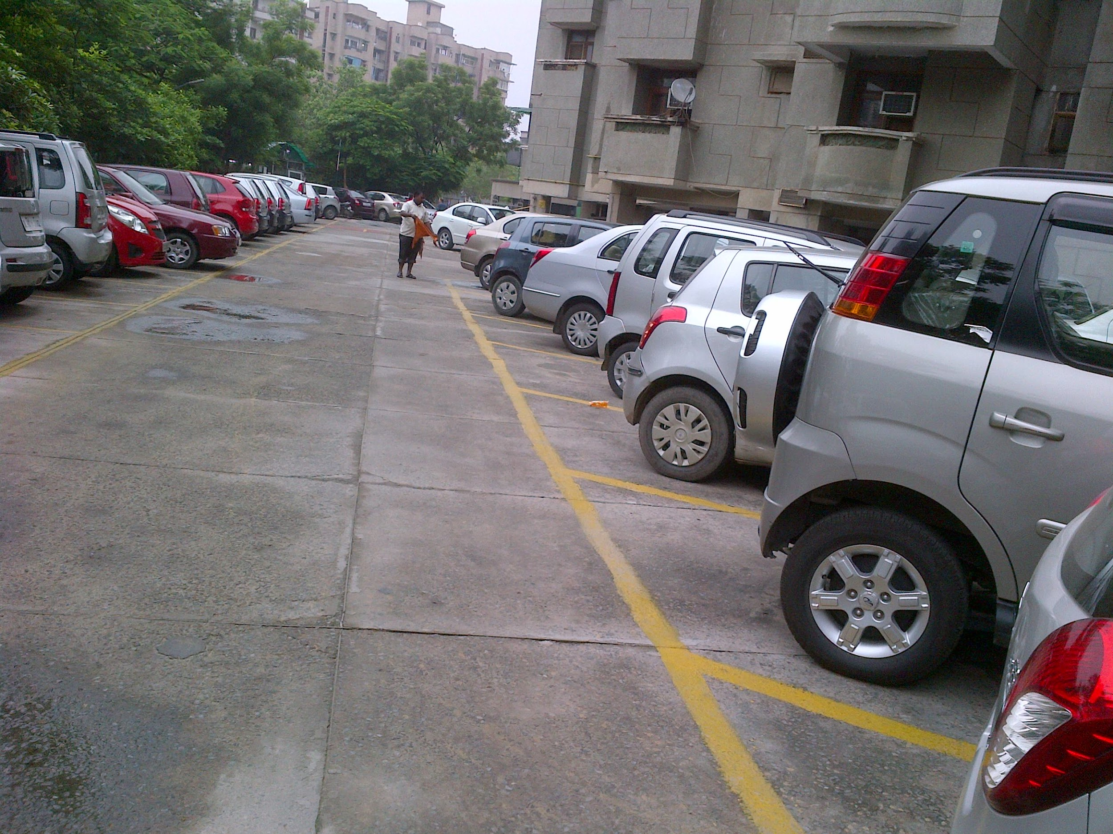
Strategy of Execution
●Get your car to the main entrance
●Hand over the car to valet
●The valet will return the keys at doorstep of customers
●The customer will call the valet whenever required.
Housing Societies

Slide 15
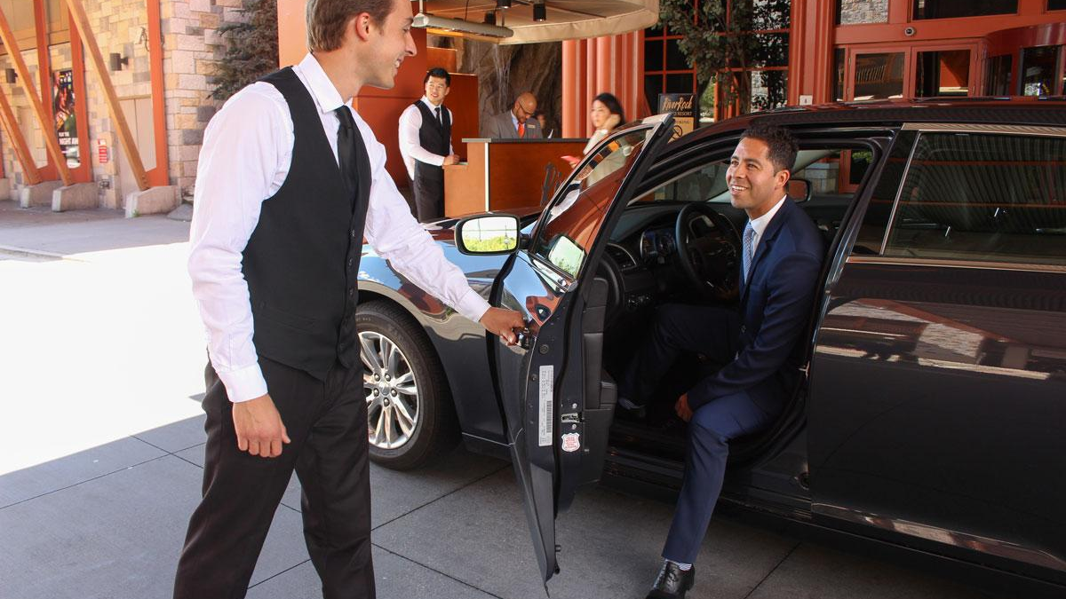
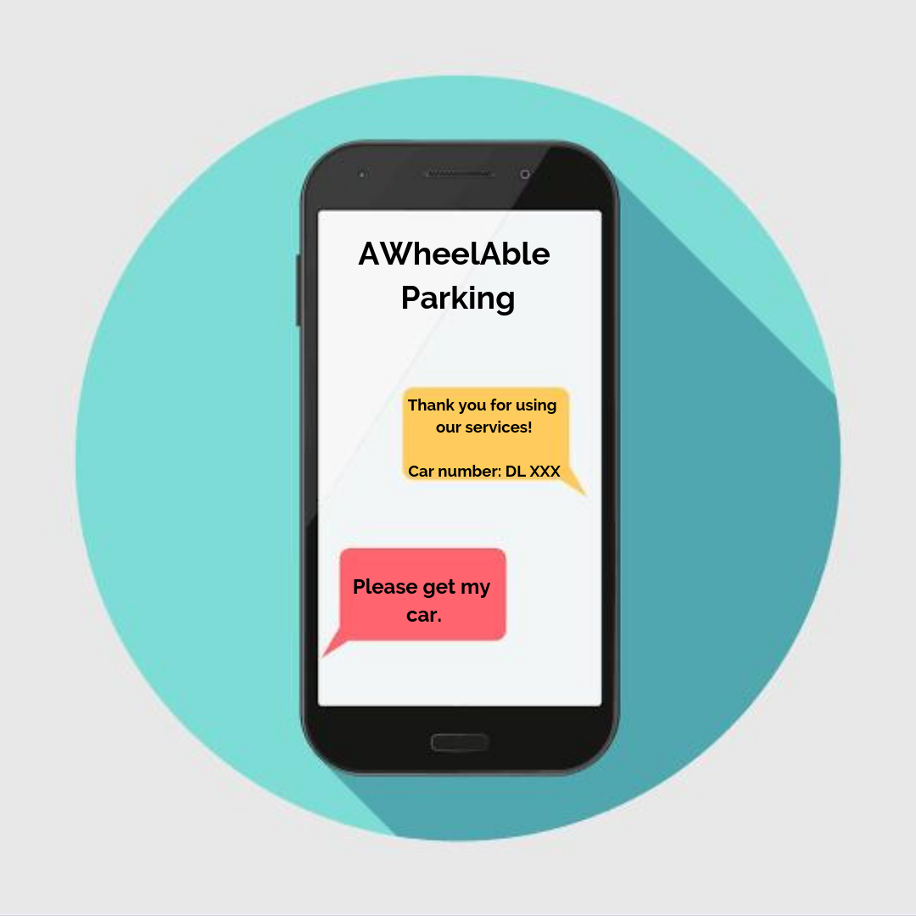
USP(Unique Selling Product)
Userfriendly App
Reduced waiting time
Capitalising on untapped markets
Provision of drop-off services in cases of banquet halls

Slide 16
Target Market
Banquet Halls and Hotels
Housing Societies
Private Universities
Shopping Streets
Minimising waiting time of customers and offering drop-off service where needed
Provision of subscription model at high-end societies
Tapped Markets |  |  |  | Untapped Markets
Minimising time spent in finding vacant spots by offering valet services to students and teachers
Provision of valet service in crowded areas like Bungalow Road, Pandara Road, etc.

Slide 17
MARKET SIZE Statement
The total addressable B2B market including top 8 cities in India is estimated to be INR 188K Cr (annually), while potential B2C market is estimated to be INR 30K Cr (annually) and it’s growing 30% YoY due to Government policies to create more paid parking zones and include surge pricing.

Slide 18
Marketing Strategies
Offline Marketing
1.Brochures and flyers supplied to housing societies and universities, along with information desks
2.Personal Selling
3.Faculty discounts
4.Collaborations with event management companies (Example Sunburn, College Fests, Craftworld Events)
5. Word of Mouth

Slide 19
Marketing Strategies
Online Marketing
1. Targeted advertising through online advertisement service providers
2. Advertisement on Colleges’ official online handles
3. Personal business website, focusing on cultivating brand awareness

Slide 20
FINANCIAL PROJECTIONS
Value-based pricing—setting a price based on how much the customer believes what you're selling is worth.
I f we talk about the trend in the parking industry it is usually seen that it cost around Rs.15 / hr and we charging the customer a nominal fee of Rs.1500/per month. If we estimates the per month cost of a person that he spends on parking is around 1800 – 25000 that to with no proper security. hence it is worth believing for the customer to pay 1500 per month along with other top class benefits and comfort.
We have estimated that their will be around 100 customer for first few days and as we go forward with marketing and see how big is the problem we analysed that around 3000 subscription will be their in a mont h and around 5lakhs in a year , this will help us to generate a monthly revenue of around Rs. 45lakh and a profit of rs.2789000 since we do not have much start up cost and operating cost these number look feasible. Due to same reasons we have a payback period of 0.77 i.e. less than a month. With a break even price of Rs. 882.7324478 with contribution of 1317.5 due to low variable cost.

Slide 21
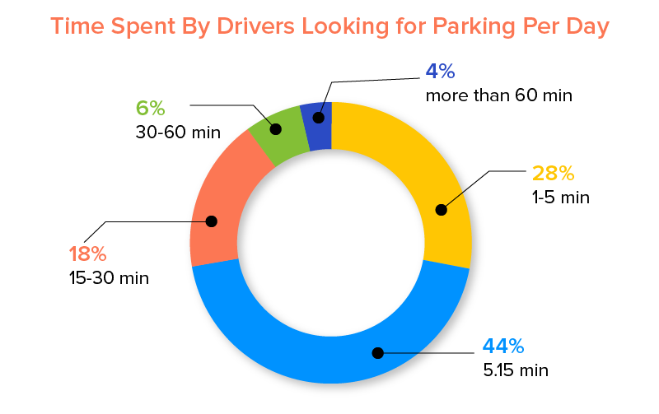
Industry and Ecosystem Positioning
With the increasing population and increase in vehicles on the road, parking stands as a major concern for the commuters.
It was noted that almost 80% of drivers do not know whether they will find a parking spot or not. The survey also assessed the time spent by drivers looking for parking every day.

Slide 22
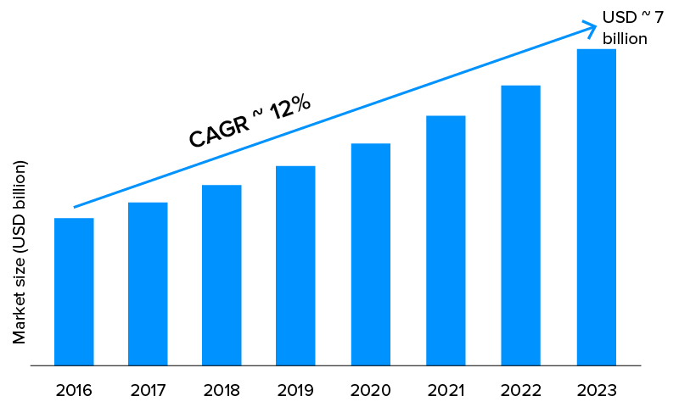
In India, there are approximate 640K paid parking spaces, split between the functions residential, work, shopping, airports, railway, hospitals and leisure in the top 8 cities in India.
The total addressable B2B market including top 8 cities in India is estimated to be INR 188K Cr (annually), while potential B2C market is estimated to be INR 30K Cr (annually).
It is growing 30% YoY due to Government policies to create more paid parking zones and include surge pricing.
Smart Parking market is anticipated to reach USD 100 Billion & growing at a CAGR of 18% from 2018 to 2023.
100
18%

Slide 23
PESTE Analysis
 | POLITICAL (Govt. Policy/ Regulatory) | ECONOMIC (Growth, Inflation, interest rates etc.) | SOCIAL ( Behavior changes, Buying patterns) | TECHNICAL (R&D, Automation, Digitization) | ENVIRONMENTAL (Ecological & Environmental changes)
FAVOURABLE | Easy incorporable for start-ups. | Low cost and affordable services | Services at comfort | App and website | Traffic free road will reduce air pollution.
UNFAVOURABLE |  | Threat of new Entrants |  | App and website maintenance costs

Slide 24




STRENGTHS
WEAKNESSES
Unique service app
Can be scaled up nationally & globally
Innovative app that will make finding a parking spot quick, cheap and easy
Has no competitors in the city
Inexperienced management & employees
High cost start-up and promotion
High chance of malfunctions, glitches or bugs
Not everyone has a android capable of using the service.
S
W
O
T
OPPORTUNITIES
THREATS
Expand nationally and internationally
Implement social media to help promote the app
“In App” advertising (major revenue source)
Population growth leading to more cars
Limited financial funding for start-up costs and launch of app
New competitors are likely to provide same service in other cities
Government and ACCC regulations
Lobbying groups influencing consumer perceptions

Slide 25
Operational Plan
Key resources
Key Activities
Providing valet drivers at various locations of high vehicle density parkings.
Key Milestones
Reaching 2 million active users in Delhi by 3rd year.
Mobile Application
Valet Drivers

Slide 26
Implementation Plan
Implementation
Less Capital Intensive
Hiring of valet driver is done through rigorous training and test.
Collaborations with event management companies (Example Sunburn, College Fests, Craftworld Events)
Goals for next 12 months
Having 500,000 active users.
Milestones achieved
Registration achieved of our company name.

Slide 27
Legal Identity
Key Legal Compliances
For car parking spaces law: Delhi Maintenance and Management of Parking Places Rules 2019 under Motor Vehicles Act
Motor Transport Workers Act, 1961
Information Technology Act, 2000 (for app)
24/7 call centre
App-based customer service & grievance redressal officer
Make all the necessary back-end customer support
Verification of the drivers: required to maintain a record of personal details about drivers including their PAN card, voter-ID card and the contact details of family members. The drivers, for their part, have to hold a KYC-compliant bank account to register with the aggregators.

Slide 28
Legal Identity
Company Incorporation
App Developers
Name reservation for new company
Incorporation
DIN allotment
Mandatory issue of PAN
Mandatory issue of TAN
Mandatory issue of EPFO registration
Mandatory issue of ESIC registration
Mandatory Opening of Bank Account for the Company
Allotment of GSTIN (if so applied for)

Slide 29
RISK ANALYSIS
Financial
Operational
Risk of Valet’s behaviour with customer
Risk of consumption of objectionable items
Risk of moving to competitors.
Risk of availability of sufficient manpower
Risk of lack of knowledgeable manpower
Risk of New entrants
Risk of differentiated service
Risk of Carelessly Parked
Risk of availability of parking space
Risk of driving skills of valet
Risk of technical glitch in the application or connectivity.
Strategic
Risk of theft
Risk of accident
Risk of damage of else’s property

Slide 30
RISK MANAGEMENT PLAN
Risk Involved | Solution
Theft | Maintaining proper records of valet, ensuring that vehicle is insured
Accident | Hiring experienced valet and regular track of customer feedback
Valet’s Service | Giving training to valet’s to ensure generalized service
Parking Space | Before starting operations in a location, proper arrangements for spaces
Working of Application | User friendly interface and network checks on all the parking lots
Retention of Valet | Providing performance based incentives and facilities.

Slide 31
ASK
Ask from the investor –
Broad Usage of Funds-
App Development
Collaboration with Parking Providers & Individual spot owners
Payment to Valets
Stakes -
Exit strategy – Mergers & Acquisition

Slide 32





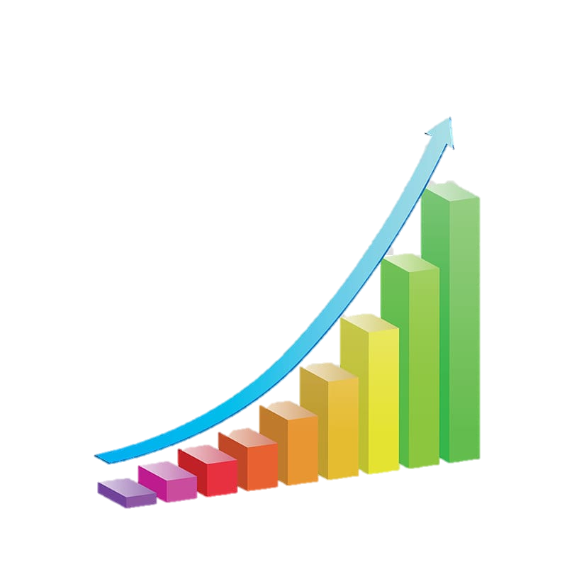


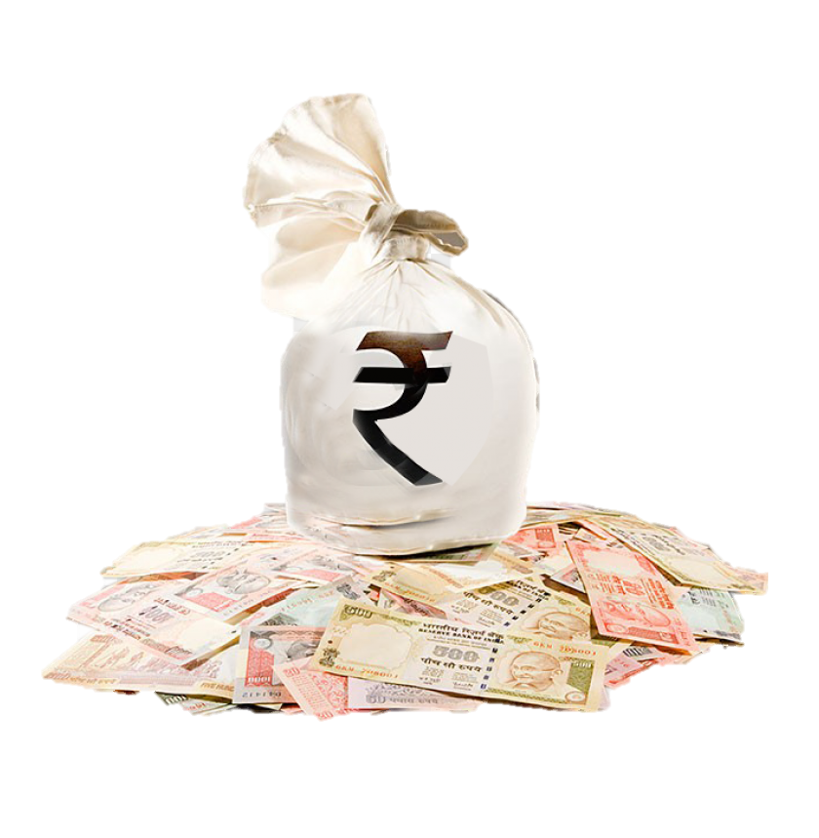
LEAN CANVAS
PROBLEMS
Traffic Jams
Unorganized Parking
Low Parking Space
Challans
SOLUTIONS
Secure And Convenient
Parking
Easy To Locate Parking Space
Location Based Parking
UNIIQUE VALUE PROPOSITION
Secure And Convenient Parking Space
Maximum Utilization Of Space
Nominal Charges
UNFAIR ADVANTAGE
All Parking Needs in a Single App
CUSTOMER SEGMENTS
Vehicle Owners
Events
Hotels/Restaurants
Offices
KEY METRICS
Parking Allocation
Parking Reservations
CHANNELS
Mobile Devices
Website
COST STRUCTURE
Mobile Application Platform Maintenance Fee
Drivers & Parking lot Expenses
Advertisement & Insurance Expenses
Miscellaneous Expenses
REVENUE STRUCTURE
Advertisement
One Time Fee
Subscription

Slide 33
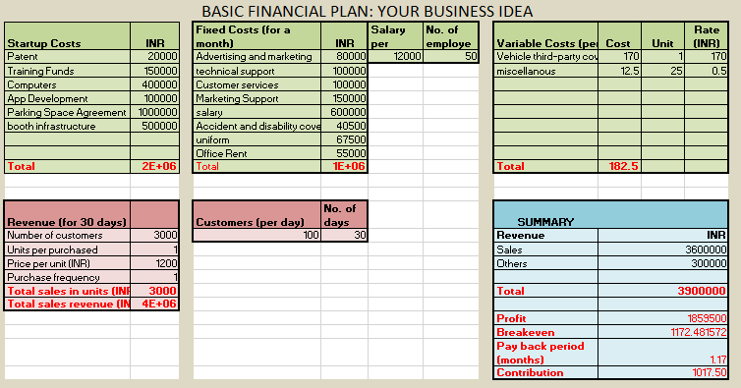

Slide 34
CUSTOMER SURVEY AND INDUSTRIAL EXPERT INTERVIEW
https://drive.google.com/drive/folders/1G5VS2rCOsT-yAq4v1oVYLkAfGeqbI5ql?usp=sharing

