Slide 1
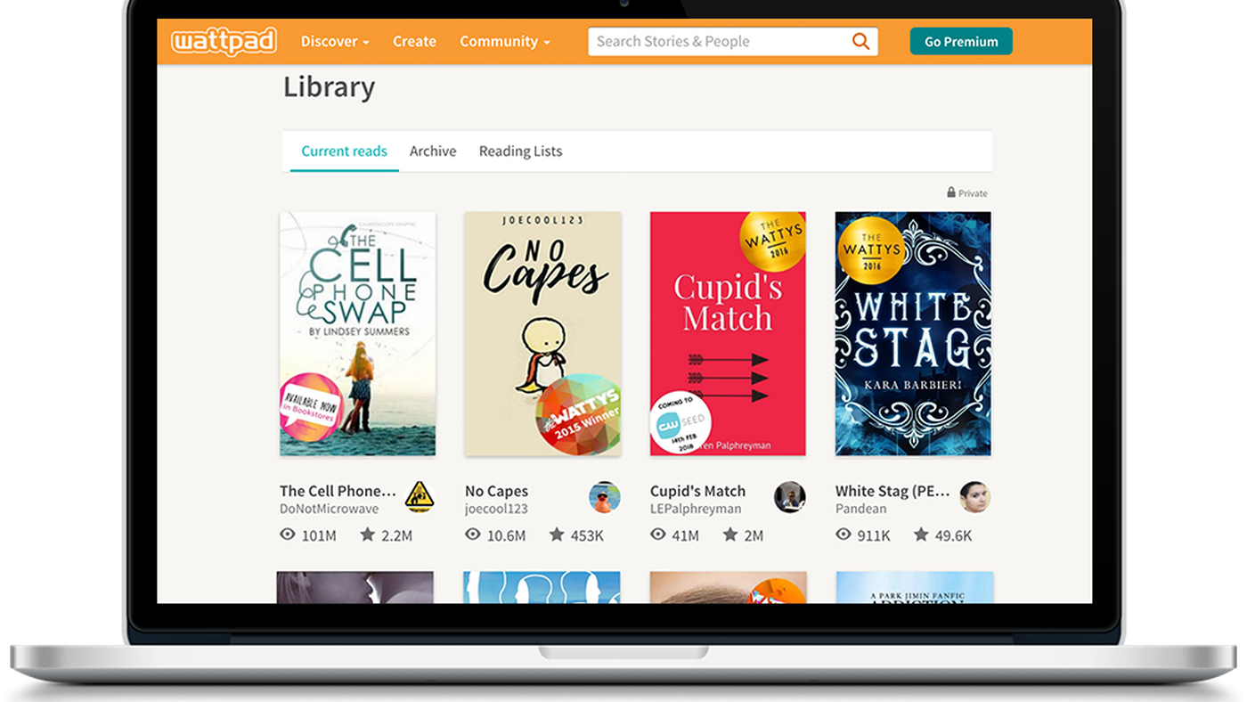
BUSINESS PLAN- BINDER
Sabhya Bajaj 20DM262
Aditi Mittal 20DM275
Avnish Bhutani 20DM289
Abhishek Patil 20DM271
Ashmita Gupta 20DM269
Arnav Mahajan 20DM288
Vernika Madan 20DM240

Slide 2
GENESIS OF THE IDEA
One of our team member, Sabhya Bajaj, was reading Fault Lines by Raghuram Rajan. While he finished reading, he had a lot of ideas and thoughts that he wanted to share with us. But we not having read the book could not show the same enthusiasm or interest in the topic. That’s when the idea of Binder emerged.
We read a lot of books, but we are not able to share our own ideas, or fan theories with people around us who share the same tastes and preferences.
This community will specifically develop around book discussions.

Slide 3
PROBLEM STATEMENT
Describe the problem being solved.
A lot of spamming happens in the existing forums so this platform will be specifically for discussion and anything unwanted can be reported immediately.
What's urgent/pressing about it?
There is no online platform for serious intellectual discussions around literature. Thus, binder will be the best solution to overcome the traditional library method as well as provide a platform for socializing amongst people who have similar tastes and preference regarding literature.

Slide 4
SOLUTION
01
Product / Service Description
it’s a social networking mobile application.
02
Intended Benefits
community building around literature, intellectual discussions.
04
Intellectual Properties
Application : Binder

Slide 5
MINIMUM VIABLE PRODUCT
Value Proposition
Solution
It is a social networking mobile application with the intended benefit to community building around literature who can have intellectual discussions with people with similar interests and tastes in books
Our application is a one stop solution for avid readers to exchange ideas with like minded people. And not only this, it will provide a platform for authors to launch their books to a wider audience. Also, general public will get a chance to have interactions with their favourite authors.

Slide 6
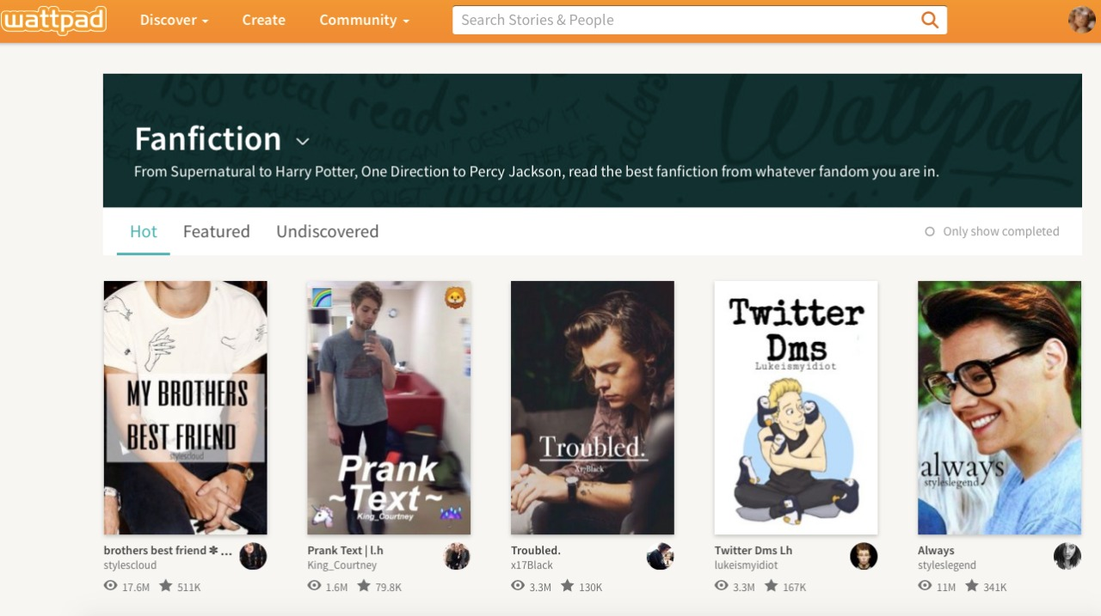
PROTOTYPE
BINDER

Slide 7
MARKET AND PRODUCT POSITIONING
1. Taregt Customer & Market Size
Reading enthusiasts as well as authors. 14+
2. Why will they pay?
The app is free for customers in the short run, but in the long run the revenue will be earned through advertisements by book publishers, private colleges, big publishing houses and we will be earning revenue through ticket sales by organizing events.
3. Projections on how market will evolve over time?
Firstly, we are service providers where we will provide opportunity and then eventually, we will be event organizers. We will organize book fests, ghazals and similar kind of events.

Slide 8
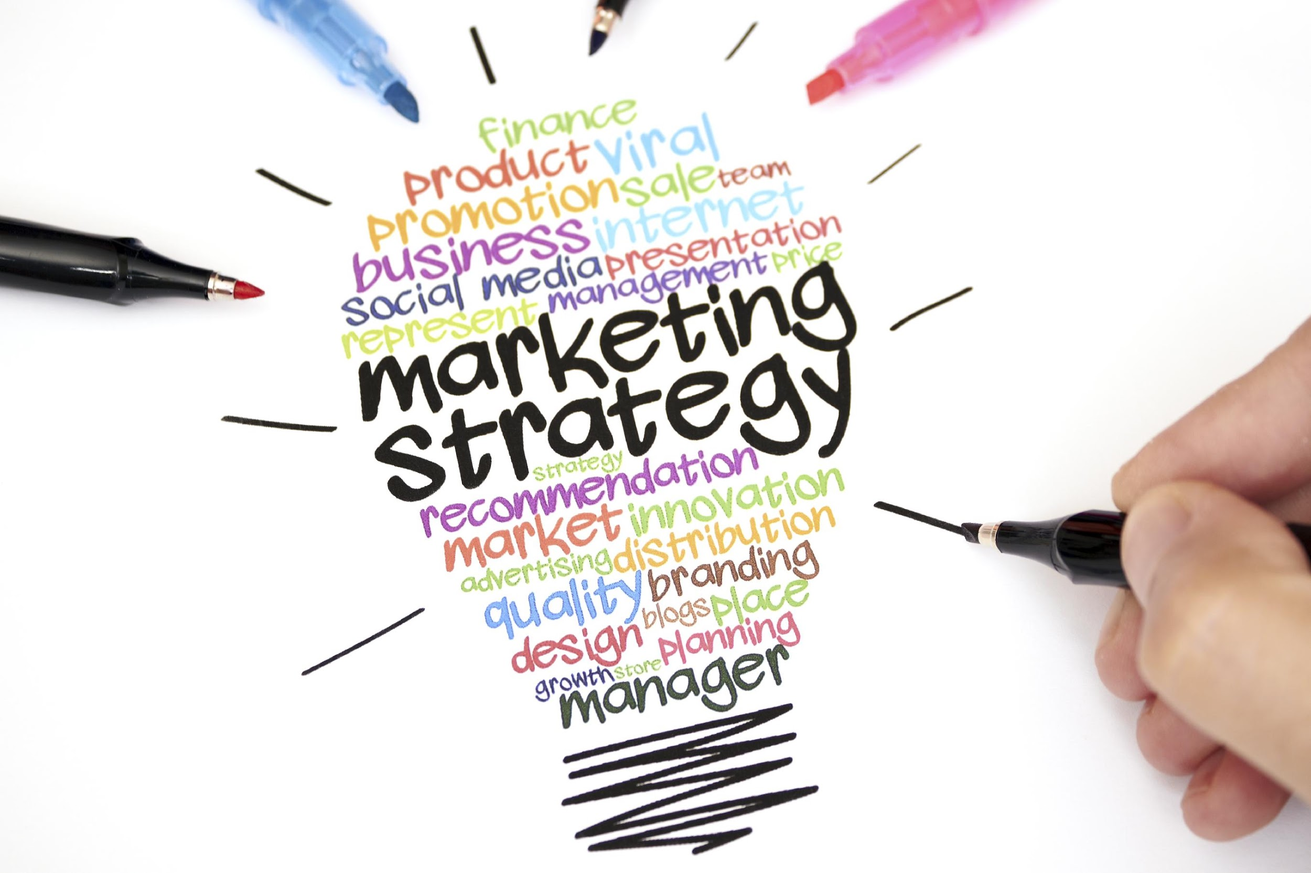
MARKET STRATEGY
How do you plan to reach out and sell to early adopters?
Promoting the application through social media marketing and by organizing literature events.
2. What is the initial market potential of the solution?
It will attract reading enthusiasts from different age groups. For example – kids of 14 years 0f age can come together to discuss fiction and similarly senior citizens can come forward to discuss Holy books.
3. How and where will you sell your products and/or services?
We will be selling the service through an app called Binder on the play store.

Slide 9
INDUSTRY AND ECOSYSTEM POSITIONING
01
03
MAJOR PLAYERS
Direct competition – Litsy
Indirect competition – Kindle, Quora, Audible, good books, Facebook pages, Instagram pages
Key connections that founders already have
Connections with top officials, angel investors and developers.
02
04
Key connections they need to establish
People who are selling books, publishing books, authors
KEY SUPPLIERS
Authors, Influencers, Publishing houses, Event organizers
5. What is the recent in the Industry? What are the key growth trends?
Everything is happening online and in the upcoming future the trend for online will increase .
Online book readers have increased manifold and online meeting sites have seen a lot of traffic. Social community building is the upcoming future, and our app will provide a platform to book readers to have discussions online.

Slide 10


PESTE Analysis of Business Environment
 | POLITICAL (Govt. Policy/ Regulatory) | ECONOMIC (Growth, Inflation, interest rates etc.) | SOCIAL ( Behavior changes, Buying patterns) | TECHNICAL (R&D, Automation, Digitization) | ENVIRONMENTAL (Ecological & Environmental changes)
FAVOURABLE | As such no regulations | as such inflation and interest rates do not impact since our product is an application. | Although it is an online platform it may allow it will provide an opportunity for users to get connected physically through online connections. | AI will be incorporated in the app Prevention of obscene content. Suggestions to users. | No direct environmental impact No resource waste
UNFAVOURABLE | censorship laws apply so that no obscene material is posted on the platform. | The disposable income of the consumers can impact the usage of the application. | Society in general is addicted to phone and this app gives them another reason for the same. Parents might be against it. | Application can crash in between, causing inconvenience to the users. | More app usage will require more technical devices which will lead to creation of carbon waste.
6

Slide 11

COMPETITION ANALYSIS
 | Litsy | Wattpad | Kindle | Quora
Strengths | Great UI | Wattpad Studios discovers untapped, unsigned, and talented writers on Wattpad and connects them to global multi-media entertainment companies. | You can download books from the amazon store and read them on your app. Power conservative | All your questions can be answered on one platform
Weakness | Incapable search structure Frequent irrelevant material posted | Inconvenient to read only 2 books offline. Advertisement after every chapter. | Accepts books only from your amazon account. | No private chat groups High downtime
Price Point | Free of cost | Earlier free of cost to the customers. Now, premium in app purchases. | The books have to be purchased. | Free of cost
UVP | Litsy members can use the app to review a book, share a favourite passage, post photos, have conversations about books, and see what others on the platform are reading. | Wattpad Books aspires to recognize and reflect diverse voices by taking Wattpad stories to published book and onto bookshelves around the world | With a screen using e-ink display technology, it allows you to comfortably read digital text in both sunlight and artificial light. The screen refresh rate when you advance an eBook page is faster than turning a paper page. | Anyone on the internet can answer your question.

Slide 12
FINANCIAL PROJECTIONS
PRICING STRATEGY
We have analyzed the subscription models of other applications like Spotify , Netflix, Kindle and Wattpad and according to that we have kept minimal charges to gain more customer base in the beginning.
PAYBACK PERIOD
5 Years 2 months
OPEX ESTIMATES
BREAK EVEN
Rs. 241800
1st year – FALSE
5th year – TRUE
FINANCIAL PROJECTIONS
CAPEX ESTIMATES
Rs. 7,21,000
Expected Revenue in 5th year from sales- Rs. 50 Lakhs
Expected Revenue from other activities- Rs. 1,20,000

Slide 13
OPERATIONAL PLAN
KEY RESOURCES
  App developer
  Authors
  AI & ML
  Big Data
KEY ACTIVITIES
  Functional User Interface
  Marketing through different channels
KEY MILESTONES (For first 3 to 5Years)
  Organising our first Book Fest
  Advertising revenue- 1 million dollars
  10 million download on play store and app store

Slide 14
IMPLEMENTATION PLAN
How convincing is the implementation?
Easy implementation as our business model is capitally "Lean".
Show us the targets for next 12 months and the plans for ‘product development’ and ‘business strategy’.
App to be functional and minimum app downloads to be 10,000.
Business Strategy—Geographical expansion, digital promotion of the app.
Any milestone achieved so far?
Application in the prototyping phase, and initial customer response is positive.

Slide 15
ORGANIZATION PLAN- TEAM
Show us team member with education / experience / past success or failure
Aditi Mittal and Ashmita Gupta
Show us your advisors / investors
Ms. Charu Bajaj – Edupreneur
Mr. Pankaj Vermani – angel investor
Convince us “you are the right team who can deliver the commitment because …….”
We are a great mix of passion and experience. Our experienced members have connects into the industry which will help us reach masses. And the ones lacking experience have great ideas, are mavericks and think out of the box.

Slide 16

LEGAL IDENTITY
COMPANY INCORPORATION
KEY LEGAL COMPLIANCES
  1) Pvt. Ltd incorporation
  2) Name of all the BOD
  AOA
  MOA
  MOU
  TIN No.
  DIN No.

Slide 17
RISK ANALYSIS
  Losing investment if the app doesn't work, credit risk
Financial
  customers fail to understand the need of the product, on the official launch the app fails to deliver, some future government regulations that might come into picture.
Strategic
  infrastructure (app development), run time error, won’t get a suitable developer for the app, sub-standard app
Operational

Slide 18
RISK MANAGEMENT PLAN
The plan would be to conduct first the pilot testing for our application, marketing the product to the right customers. If the product fails, then our ultimate plan is to sell it off on the valuation we get.

Slide 19
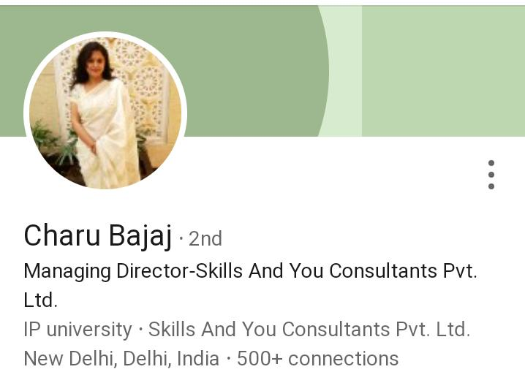

CALL RECORDING
WITH
INVESTOR & INDUSTRY EXPERT

Slide 20

ASK
1. How much do you ask from the investor?
50,000 Dollars
2. Broad Usage of Funds?
App development and working capital requirements.
3. How much stake do you offer in the company?
15%
4. What is the exit strategy if this business goes sideways?
Selling app infrastructure to the big social media websites.

Slide 21

ANNEXURE

Slide 22
FINANCIAL
PLAN

Slide 23
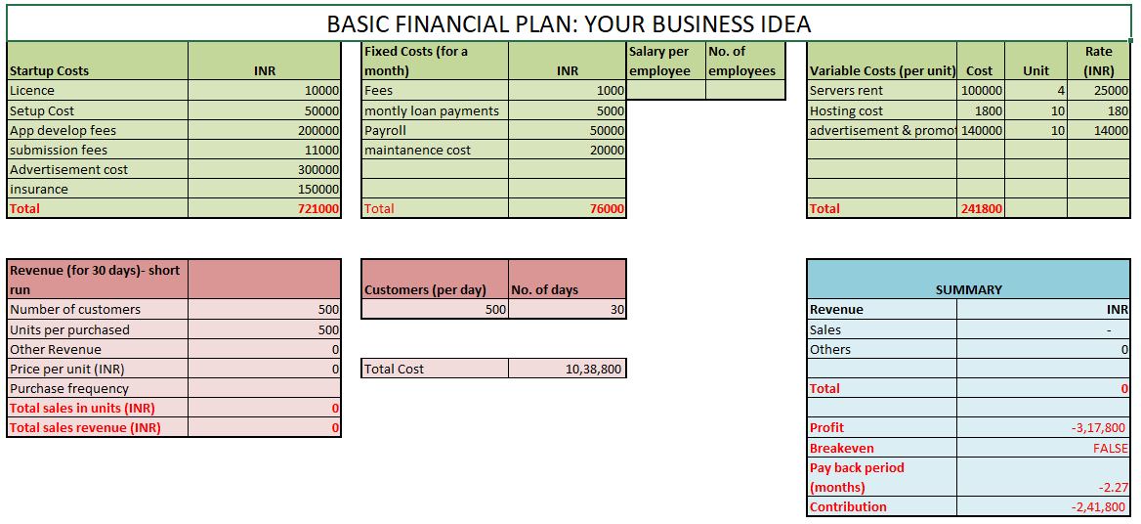

Slide 24
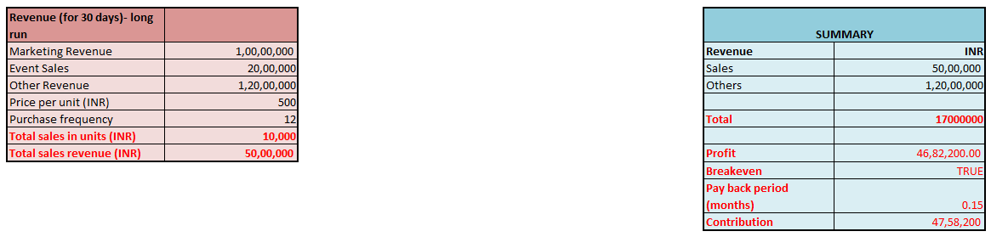

Slide 25
CONSUMER
SURVEY

Slide 26
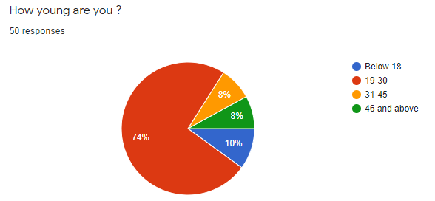
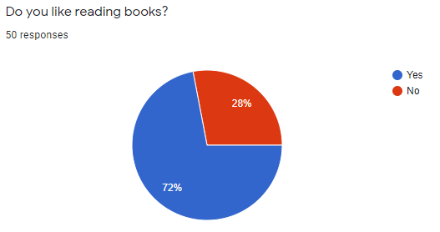
Almost Three- Fourth of respondents like reading books.

Slide 27
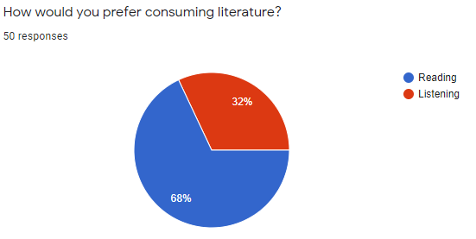
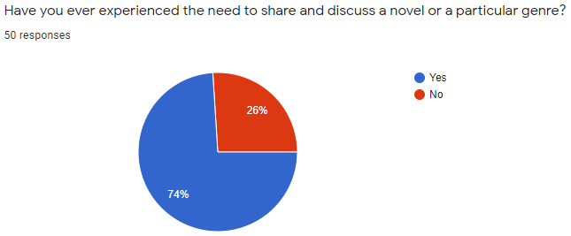
Two-Third of the respondents prefer reading books rather than listening.
74% of the respondents like having discussions about novels with others.

Slide 28
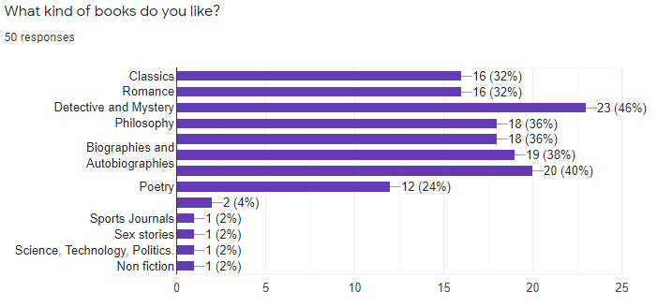

Slide 29
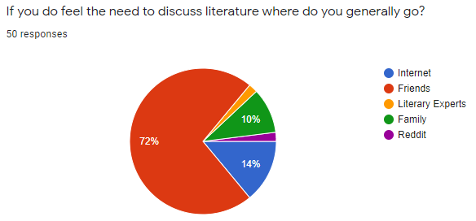
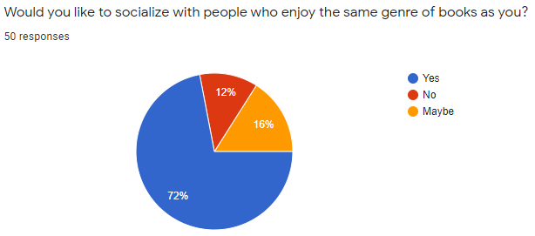
Almost Three-Fourth of the respondents like to socialise with people who like similar genres.

Slide 30
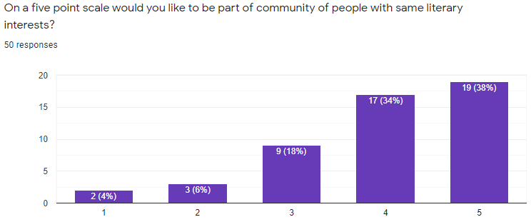

Slide 31
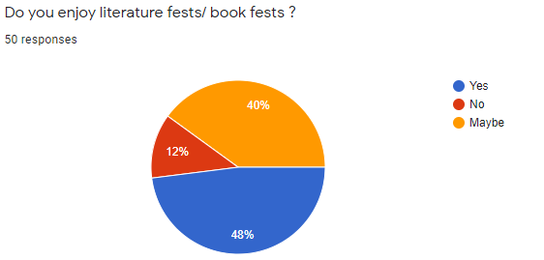
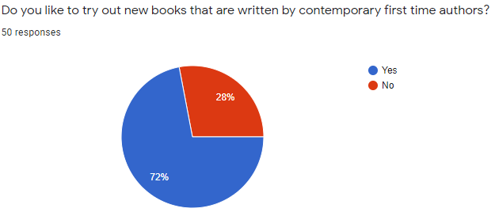

Slide 32
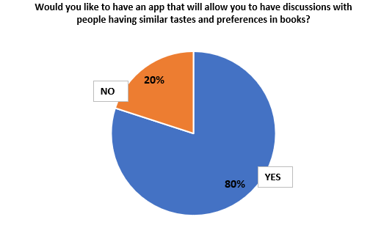
So majority of the respondents would like to have an application that would allow them to have discussions with people having similar tastes and preferences in books.

Slide 33
THANK YOU

