Slide 1





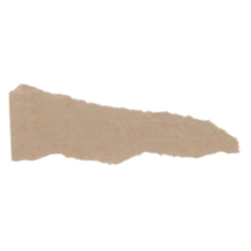
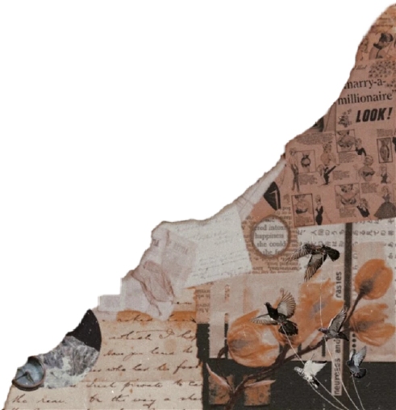
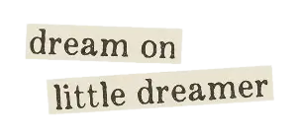
INTRODUCTION
COMPANY NAME: DISENADORA
TAGLINE: YOUR OWN DESIGNER
TEAM: GROUP 8

Slide 2

Genesis of the Idea
Process of arriving at the idea. – We brainstormed on what problems we were facing right now. We discovered that due to COVID , many local retailers had lost their jobs . The local tailers and boutiques were not able to sell their materials to customers. Nowadays, bigger corporations are taking their places, and local interests are being compromised. Also , customers to give wider range of preferences . So, we thought of furthering the interests by creating a application that connects local tailors and customers , where the customers can customize their own dresses , which the local tailors can work on fulfilling their requests.
Why this opportunity? – Unemployment of Tailors and furthering local interests.
What’s special about it? – Never been done before , Unique idea
What were the alternatives? – Creating a union of tailors to serve customer interest, only creating a portal of customers connecting all major corporations
Why were they dropped? - Not able to serve interests of both customer and tailor .
4

Slide 3

Problem Statement / Market Pain Point
Unemployment of local tailors , lesser preference of customers
Customers, Tailors
COVID times, local tailors losing their position , big corporations capturing their market
Taking customer survey and tailors survey . Real life scenario seen through our eyes.
4

Slide 4

Product / Service / Solution
Product / Service Description – A application+ Website portal
Intended Benefits –
Customization of preferences
Mobility issue
Establishing Connection between tailors and customers
Intellectual Properties – All dresses are under our copyright .
4

Slide 5
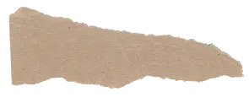
Solution Prototype / MVP
Describe your Solution – We provide an application and website for customers and tailors , where they can connect with each other , and customer can give an request with their own customized preferences , and tailors can set on creating it.
Details of Proof of Concept/MVP (create a prototype if it is an original idea)
What is your value proposition to your client – Delivery of Customized preferences , Normally , customization is for premium customers but we are offering this to all people.
PROTOTYPE AT LAST
6

Slide 6

Market and Product Positioning
Target Customer and Market Size
Who are the early adopters? Why will they pay? – Middle class adults after , They will pay because they are getting customized preferences .
Projections on how market will evolve over time? – We are targeting all target groups after particular amount of time.
Go to Market Strategy
How do you plan to reach out and sell to early adopters? – Social media , Advertising , Door to door contacting of tailors and further networking through their contacts.
What is the initial market potential of the solution? - Market potential is pretty high as everybody has been adopting technology and getting into E – Shopping.
How and where will you sell your products and/or services? – We will be selling on the portal after getting their requests.
6

Slide 7

Industry and Ecosystem Positioning
What is the recent in the Industry? – Selling on virtual platforms on an all time high , preference of personalization
What are the key growth trends? –
There will be a growing volume of voice search.
AI helps shops learn about shoppers.
On-site personalization uses those insights to create individualized experiences.
Big data plays a big part in creating personalized experiences.
Chatbots improve the shopping experience.
Mobile shopping is still on the move.
More ways to pay.
Headless and API-driven ecommerce allow continued innovation.
Customers respond to video.
Subscriptions keep customers coming back.
Sustainability is becoming more important.
Businesses should optimize digital strategy for conversion.
Who are the major players and key suppliers? – Major Players – Local tailors and customers
Key Suppliers – Tailors , Boutiques
Key connections that founders already have? – Local Customers and Local Tailors
Key connections they need to establish? – Non - local Customers
6

Slide 8

PESTE Analysis of Business Environment
 | POLITICAL (Govt. Policy/ Regulatory) | ECONOMIC (Growth, Inflation, interest rates etc.) | SOCIAL ( Behavior changes, Buying patterns) | TECHNICAL (R&D, Automation, Digitization) | ENVIRONMENTAL (Ecological & Environmental changes)
FAVOURABLE | 1)Government support for increasing penetration 2)Tax benefit to corporate 3)Foreign investors | 1)Booming Indian Economy 2)Increasing Disposable Income 3)Changing fashion trends | Increasing entrepreneurial mindset. Ease of doing business | 1)Advent of online shopping 2) Better E- Commerce site 3) Easy interface | 1) No wastage
UNFAVOURABLE | No adequate loss to protect intellectual property right. Instable government policies | 1)Lack of proper human resource 2) Underdeveloped transportation and infrastructure 3)Direct competition with brick and mortar stores and e – commerce competitors | Cultural diversity of customers Absence of touch and feel Replication of designs | Internet connectivity issues in local regions Payment failures Faulty payment gateways | 1) Non eco friendly
6

Slide 9
Competition Analysis
 | Branded retail stores | Local retail stores | You
Strengths | 1)Branded Names 2)Occupied huge market size 3)Associated with celebrities | 1)Easy to trust 2)Local reach | Local reach Customized clothing
Weakness | Lack of local reach , lacking customization , lacking particular size estimates | Non preference of high end customers | 1) Lack celebrity endorsements
Price Point | High price and high fashion. | Affordable price | Price based on customization
UVP | On-trend clothes at affordable prices. | Non- mobility issue | Non – mobility issue , customized clothes

Slide 10
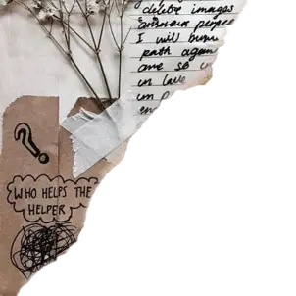
Financial Projections
Pricing Strategy – It is a dynamic pricing model where customer will pay for the choices they made.
OPEX – Rs2375/unit
CAPEX Estimates – Rs 4.5 Lakh
Cash Flow Projections – Sales revenue Rs.12.15 Lakh
Payback Period – 3 months
Basic Financial Projections – Attached as Annexure
10

Slide 11

Operational Plan
Key Resources – Raw material Supplier, Tech Team, Local Labour, Skilled Designers, Capital Fund, Telecom services.
Key Activities – Online marketing. Order fulfilment, customer service.
Key Milestones (For first 3 to 5 years) – We aim to cover Tier – 2 cities first with further expansion in Tier -1 cities. We might collaborate with bigger brand in near future.
12

Slide 12

Implementation Plan / Milestones
How convincing is the implementation?
As per industry expert the idea can be implemented easily but the requirements are management should be strong enough to manage any conflicts between the parties and to avoid patent and copyright issue.
The targets for next 12 months and the plans for ‘product development’ and ‘business strategy’.
In 12 months we are aiming to cover Tier-2 cities first and in near future we will connect with bigger brands.
Milestones achieved so far – Pilot testing of the software, collaborated with tailors and boutiques, customer base targeted.
11

Slide 13
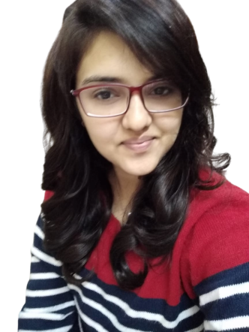
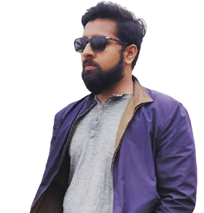
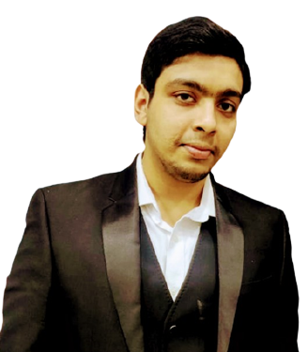
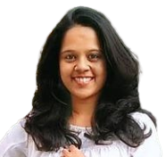
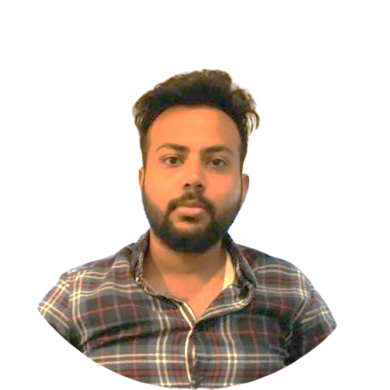
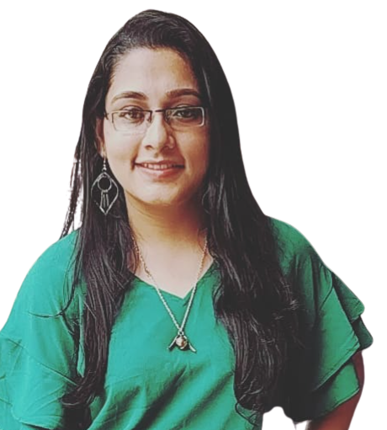
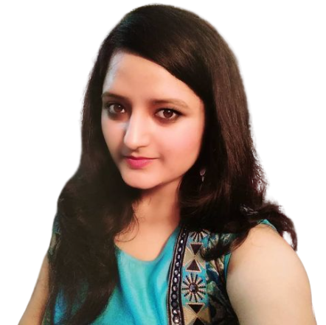
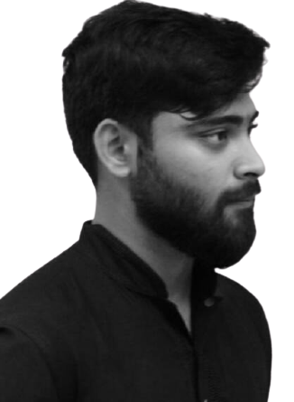

Organizational Plan - Team
TANVI BATRA
B.COM GRADUATE
CA-INTERMEDIATE
ANIKET SHARMA
B.TECH CS GRADUATE
EX-WIPRO (2 YEARS)
ANIKET KHANDELWAL
B.COM GRADUATE
CA-INTERMEDIATE
SMRITHI HEMARAJ
B.COM GRADUATE
ACCA AFFILIATE
SHRUTI AGARWAL
B.COM GRADUATE
AKSHAT SINGH
B.A (HONS.) HISTORY
SHREEYA MUKHERJEE
B.TECH CS GRADUATE
EX-URBANCLAP (10 MONTHS)
SUBHADEEP GUHA
B.COM GRADUATE

Slide 14
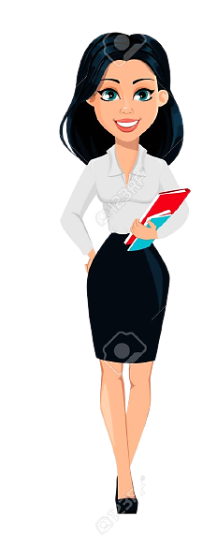

Team advisors
A budding fashion designer from pearl institute of Delhi, currently working with a reputed company.
A senior professional from fashion export house.

Slide 15
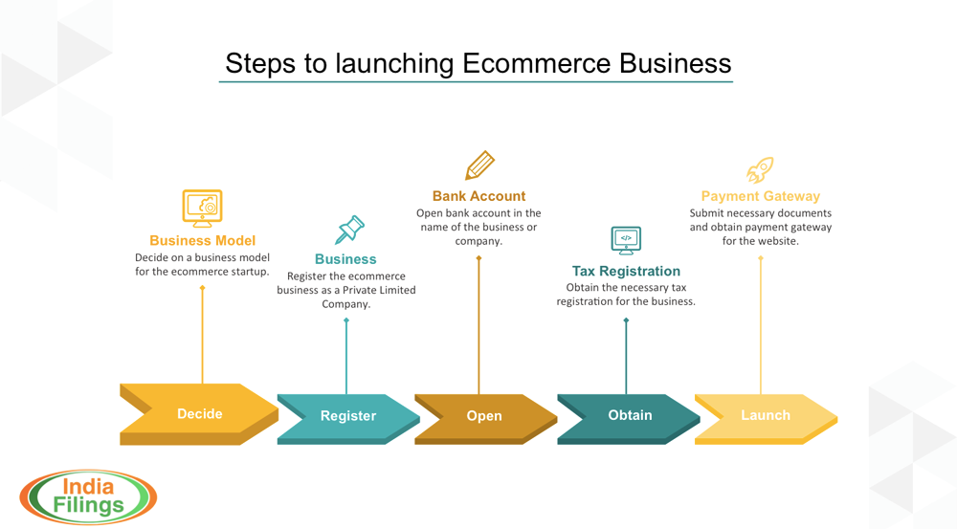
Company incorporation

Slide 16
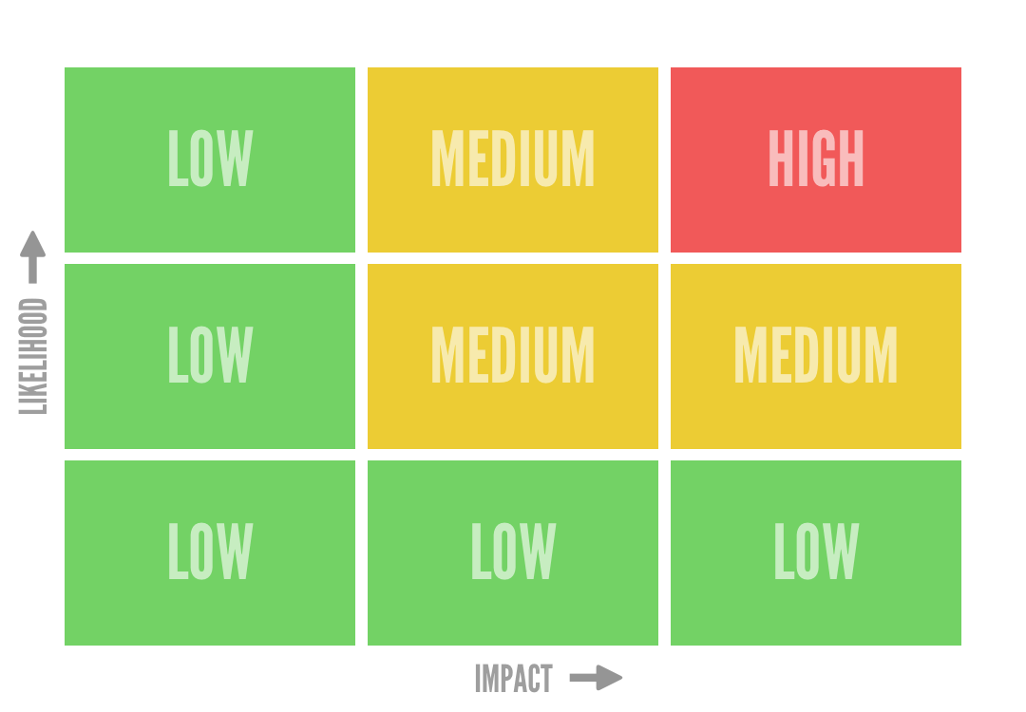
Risks
Risk Matrix
Strategic Risk:
Market
Technology
Legal
Hacking
Misinformation by customer
Power Outage
Operational Risk:
Hiring of skilled labour
Retaining
Delayed deliveries
Quality Issue

Slide 17
Investor Pitch
We are asking for INR 20 lakhs for 10% equity at 𝐃𝐢𝐬𝐞ñ𝐚𝐝𝐨𝐫𝐚.
Exit Strategy:
Venture into software as a service (SaaS)
Collaborate with other big fashion ventures and sell our platform to market leaders
Venture into custom home décor using our existing platform and customer base

Slide 18
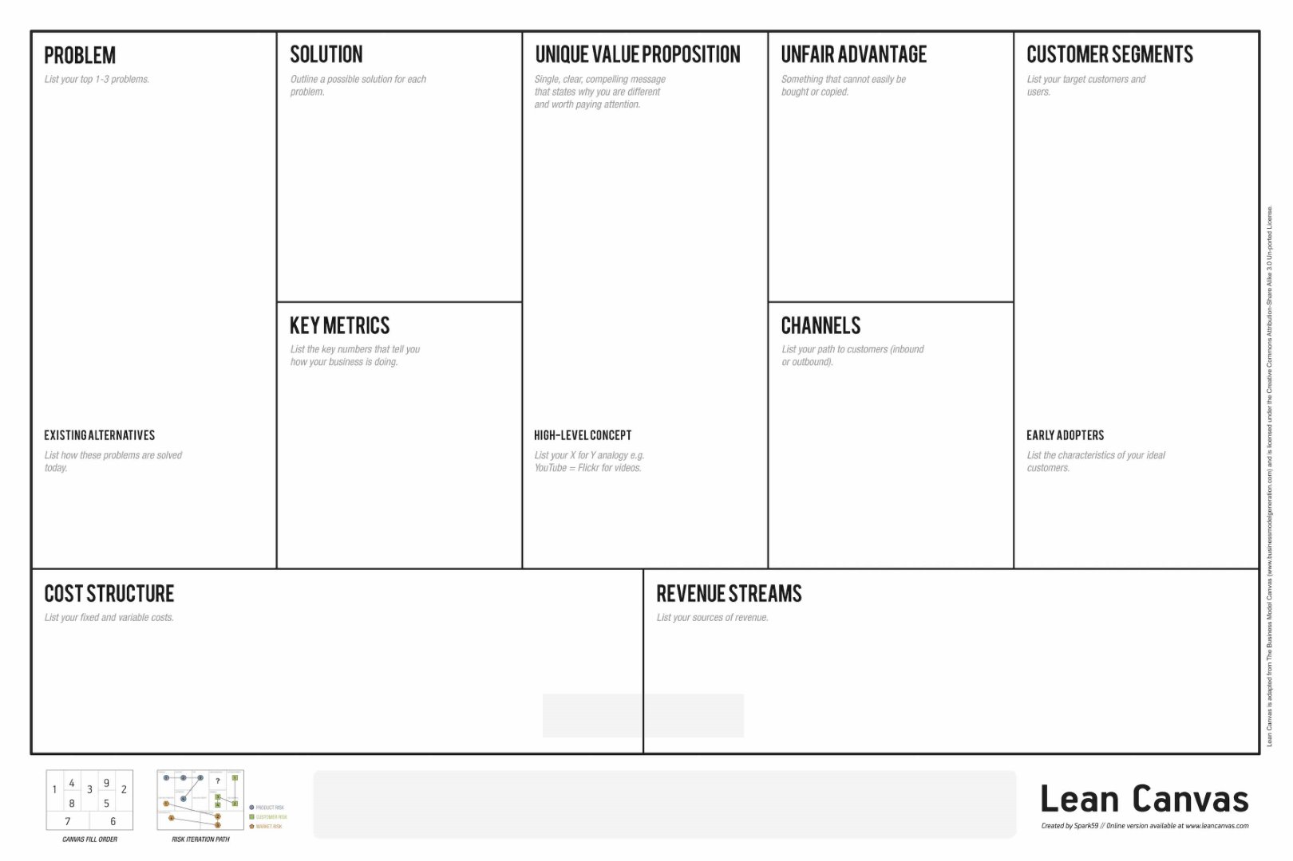

Addressing the issues of small scale tailors and boutique owners
An application to provide customized apparels
Connecting the customer with local
Middle class adults
Connections
No. of orders placed
Online
Response on social media
Registration fees
Fees
Salary and Wages
Lean Canvas

Slide 19
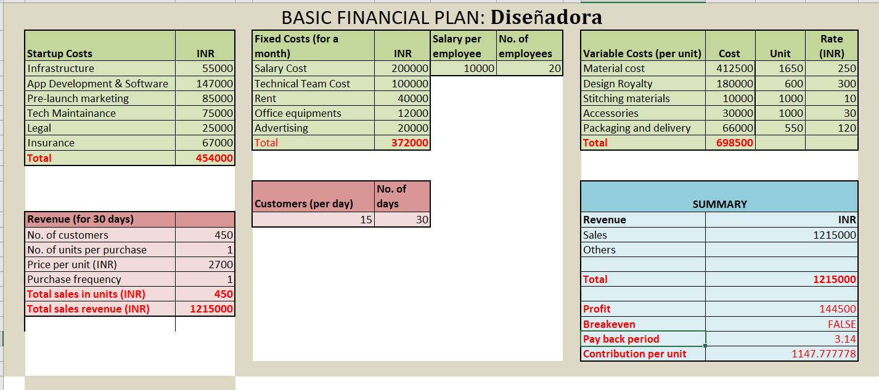
Annexure – Financial Plan

