Slide 1

Eco
Parking
Parking Solution for Smart generation
Group 7
Aaryan Jain (20DM003)
Aayush Garg (20DM004)
Aditi Garg (20DM007)
Aman Aggarwal (20DM024)
Arushi Kohli (20DM046)
Ayushi Bansal (20DM054)
Ayushi Garg (20DM055)
Smriti Agarwal (20DM213)

Slide 2
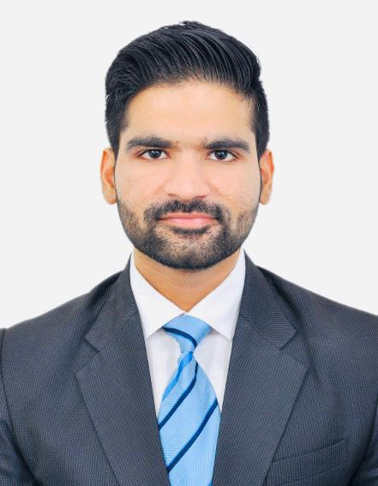





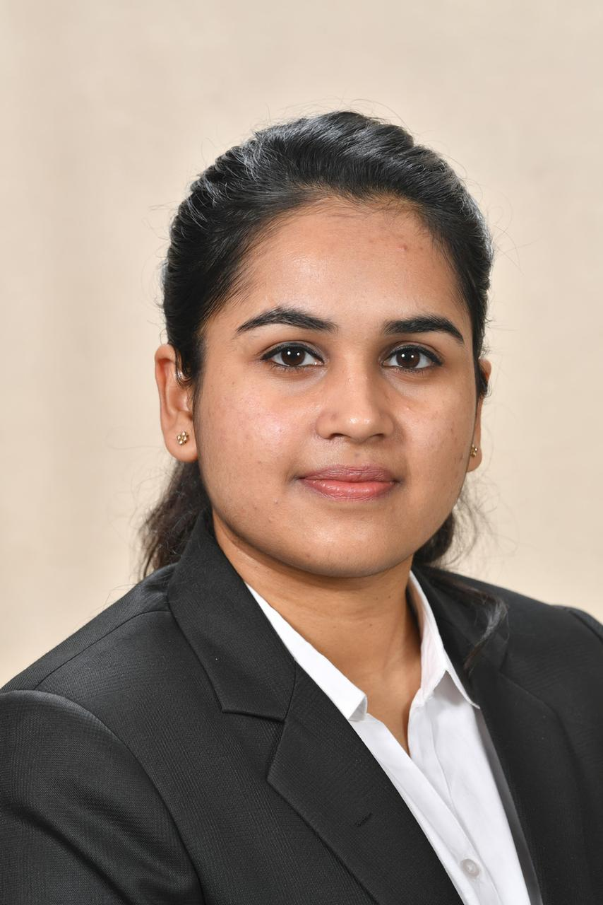

Organizational Plan
TEAM
Aman Aggarwal
Arushi Kohli
Aaryan Jain
Aditi Garg
Ayushi Garg
Smriti Agarwal
Ayushi Bansal
Aayush Garg

Slide 3
OUR COMPANY
“ECO PARKING” provides a full-stack approach to solving for parking related problems in today's cities. Products based off its platform solves problems of parking lot operators & owners, urban motorists, corporates, city planners and administrators.

Slide 4
01
ELEVATOR
PITCH

Slide 5
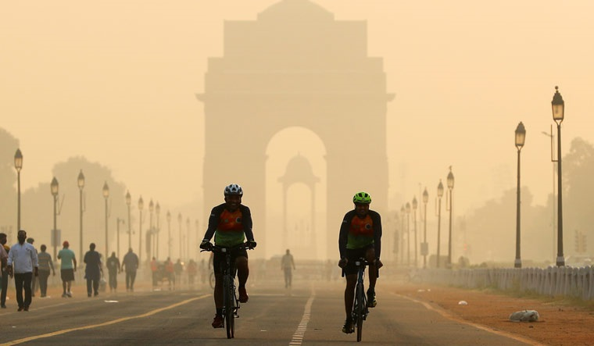
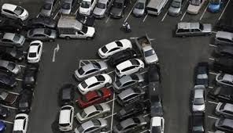
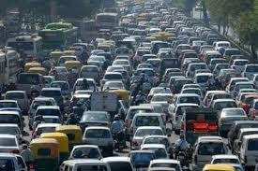
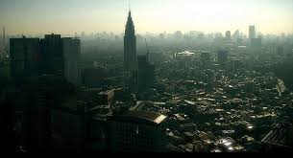
PROBLEM IDENTIFICATION & GENESIS OF THE IDEA
Shortage of parking space.
Increases traffic congestion.
Increase in the level PM 2.5.

Slide 6
PROTOTYPE

Slide 7



09:41
Personal Info
Step 1 of 2
Enter Your Information
Name
Akash Pande
Email
akash.pande22@bimtech.ac.in
Phone
7567753073
NEXT

Slide 8

09:41
< Vehicle Info
Step 2 of 2
Enter Vehicle Information
Vehicle Name
BMW X 6
License Plate
GJ 15 AK 8033
Model Year
2015
SIGN UP

Slide 9



09:41
Please select nearby parking
SOUTH EXTENTION
Get Directions
50/hr
1.5 k.m.
MOOLCHAND
Get Directions
35/hr
1.1 k.m.
LAJPAT NAGAR
Get Directions
20/hr
750 m
JANGPURA
Get Directions
Free
1.3 k.m.

Slide 10
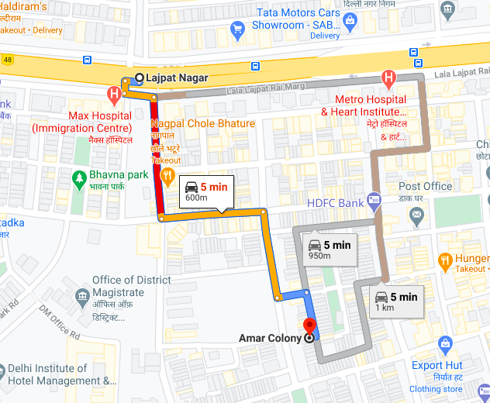
09:41
Please follow the map
Enter Your Information

Slide 11


09:41
Reached at Destination
Congratulations! You have contributed towards environment by saving 0.5 pound of carbon dioxide.

Slide 12
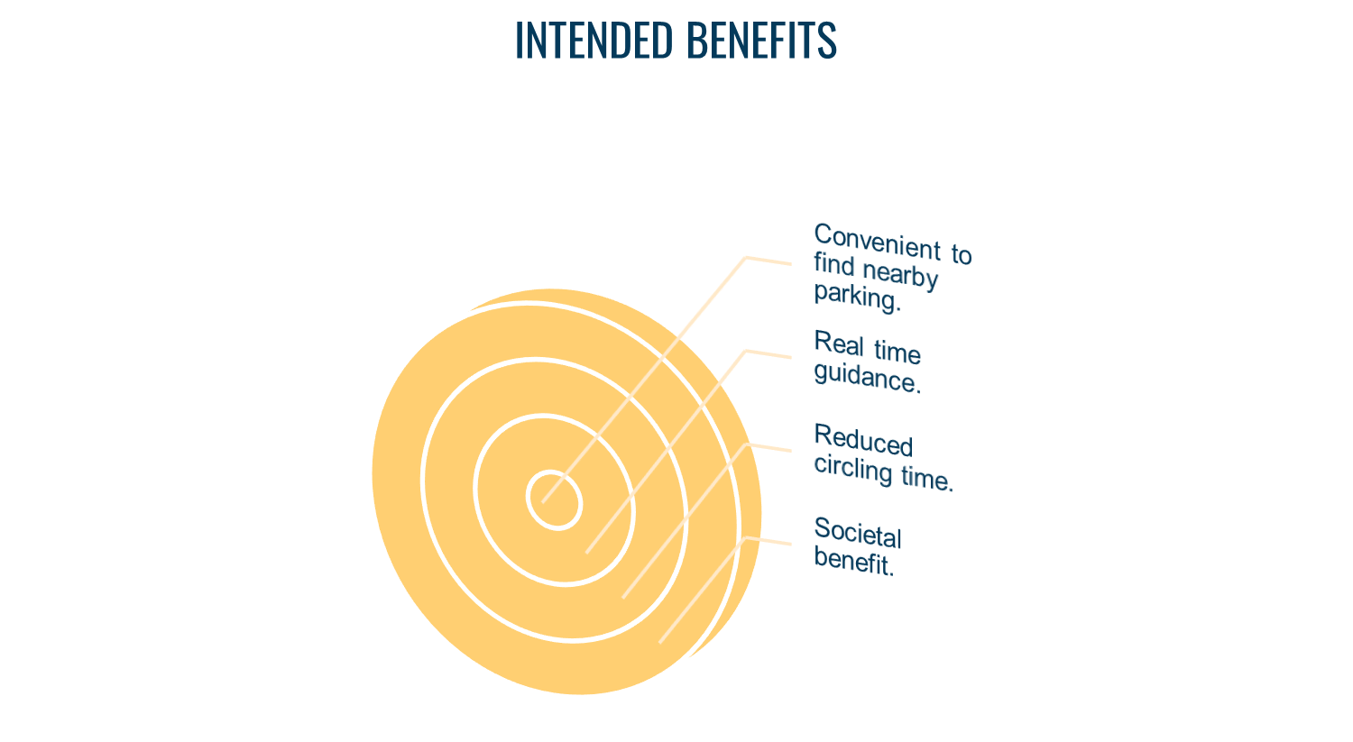

Slide 13
Target Customer and Market Size
Early Adopters
Why will they pay?
Go to Market Strategy
Tourists visiting Delhi
Cab drivers
“Always in a hurry” customers, diligent workers
Private car owners
Cities like Delhi, where there is a fast pace life and people have less time.
Increasing population in cities like Delhi .
Identify the customers
Understand the customer, put ourselves in their shoes
Proposition statement
Apple app store and Google play store
Pricing of the product
Major players and suppliers
Metro Stations
Commercial places- Malls, metro stations etc.
Congested public places

Slide 14
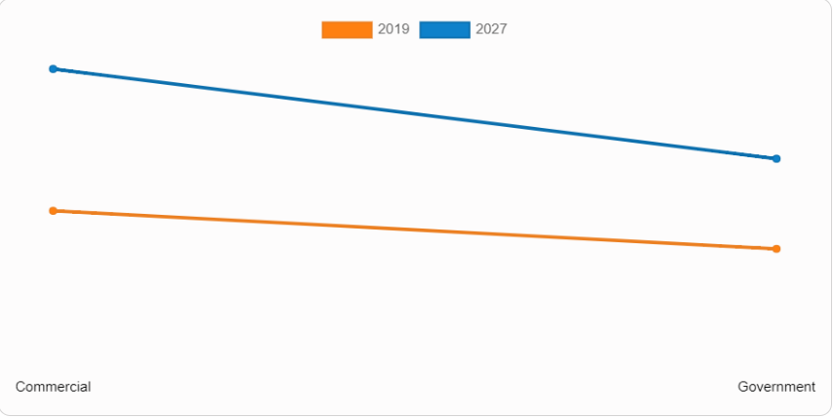
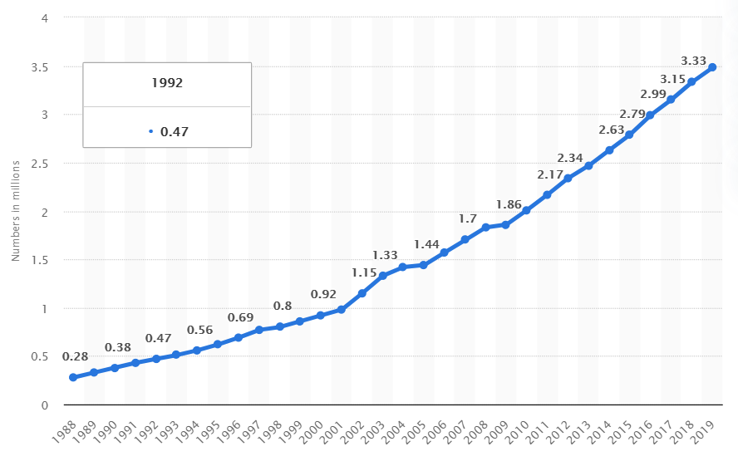
Industry Positioning
Commercial is projected as the most lucrative segment
Number of registered private cars in Delhi

Slide 15

PESTEL ANALYSIS OF BUSINESS ENVIRONMENT
PESTE Analysis of Business Environment
 | POLITICAL (Govt. Policy/ Regulatory) | ECONOMIC (Growth, Inflation, interest rates etc.) | SOCIAL ( Behavior changes, Buying patterns) | TECHNICAL (R&D, Automation, Digitization) | ENVIRONMENTAL (Ecological & Environmental changes)
FAVOURABLE
UNFAVOURABLE
Physical, electronic, and procedural safeguards to protect information
Accurate information to be provided
Skill level of workforce in Technology Hardware & Equipment industry.
Exchange rates & stability of host country currency.
Concept of smart cities
Prominent car problems in urban cities
Attitudes (health, environmental consciousness, etc.)
Smartphone penetration
Ease of app development
Easy checkout & seamless transactions
Reduce pollution
Less traffic on roads
Reduced noise pollution
Certain information collected automatically irrespective of permission
Privacy policies can be updated anytime
Using GPS information
Aversion to new technologies
Education level as well as education standard in the Smart Parking Limited ’s industry
Bugs while using app
Access to high end technology
Mobile phones emit UV rays
Waste management in Technology Hardware & Equipment sector
Low income level
Access to automobile
6

Slide 16




COMPETITION ANALYSIS
MAJOR SMART PARKING APPS IN DELHI NCR

Slide 17

HOW IT WORKS
FOUNDED | CUSTOMER BASE EXISTING | PARTNERS | INVESTMENT RAISED TILL DATE | MAJOR INVESTORS
2015 | Has already mapped more than 320 areas and has extended to more than 22 million parking lots in the capital city – Delhi and NCR. | Christopher Perry & Kevin Woznicki of ParkTrans Solutions, US Hugo Rohner, Swiss Advisor & Investor APCOA (Europe’s Largest Parking Operator) | $4.5MN IN 4 ROUNDS (latest funding was raised on Sep 12, 2017 from a Series A round) | 6 BEENEXT & Indian Angel Network are the most recent investors.

Slide 18
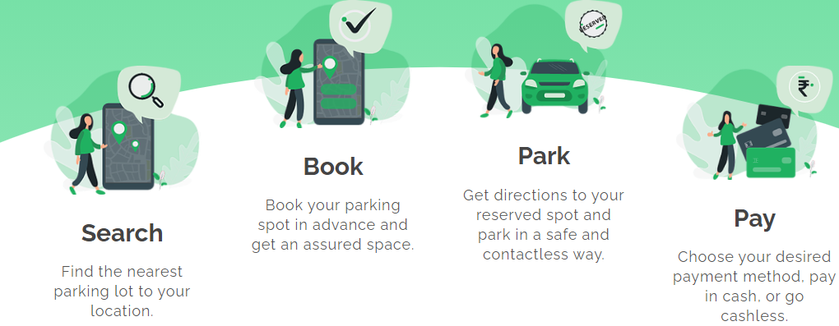




HOW IT WORKS
FOUNDED | CUSTOMER BASE EXISTING | PARTNERS | INVESTMENT RAISED TILL DATE | MAJOR INVESTORS
2019 | Currently 100+ downloads on playstore besides major clients like EMAAR, Hyderabad metro etc. |  | $200k | 2 Marwari Angels & ah! Ventures

Slide 19
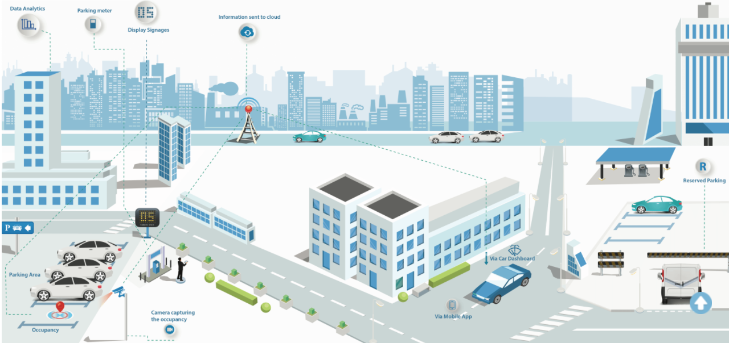
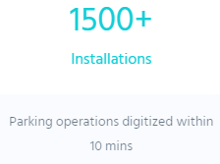









HOW IT WORKS
FOUNDED | CUSTOMER BASE EXISTING | PARTNERS | INVESTMENT RAISED TILL DATE | MAJOR INVESTORS
2014 |  |  | $560K | 1 Northeast Venture Fund (NEVF)

Slide 20
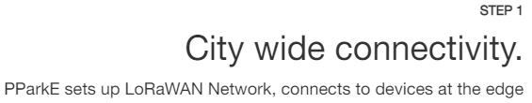
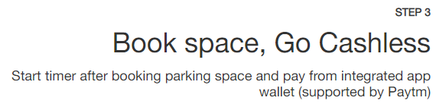
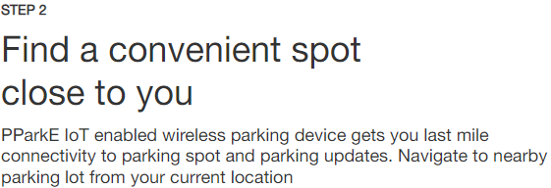

HOW IT WORKS
FOUNDED | CUSTOMER BASE EXISTING | PARTNERS | INVESTMENT RAISED TILL DATE | MAJOR INVESTORS
2013 (Currently in seed stage) | 10,000+ | TATA Communications CISCO BOSCH Microsoft Prestige Group Ford Intel etc. | $$1.37M Annual rev: $68.5K

Slide 21
FINANCIAL PROJECTIONS
PRICING STRATEGY
OPEX
RETURNS
Pricing Strategy
Monthly Pass
Occasionally
Rs. 900 per Month
Rs. 50 per Day
Electricity
Employees Salary
Billing Machine
Lease Rent
Break Even Cost:
25,000 Customers
CAPEX
Sheds
Construction

Slide 22
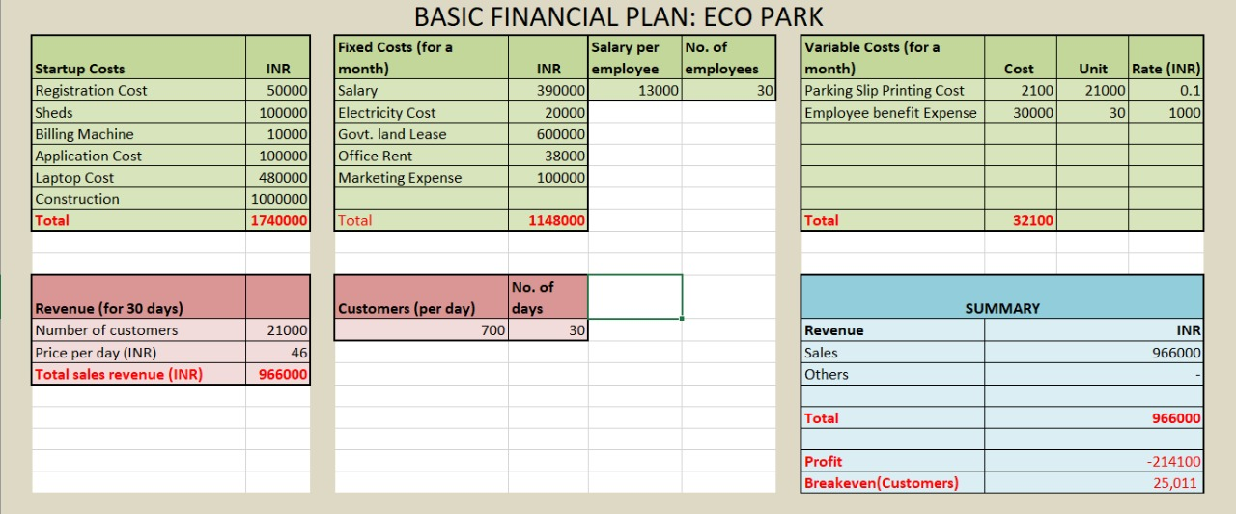

Slide 23
OPERATIONAL PLAN
Key Resources
Key Activities
Key Milestones
500
1000
2000
Physical
Computer
Barricades
Human
Skilled Employees
Unskilled Workforce
Intellectual
Customer Database
Application Copyright
Customer
Payment Mode
Allotment of space
Customer Arrival
Service Fulfilled
Ordering for service(Parking Space)
Customer base per month

Slide 24
LEGAL IDENTITY
COMPANY INCORPORATION-
Part A: Name Reservation for New Companies
b) Part B: Offering bouquet of services which are as follows:
Incorporation
DIN allotment
Mandatory issue of PAN
Mandatory issue of TAN
Mandatory issue of EPFO registration
Mandatory issue of ESIC registration
Mandatory Opening of Bank Account for the Company and
Allotment of GSTIN (if so applied for)

Slide 25
IMPLEMENTATION AND MILESTONES
Number of parking lots
Customer Base
Revenue
Profit
Loyalty Reward Program
15 parking lots in next 12 months
40,000 in next 12 months
18 lakhs in one year
15-20% of the total revenue
Reward for regular customers

Slide 26
RISK
Unfavorable weather conditions
Economic Slowdown
Change in vehicle preference
Change in Government Policies
Competitor Risk
Internet Connectivity

Slide 27
RISK
Configuration Complexity
Technical Risk (H/W, S/W network
Organizational risk (Executives not working)
Project Management risk (Estimates, communication, resources)

Slide 28
RISK MANAGEMENT PLAN
Hazards/ Risks | Impact of the risk | Actions Taken
1. Unfavorable weather conditions | Decrease in number of customers Absenteeism of on-site executives | No action can be taken
2. Economic Slowdown | Higher business cost Falling average income | Incentivise customers and employees
3. Change in vehicle preference | Decrease in demand and consequentially, revenue | Incentivise car owners
4. Change in government policies | Increase/ decrease in demand and consequentially, revenue | Change in operational strategy
5. Internet connectivity | Loss of customers Not user-friendly | Development of app in offline mode in the future
6. Competitor Risk | Higher marketing cost Loss of market share | Focus more on customer retention through Aggressive marketing
7. Configuration Complexity | Frequent down-time Delay in problem resolution | Hire a sound and competent technical team Outsourcing to third party
8. Technical Risk (H/W, S/W network) | Installation problems Delay in booking parking space | Timely upgradation
9. Organizational risk | Customer dissatisfaction | Incentivise/ reward workers Team building program
10. Project management risk | Inaccurate budget allocation Impedance in executing tasks | Effective communication within teams Alternative resources

Slide 29
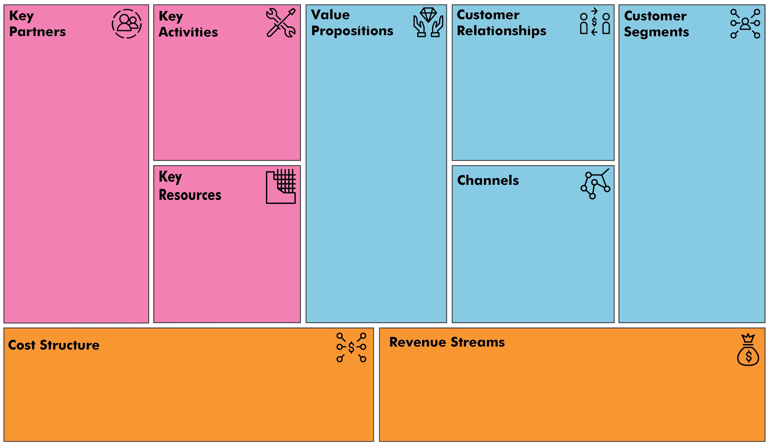
LEAN CANVAS
Municipality
DDA
App developers
Provide appropriate parking space
Customer Service
Building parking spaces
Societal benefit
Reduce circling time
Hassle-free parking
Customer support
Reward programs
Timely follow-up
Private Users
Tourists
Commercial
Google Play store and Apple Store
Service team
Integrated system, website and application
Exclusive parking areas
Fixed costs:
Lease Rent
Salary of employees
Marketing expense
Variable costs:
Printing Cost
Employee benefit expense
Maintenance
Subscription fee
Daily rental fees

Slide 30
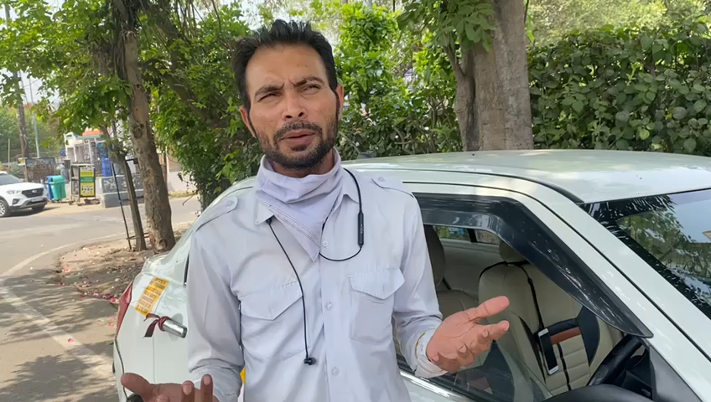

Slide 31
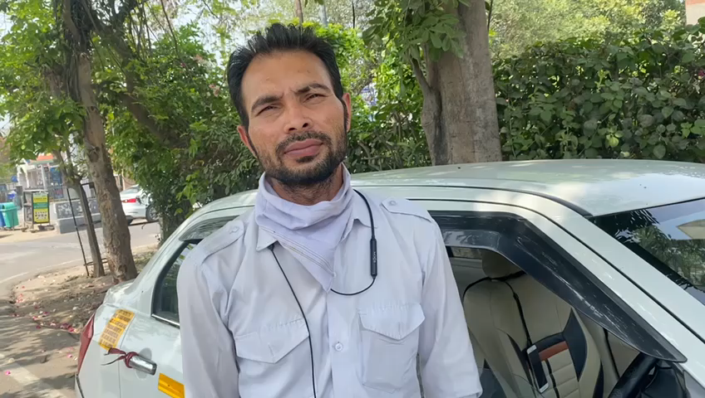

Slide 32
Thanks!
Do you have any questions?
]]

