Slide 1


ROBOCOP
One team. One robot. Limitless possibilities.

Slide 2
Robocop brings you a way to do day-to-day activities effortlessly. With increasing complexities in today’s world, a lot of difficulty is faced by households. So in order to bring efficiency our company intends to bridge the gap between work and efficiency by creating the intelligent systems for everyday devices in Robots. The robots would become the part of “internet of things” an extension of the internet in which appliances and other objects share information with each other. The company is building task oriented intelligent system for household’s activities to introduce robotics into daily life.
As the world is moving towards technology we believe that the idea has the potential to dominate the market.
We are seeking an investment of $100,000 for a 12.5% stake in the company.
ELEVATOR PITCH

Slide 3

Our research on the robotics shows that with increasing complexities in today’s world a lot of difficulty is faced by households. So, in order to bring the efficiency our Company intends to bridge the gap between work and efficiency by creating intelligent systems for everyday devices in Robots. The robots would become part of the "internet of things," an extension of the internet in which appliances and other objects share information with each other. The Company is building task-oriented intelligent system for household’s activities to introduce robotics into daily life.
Genesis of the Idea

Slide 4

Problem Statement
How can Inefficiency and ineffectiveness of humans in complex tasks be resolved or made easier?

Slide 5

Will bring efficiency in the household chores
Helping elderly in performing their routine activities
Product / Solution
(Intended Benefits)
Will help people to manage their work life in a better manner
Help people in taking care of their children

Slide 6
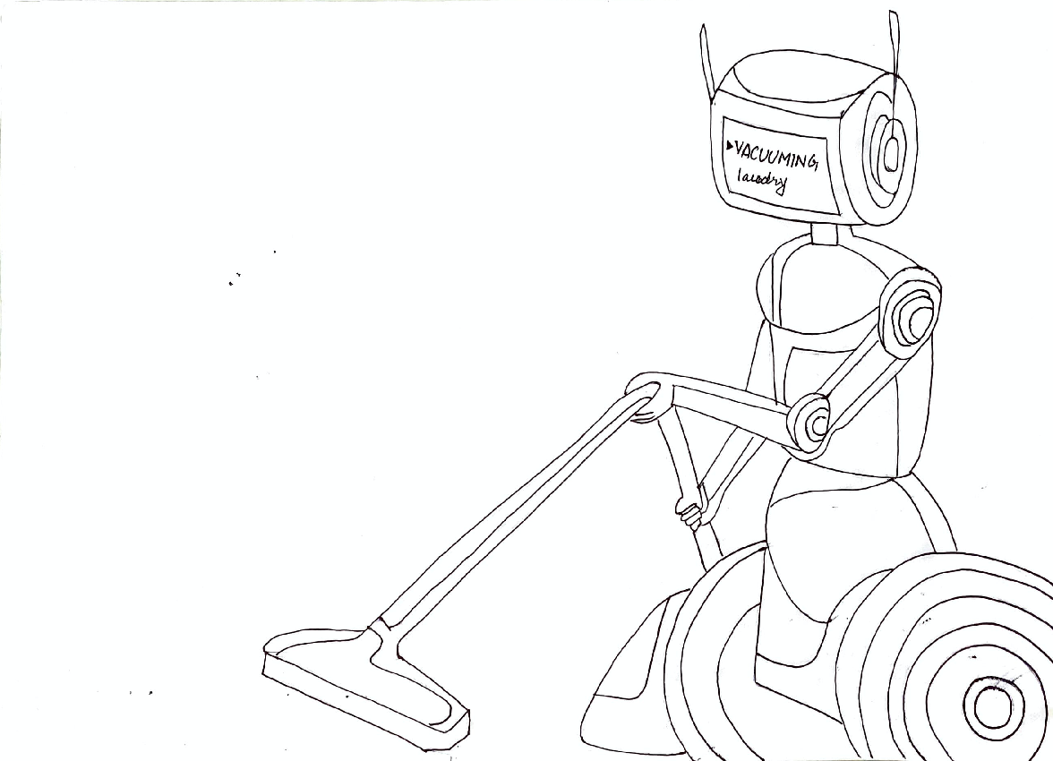
Cooking
Washing
Cleaning
Ironing & folding clothes
And all other household work
PROTOTYPE

Slide 7
Market Type – Domestic
Target customers - Households and elderly people who face difficulty in day-to-day tasks.
Industry expected to grow to $9.5 billion in 2024.
Reach
  Advertisement on social media
  Conduct Workshop
Sell Through
  Website
  Owned Retail Shops
Market and Product Positioning

Slide 8
Key growth trends
The household robots market is expected to grow from USD 3.3 billion in 2019 to USD 9.1 billion by 2024; it is expected to grow at a CAGR of 22.4%.
Major players and key suppliers
FLIPPY
SALLY
Recon Robtics
FANUC India
ABB Robotics
YASKAWA India
Key connections
There are no key connections that founders have.
Key connections they need to establish
Suppliers of parts and components
Investors and banks
Industry
and Ecosystem

Slide 9
PESTE Analysis
 | POLITICAL (Govt. Policy/ Regulatory) | ECONOMIC (Growth, Inflation, interest rates etc.) | SOCIAL ( Behavior changes, Buying patterns) | TECHNICAL (R&D, Automation, Digitization) | ENVIRONMENTAL (Ecological & Environmental changes)
FAVOURABLE | Stepping in where humans should not- useful in many government agencies. (COVID-19) Sometimes can be used primarily for handling improvised explosive devices. | India being a developing country, a boost of income can help India grow at faster pace and robots can do it. Since literacy rate is also on rise, there will be more people in future who can understand the working of robots. | Since more usage of robots is expected in future, robots can generate good returns. When it comes to class statement, robots can be flashy | Govt is spending a huge amount of money in R&D Automation will lead to more such inventions | Will lead to less wastage as compared to humans
UNFAVOURABLE | Government institutions should start collaborating with the service sector so that industry specific and futuristic courses are introduced for employees. Bad decisions towards poor people will also lead to a decline in products growth | Being in a more labour oriented working environment, it can be difficult for people to switch to machines. Unemployment is already high, and introduction of robots will make matter worse | Introduction of robots will take us to a futuristic world, thus basic or simple lifestyle will no longer be needed. | Robotics being a disruptive technology, people will take time to adjust to robots in the short run | Excessive usage will lead to increase in Co2 emissions

Slide 10
Competition Analysis
 | SPOT DOG- Boston Dynamics | FLIPPY- Miso Robotics | SALLY- Chowbotics | You
Strengths | Makes a host of different robots that have human- and animal-like dexterity | Miso can offer Flippy’s to fast food restaurant owners for an estimated $2,000 per month on a subscription basis...A human doing the same job costs $4,000 to $10,000 and up per month, depending on a restaurant's hours and the local minimum wage | Introduced World’s first salad making robot | Expertise in making household robots
Weakness | Boston Dynamics applies closed innovation when generating ideas | The robot's human co-workers weren't able to assemble the burgers as quickly as Flippy could grill the patties | No weakness as this is company’s first robot and is doing amazingly well in the market | Still in the experimenting phase
Price Point | Spot is available to purchase from Boston Dynamics for $74,500 | Prices for the contraption (known as the Flippy Robot-on-a-Rail or Flippy ROAR) start at $30,000, though Miso Robotics wants to bring the cost down to $20,000 in the future | $30,000 | $25,000
UVP | SPOT DOG- Recent development The most advanced robot in the world | The robotic fry cook combined a jointed arm — capable of wielding a spatula or a grill scraper — with cloud-based artificial intelligence (AI) and thermal vision that enabled it to tell whether a burger was raw or well-done. To ensure that all burgers were thoroughly cooked, Flippy would monitor each patty in real time, using a display screen readout to inform its human co-workers when a burger is ready for dressings and a bun. | SALLY- the only salad making robot | One single robot can do all household activities from cooking to gardening.

Slide 11
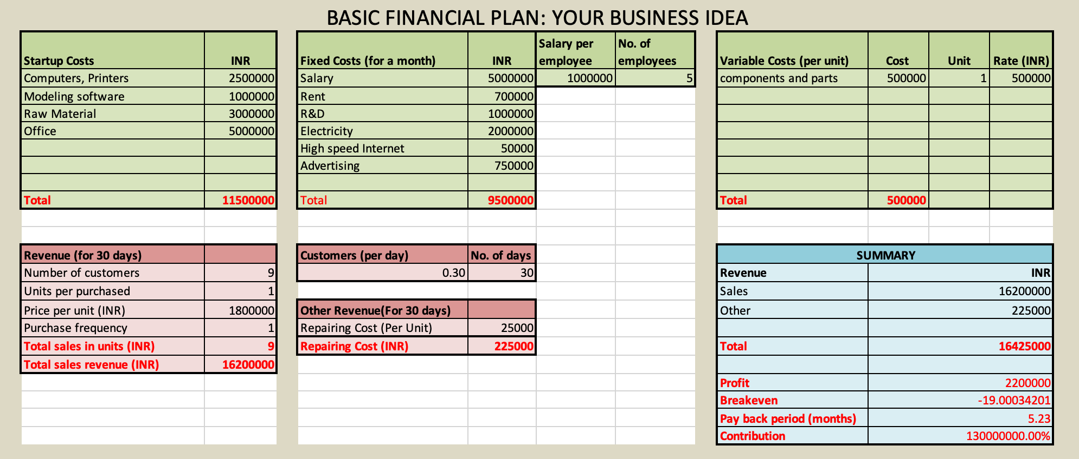
ROBOCOP
Financial Plan

Slide 12
Operational Plan
1
2
3
Key Resources
Key Activities
Key Milestones
Motors
Intera software
Technology expertise
Marketing and Sales
Logistics
Distribution
Customer Support
Software Development
Artificial intelligence
Attracting Large Customer base
Gain huge popularity

Slide 13
What are our targets for the next 12 months??
Leadership in the SMB market
Building the brand
Becoming data-driven

Slide 14

Product Development Strategy
Developed the “Robot” workers
Helpful for human beings
Launch Minimum Viable Product
Official launch
Growing intelligence in the new industrial revolution.
Collecting feedback during this phase is crucial to making your product work in a way that customers will love.

Slide 15

Establish market validation aka sign up a few paying customers
Commit to great customer service
Business Strategy
Focus on daily and monthly growth rates (get to 10K, 100K, 1M, 10M users)
Within the first year we’ll be focusing on daily and monthly growth rates.
Focus on the proximity, reliability, quality, reputation and the prices.
Reduce risks.
Review our own product and implement the suggestions and correct the drawbacks

Slide 16
Team members Expertise
Manuj Nangia - Business Advisor & Consulting
Kartik Balaji - Branding, Marketing and social media handling expert
Nehal Jain - Financial Management Expertise and Accounts head
Joydeep Kaur - Customer Relationship Management & Support
Mohan Nihal - Managerial Expertise
Aditya Saxena - Developer
Swetha Vinjamuri - Quality Control
Nehal Jain - Tech Support
Show us your advisors / investors
Friends and family, Business Consultancy firm, Private Investors and banking institutions
Commitment:-
“Not only we have the resources but also we have laid out business plan which will make our idea into a reality”
Organizational Plan-Team

Slide 17
Legal Name- Robocop Corporation
Company Incorporation- ISO Certified
Reg. No.- 12345
Legal Identity

Slide 18
Risk Involved
1
2
3
Financial Risk
Strategic Risk
Operational Risk
Availability of funds/ working capital
Huge capital involved in development of technology
Increase in cost of borrowing
Owners’ degree of control
Entry of new innovative companies
Losing of License
Technical Glitches
Huge operational cost
Governing Bodies intervention regarding upgradation of technology
Inefficient management
.

Slide 19
Proper training of staff & workers regarding working of robots
Follow the guidelines as per the governing body
Investment in proper equipment and
Up-to -date technological support and security
Adherence to health and safety codes
Risk Management Plan

Slide 20
ASK
$100,000 for 12.5% Stake
Usage of Funds
To purchase Computers, printers, modelling software, raw material, work space and to incorporate the company

Slide 21
Key Partners
Key Activities
Unique Value Proposition
Early Adopters
Customer Segments
Investors
Distributor
Channel Partner
Robotics Industries Association
Design manufacturing
Artificial Intelligence
Software Development
Systems engineering
Distribution
Logistics
Marketing and Sales
One single robot can do all household activities from cooking to gardening.
High income groups
People living in areas where housemaids are not easily available
Households
Older people living alone
Existing Alternatives
Key Metrics
Channels
FLIPPY
SALLY
Technology expertise spanning robotics
Skilled professionals
Required software
Distributors
Website
Press
Social networks
Blog
Cost Structure
Revenue Streams
R&D Licenses
Manufacturing Hardware
Maintenance Marketing
Software
.
Sales of robots
Maintenance and service fee

Slide 22

“ Our company Sastra Robotics too started with the vision of a future where man and machine coexist. Robots in home is something that almost everyone has been wondering of since their very childhoods but bringing that into work would be a great achievement since people will be reluctant to buy expensive machines for household chores, but again relentless pursuit of perfection and assurance of quality will garner you the customer base. Building and working on developing and delivering scalable robotic solutions for things that have not been automated till now in India is a great thought and if executed correctly buy you guys, it might as well turn into one of greatest and most promising start ups. The secret to success in this is know what your customer wants because every household requires different work at different time, but the basics are always the same. So, all that you need to focus is on what the customer wants and how far are you willing to experiment since you need to make it possible to conduct rigorous testing beyond the human capacity and capability. Such exhaustive and extensive testing ensures the supreme quality of your customer’s products and empowers you to retain your market leadership in this ever more competitive world. Best of luck for your future and the machines’ too.”
Industry Expert’s Feedback
Akhil Asokan
COO, Founder
Sastra Robotics

Slide 23
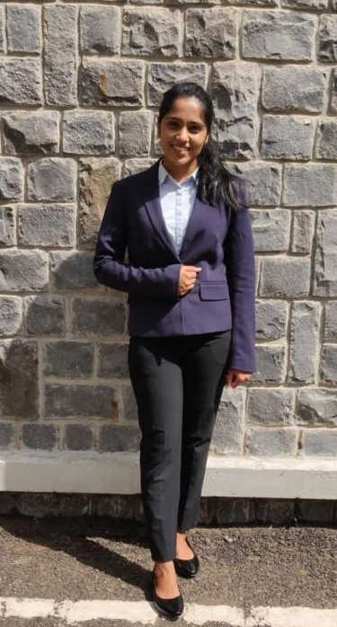
We interviewed one of our potential customers Kanika Khandelwal.
She is a working individual living alone who has to manage everything all by herself.
When we explained her our business plan she seemed excited about it. She felt it will ease work burden on her and will help her to focus on her work life in a better manner
Customer Feedback

Slide 24
THANKYOU!

