Slide 1

Business Plan
Group 5
By:-
Priya Thukral 20DM160
Rohan Agarwal 20DM179
Shagun 20DM193
Shashank Dhruva 20DM194
Shaurya Rajput 20DM195
Shrenik Jain 20DM201
Shrivriddhi Jaiswal 20DM203
Suhail Larzoo 20DM219
1

Slide 2

The Saviours,
Blessing in Disguise

Slide 3

GENESIS OF THE IDEA
The process of arriving at the idea
Road accident is one of the leading cause of human death. Worldwide, yearly over 1.3 million people are killed in road traffic accidents 3,500 person daily. This is 8th leading cause of death.
Road traffic crashes cost most countries 3% of their gross domestic product.
Opportunity
Increased Safety on the Roads
Less Maintenance Required
Specialty
Prevent collision with dangerous obstacles
Shock absorb system
Sensors
Color of Barrier
Convert shock energy to rotary rotational energy
Alternatives
Speed violation citation
Sensors
Why they dropped
Not effective in preventing accidents
High Maintenance cost

Slide 4
PROBLEM STATEMENT / MARKET PAIN POINT
Problem
Road accidents Hazards
Who has it?
General public
Why is it pressing?
To save precious life and maintenance cost
How do you know
Total of 1,51,113 people killed in road accidents
HOW CAN WE REDUCE THE ACCIDENTS AND PROPERTY DAMAGE?

Slide 5
PRODUCT / SERVICE / SOLUTION
Product description
Convert that impact energy into rotational energy to propel the vehicle forward rather than potentially breaking through an immovable barrier.
When a car hits the barrier, the rotating barrel converts shock from the vehicle to rotational energy. Upper and lower frames adjust tires of large and small vehicles to prevent the steering system from a functional loss.
The rolling barrier can be effectively used in curved roads sections, ramps, medians and entrance or exit ramps in parking garages.
Intended benefits
Early threat detection
Avoid delay in medical service
Less maintenance required
Increased safety
Intellectual property
Utility patents: for tangible inventions, such as machines, devices, and composite materials, as well as new and useful processes
Design patents: for the ornamental designs on manufactured products
Plant patents: for new varieties of plants

Slide 6
SOLUTION PROTOTYPE / MVP
Describe your Solution
To secure and keep wild vehicles from going into the path of different vehicles. Consequently, the road safety barriers are put on the middle of the road.
To shield the vehicles from falling into a lope. The road safety barriers are ought to be set toward one side of the street if there is a drop of at least 5 meters close to the street.
To keep a crazy vehicle from slamming and hitting a street side object. The importance of safety road barriers can be seen by the benefits.
What is your value proposition to your client – What is so unique/special about it?
Government
Reduce maintenance cost and compensation to victims
Reduce property damage
Save most precious resource – human resource

Slide 7
MARKET AND PRODUCT POSITIONING
Target Customer – Government
Market Size- NHAI, NHBP
Early adaptors- NHAI
Projections on how market will evolve over time
To grow from USD 3.0 billion in 2020 to USD 4.9 billion by 2025, at (CAGR) of 9.3%
Major factors include rising urban population and high demographic rates, rapid motorization, increasing number of road fatalities/accidents, and government initiatives for enhancing road safety.
Market Strategy plan to reach out and sell to early adopters
Mails
personal meetings
MyGov : A platform for citizen engagement
Initial market potential of the solution
How and where will you sell your products and/or services – We will approach Government and Construction company and tell them the market potential of company.

Slide 8
INDUSTRY AND ECOSYSTEM POSITIONING
Key growth trends - Global road safety market size is estimated to reach $4.6 billion by 2026, forecast to grow at a CAGR of 8.4% during 2021-2026
Major players – Government
Key suppliers – Chemical industry suppliers, steel industry and nut bolt suppliers
Key connections they need to establish – Construction companies, NHAI authorities, licensing authority

Slide 9
PESTE ANALYSIS OF BUSINESS ENVIRONMENT
 | POLITICAL (govt. Policy/ regulatory) | ECONOMIC (growth, inflation, interest rates etc.) | SOCIAL ( behavior changes, buying patterns) | TECHNICAL (R&D, automation, digitization) | ENVIRONMENTAL (ecological & environmental changes)
Favorable | Licences Taxations Documentation | Government is giving incentive to startups. Financial incentives | High population hence more requirement of road safety equipments | New technologies are being proposed E.G. Encouraging application of intelligent transport | Recycled plastic
Unfavorable | Risk of governmental intervention Corruption | Fluctuations in input prices and market demand | - | - | Usage of plastic

Slide 10
COMPETITION ANALYSIS
 | Competitor 1 | Competitor 2 | You
Strengths | Sufficient reserves of iron ore High tensile strength | Increasing demand Weather resistant Low cost as compared to metal barriers Flexible designing | Sensors Reduction of vehicle damage
Weakness | High cost Corrosive | Low tensile Strength Causes substantial CO2 emissions | Higher costs Difficult installation
Price Point | Using of better quality of alloy | Enhancement of durability Increase the use of waste and recycled material. | Charging of sensors due to spinning of rollers
UVP | High tensile strength | Good aesthetic value | Less vehicle damage

Slide 11
FINANCIAL PROJECTIONS
Pricing Strategy
Cost of making 1 rolling barrier will be Rs.3,000 and it will be sold at Rs.3,100
OPEX and CAPEX Estimates
Operating Expenditure –Rs. 3 Crore
Capital Expenditure- Rs.12 Crore
Highway length is India is 1.42lakhs km
No of rolling barrier installed per km is 1,000 units
Total profit per km of installing rolling barrier will be 1,000*100 =1lakh
Assuming that 1% of highway is installed with rolling barrier in first year .
Total kms covered will be 1,420kms
Profit =1,420*1,00,000 = 14,20,00,000=14.2crore in 1st year
Cash Flow Projections
10

Slide 12
Breakeven
A factory to produce rolling barrier will be set up costing 12 crore and 3 crore will be the variable cost so total cost will be 15 crore.
No of rolling barrier needs to be sold for breakeven
15crore/(3,100-3,000)= 15 lakhs barrier
Hence breakeven point will be achieved when 15 lakhs rolling barrier will be installed
Payback period
Payback Period = Initial investment/Cash flow per year
15crore/14.2crore=1.056 year
Now assuming cash flow to remain constant and discounted rate at 10%. No of years taken =10

Slide 13
Payback Period: 1.056 years
Discounted Payback Period: 1.171 years
Cash Flow Return Rate: 94.54% per year
 | Cash Flow | Net Cash Flow | Discounted Cash Flow | Net Discounted Cash Flow
Year 0 | $-150,000,000.00 | $-150,000,000.00 | $-150,000,000.00 | $-150,000,000.00
Year 1 | $142,000,000.00 | $-8,000,000.00 | $129,090,909.09 | $-20,909,090.91
Year 2 | $142,000,000.00 | $134,000,000.00 | $117,355,371.90 | $96,446,280.99
Year 3 | $142,000,000.00 | $276,000,000.00 | $106,686,701.73 | $203,132,982.72
Year 4 | $142,000,000.00 | $418,000,000.00 | $96,987,910.66 | $300,120,893.38
Year 5 | $142,000,000.00 | $560,000,000.00 | $88,170,827.87 | $388,291,721.26
Year 6 | $142,000,000.00 | $702,000,000.00 | $80,155,298.07 | $468,447,019.32
Year 7 | $142,000,000.00 | $844,000,000.00 | $72,868,452.79 | $541,315,472.11
Year 8 | $142,000,000.00 | $986,000,000.00 | $66,244,047.99 | $607,559,520.10
Year 9 | $142,000,000.00 | $1,128,000,000.00 | $60,221,861.81 | $667,781,381.91
Year 10 | $142,000,000.00 | $1,270,000,000.00 | $54,747,147.10 | $722,528,529.01

Slide 14
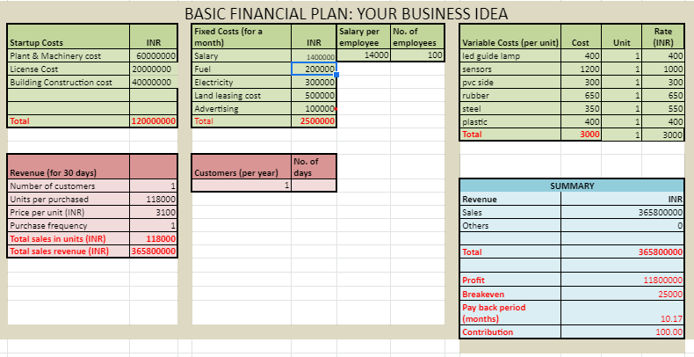

Slide 15
OPERATIONAL PLAN
Key Resources –
physical resources
Human resource
Financial capital
Ethyl vinyl acetate, steel
Warehouses
Intellectual property
Key Activities –
Manufacturing
Assembling
Product development and testing
Product distribution
Key Milestones (For first 3 to 5 years)
Within next three years to five years it should be present in all the highways of our country.
Till the end of five years we will expand our business globally.

Slide 16
IMPLEMENTATION PLAN / MILESTONES
How convincing is the implementation?
It is easy to install
More durable
Recyclable material
Environment friendly
Shock absorb system
LED lights
Show us the targets for next 12 months and the plans for ‘product development’ and ‘business strategy’.
Targets for next 12 months
Planning to install rolling barrier in 1,420 KM range.
Proposing idea to the investors
Operational information such as where your business is based, who your suppliers are and the premises and equipment needed.
Financial information, including profit and loss forecasts, cash flow forecasts, sales forecasts and audited accounts.
Hiring team
Product development strategy
Modify an existing product
Increase product value
Offer a trial
Specialize and customize
Business strategy
Will pitch the idea to the government ,give trials
Any milestone achieved so far?
None
11

Slide 17
ORGANIZATIONAL PLAN - TEAM
Our advisors / investors
Government
Construction company
Convince us
We are the right team who can deliver the commitment because we have a great idea which will help to reduce the road accident we have skilled people who have knowledge in the particular area

Slide 18
LEGAL IDENTITY
Key Legal Compliances
NHAI regulations
RTO
Ministry of Road Transport
12

Slide 19
RISK ANALYSIS
Strategic - A competitor coming on to the market compliance , change in government policy
Financial - Non-payment by a investors or external factors such as interest rates and foreign exchange rates.
Operational – Heavily reliant on one supplier for a key component
12

Slide 20
ASK
We are asking 15 crores from our investors for 10% stake on our company
Exit Plan
An exit plan may be used to: Close down a non-profitable business Execute an investment or business venture when profit objectives are met Close down a business in the event of a significant change in market conditions Sell an investment or a company Sell an unsuccessful company to limit losses Reduce ownership in a company or give up control
We will sell our business to venture capitalist or government.
10

Slide 21
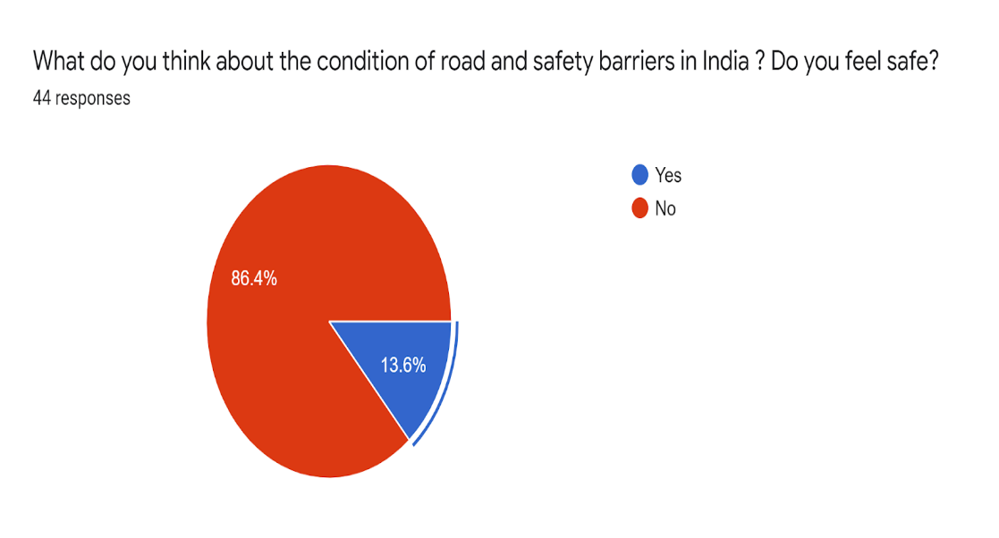
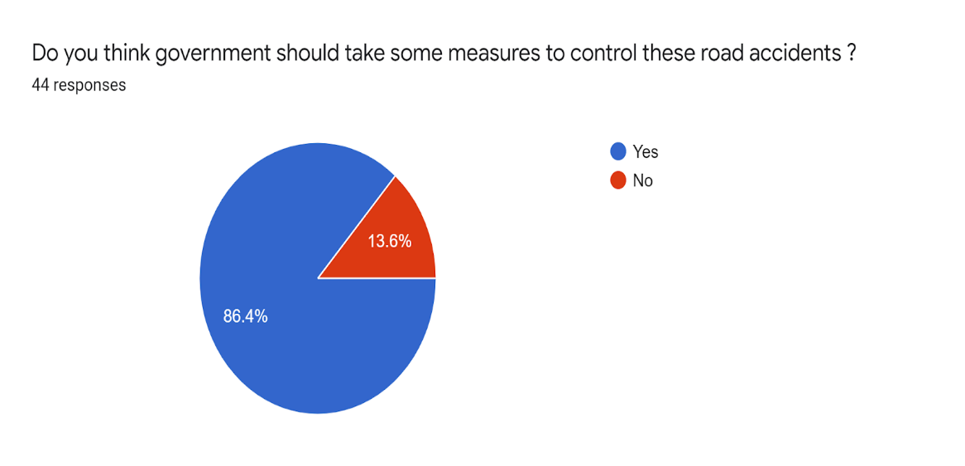
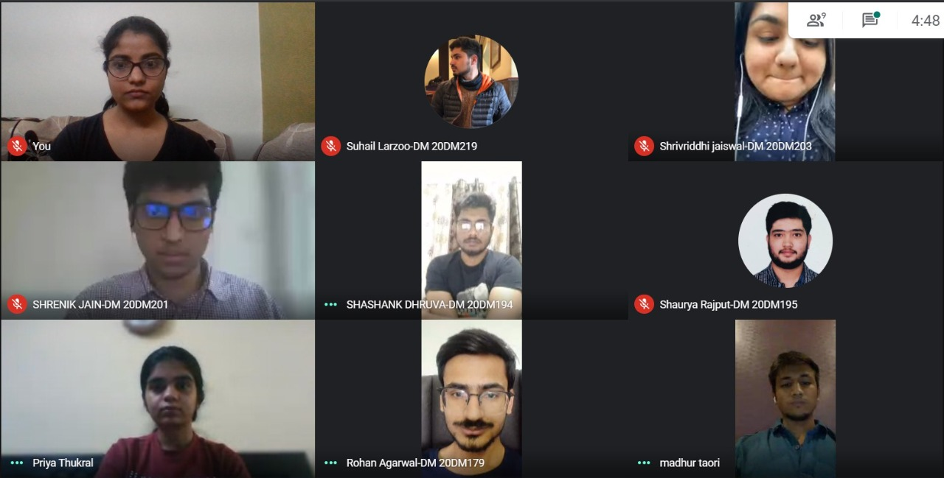
ANNEXURE SLIDES

Slide 22
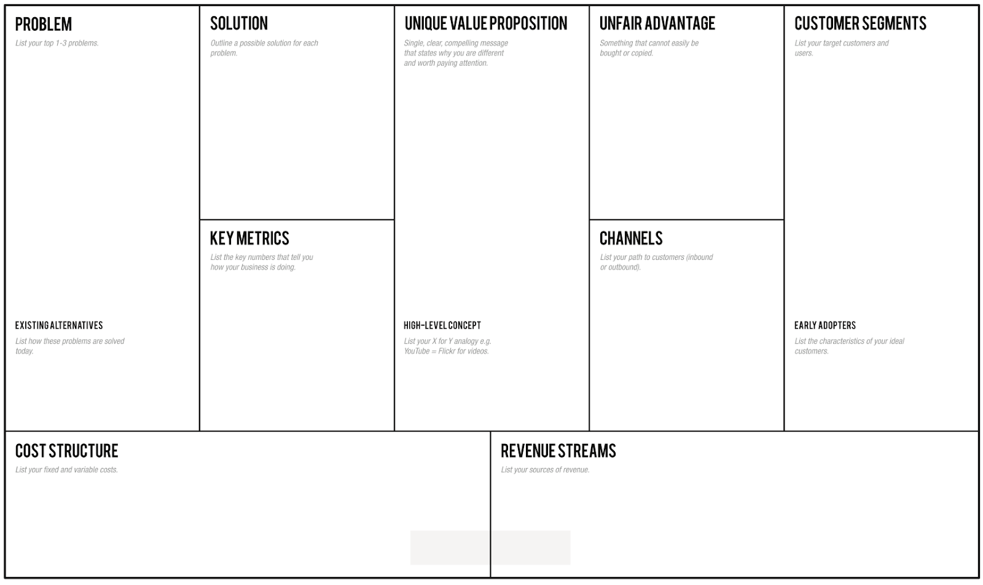
LEAN CANVAS
How can we reduce the accidents and property damage?
Introduction of rolling barriers with sensors and LED lights
Less damage to property
Increased safety
Low maintenance
Avoid delay in contacting medics
Early threat detection
Inclusion of sensors to our barriers
More durable
Easy installation
Shock absorb system
Government
Manufacturing
Product development
B2b
Speed violation citation
Sensors
NHAI
Costing Per Roll- Rs 3,000
Sale of our product

