Slide 1

FOODEASZZ
We deliver good health
ARCHIT NAMDEO
GARGI MANGAL
GARV JAIN
GOURANGI AGARWAL
MANSI JAIN
NIKHIL TAKKAR
NIMISHA AGRAWAL
PARIDHI GARG
20DM041
20DM077
20DM078
20DM080
20DM115
20DM143
20DM144
20DM148

Slide 2
BACKGROUND
Source: Times Of India

Slide 3
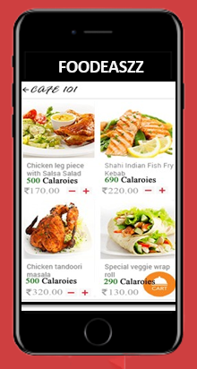
OBJECTIVE
To create a change in food delivery system and also make conscious about balanced nutrition and calories in the foods.
To provide greater selection of foods to choose when ordering from different restaurants.
To connect restaurants and customers even when facing unfavorable weather.
To provide food hot so that the taste doesn’t change due to delay in delivery.

Slide 4
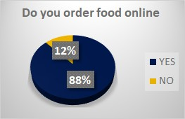
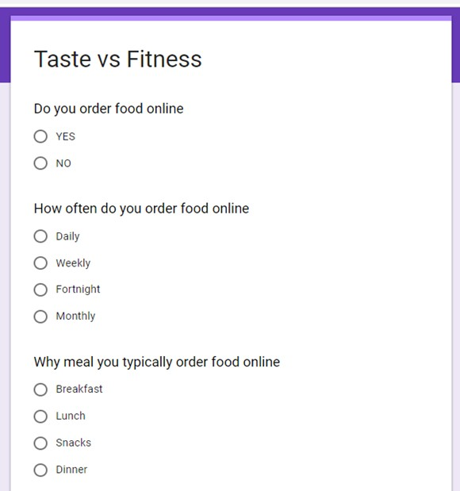
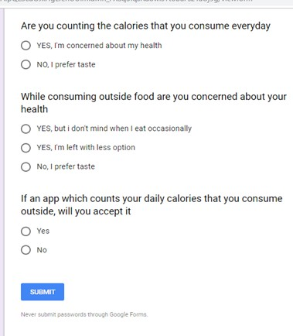
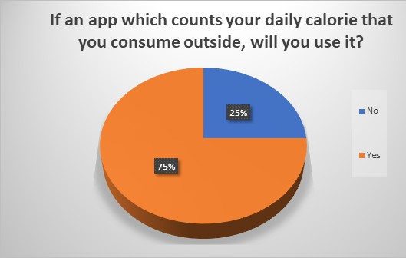
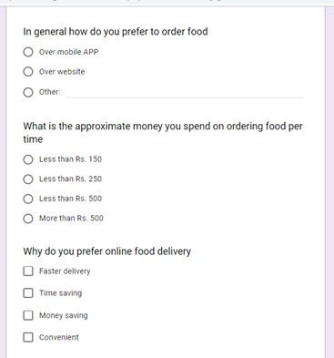
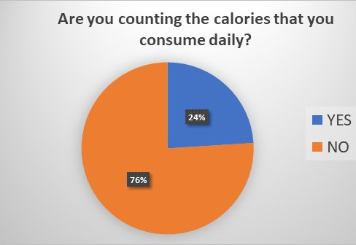

Slide 5
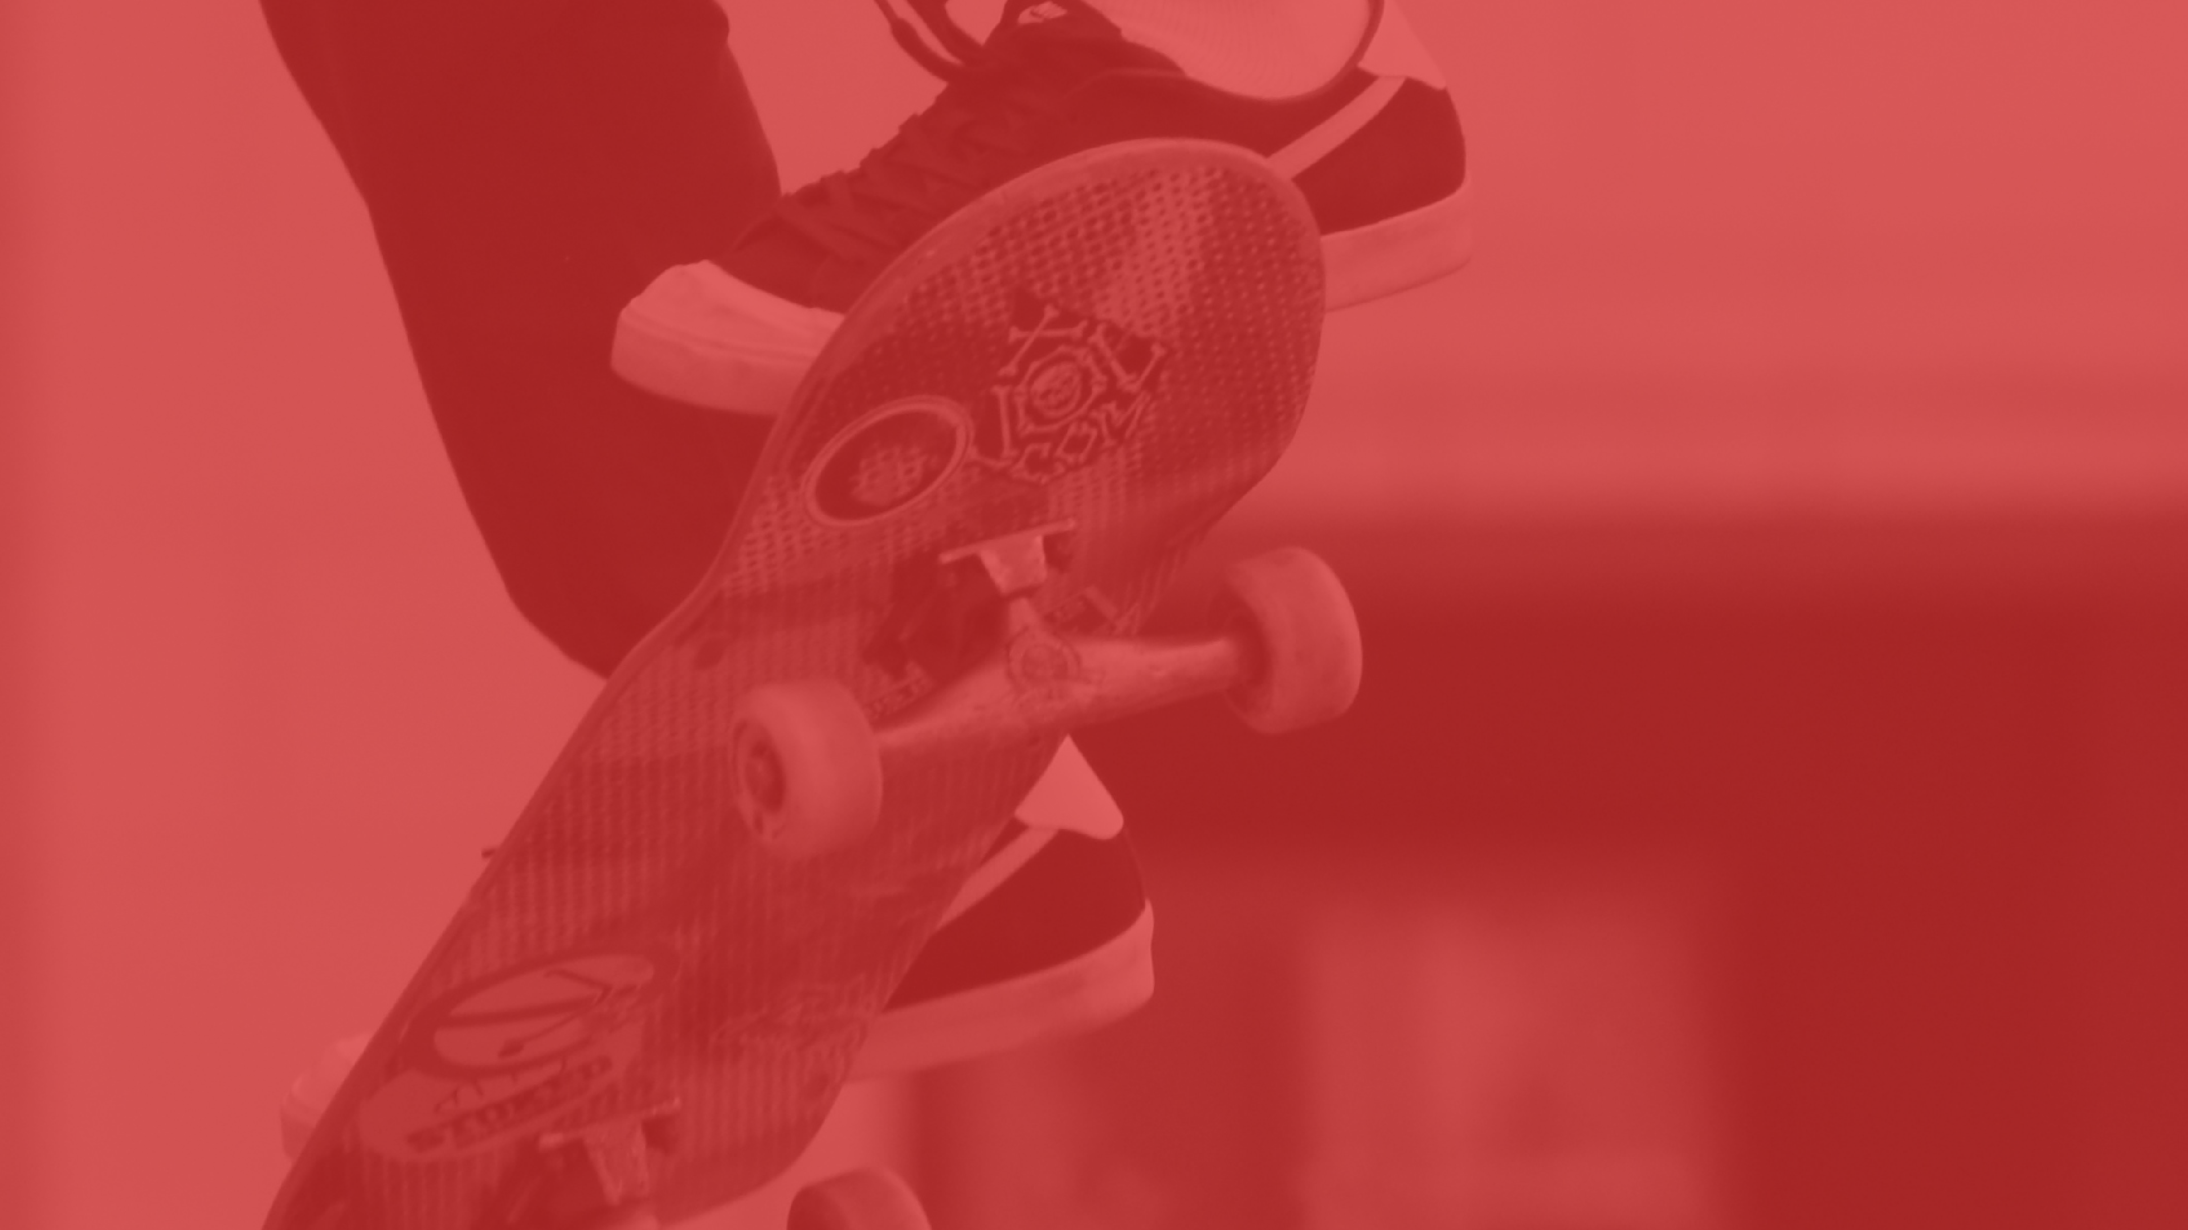
Problem Statement
Being unaware about the healthiness and quality of food and also along with that food temperature is not maintained.

Slide 6
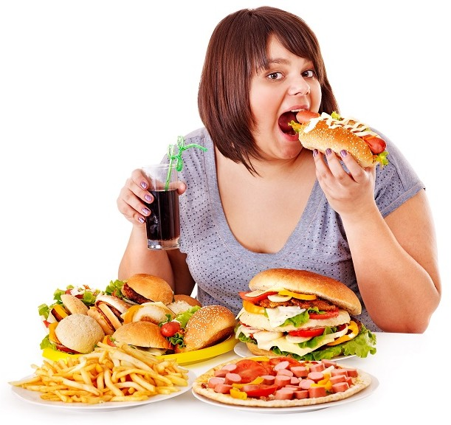
Problems
1
Unawareness about what they are eating.
Compromise in food quality.
Traffic delay leads to the delivery of cold food.
2
3

Slide 7
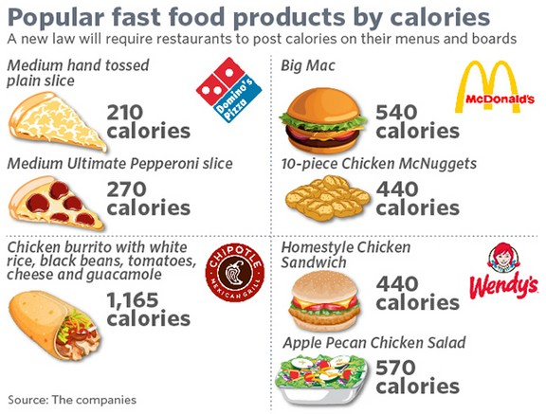
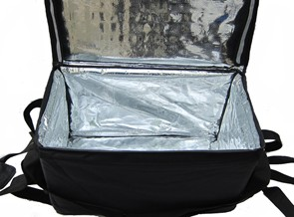
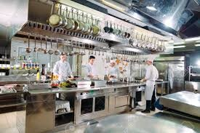
SOLUTIONS
Showing the nutrition and calorie count of each food on the menu to create awareness about their food intake.
Installation of thermal setup in delivery, box to keep the food hot and tasty.
Tie-ups with restaurants that are certified for providing quality food ; fssai certification
1
2
3

Slide 8

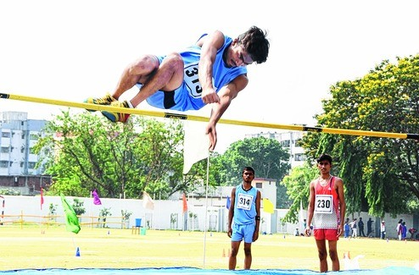
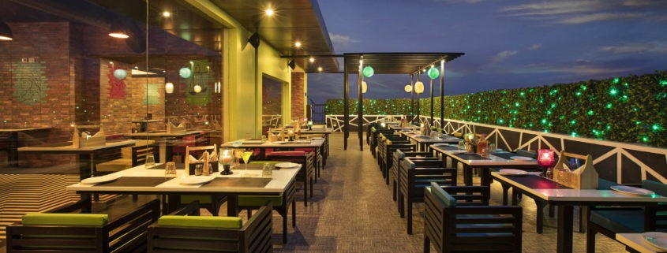

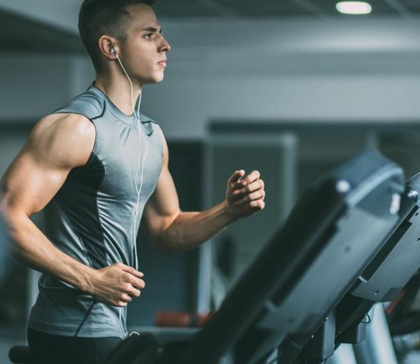
Target Market
Upper Middle - class
Sports Enthusiasts
Restaurants
Youngsters
Health-conscious people

Slide 9
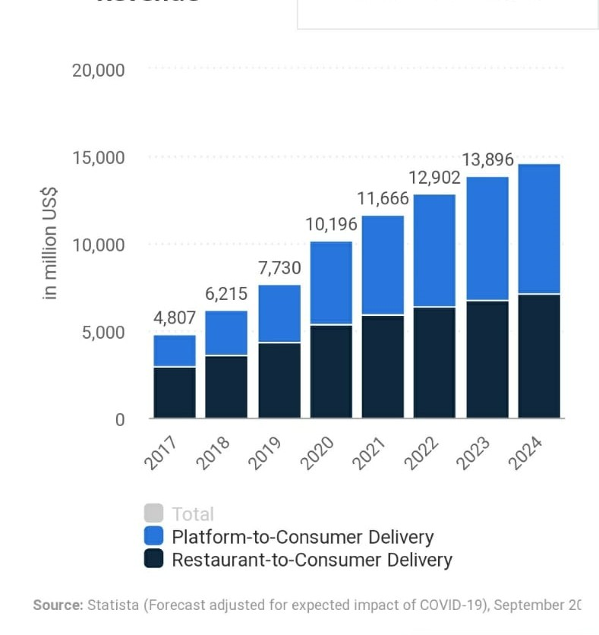
Size of the Market
US$ 11,666m
Revenue
225.6m
Total Users of Online Food Delivery

Slide 10


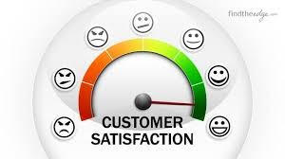

Customer Acquisition
Content marketing
Highly targeted advertising
Developing business partnerships
Create a lead generating site
Focus on benefits over features
Be present on social media
Offer deals and promotions
Run giveaways
Showcase testimonials
Keep track of the competition
Ask for referrals
Make sure your SEO is up to date

Slide 11

PESTE Analysis
POLITICAL
ECONOMIC
SOCIAL
TECHNOLOGICAL
ENVIRONMENTAL
Increased Job Opportunities
Increase in sales of traditional restaurants
Disposable Income
Convenient urban life
Impact on public traffic
Promoting healthy life style
Increased carbon footprints
Plastic Waste
Reduced food waste
Automation
Policies and Guidelines
Reduced food waste

Slide 12

Competition Analysis
 | Swiggy | Zomato | Foodaszz
Strengths | Fast delivery Trained employees | Multiple acquisitions Huge customer base First mover advantage | Tie ups with fssai certified restaurants Fast delivery
Weakness | Target zonal restaurants Do not show calorie count | Do not show calorie count | Lack of brand awareness
Price Point | Commission from restaurants (18-40%) of total order value. | Commission from restaurants(7%) of total order value | 14-15 % commission from restaurants
UVP | InstaMart : delivery of grocery and daily essentials within 30-45 minutes. | They provide full information about restaurants from where you want to order | Maintaining food temperature Providing calorie count of each food item

Slide 13
Advantage 1
Packaging: keeping the food warm
Advantage 2
Fast deliveries
Competitive Advantages
Advantage 3
Easy payment options
Advantage 4
The exclusivity of restaurants(healthy ones)
Advantage 5
Exclusive deals for regular customers

Slide 14

FINANCIAL PROJECTIONS
Expected no. of users in the first month: 19,500 if we get 0.3% market share of Chennai
Initial Cost (in app development and usage): Rs. 12,00,000
Expected Revenue per month :
19,500 * Rs.12 = 2,34,000
Break even = 8.05 months

Slide 15
Operational Plan
Key Resources
High-Quality Database – Massive Database of restaurants and businesses
Employees – that are working diligently to extend its outreach,
Foodeaszz Platform
Partner Restaurants
A community of content contributors or reviewers
Funding Partners
Thermal setup.
Key Activities
Building partnerships with eateries and retail shops
Hiring delivery providers and suppliers (full-time/part-time/freelancers)
Acquiring customers and managing their orders
Managing delivery and payment process
Managing technical operations
Updating system and building IT infrastructure
Handling queries and concerns of customers and partners
Picking and delivering items for customers
Counting calories and nutrition of each food items

Slide 16
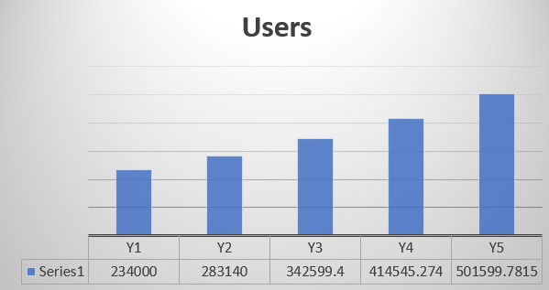
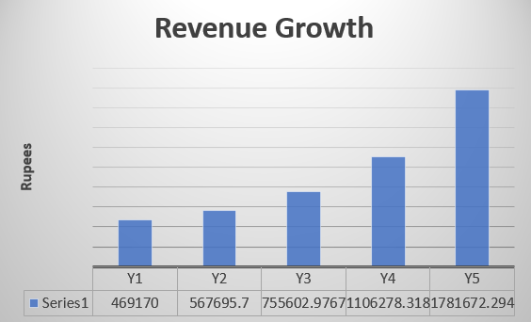
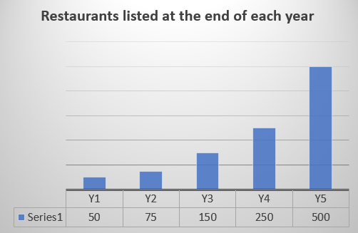
Key Milestones

Slide 17
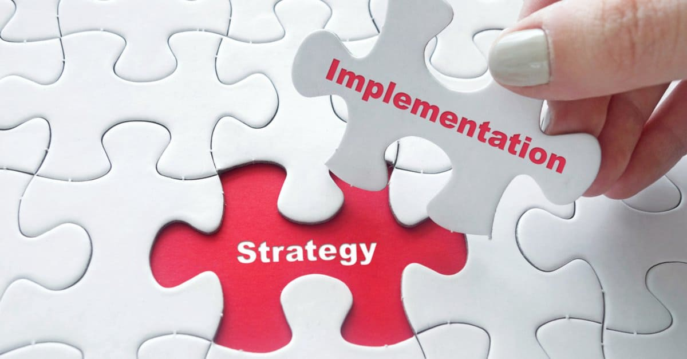
IMPLEMENTATION PLAN
We have decided to set up our business in Chennai. Hence we have done the customer survey through google forms of the population from Chennai.
We will hire delivery boys/women in china and will do the tie up with the restaurants having fssai certificate.
We will also hire software engineer to develop our app and continuously keep updating it according to the requirement.
Main focus will be advertisement. We will advertise our USP on social media and television ad.

Slide 18
Organizational Plan - Team
CMO
CTO
Paridhi – BBA, work exp of 10 years in food industry
Mansi – MBA with 3 year of work ex
Archit- B.Tech. Computer science, 8 years work ex.
Nimisha -MTech, 4 years of work experience.
Founders
Garv – B.Tech, MBA with 3 years of work experience
Gargi- B.Tech with 5yrs of work experience
COO
CFO
Nikhil - B.Tech, MBA with 7 years of work experience.
Gourangi - BCom, MBA in finance , 4yrs work exp.
“We are the right team who can deliver the commitment because we have team of experienced professionals with diversified portfolio.”

Slide 19

Legal Identity
Form of business – Registered Partnership Firm
Firm Incorporation
Firstly, we need to Form a Partnership deed and get It signed by all The Partners in the organization and gather the Legal documents of all partners.
For the Registration, we have to contact the Registrar of firms that are Situated in the state where your partnership firm is Located and need to submit documents there.
Once you submit the application, the registrar of Firm Will verify all the details and if the registrar is satisfied, a Certificate of Incorporation will be issued to you which means your partnership is Registered.
Key Legal Compliances
In the case of a Partnership Firm
a Partnership Deed along with the registration at a local Registrar of Firm
regularisation of IT Returns filing along with GST Returns (if applicable)
preparation of financial statements.
Opening a Current Bank Account.

Slide 20
Risk
Financial Risk: If our business fails then we will not be able to repay our loans
Operational risk: There can be challenge in hiring new talent as there are already well-established brands in the similar line
Business Risk: Once the product is in the market than it will not take time for established brands to adapt the same idea.
Risk Management Plan
Main risk in our business is tapping the market, so we will focus on the advertisement to spread the awareness of our brand.

Slide 21
How much do you ask from the investor?
2 Million for 20% stake
Exit Strategy
We will sell our idea to a similar company if we are not able to tap the market and goes into losses
Broad usage of funds?
Salary of delivery partners
Tie up with more restaurants
Expanding in different cities

Slide 22
