Slide 1
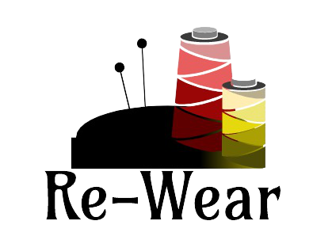
Wearing in a sustainable way

Slide 2
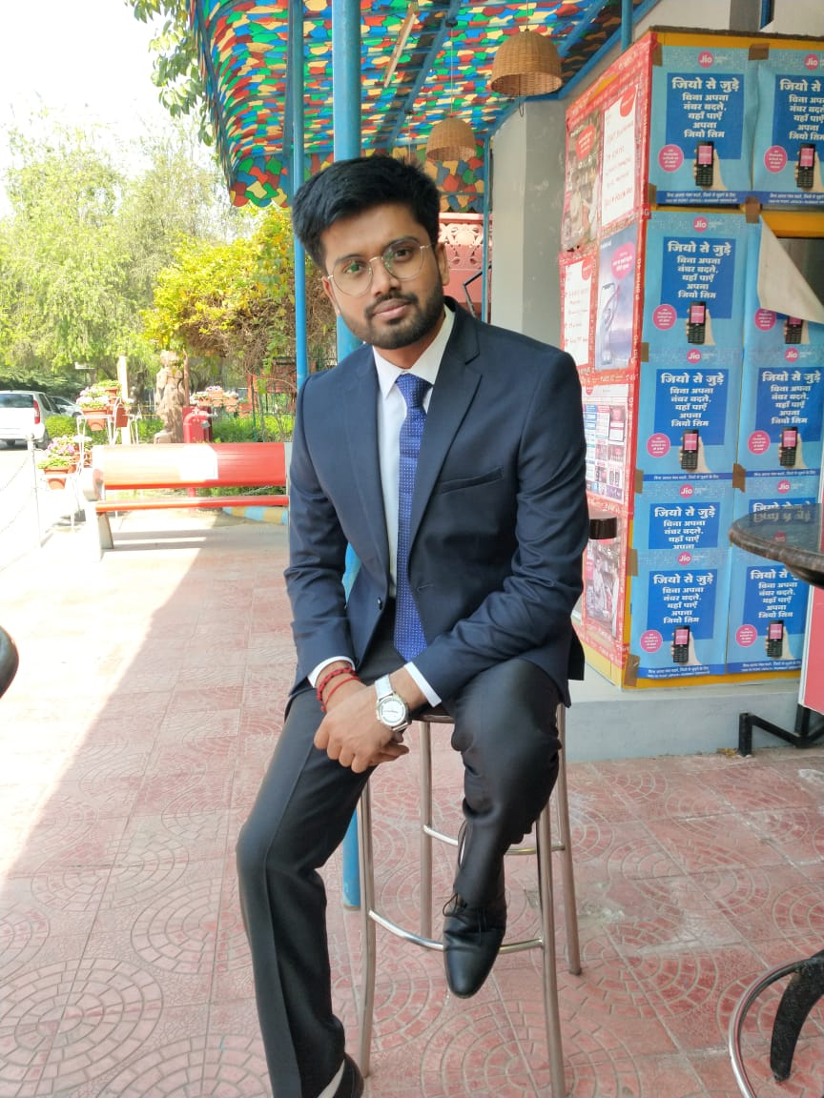
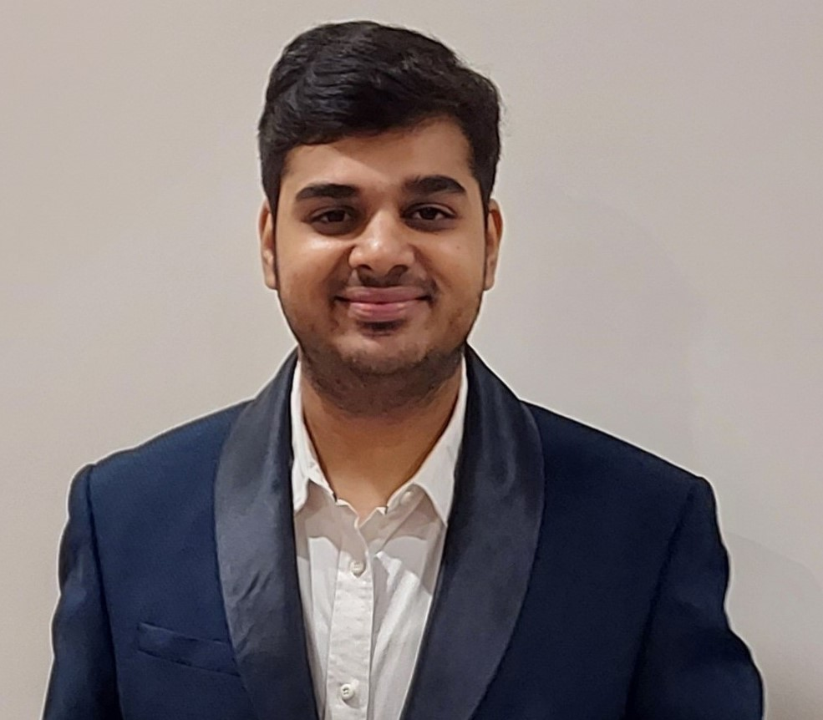
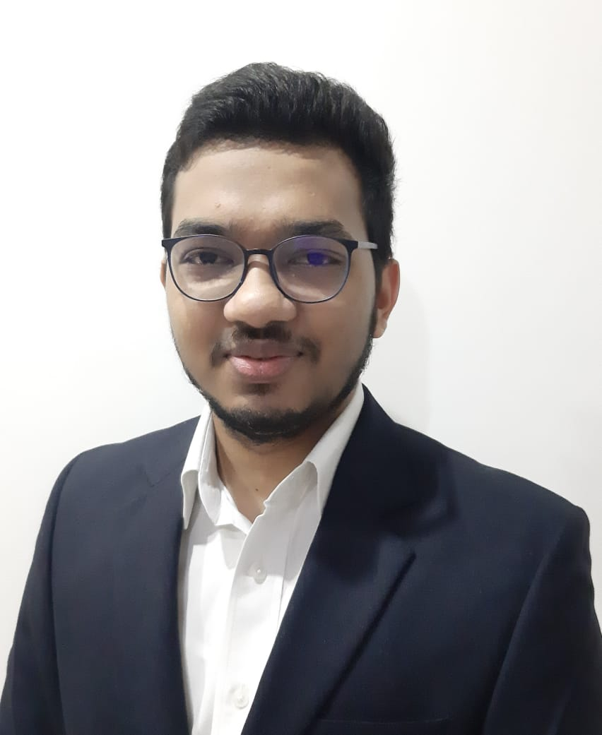

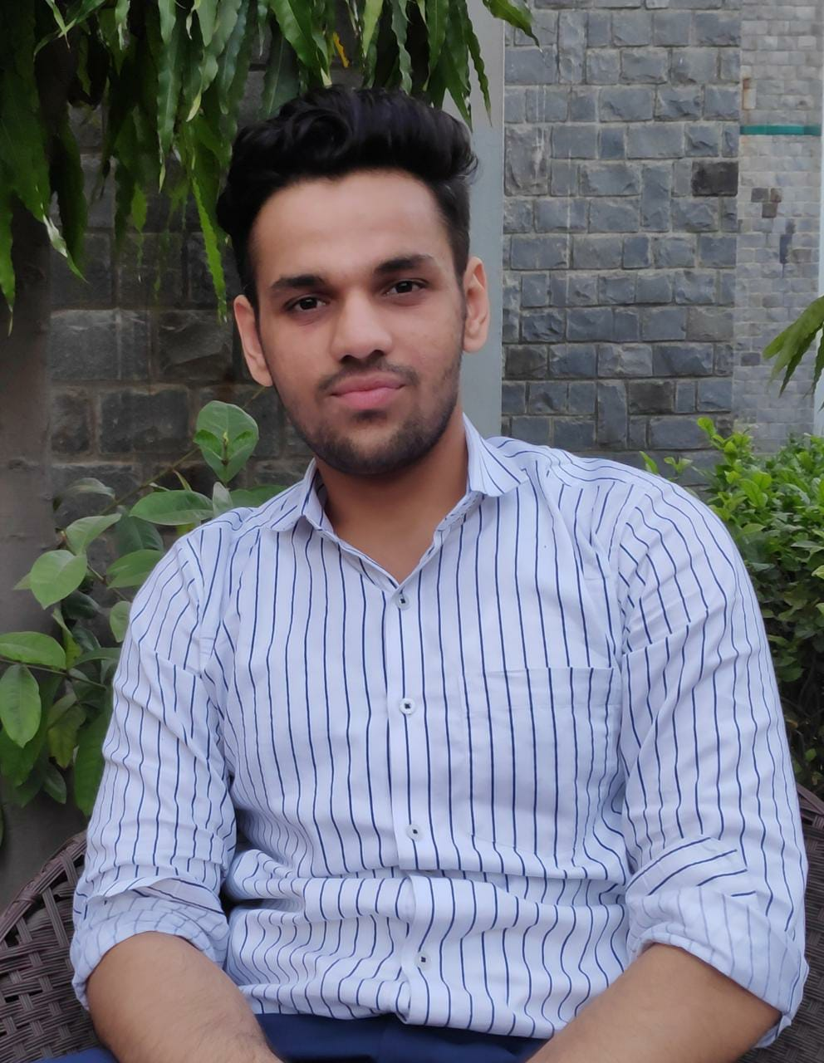
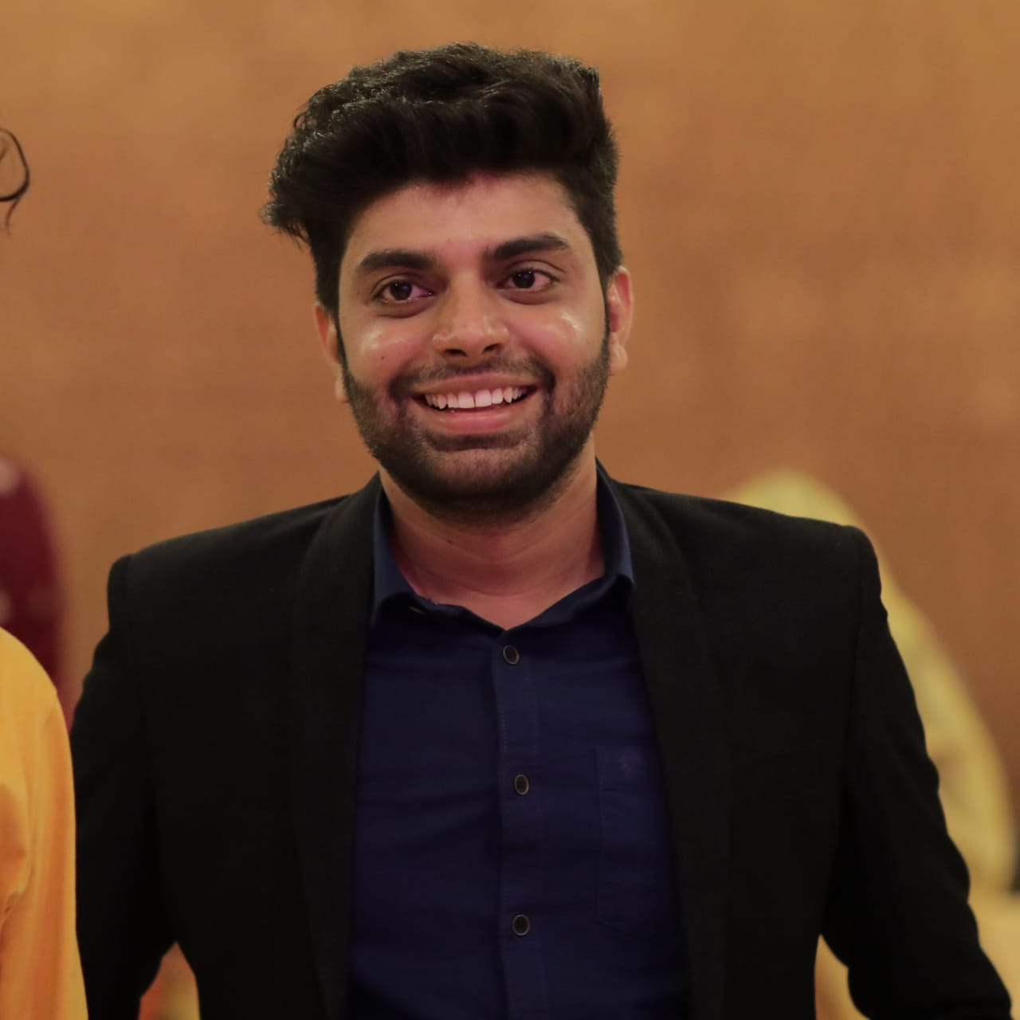
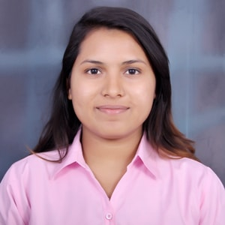
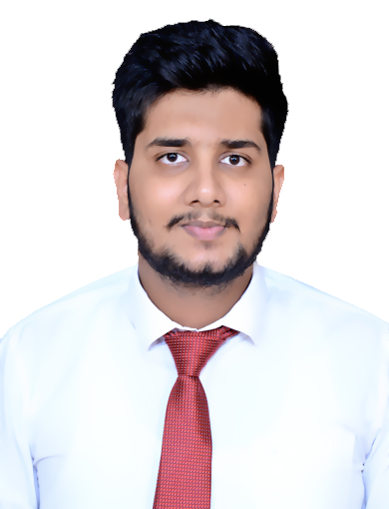
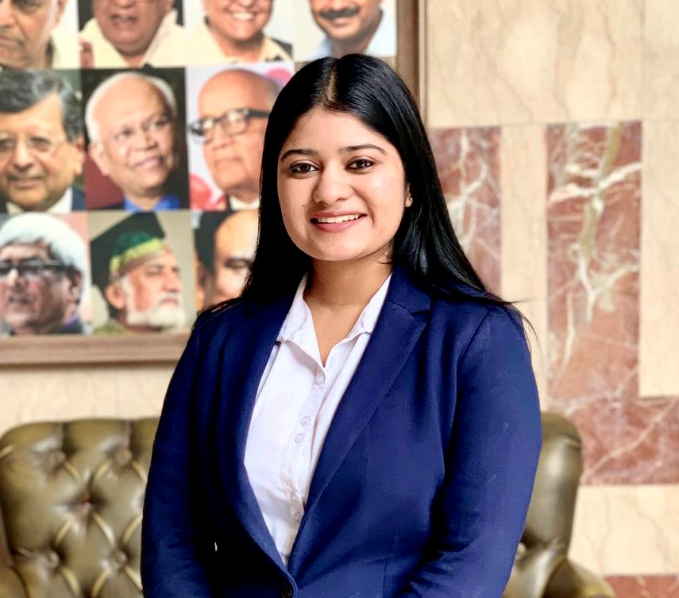
Team Members
Utkarsh Agarwal
Qualification - B.com(hons)
Strength -Leadership Skills, Problem Solving
Utsav Mahajan
Qualification: B.com
Strength - Problem solving
Utkarsh Singhal
Qualification – B.com (H)
Strength – Team Player, Planning
Vikas Dagar
Qualification – Eco Hons.
Strength – Collaborative, Laborious
Yaman Mittal
Qualification – B.com
Strength - Punctual, Approachable
Swasti Jain​
Qualification – B.com(Hons)​
Strength - ​Good Listener, Observer, Responsible
Vaishali Aggarwal
Qualification – Eco Hons.
Strength - Good listener and quick learner
Yashvardhan
Gehlot
Qualification - Commerce
Strength – Facilitation, Humbleness, Coordination

Slide 3
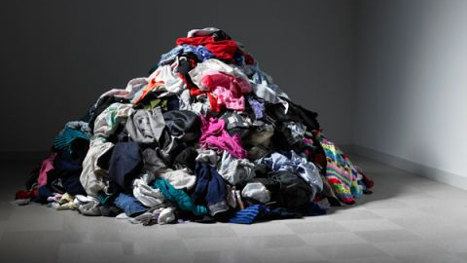
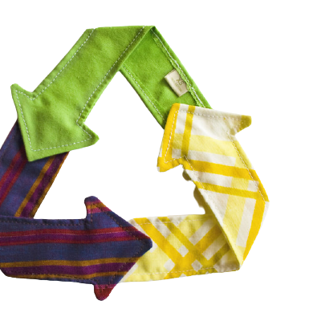
ELEVATOR PITCH​

Slide 4



Genesis of the idea
Arriving at the idea
Why this Opportunity
What to do with our old clothes?​​
Is there any way we can re-use them?
To bring down the expenditure on clothing.
Reusing the clothes

Slide 5
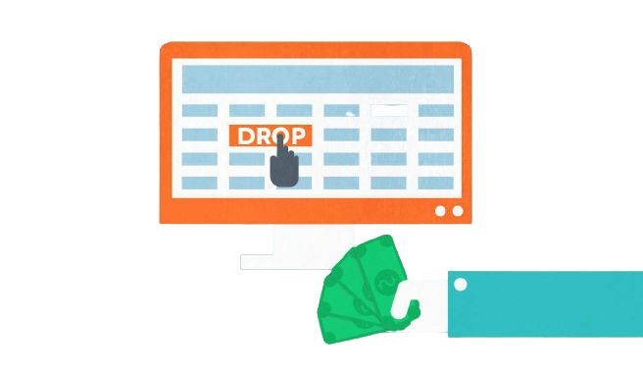

Genesis of the Idea
What were the alternatives?
Why were they dropped?
Started with improvising the business model for NinjaKart.
Dealing with the problem of seasonality and exotic fruits and vegetables.
Unable to estimate viability and feasibility of the idea

Slide 6

Genesis of the Idea
What special about it?
By not discarding the old clothes, we are moving towards a sustainable future.
Providing employment opportunities to artisans.
To provide value to the customers who constantly seek something new and unique

Slide 7



PROBLEM STATEMENT
WHAT IS THE PROBLEM?
WHO HAS IT?
WHY SOLVING IT?
Frequently change in designs
What to do with old but still useable clothes?
Fashion enthusiasts
People who finds difficult to give away their expensive clothes.
To create unique value for our customers.
To provide customer with unique services at affordable price.

Slide 8
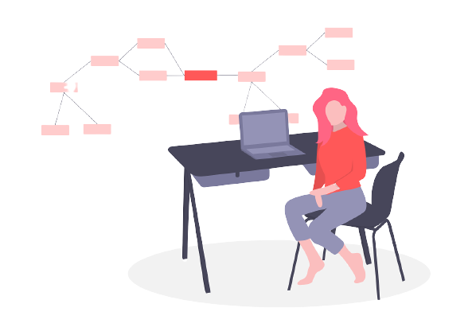
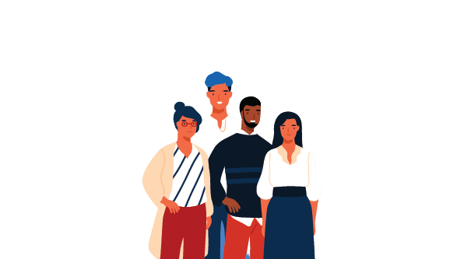
PRODUCT/ SERVICE/ SOLUTION
SERVICE DESCRIPTION
BENEFITS
To provide a platform to re-design used clothes.
Suggestions through a mobile app for possible design (Ex. – Myntra, Lenskart).
At later stage- Can move to offline channels for better connectivity.
Providing new design to customer at nominal cost.
To provide emerging artisans with new working opportunities (CSR).
Efficient utilization of resources.

Slide 9
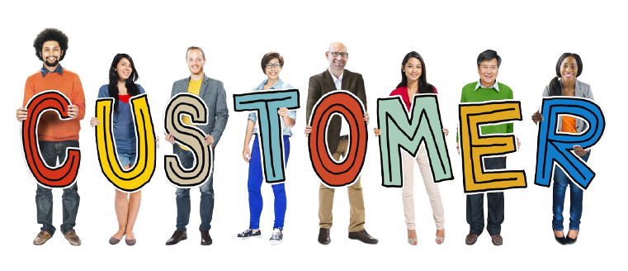
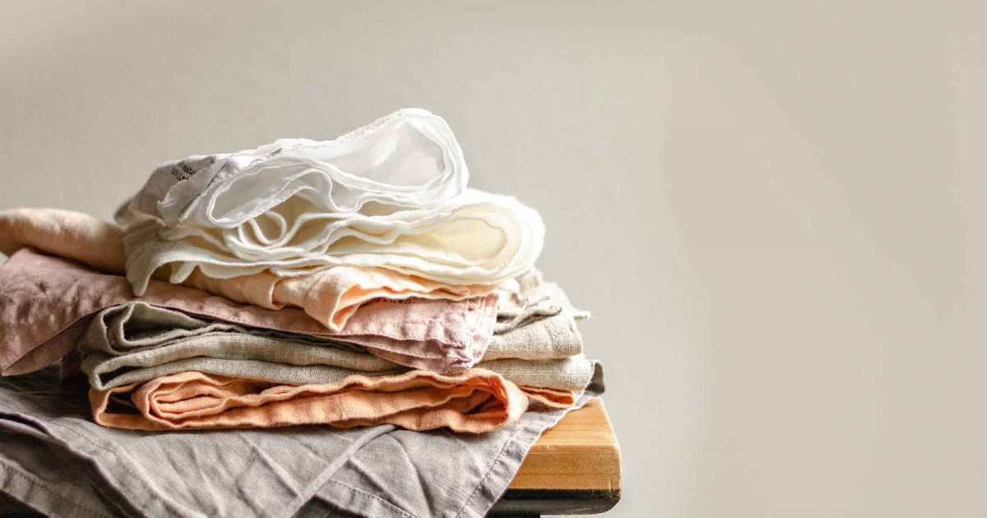

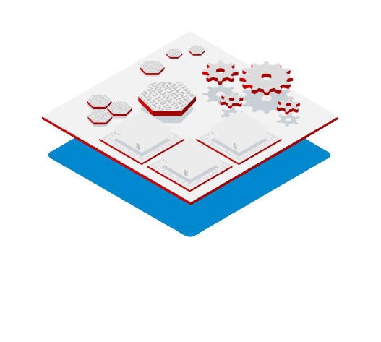
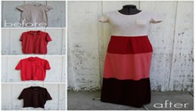
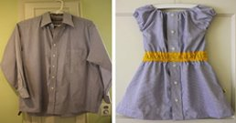
Business Concept
Our Business

Slide 10

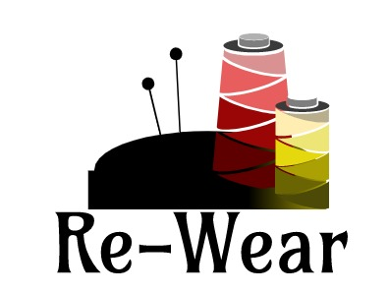

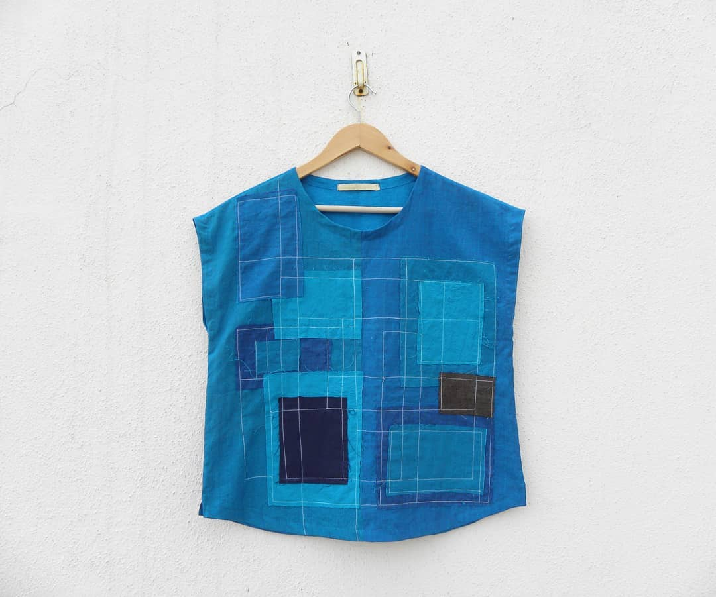

Bienvenue to Re - Wear
HOME
OUR PRODUCTS
CONTACT US
ABOUT
Delivery: Receive by 14th April, 2021
Cost: Rs. 3500
Number of Clothes to be Up-cycled:
2
Cloths you want to Re - wear
This is what we can do!
Let’s wear in a sustainable way

Slide 11
MARKET & PRODUCT POSITIONING
Why will they Pay?
How will the market Evolve?
How to reach & sell to Early Adopters?
Early Adopter
Fashion blogger
Fashionable clothes at nominal price.
New & Unique Design
Affordable Prices
Not forgo branded clothes
As people are moving towards sustainable living, we assume that the market for our product is very bright
Where & How sell our Product?
At initial stage,
- Educate customers through kiosks.
- Online Application will be the main mode of
interaction with our customers.
If our idea gains momentum, then we will establish offline stores for the same.
Online application.
Advertisement.
Setting up a kiosk for advertising purpose.
Collaborating with fashion lovers.

Slide 12


Industry
1
01
Fasion Industry CAGR - $108 bn, $223 bn by 2021
02
Fashion Resale Market $80 bn by 2029
03
20% Global waste Water & 10% Global Carbon Emission
Trends
01
Recycling and Upcycling
02
Local is Luxurious

Slide 13



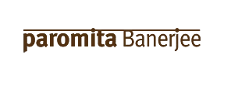

WHO ARE THE MAJOR PLAYERS?

Slide 14
Key connections founders already have?
Key connections they need to establish?
Designers, Tailors, Management services, Website mangers
Ad agencies, publications, fashion bloggers, software engineer.​

Slide 15



COMPETITION ANALYSIS
​ | Local Boutiques/ Tailors​ | Doodlage​ | You​
Strengths​ | Customer Reach.​ Affordable.​ | Strong online Presence.​ Celebrity endorsement.​ | Customization.​ Low prices​
Weakness​ | Lack of innovation and design.​ Restricted to a specific area.​ | Expensive.​ Lack of customization.​ Exclusively for Women.​ | Lack of reach.​ ​
UVP​ | Customer trust.​ | Plastic free packaging.​ Ethical production​ | AI based suggestion.​

Slide 16
PESTE ANALYSIS
​ | POLITICAL (Govt. Policy/ Regulatory)​ | ECONOMIC (Growth, Inflation, interest rates etc.)​ | SOCIAL ( Behavior changes, Buying patterns)​ | TECHNICAL (R&D, Automation, Digitization)​ | ENVIRONMENTAL (Ecological & Environmental changes)​
FAVOURABLE​ ​ ​ | Subsidies from government as we will be generating employment opportunities.​ | Employment opportunities for the new workers.​ A new industry will grow which escalates the economic growth.​ ​ | People may start thinking more conservatively about the future when they have an opportunity to rework on their used clothes.​ | Usage of AI in online application.​ | Efficient use of resources by reusing the old clothes.​
UNFAVOURABLE​ ​ ​ | ​ | Major big clothing industries may have a hit as second hand clothing industries growth and economic growth from that sector will hamper​ | Idea will not work for people who are into charity.​ | If any new machinery comes with automation that takes over the work of making the clothes then the employment may suffer.​ | ​

Slide 17
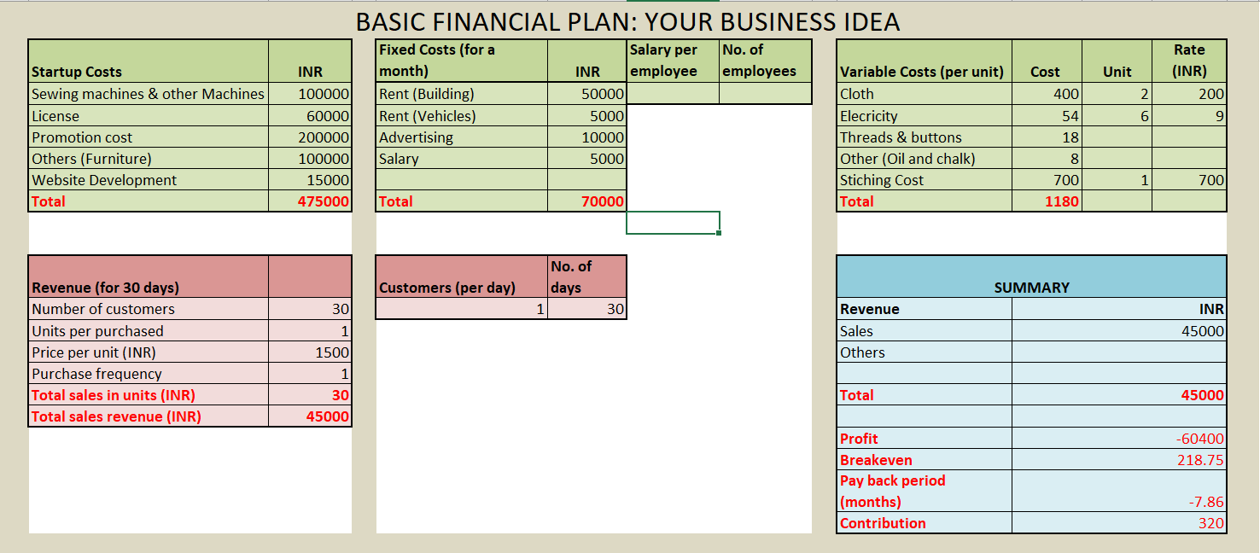
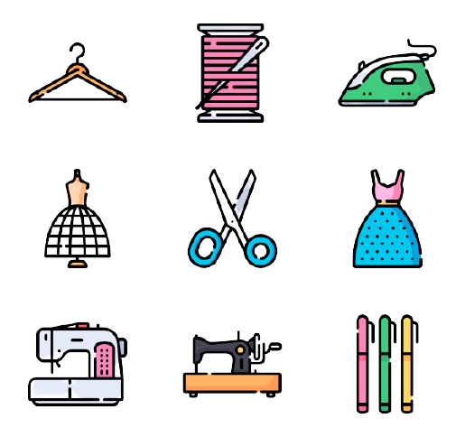

Slide 18




OPERATIONAL PLAN
Key Activities
Collaborating with Designers
Hiring Tailors, CRM
Ensuring timely delivery
Advertising to gain more customer base
Key Resources
Key Milestones
Customers
Human Resources -Tailors, Designers, Quality Checker, Website Maintenance, Manager
Website Portal​
Becoming a profitable organization
Multiplying the customer base
Increasing Customer Royalty
Brand recognition
Tie-up with prominent Brands.​

Slide 19

IMPLEMENTATION PLANS/ MILESTONES
How convincing is the implementation?
Targets for next 12 months; plans for ‘product development’ and ‘business strategy’.
Any milestone achieved so far?
Providing a platform with quality, trust and upgraded services
Product Development – Better Services, increasing customer base, Better designs, Increasing Customer Loyalty
In Development Phase
Attract the customers and help the brand grow.
Business Strategy – Aggregation of Stakeholder(tailors, Designers, Service Providers etc.)

Slide 20
LEGAL IDENTITY
Company Incorporation
Digital Signature Certificate (DSC)
The Director Identification Number (DIN)
Key legal Compliances
Appointment of Auditor
Annual general meeting (AGM) filing
Registration on the MCA Portal & SPICe+ form
Board Meetings
Reports of directors
Income tax
Other compliances
Maintenance of records
LEGAL IDENTITY​

Slide 21

RISK ANALYSIS
Financial Risk | Strategic Risk | Operational Risk
Nonpayment by customers, price of raw material | Advance Technology which will replace the workers | Product quality, the health and safety of workers, regulatory compliance and the management of externalities
Mitigate risk by taking advanced payments and making contracts with suppliers | Mitigate risk by making contracts with workers | Mitigate risk by Monitoring work processes and work conditions

Slide 22

1
How much do you ask from the investor?
2
Broad Usage of Funds?
3
How much stake do you offer in the company?
4
What is the exit strategy if this business goes sideways?
ASK
Rs. 500000
Startup Cost
10%
Selling the business to some local boutique.

Slide 23










Solution
Unfair Advantage
Customer Segments &
Early Adopters
Problem
Unique Value Proposition
Low Cost
Expertise Designer
To minimize the wastage of used clothes
How to create new and unique designs?
Creating new design by combining new clothes
Updating the artist about the latest trend.
Reinventing fashion via sustainable design.
.
Customer who wants to remain updated with the current fashion trend.
Fashion Bloggers
People Who wants to lead a sustainable lifestyle
Key Metrics
High Level Concept
Channels
Existing Alternatives
Repurchase Rate
Direct interaction with workers
Feedback/Reviews from customers
Re-wear Mobile Application
Kiosk setup in mall.
Offline Store
Social Media handles (Instagram, Facebook)
Re-wear is a substitute for brand new expensive cloths.
  Local Boutiques
  Doodlage,BORO
Cost
Structure
Startup Cost
Machines
License
Promotion Cost
Other(Furniture)
Website Development
Fixed Cost
Salary
Fuel
Electricity
Rent
Advertising
Variable Cost
Cloth
Electricity
Thread & Buttons
Stitching Cost
Other(Chalk, Oil)
Revenue
Stream
Fees for Designing the clothes

Slide 24
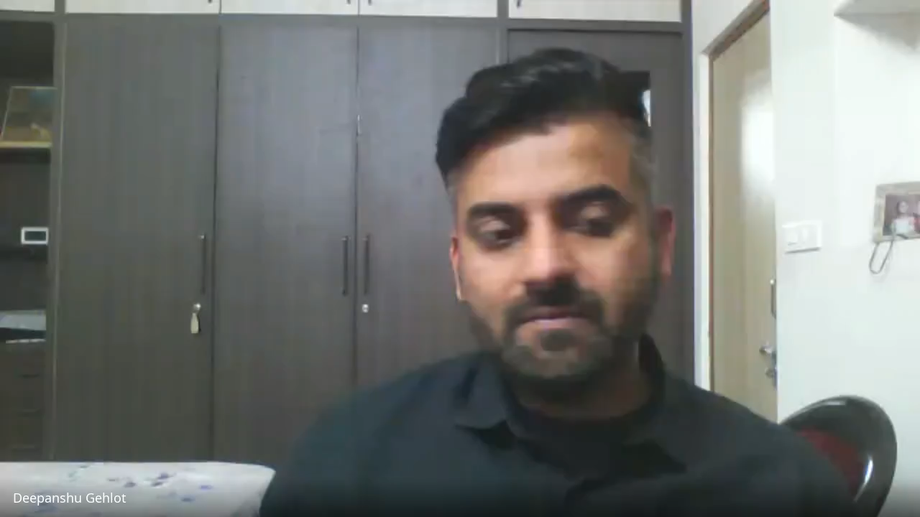
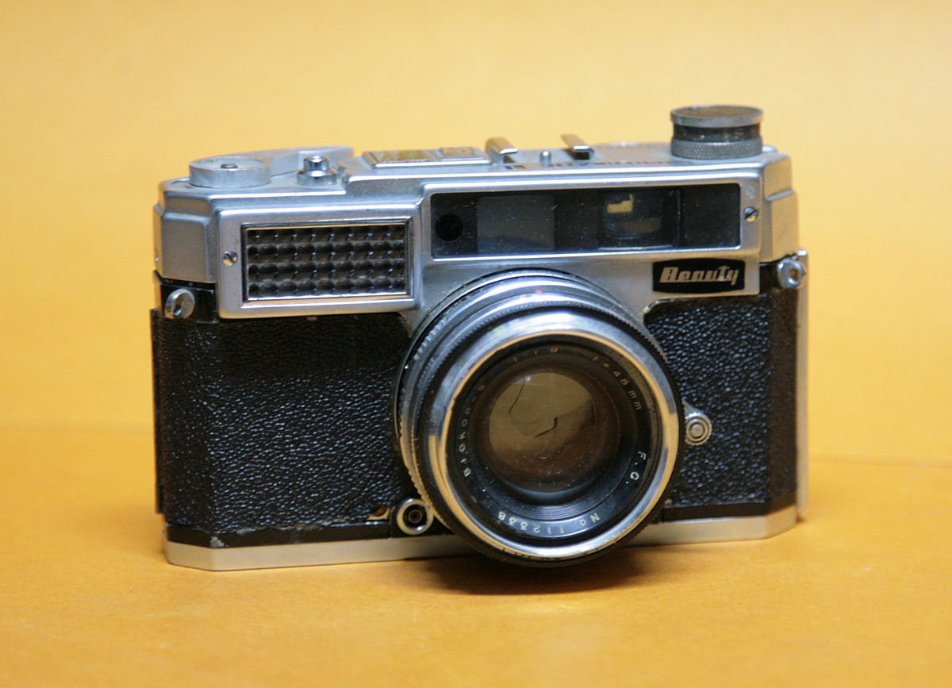
https://drive.google.com/file/d/1frfGoOrJyvXQDaU8SDC6ZRLcFkfJ9Oyz/view?usp=sharing

Slide 25

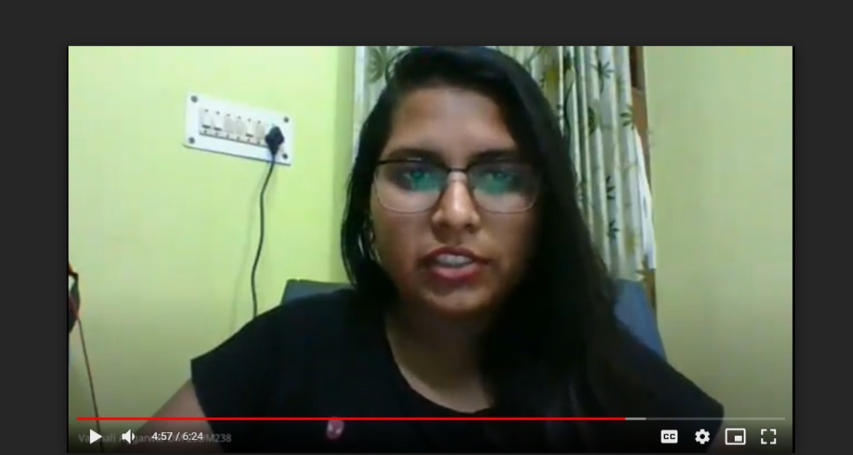
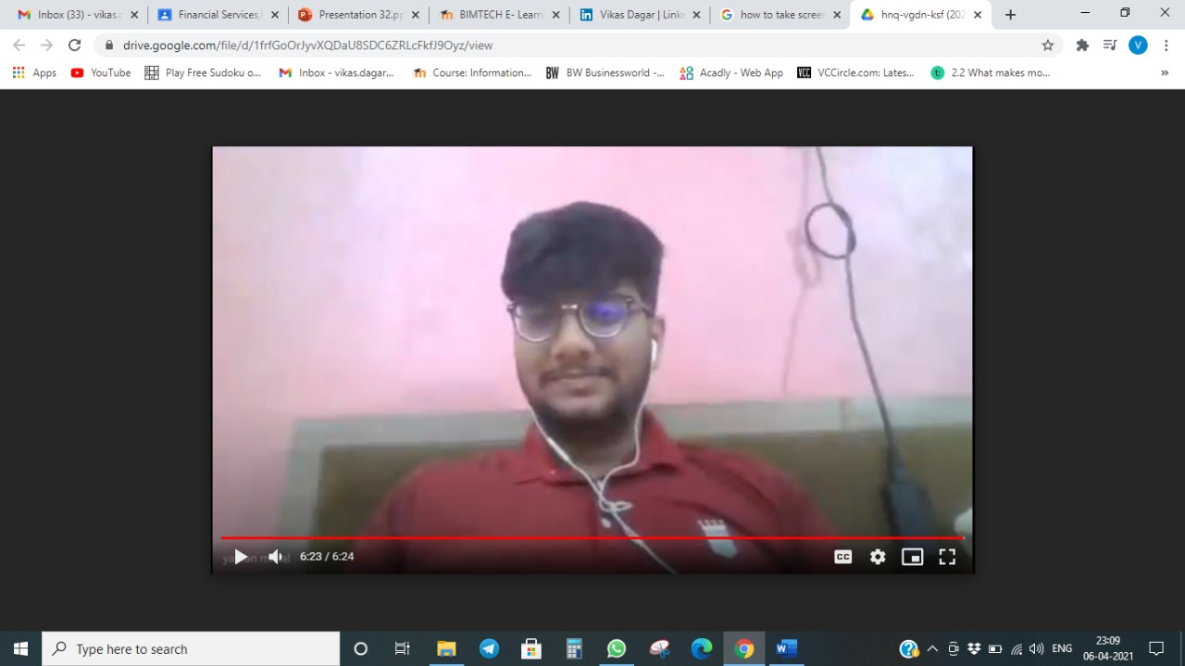
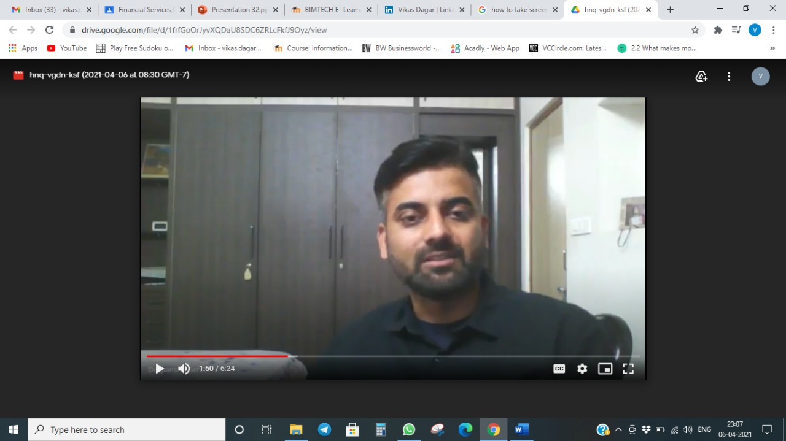
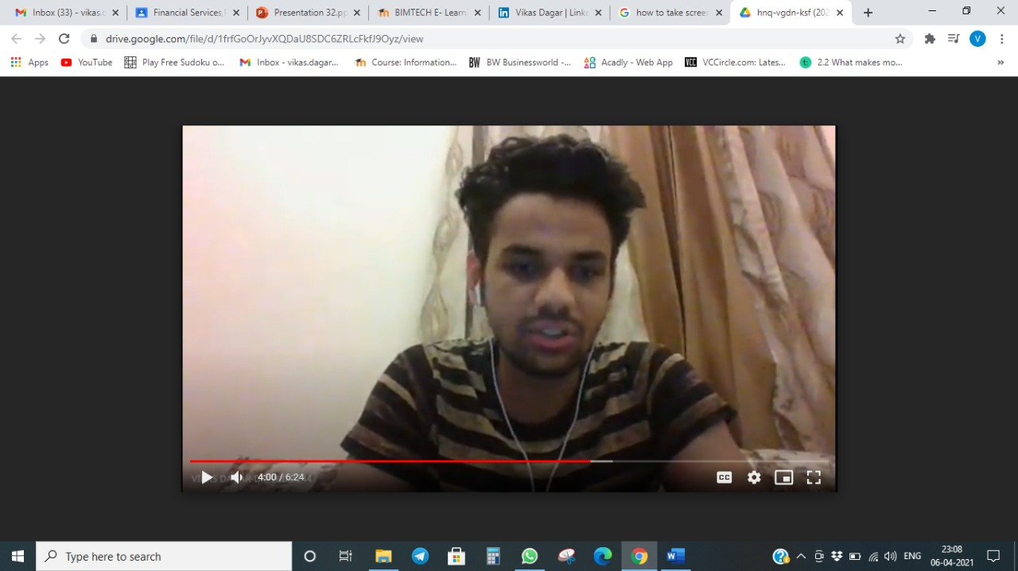
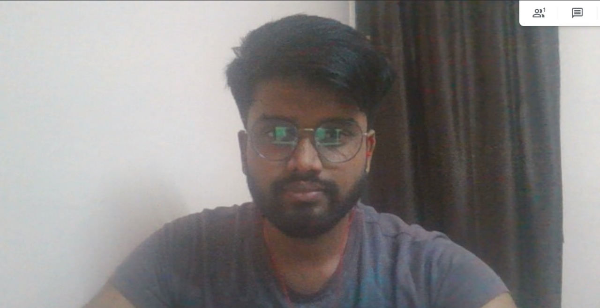
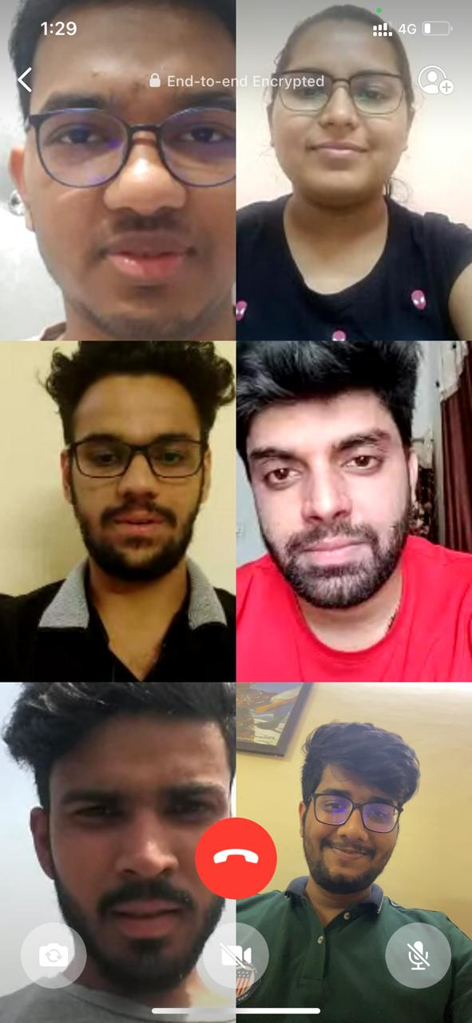
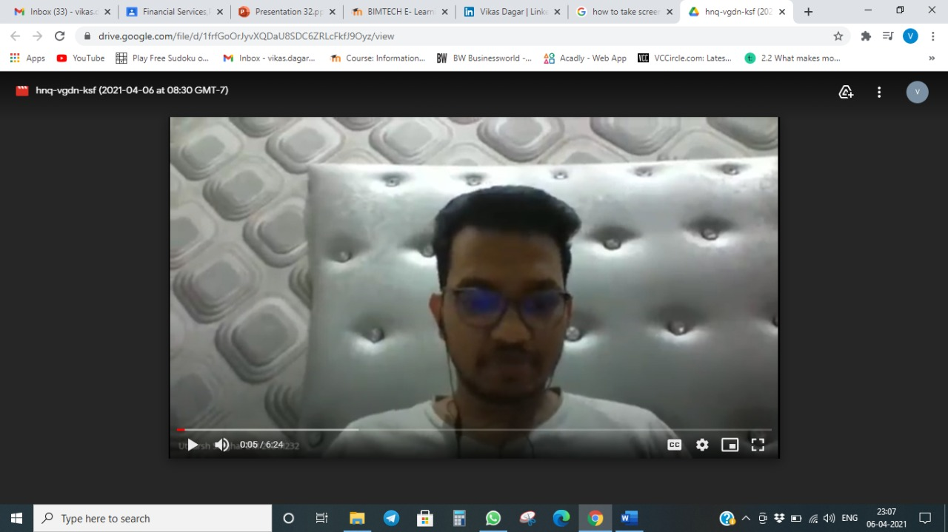
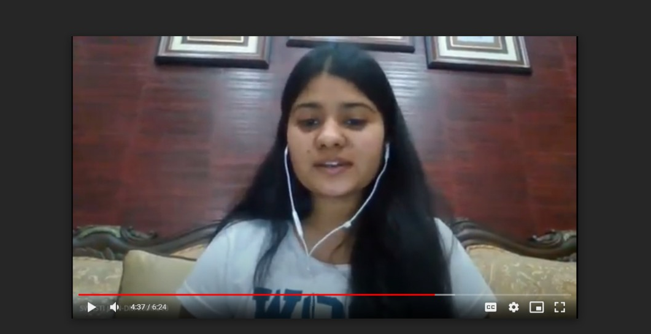
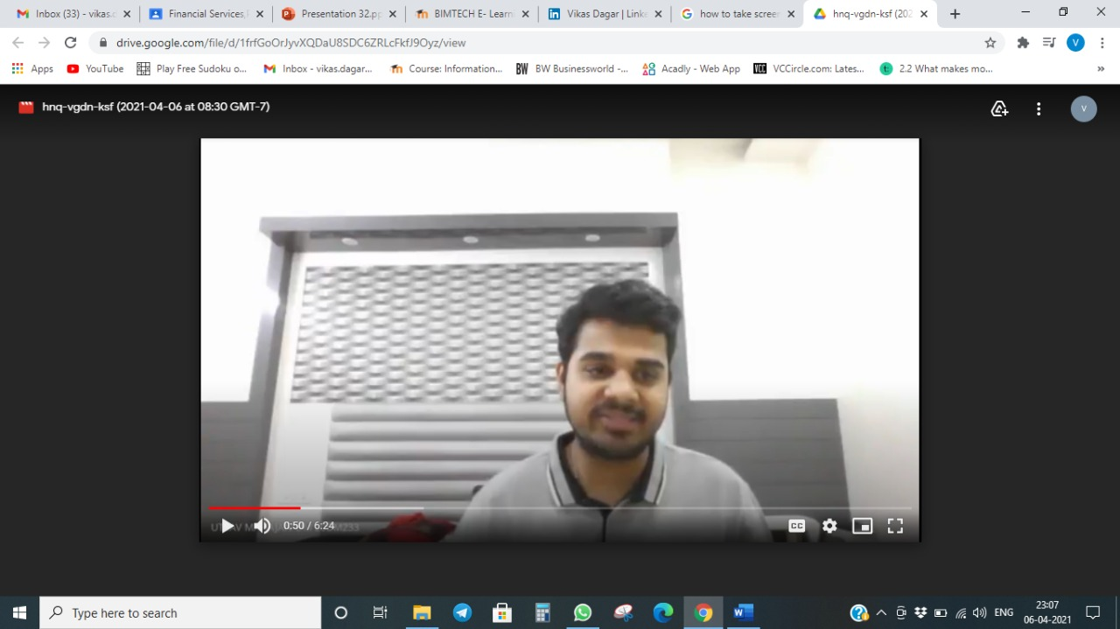
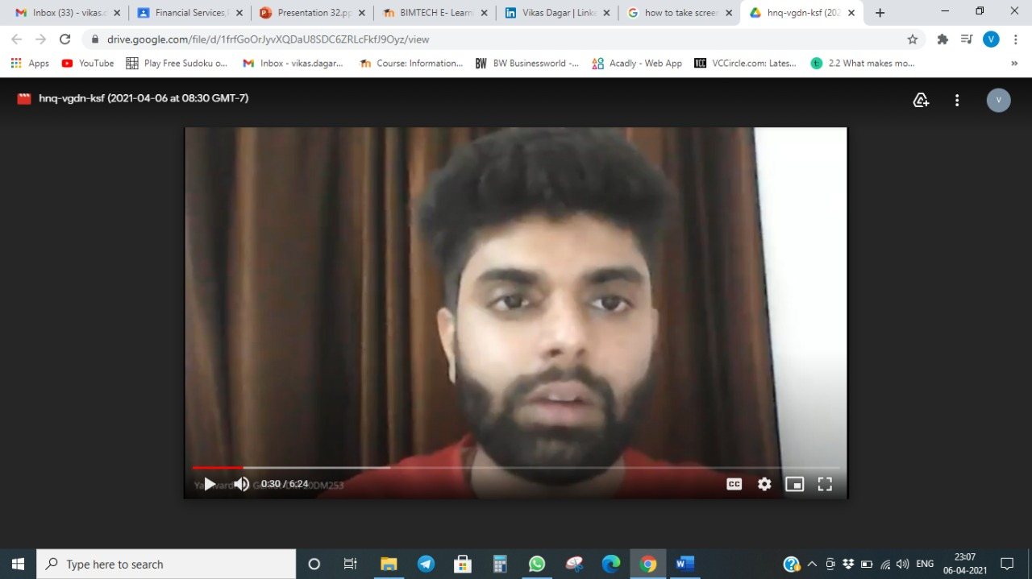

Slide 26
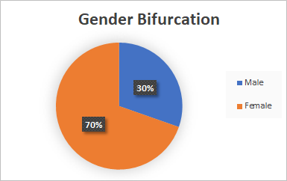
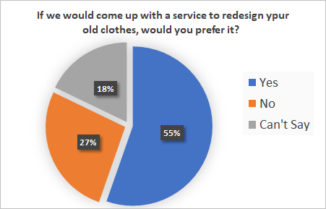
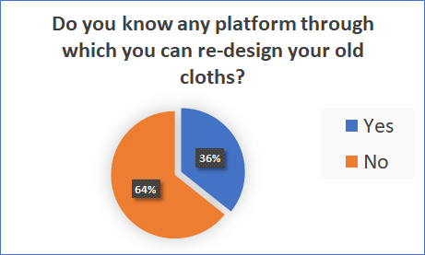
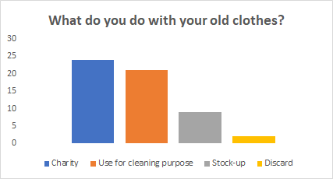
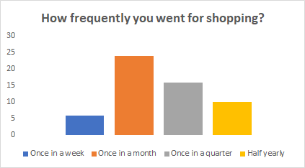
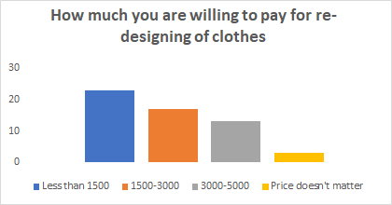
CUSTOMER RESPONSES

Slide 27


