Slide 1
E-LAB BUSINESS PLAN
Niveshgram
Group-2
Amal Geevargheese 20DM022
Prerana Rawat 20DM158
Raju 20DM167
Rishabh das 20DM173
Sanjay Pareek 20DM187
Shivangi Gupta 20DM199
Shefali Satija 20DM196
Tanya Jain 20DM261

Slide 2
Genesis of the idea
By Going through stock investment site for daily market update a thought clicked in mind like how stock market is becoming most common investment platform in our day to day life then thinking about the life in tier 2 3 and rural cities we came on a problem that how life is different there as there is no proper literacy in those areas so we came up with an idea to make a platform where we can teach people train them about the investment market and they can further preach the people of their cities and motivate them about investment in online media and it’s advantages.
Special things to be included in idea was to train the people provide them employment to the ones who are actually having keen interest in learning the investment market and how they can further motivates others too second thing is providing a user friendly platform along with all time customer support, along with features like short term credit facility to the new investors

Slide 3
Market Pain Points
Lack of knowledge in Online Investment Market
Low Reach
Credibility Issue

Slide 4
Service Description
Intellectual Benefits
A Company providing training to avid investors who wants to work in investment markets.
Providing user friendly platform for investing (website , App).
Providing Credit Facility.
Trustworthy Platform to invest in.
Features like emi , credit facility for investing.

Slide 5
Market and product positioning
Tagret customer and market size and future projections of market:
People in tier 2 3 and 4 cities.
People in rural areas.
Who do not have that many sources of regular income and hence want to earn through investing activities once they are provided literacy in that area.
Market size can be huge as around 70% as of India’s population lives in rural areas, tier 2, 3 4 cities and rural areas as well.
Market may grow only slowly and steadily as people in these areas do not have that much knowledge about investment and they may initially be hesitant to invest their limited savings if at all. However once they are educated in this area they may gradually gain confidence and may be willing to invest and seek it as one suitable source of income.

Slide 6
Go to market strategy and market potential:
We would invite applications from young educated people in these cities and rural areas who maybe working outside but belong to these areas and have contacts here. Basic graduation degree would be the criteria for selection.
Will be offering free trainings to them on investment domain.
Will Provide them bonus along with fixed salaries for bringing each new investor to invest through the online investment platform developed by us.
Initially the market potential seems to be low as the target customers are not having knowledge regarding the same but in the long run the potential of our business idea is huge.

Slide 7
Industry and Ecosystem Positioning
Industry trends
Businesses recovering from the downfall brought in by covid.
More Indians recognizing the compounding of returns from capital market investments.
Changing perspectives regarding wealth management.
Democratization of asset classes and financial knowledge.
Increasing regulations in wealth management industry.

Slide 8
Industry and Ecosystem Positioning
Major players
Centrum Wealth Management
Bajaj Capital Limited
Motilal Oswal Wealth Management Limited
Anandrathi Wealth Services Limited
Karvy Private Wealth
Sanctum Wealth Management Private Limited
Waterfield Advisors Private Limited
Edelweiss Asset Management Limited
Alpha Capital
Key Suppliers
The key suppliers are the agents selected from each locality and trained by the company in Financial products, marketing and customer engagement

Slide 9
Industry and Ecosystem Positioning
Existing connections of the founders
All eight founders come from different parts of the company, graduated in different streams from different institutes currently pursuing MBA and hence bring a diverse range of –
Network of colleagues, friends and family(The business model is dependant on reaching out to maximum people)
Knowledge and Experience
Perspectives
Connections to be established
Investors for the initial capital required
The agents to manage each locality
Legal professional to ensure legal compliances required by the company
Regulators
Wealth Management Industry experts
Rural development experts and government officials etc

Slide 10


PESTLE Analysis of Business Environment
 | POLITICAL (Govt. Policy/ Regulatory) | ECONOMIC (Growth, Inflation, interest rates etc.) | SOCIAL ( Behavior changes, Buying patterns) | TECHNICAL (R&D, Automation, Digitization) | ENVIRONMENTAL (Ecological & Environmental changes)
FAVOURABLE | A stable government in the country gives investors confidence to invest | Economy in a recovery phase from covid impact and hence offers ample scope for growth | More middle class people recognizing the importance of investing outside the traditional modes of savings for ensuring economic growth | Technology can make it easier to manage a pan India business | Scope for various innovations such as investing in green bonds, sustainability projects etc.
UNFAVOURABLE | Establishing a wealth management firm collecting money from public is subject large number of regulations | Common people are still recovering from the financial impact of covid and hence might not have the surplus to invest | Indians by nature are risk averse and prefer to keep their savings in more familiar instruments such as bank deposits, post office savings scheme | In order to build the technological infrastructure required to manage the business a huge financial outlay is required | Like any other business our business also has to take extra efforts to deal with legal compliances as regards ecological compliance
6

Slide 11

Competition Analysis
 | Zerodha | Upstox | Edelweiss | Niveshgram
Strengths | Most popular and the cheapest discounting brokerage firm in India. The best trading platforms & tools in the industry - Kite, Console and Coin One click-solution for Portfolio Management Service. Zerodha GTT orders Zerodha Kite 3 mobile app Online IPO Application | Access to a large number of trading platforms. Free Mobile trading app is available. After Market Order (AMO), Cover Order and Bracket Order(BO) or One Cancels Other (OCO) orders and Trailing-Stop/Stop-Loss (SL) is available in both web and mobile. Upstox Pro Web Trading Platform Upstox Bridge for AmiBroker Upstox Developer Console Upstox Option Chain Tool Upstox MF Platform Margin Against Shares Online IPO Application (UPI) is available. | Full-service broker offering discount brokerage plan. Excellent mobile application, website & desktop trading software for trading. Online IPO investment. High leverage facilities across Cash, F&O and CDS segments. Wide offline presence through branches and franchises. Relationship managers and add-on services like PMS are available. | User-friendly platform 24/7 customer support Additional features like short term credit facility to the new investors. Platform for learning investment market. Providing resources for market tips and investment ideas. Free mobile application, website & desktop trading software for trading.

Slide 12
Competition Analysis
 | Zerodha | Upstox | Edelweiss | Niveshgram
Weakness | Unable to handle peak volatility Technical glitches Poor Customer Service Poor Bracket Order Management Doesn't provide stock tips, research reports or recommendations. Monthly unlimited trading plans are not available. Lifetime free AMC demat account plans are not available. An additional charge of Rs 50 per executed order for MIS/BO/CO positions which are not square off by the customer. Call & Trade is available at an additional fee. Zerodha Back Office (console) is not integrated with its trading platform. | Limited resources provided for market tips and investment ideas No access to cryptocurrency or IPOs Margin Funding is not available on delivery trades. Doesn't offer unlimited monthly trading plans. Call and trade fee is charged at extra Rs 20 per executed order Additional Rs 20 per executed order is charged for Intraday square MIS/BO/CO orders Though brokerage is free, customers still have to pay the Demat Transaction Charges. 24/7 customer service is not available. Upstox NRI Trading and demat account is no more available (since Jan 2018). Doesn't offer API access for automated trading. | Bracket orders and Good-Till canceled (GTC) orders are not available. Charge high minimum brokerage: 3 paise per share in delivery, 1 paisa per share on Intraday and Futures Call & Trade is available at an additional cost of Rs 20 per call. Rs 50 per month for research calls and trading tips.

Slide 13
Competition Analysis
 | Zerodha | Upstox | Edelweiss | Niveshgram
Price Point | Brokerage free Equity Delivery Trades Simple pricing model Zerodha Referral Program Self-Clearing Broker No Prepaid Brokerage Plans | Brokerage free trading in Equity Delivery segment (Customer does not have to pay brokerage for delivery trades in equity segment). | Flat Rs 10 per executed order brokerage across the trading segments. Free research, trading tips, and recommendations. Instant paperless online account opening
UVP | Charges a flat brokerage of Rs. 20 or 0.01%, whichever is LOWER, on every trade. | Advanced trading platforms | Provides resources for market tips and investment ideas, and recommends some best among the rest stocks. | Providing a platform for learning and getting trained in investment management, with a view to help Rural people generating income through it and thus upgrading their lifestyle.

Slide 14
Financial Projections
Pricing Strategy – We are pricing our services basis industry standards (2% p.a., for portfolio management) and similarly competitive fees for training and seminars. We are not reducing our fees to gain clients, because its sensitive business of money management.
Opex & Capex – Our business model is not capital intensive, payroll expenses form majority of operating expenses.
Cash Flow Projections – We expect to generate positive cash flow from Year 2 from its operating activities. The investors will pool in the initial capital requirement of 2 million to kick start the venture. We are not relying on external funding for the same.
Break Even – Company is expected to break even in Year 2, with projected growth of 15% in revenue every year.
Payback Period – Our firm will recover the initial investment cost of 1.7 million by the end of Year 5.
Basic Financial Projections – Please refer financial projection annexure

Slide 15
Operational Plan
Key Resources-
Well-equipped office for imparting training and consultancy purposes.
Sound HR Team for hiring the right candidates who can later act as consultants for our firm.
Talented and interested candidates with quick learning skills, pleasing personality and convincing power.
Trainers who are technically sound and have years of experience.
Initial round of funding for running operations of the company.
Strong connections for quick growth of our business

Slide 16
Key Activities
Training
Consultancy
Investing
Key Milestones (For first 3 to 5 years)
We expect to touch the milestone of 5000 customers in the first year of operation and continue to grow at 10%-15% every year post that.
We plan to focus in the first 3 years on Maharashtra, Gujarat, Tamil Nadu, West Bengal and Uttar Pradesh, these 5 states account for most of the stock market investors.
We plan to expand PAN India in five year time, and have more a 1000 consultants working for our company.
We plan to have manage a portfolio of 50 crores for our customers in five year time.
We plan to build some high net worth loyal investors (clients) for our firm.

Slide 17
Implementation Plan
The plan is feasible, hiring the right employees & convincing investors to trust our company will two important steps of this plan.
The plan does not need huge investment to begin with.
It need the right human resources and connections to grow
Indian household savings, one of the highest in the world, at 30% can be channelized yet only 2 million in India currently invests in stock market, great scope in Indian market to succeed.
The implementation will take atleast 6 months, so we are looking at somewhere between 5000-7000 customers in the first year.
The average ticket size of investment in equity in India for a retail investor is Rs.63,000.
So we can expect a minimum investment of 315 million from our customers in the first year.
We project we will be able to hire and train 200 candidates in first six months to act as consultants for us.
We plan to hire the candidates/consultants PAN India, to help us grow the business and gain investors.

Slide 18
Organizational Plan
Training Team
Learning & Development Lead – CA, MBA(Finance), CFA with over a decade of experience.
First batch of 200 candidates – Team of 5 trainers required – CA/MBA(Finance) from a reputed college, and minimum 5 years of experience with L&D team of reputed firms.
Candidates/ Consultants– Fresher/upto 2 years of work experience, CA, CFA, FRM, MBA(Finance), graduates from reputed colleges of India
Potential clients – Tier – 2 & Tier -3 cities middle and upper middle income category, High Net worth individuals.
We are right team to deliver the commitment because our firm has fine balance of industry experts (trainers) with years of experience in relevant field and connections required (brought by our consultants) to grow our business, We understand the worth of your money and we believe that our firm will grow with your investment.

Slide 19
Risk
Financial Risk- Credibility issues with new investors, Investment Risk, Liquidity risk
Strategy- data theft , risk of malware on tech area
Operational- Hiring risk of employees, risk of fake documents of applicants

Slide 20
FUND REQUIREMENTS, AND INVESTOR STAKE
We would require around 60 lakhs initially for setting up our registered office and for developing online investment platform of NIVESHGRAM along with hiring employees both skilled and unskilled and for meeting registration expenses other legal requirements. Funds will also be needed for other office assets.
Out of total initial fund requirements 30 lakhs shall be invested by we the promoters itself, 15 lakhs debt will be raised from the market at the rate of 11% p.a. and the other 15 lakhs by issuing equity shares for 25% stake.
EXIT STRATEGY
Though we are not moving on with any situations in mind where our startup needs to be closed down. However we assure that incase of any such situation we will not let our investors bear any loss. Whatever the loss if at all shall be born by the promoters itself.
Also incase such a situation arises we will be selling our already developed online investment platform for a price higher than the cost that has been incurred by us in developing it because all the R&D cost has already been incurred on it and the recipient purchaser is getting a totally developed product.

Slide 21
Legal Identity
Company Incorporation- Niveshgram Pvt ltd.
MOA AND AOA
Key Legal Compliances
Books of Account to be maintained as per Securities & Exchange Board of India (SEBI) Stock Brokers & Sub-Brokers Rule, 1992.
Books of Account to be maintained as per Securities Contracts (Regulation) Rules,1957
The Audit Report to be submitted by the members should be in the format prescribed by Securities Contracts (Regulation) Act
Format of Half yearly Internal Audit Certificate prescribed by stock exchanges/SEBI
Checklist for Compliance Audit/Review relating to stock brokers

Slide 22
Annexures

Slide 23
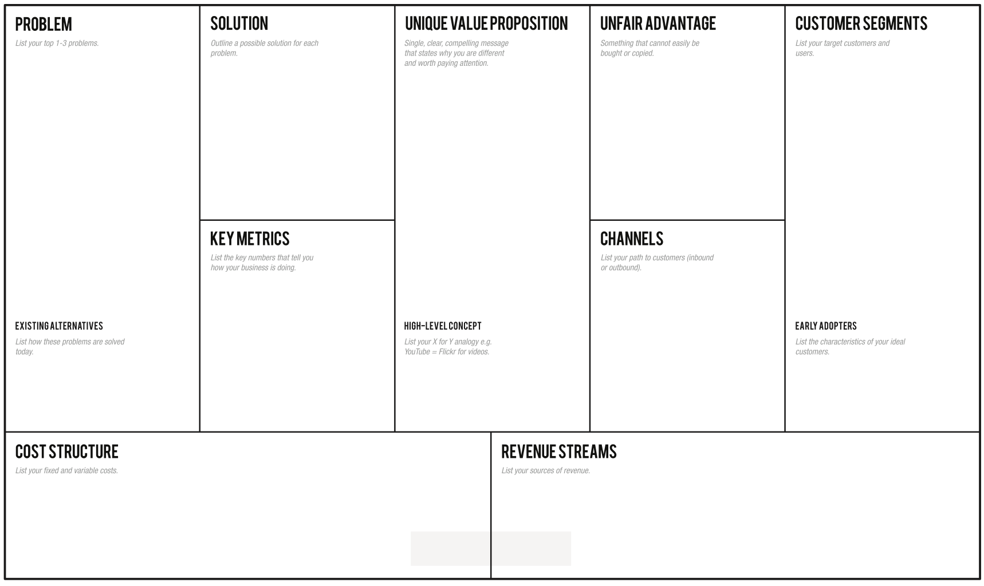
In the customer survey most people said they wouldn’t make an investment trusting a friend or a neighbor
People are recovering from covid induced financial crisis and might not have sufficient savings
Success should depend on not just familiarity of our representative but also on the quality of the services offered
First mover advantage in respect of a business model based on agents rather than employees
Greater peace of mind because the company is endorsed by some one familiar
Customized investment plans depending on the needs of the investor
Combined investment plans
Middleclass families currently not associated with any wealth management firm
Number of representatives working for us
Number of customers
Quantum of investment
Capital gains on investment
The contact point for customers will be the representatives/Agents working for us
Currently wealth management companies depends on massive advertising and letting customers come to them
The early adopters will be the agents we recruit who would make investments themselves
NIVESHGRAM = Safety + Liquidity + Return
Fixed cost: Payment for infrastructure(buildings, technology etc.)
Variable cost: Commission to agents, Traveling cost , Communication cost etc.
Commission on capital gains received by the customers
Annual maintenance fee

Slide 24
Customer Feedback –Identifying pain points
Customers in the age group 18-30 prioritise return over safety and liquidity, the equation changes as the age bracket increases.
More than 80% of the respondents have never been associated with a wealth management company before which leaves huge scope for financial consultancy.
A lot of customers expressed their concerns about loosing their money and safety of their investment.
Remaining customers were not happy about the returns their existing investments were generating and are looking for higher returns.
Liquidity emerged as least of the customer’s concerns.
About 25% of the customers agreed that they might invest in an instrument solely because a friend/neighbour suggested it without adequate research and almost all of them are postgraduates and above, which points to status of financial literacy.

Slide 25
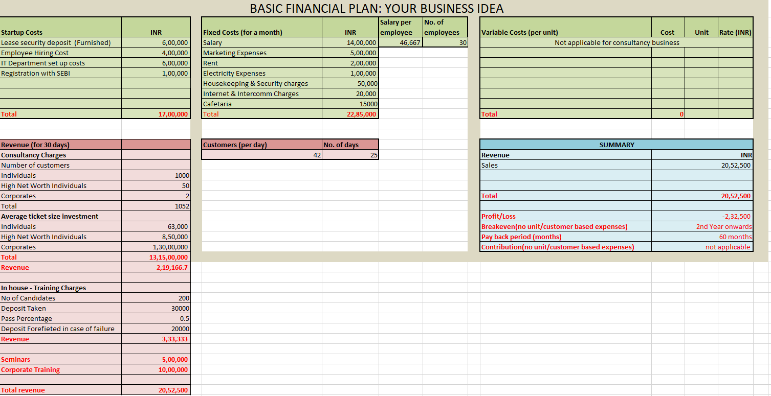
FINANCIAL PROJECTIONS

Slide 26
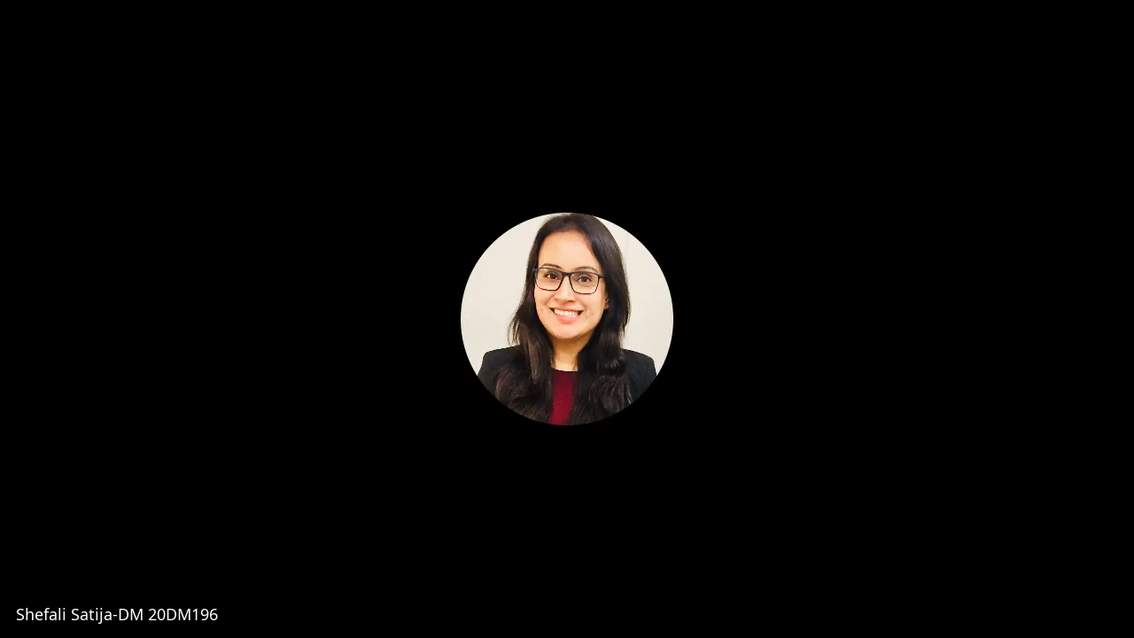


INTERVIEW WITH INDUSTRY EXPERTS

Slide 27
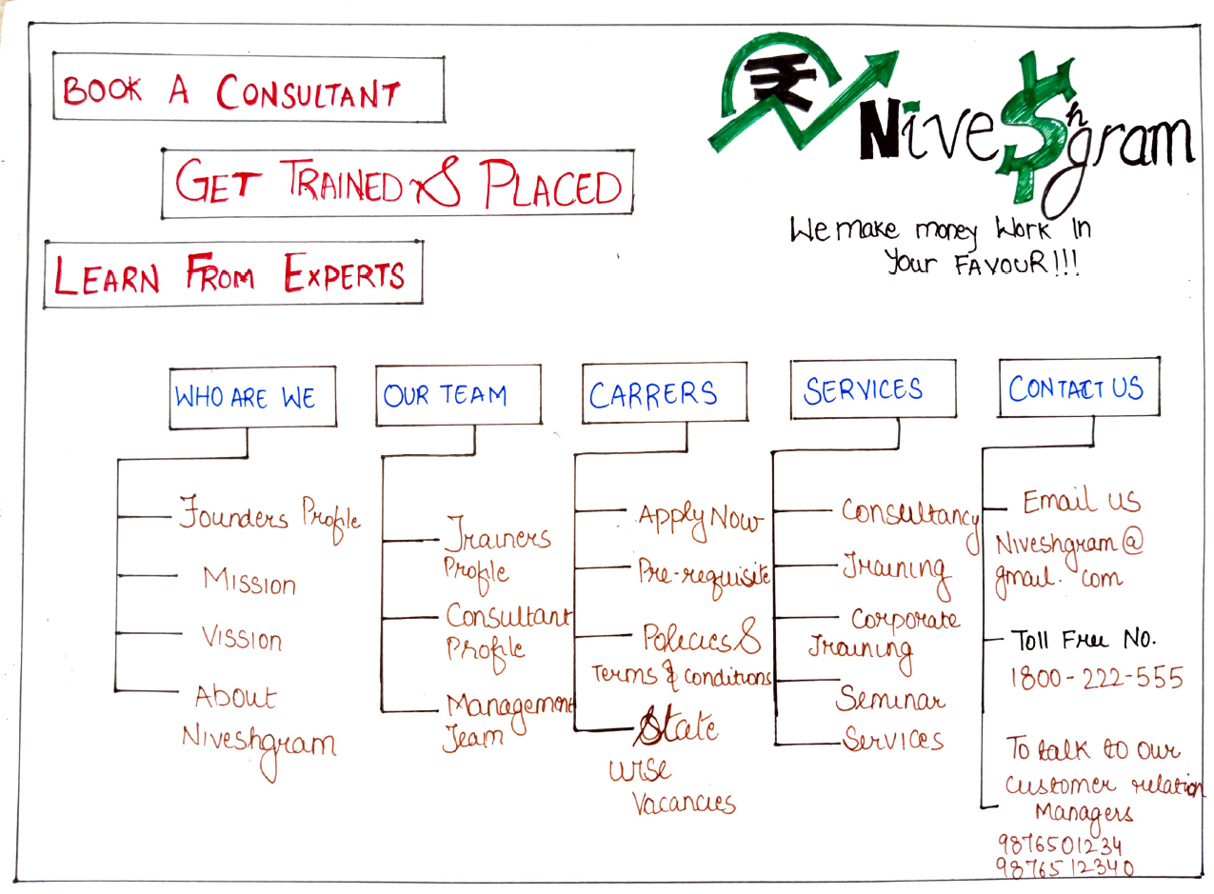
PROTOTYPE

Slide 28



Welcome to

Slide 29
OUR SERVICES
CONSULTANCY
TRAINING
CORPORATE TRAINING
SEMINARS
Other Services

Slide 30


Who we are
Our team
careers
Our services
Customer Support

Slide 31
WHO WE ARE
Founder’s profile
Mission
Vision
About Niveshgram

Slide 32
OUR TEAM
Trainers’ profile
Consultant’s profile
Management team
OFFERINGS
PACKAGES
ASSESSMENTS

Slide 33
CAREERS
Apply now
Pre-requisite
Policies, terms & conditions
State wise vacancies
OFFERINGS
PACKAGES
ASSESSMENTS

Slide 34
CUSTOMER SUPPORT
email us at niveshgram@gmail.com
toll free no. 1800-225-555
to talk to our customer relation managers call at
9876501234, 9876512340
OFFERINGS
PACKAGES
ASSESSMENTS

Slide 35
Thank You

