Slide 1


SUPER MAT
Charging the Future ..

Slide 2
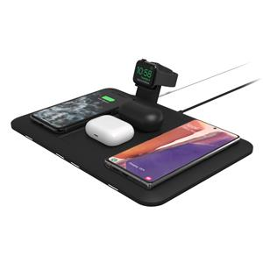
ELEVATOR PITCH
Carrying multiple chargers for multiple devices.
Multiple types of devices can be charged by the use of this Mat at a single frame of time without carrying the charging wires.
People have to carry this single wireless mat with them to prevent any wire damage or breakage.
Charging wires getting damaged due to carrying them.
.
Portable Mat with easy features of handling and usage.
Non-portability of charging points

Slide 3
Genesis of the Idea
01
Diffrent Electronic devices with Different types of charging pins.
02
Wire of charger is short and damages easily.
03
Increased usage due to lockdown and work from home
04

Slide 4
Problem Statement
How do you know ?
Why is it pressing?
From our experience and By talking to other people.
Who has it?
Extensive use of device irrespective of time
Pandemic situation
portability issue, damaged cables
What is the Problem?
Anyone who has Multiple devices
Devices including Mobile, Laptop,Tablet, need us to carry different chargers and cables.

Slide 5
Solution
Product Description
We will provide solution to the ones who have to carry multiple chargers are looking for a desk ,a wireless device to charge there phone, Laptop, Tablet with portability in our all in one device.
Intended Benefits
2 year warrenty, Home delivery, Convenient app or website, option of modification. Battery Replacement , Online Payment or COD

Slide 6
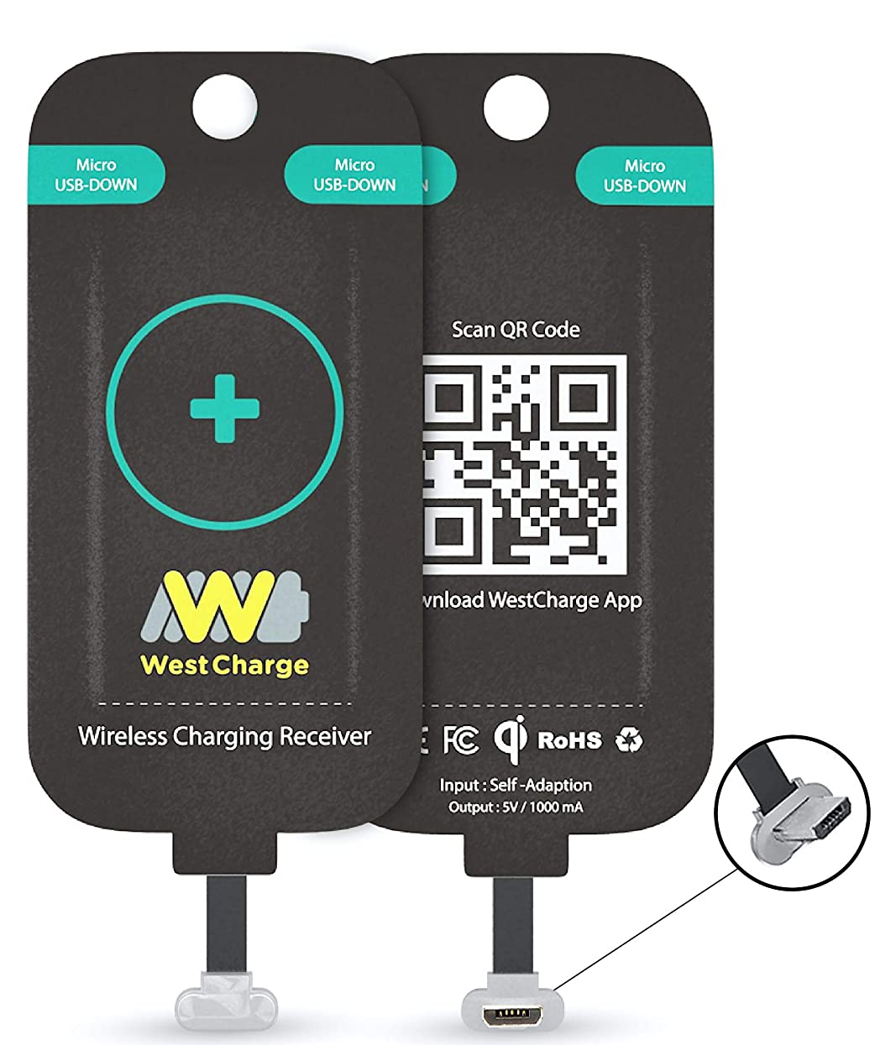
-Solution
What we wish to do is eliminate the need to carry multiple chargers, or chargers anywhere In 2021 when everything is wireless, why are we not charging our laptops wirelessly, when it is the most practical thing to charge as it is not moved whilst charging. A wireless charging table for your laptops and phone and other devices.
Previously the hardware didn’t allow more that 30 watts to be transferred wirelessly, but today tech to transfer 65watts wirelessly is available and laptops charge at 65 watts.
New laptops charge thru barrel pin chargers or type C charging capabilities, until laptops are built with wireless charge receiver coils. We get wireless charge receivers which connect thru the type C port and can be used to charge laptops.
Value proposition to your client – What is so unique/special about it?
Laptops don’t charge wirelessly, the hardware is out there but the compilation of tech isn’t being done on a bigger scale.
The product is unique since it’s a product which is greater than sum of its parts.

Slide 7
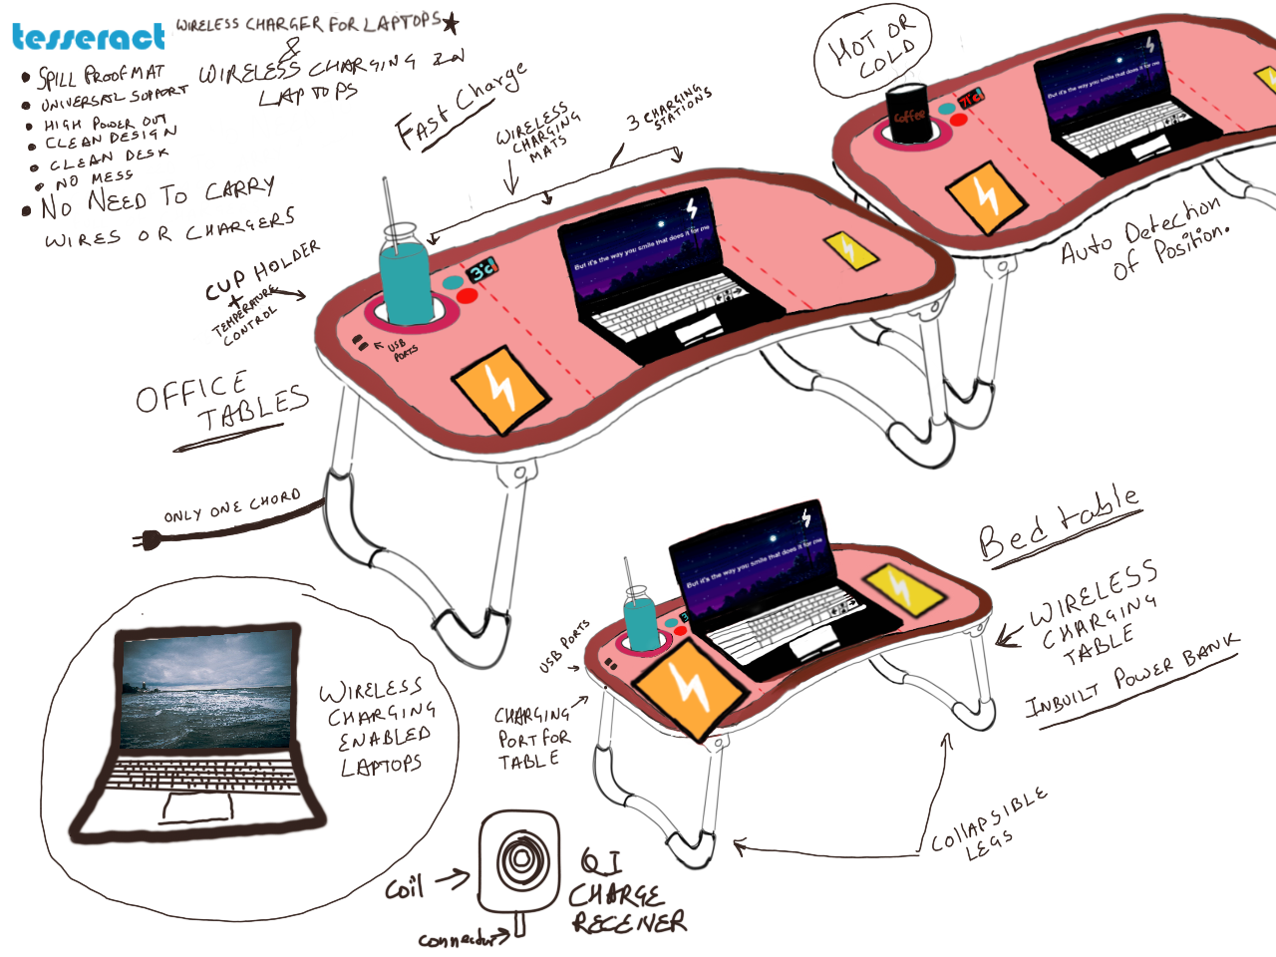
Solution Prototype / MVP
Prototype
6

Slide 8


Market and Product Positioning
Target Customer and Market Size
The Early Adopters
Corporate jobs
Students
Bringing new technology and tools into your organization can increase productivity, boost sales, and help you make better, faster decisions.
Having a multiple device charging station (table) will not only help you to charge your smartphones but also likewise devices like tablets, laptops, etc.
6

Slide 9
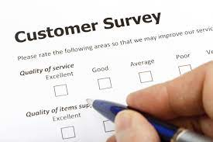
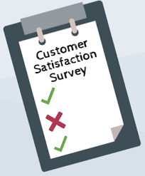
Market and Product Positioning
Market Strategy
Provide consistent customer experience.
Cutomers testimonials.
Referral program.
Connected via newsletter.
Customers feedback.
Demonstrate your products or services.
6

Slide 10
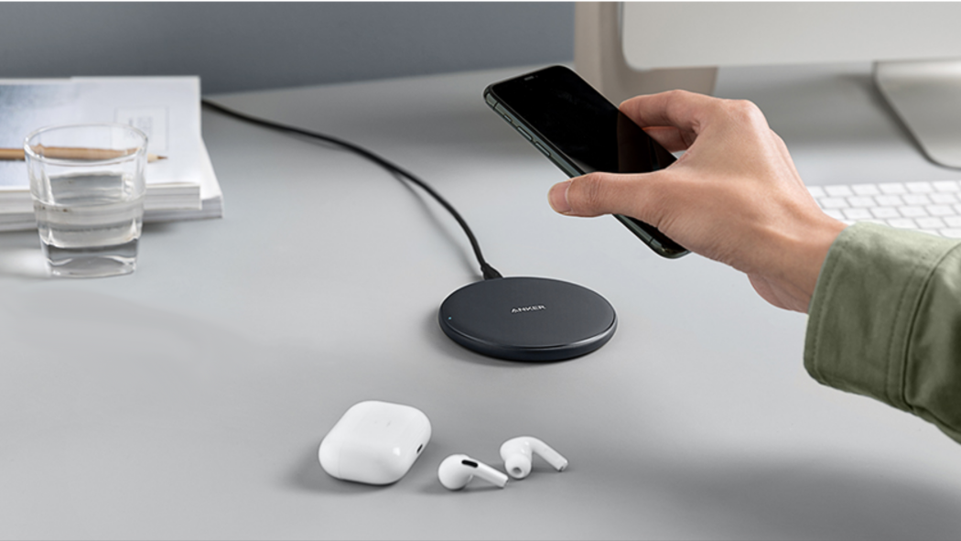
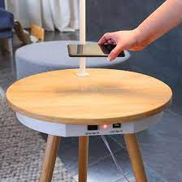
Industry and Ecosystem Positioning
What is the recent in the Industry?
C type pins and wireless charging
What are the key growth trends?
Wireless
Who are the major players?
Charging tables, charging pads, portable devices
6

Slide 11
PESTE Analysis of Business Environment
 | POLITICAL (Govt. Policy/ Regulatory) | ECONOMIC (Growth, Inflation, interest rates etc.) | SOCIAL ( Behavior changes, Buying patterns) | TECHNICAL (R&D, Automation, Digitization) | ENVIRONMENTAL (Ecological & Environmental changes)
FAVOURABLE | -The Government of India attaches high priority to electronics hardware manufacturing and it is one of the important pillars of both “Make in India” and “Digital India” programmes. | -Prices of technology goes down with time so eventually the prices will drop. | People will shift to a wireless tech when they realize how much it makes their lives easy. | -Fast charger technology is coming in. -With time the prices of technology will go down eventually. | -Use of eco-friendly substance, bamboo. -Less carbon footprint because of use of plastic wires will go down.
UNFAVOURABLE | -Importing tech for the compiled product might be cheaper but there are certain restrictions from importing goods from China (Biggest Electronics market). | -When a new product moves in, competition increases at a rapid rate and eventually the growth rates will go down unless constant innovation is done. | -People take time to change because they don’t realize they have a problem unless they are told so | -Initial R and D Price will drive the price of the product up. | -Disposal of older tech will increase the disposal amount. -Although bamboos are the fastest growing plant and easiest to process, overharvesting is a problem.
6

Slide 12

Competition Analysis
 | Brightech Madison w. Wireless Charging Station & USB Port | INIU Portable charger with LED display | POWERADD Energy Cell 10,000. | Charging table.
Strengths | Top-end capabilities | Highest-grade materials, | It is the lightest and smallest in the market. It is easy to carry and can be carried on airplanes. | . It is easy to carry and can be carried
Weakness | A huge decrease in performance | after 3 total drain/recharging cycles the meter simply is not accurate | it was not compatible with many devices, even though the description says it is. | Not portable
Price Point | 56.99$ | 27.99$ | 14.43$ | 40$
USP | COMPATIBLE, ATTACHED SWING ARM LIGHT WITH WIRELESS CHARGING STATION AND USB PORT | speed and capacity | lightest and smallest | COMPATIBLE Speed and capacity

Slide 13
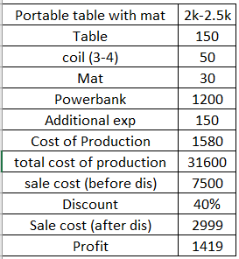
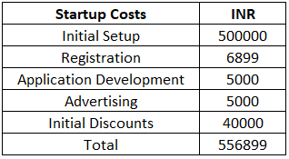
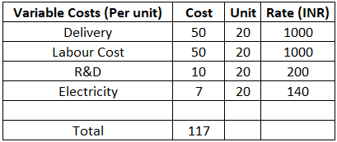
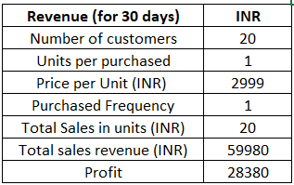
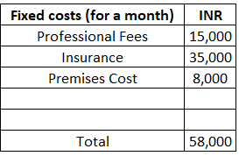
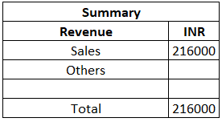
Finances
20
2340

Slide 14

Operational Plan
01
02
03
Key Resources
Key Activities
Milestone Achieved
Capital
Wireless charging technology
Engineers
Customers
ROI estimation
Build model
R&D
Testing
In development phase

Slide 15
IMPLEMENTATION PLAN
PRODUCT EVALUATION
IDEA GENERATION
Finalize product
Finalize market plan
Start marketing plan
Start new production
6
1
♗
♘
TEST MARKETING
5
SCREENING
2
ROI estimation
♖
Prototype introduced for research and feedback.
♙
IDEA EVALUATION
DEVELOPMENT
4
3
Build model
ROI estimate
Revise product
Concept testing
ROI verification
♔
♜

Slide 16
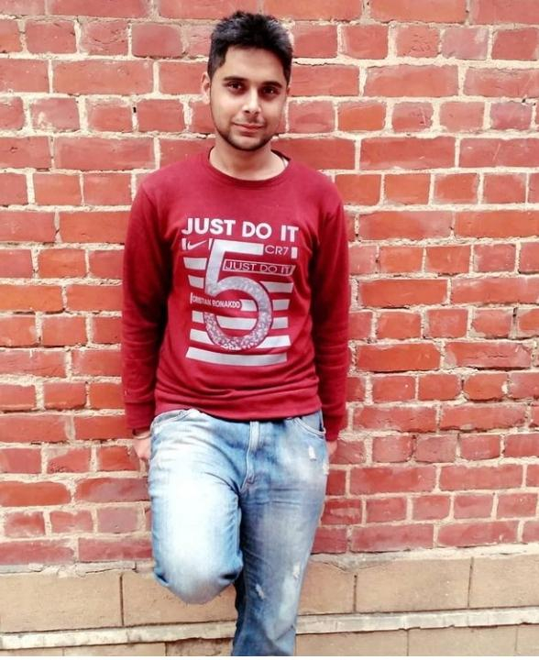
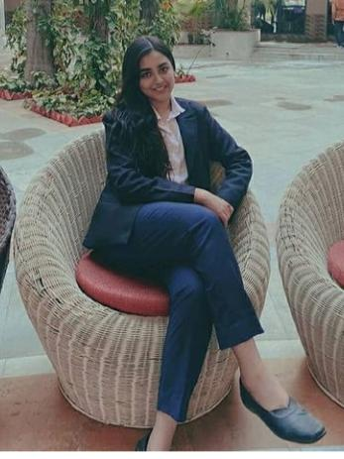







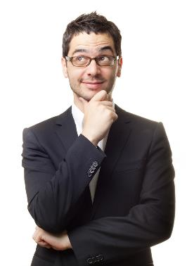
OUR TEAM
Vishal Khurana
Deepanshi
SHRIYANSH
Ashif Ali
Founder
Co-Founder
Sale Manager
Finance Head
Harsha
Vishal Shinde
Vibhor Kaul
AYUSHI
C.F.O
operation head
C.E.O
Trainee

Slide 17
Legal identity
Company Incorporation:
Registered as I like move it move it Private limited company under Companies Act, 2013.
Key Legal Compliances:-
Permanent account number (PAN) - ALWPG5809L
Tax Deduction and Collection Account Number – gytu52369z
Minimum Wages
Goods & services Tax
Acts related to Statutory Compliance
The Trade Unions Act, 1926
The Industrial Disputes Act, 1946
The Minimum Wages Act, 1948
The Factories Act, 1948
The Contract Labor (Regulation & Abolition) Act, 1970
The Child Labor (Prohibition & Regulation Act), 1986.

Slide 18
Risk Analysis
Financial
Operational
Strategic
  Credit Risk - we might have to supply the shipments to the suppliers on credit and take on credit risk wit the probability that the default on their payments.
  Liquidity Risk - we might need to take some debt to meet the working capital requirements especially during the production
  Production costs and base planning of the product. There are risks that there will be a mismatch between the initial design and the limitations of the productions team.
  The charging mat/table will face an innate risk of continuous innovation, i.e., the underlying technology is nothing patented to us particularly, so we will have to make continuous improvements and additions to stay relevant in the market.
12

Slide 19
Risk Mitigation
Agile approach to product development
Constant Innovation programs
Maintain good relations with suppliers and distributors
Patent the designs
Maintain reserves for financial uncertainties
12

Slide 20
Ask
We are asking for Rs…400000
In exchange if 25% stake of the company
USAGE:
Protype testing and production of first batch
Market testing and setting up distribution channel
Creating online ad via influencers
Exit Strategy :
Merge with an electronics manufacturer
Sell Stake to third party
Initiate IPO if things go as planned
Get acquired by a competitor
12

