Slide 1
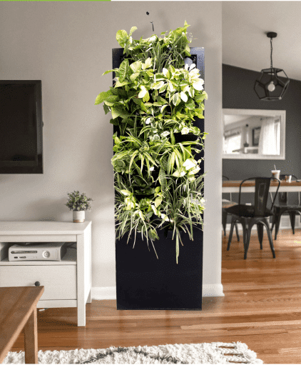
Business Plan for
OXYGARDEN
GROUP 1
Pranav Kumar Saini (20DM155)
Pranav Verma (20DM156)
Prateek Wadhwa (20DM293)
Mohit Jain (20DM294)
Shrey Sharma (20DM295)
Ankit Goswami (20DM257)
Under Guidance of
Prof. Dr. Shalini Singh

Slide 2



Vision
In The years to come, Oxygarden will enhance the quality pf indoor air, raised the health and happiness index and increase the life span of people who homed “Forest” into their living spaces. Our vision is that people across the country share the power of Oxygarden.
To Purify and humidify air naturally

Slide 3

Problem Statement
Problem – Air Pollution
What are you solving and why?
The indoor polluted air is one of the biggest environmental health risks of our generation, so providing fresh oxygen in their living spaces is our first step towards our bigger dream Happy, Healthy and long life for humanity.

Slide 4



Solution
Solutions
Providing a plant-based purifier,
Carbon Filter, HEPA Filter
Microbes in roots of Plant
Aerated growing media with activated Charcoal
Value Proposition
Pumps Fresh Oxygen to breathe in
Purifies indoor air by removing pollutants
Naturally Humidifies the environment
Minimum Viable Product
Mobile App
Live Demo
Reduction in Manufacturing Costs

Slide 5
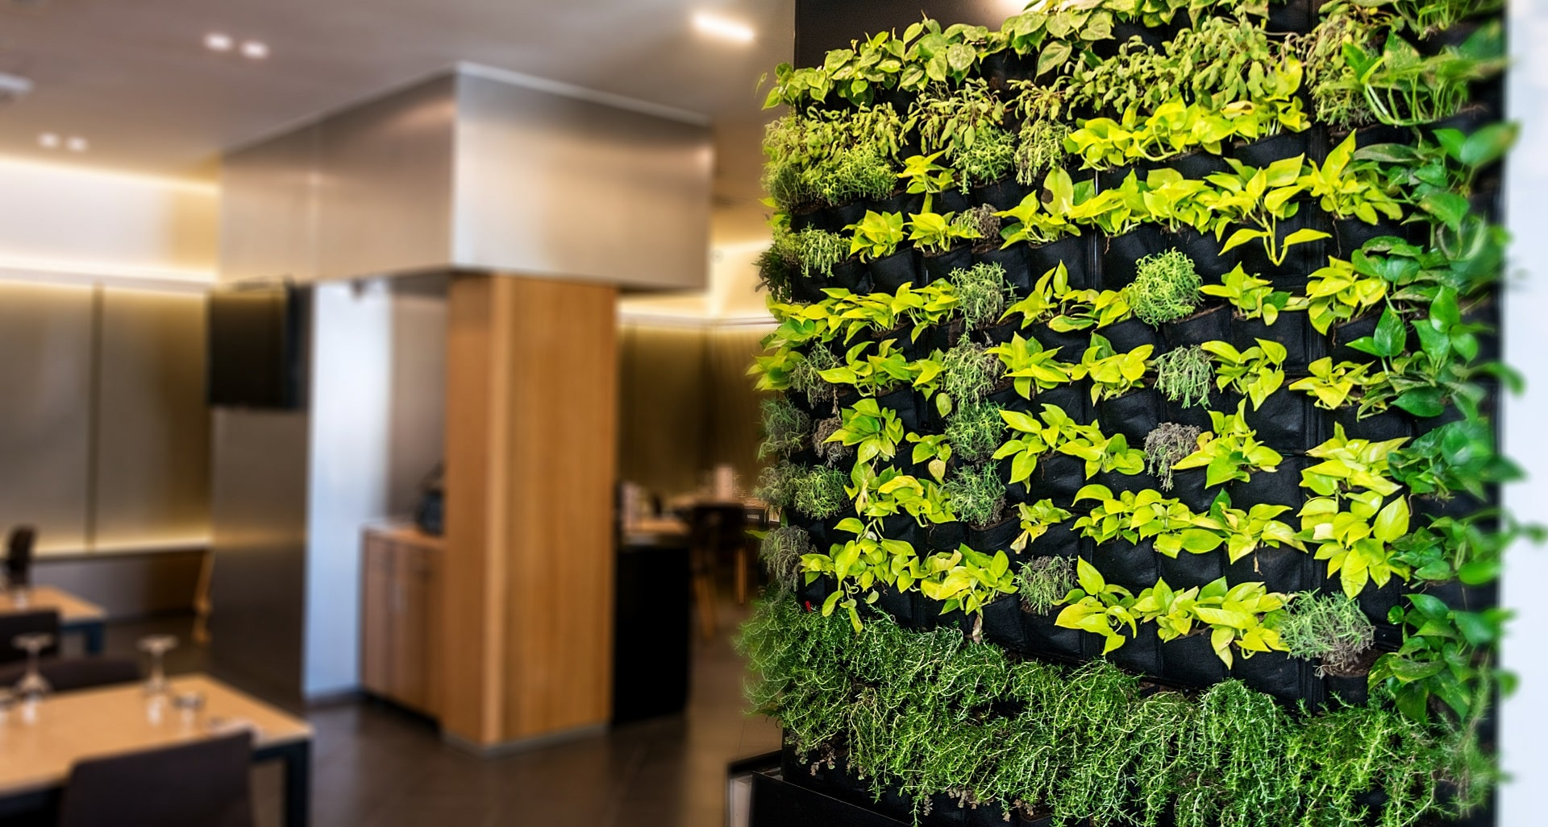
Pictorial Demonstration

Slide 6
Industry Analysis
The global air purifier market is expected to expand at a compound annual growth rate (CAGR) of 12.6% from 2020 to 2027
Rising air pollution levels, increasing disposable income, and growing health awareness regarding the harmful effects of air pollution on human health are expected to boost market growth over the forecast period.
The High-efficiency Particulate Air (HEPA) technology segment led the market and accounted for 40.0% share of the global revenue in 2019
Air purifiers are used in educational institutes, research and development laboratories, and pre-school and secondary educational facilities
Key factors driving market growth - improved standard of living, increasing disposable income, and growing health consciousness.

Slide 7
Industry Analysis | POLITICAL | ECONOMIC | SOCIAL | TECHNICAL | ENVIRONMENTAL
Opportunity | The government is announcing lockdowns since April 2020 due to Covid-19. This leads people to stay in a home which will give rise to plant-based purifiers | Emerging markets such as China, India, Brazil, and Russia are expected to offer significant opportunities to the manufacturers and distributors of residential air purifiers in the coming years | With the increasing air pollution levels in Delhi NCR region, a lot of people would develop a need of a air purifier. | Based on technology, the residential air purifiers market is segmented into HEPA filters (high-efficiency particulate assistance or high-efficiency particulate air) and other technologies. The other technologies segment comprises electrostatic precipitators, activated carbon, UV filters, and ionic filters. | The growing awareness among consumers regarding air purification and the increasing importance of natural and purified air( plants and trees) in the wake of increasing air pollution in Delhi NCR provides an opportunity for air purifier retailers to scale up their sales. Some companies are.
Threats | Government regulations in the time of COVID-19 scenario. | Oxygarden is quite an expensive purifier which costs around 80k and target the upper-middle class. | An air purifier is a perception product, a lot of people in a market may not want to buy it. | Technologies which provide maintaining of room temp., Bluetooth facility, Wi-Fi facility, Google voice, screening of air pollutants on app, etc can be the threats for our product. These are the extra facilities which are provided by the competitors at very low cost. | Indoor air pollution is one of the most serious environmental threats to human health. These indoor pollutants can release gases like carbon monoxide and nitrogen dioxide, which are difficult to break down with conventional air filters.

Slide 8



Customer Market & Analysis
Demographic –
1. Office & Workplace 2. Home 3. Yoga Clubs 4. Meditation Halls
Geographic –
1. North 2. South 3. East 4. West 5. Central 6. Union Territories
Psychographic/Behavioral -
1. Children's Health 2. Adult Mental Health
Market Type –
New Market
Jobs to be done – Functional

Slide 9

 | Dyson | MI | Philips | OxyGarden
Product / Offering | Pure Hot & Cool-Air Purifier | Air Purifier 3 | Philips AC5659/20 | OxyBreathe Pro Oxygen
Features | Purifies and warm a room accordingly Patented Air Multiplier TM technology Automatically Senses & reports air quality on LCD screen & Dyson Link App | True HEPA Filter with filtration OLED touch Display Smart app control Effective coverage–484sq | Aera Sense gives Real time monitoring with triple sensor Purifies a standard room within 6 minutes with a Clean Air 3-Smart-purification modes. | Uses a unique 5 step purification process. Fully automated soil watering and growing light system Fully automated soil watering and growing light system
Price Point | Rs59,900 | Rs12,999 | Rs 49,995 | Rs 80,000
Advantage | Suitable for any rooms Energy efficient Various Modes Inbuilt | Power: 38 watts Effective coverage–484sq Works with Google assistant and Amazon Alexa | Unique dual air flow design ensures maximum performance with minimum noise Vitashield IPS removes 99.97% airborne pollutants | Zero Noise functioning Takes just 30 energy units to operate Self-Sustainable Natural humidifier Filter auto-refills
UVP | Only air purifier with heating functionality. It senses and displays 4 different pollutants | Maximum features at very low prize CADR - 380 m/hr | Control remotely via Wi-Fi/4G Unique dual air flow design | Activated charcoal present in growth media 50 NASA certified smart plants of high purification capacity
Competitors
Competition Analysis

Slide 10
Team Strength and Commitment
Fulfilling their bigger dream Happy, Healthy and long life for humanity
Company Structure
Franchise Model
Compliances
Service Centre
Retail Outlets
Exclusive Furniture Store
Trade Fairs
Environmental Shows
Organizational Plan

Slide 11
Key Resources -
50 NASA certified smart plants of high purification capacity
HEPA Filter
Carbo Filter
Soil – Compatible with the Plants
Key Activities –
Manufacturing of Air Purifier
Installation of Air Purifier
Key Partners –
Selling Channels
Service Centre,
Retail Outlets
Exclusive Furniture Store
Trade Fairs
Environmental Shows
Operational Plan

Slide 12
Market Plan – B2B, B2C
Market Size
Total Available Market – $ 7.8 Billion
Serviceable Available Market - $ 1.38 Billion
Serviceable Obtainable Market - $ 30.29 Million
Outline Go to Market Strategy – Franchise Model
Sales & Marketing Plan

Slide 13




Revenue Model
Pricing – Rs 80,000 per set up
Financial Plan
Break Even – Approximately 4 years
Payback Period - ^ years

Slide 14
Risk Evaluation & Coping Strategies
Technical Risks
Market Risk
Operational Risk
Others

Slide 15
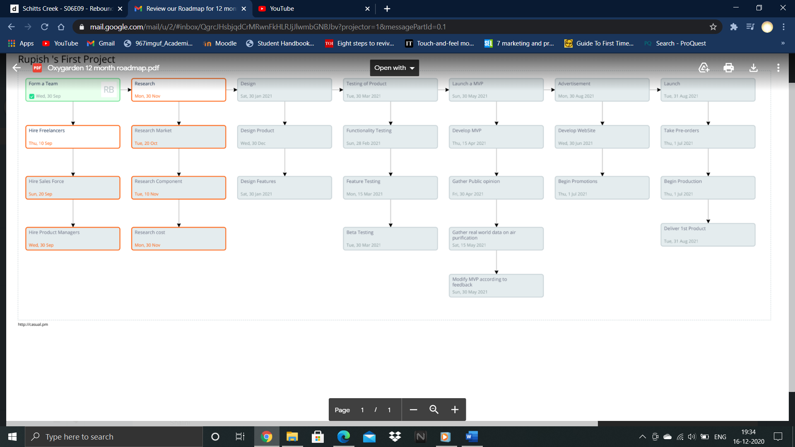
Roadmap for next 12 months

Slide 16
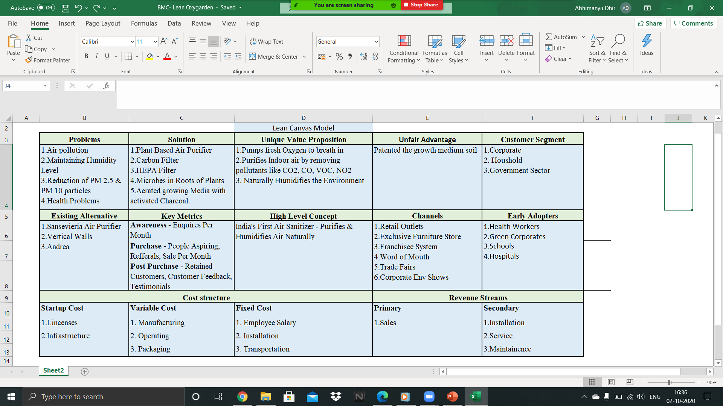
Lean Canvas

Slide 17
THANK YOU!

