Slide 1

BOOK-O-EASE
Place your screenshot here
GROUP 10C

Slide 2
COMPANY PURPOSE
Through this venture we intend to make reading books so hassle free cost-effective and a pleasurable experience.

Slide 3
PROBLEM STATEMENT
How can we enrich the procuring and reading experience of books?

Slide 4
PAIN POINTS
Expensive books.
Non availability of books.
Lack of connection between fellow readers.

Slide 5
Solution
A platform for book renting.
Books, e-books and Audiobooks playlist.
Connect with fellow readers.

Slide 6
Why now?
2600
BC
First Library in Sumerian civilization.
1600
AD
Kashi-hon book renting company in Japan.
2000
AD
Online renting through various mediums.

Slide 7
MARKET SIZE
TAM
People residing in Delhi/NCR.
SAM
People above 18 years
ITM
People between 18-35 years

Slide 8
Competition
Competitors
Doorstep book
library at home
iLoveRead
Librarywala
Pustaka
Competitive Advantage
e-books, discount on bulk purchase, connect with fellow readers
e-books, customized playlist with respect to the book mood, connect with fellow readers
track the books wanting to be read, available to all.
reaching to every want that arises, customized playlist with respect to the book mood.
Reaches out to every kind of book reader with paperbacks and e-books both.

Slide 9
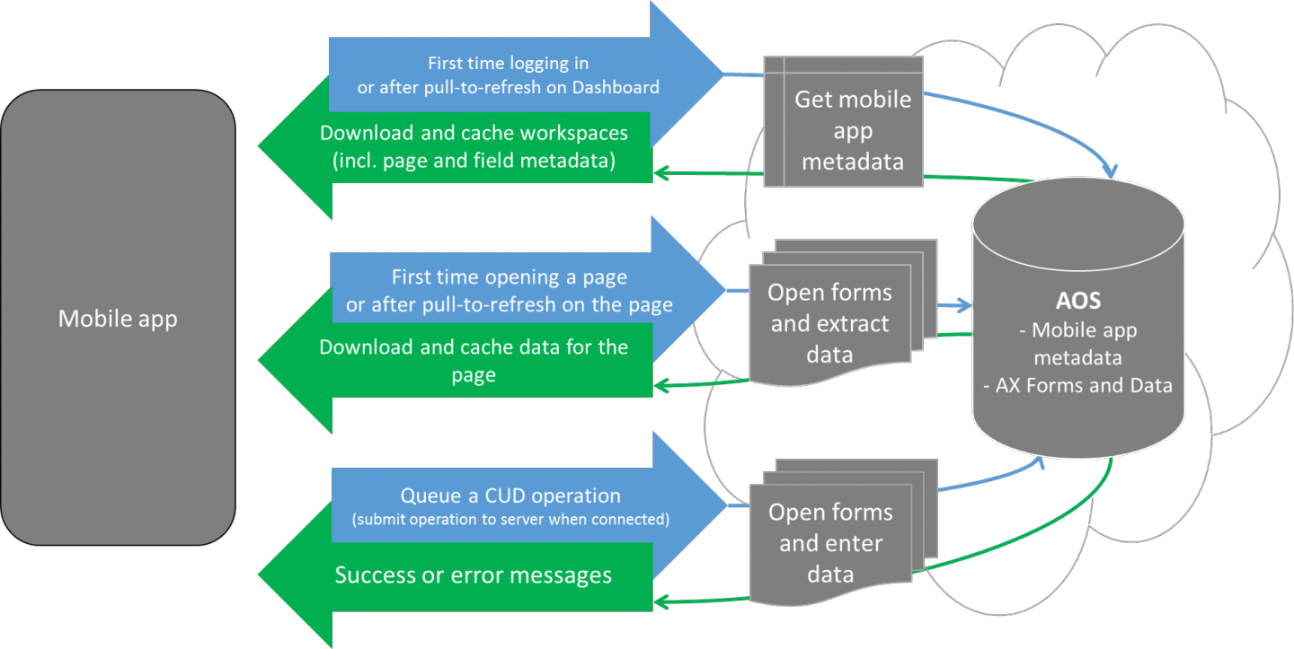
PRODUCT
ARCHITECTURE
Form factor – No physical device required.
Functionality – User friendly interface.

Slide 10
BUSINESS MODEL
Revenue (for 30 days)
Number of customers | 300
Units per purchased | 1
Expected new customers pe month | 100
Price per supscription | 550
Purchase frequency | 1
Total sales in units (INR) | 300
Total sales revenue (INR) | 165000

Slide 11
TEAM
Founders – Lincoln and Kumari Shreya
Board of directors –
Ishita Jha
Harshit Gupta
Kashish Garg
Karthikyean

Slide 12
Financials
 | BASIC FINANCIAL PLAN
 | Startup Costs | INR |  | Fixed Costs (for a month) | INR | Salary per employee | No. of employees |  | Variable Costs (per month) | Cost | Unit | Rate (INR)
 | Website Setup | 20000 |  | Advertisment | 5000 | 10000 | 3 |  | Fuel | 6000 | 30 | 200
 | Website license | 5000 |  | Maintaince | 5000 | 20000 | 1 |  | logistics | 3000
 | Launch cost | 5000 |  | Office rent | 25000 |  |  |  | Banking transaction fees | 3795
 | Second hand delivery vehicle | 75000 |  | misc expenses | 3000 |  |  |  | Other Expenses | 3000
 |  |  |  | Inventory holding cost | 7000
 | Total | 105000 |  | Total | 45000 |  |  |  | Total | 15795
 |  |  |  |  |  |  |  |  | Variable cost per unit | 526.5
 | Revenue (for 30 days) |  |  | Customers (per day) | No. of days |  |  |  | SUMMARY
 | Number of customers | 300 |  | not applicable |  |  |  |  | Revenue | INR
 | Units per purchased | 1 |  |  |  |  |  |  | Sales | 165000
 | Price per supscription | 550 |  |  |  |  |  |  | Others | 0
 | Purchase frequency | 1
 | Total sales in units (INR) | 300 |  |  |  |  |  |  | Total | 165000
 | Total sales revenue (INR) | 165000
 |  |  |  |  |  |  |  |  | Profit | 104205
 |  |  |  |  |  |  |  |  | Breakeven | 1914.893617
 |  |  |  |  |  |  |  |  | Pay back period (months) | 1.01
 |  |  |  |  |  |  |  |  | Contribution | 149205

Slide 13
Milestones & Key metrices
Milestone
Key Metrices
2500 customers
100 new customers per month

Slide 14
Risk evaluation
Technical risk
Cloud storage
App crashing
Operational Risk
Tax regulations
Change in state or central government rules.
Other risk
New technological advancements.
Geopolitical factors.
Market risk
Network issue
Price competition
Low consumer confidence
Monopoly by rival

Slide 15
Legal Environment
Compliances – Data should not be shared with any third party.
License – Developer account with play stores meeting all their requirements.
IP protection – Name and logo should be registered as a trademark.

Slide 16
VISION
Through this venture we intend to make reading books a hassle free, cost effective and pleasurable experience.

Slide 17
THANK YOU

