Slide 1

Business Plan Template
By Group 7 :-
Shreyansh Singh
Chaitanya Chaudhry
Zaisha Chadha
Sneha Shaw
Divya Singhal
Shivani Sharma
1

Slide 2
Bhoomi – Democratizing technology
1

Slide 3


  Bhoomi’s Purpose
To democratize the use of existing technological solutions and create untapped value for its customers.

Slide 4
Problem
Despite possessing a smartphone target customers are unable to realize its potential due to difficulty in use, language barriers and absence of reliable assistance.
As of now to address this issue customers rely on their friends and family for help.

Slide 5
Solution
We provide a vernacular virtual assistant in smartphone devices that can operate full range of functionalities of the device at the verbal command of users.
The product sits in the smartphone devices
Operating 3rd party apps through speech.

Slide 6
Why Now
Starting in 1970, speech recognition technology was the stepping stone for automated virtual assistants. Today AI assistants are driving human-Machine interaction to next level.
Advances in machine and deep learning technologies and a surge in the availability of data.

Slide 7
Market Size
Identify/profile the customer you cater to
TAM (Total Available Market) – 401.7 Million
SAM (Serviceable Available Market) – 200 Million
ITM ( Initial Target Market) – 20 Million

Slide 8
Competition
Competitors-
Google
Apple
Samsung
Microsoft
List competitive advantages
Vernacular Language enabled.
Permissions to 3rd party applications.

Slide 9
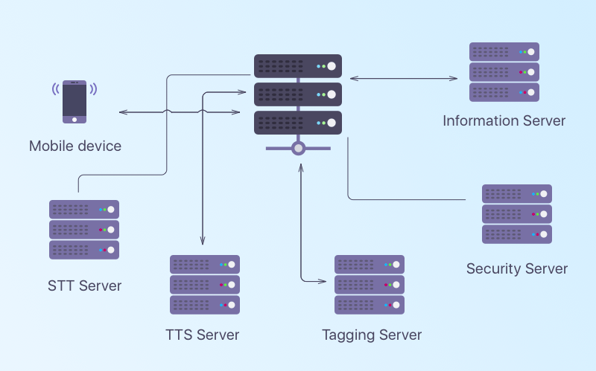
Product - BHOOMI
Product line-up
Software
Operate entire smartphone functionalities
Vernacular enabled
Development roadmap

Slide 10
Business Model
Revenue model – License
Pricing – Per handset basis
Sales & distribution Channels – Manufacturing Partners
10

Slide 11
Team
Founder – Shreyansh Singh
Board of Directors/Board of Advisors
Chaitanya Chaudhry
Zaisha Chadha
Sneha Shaw
Divya Singhal
Shivani Sharma
11

Slide 12
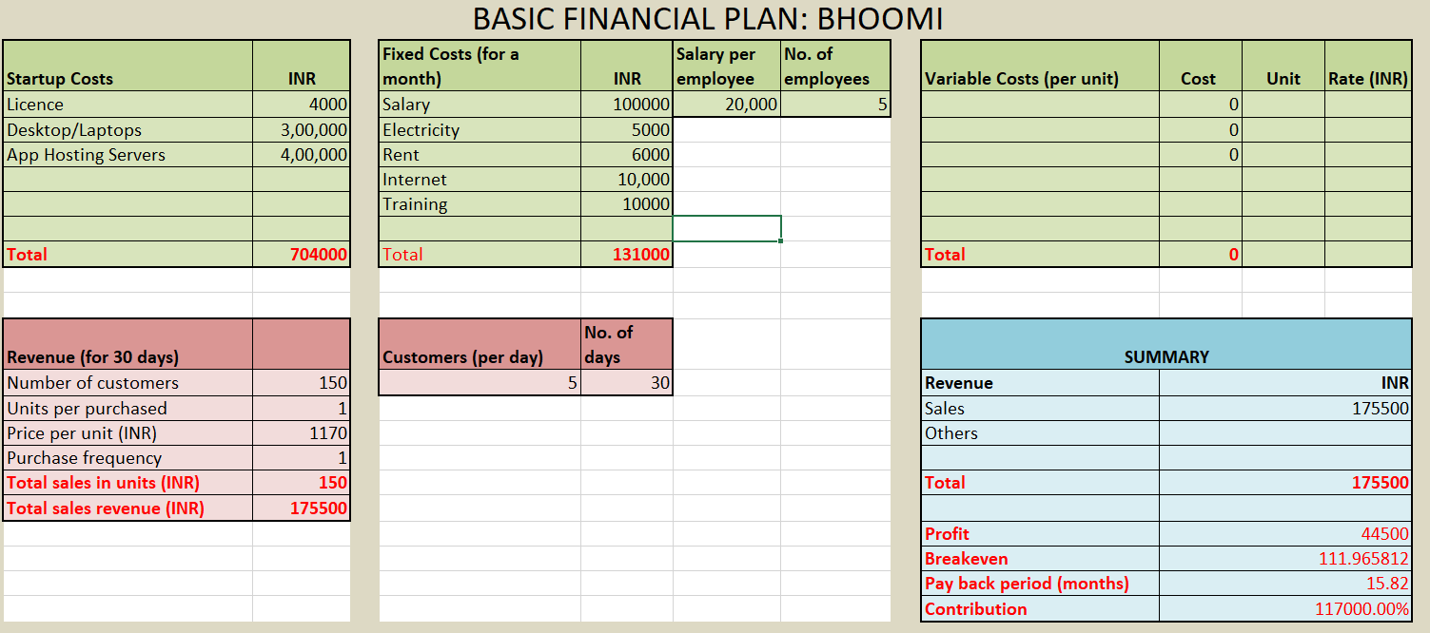
Financials
12

Slide 13

Risk Evaluation and Coping Strategies
Technical Risks - Changes in technology. Constant upskilling
Market Risk – Competition bringing in vernacular feature. 3rd party application handling feature.
12

Slide 14
Legal Environment
Details on Company Structure -
Bhoomi will be Limited liability private company.
12

Slide 15
Vision
If all goes well, what will you have built in five years?
An environment where no one will have to touch their phones to operate it.
12

