Slide 1
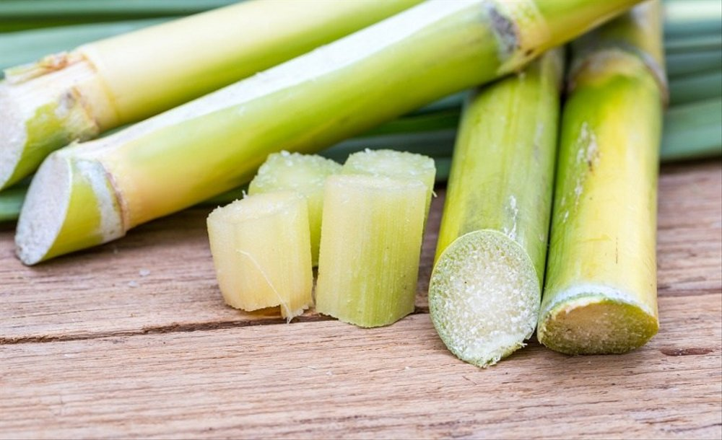
SugarCan
FRESH & ORGANIC
FOUNDED BY-
Himanshu Agarwal(19DM080)
Khushboo Goyal (19DM094)
Morvin Lall (19DM115)
Mukul Sanduja (19DM116)
Nainika behl (19DM117)
Namit Jain (19DM118)

Slide 2
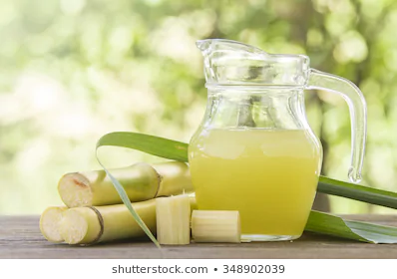
Company Purpose
To provide fresh and organic sugarcane juice in a hygienic manner and to capture health drinks market.

Slide 3
Problem
Sugarcane juice is provided mainly by roadside vendors which is non-standardized.
General opinion of people that juice is unhygienic and unbranded.
Sugarcane farmers are not getting fair price for their harvest.
Customers looks for vendors providing clean and hygienic juice.

Slide 4

Solution
Providing customers with healthy, hygienic and organic Sugarcane juice.
Selling our product through retail stores and e-commerce websites.
Making are product available in different variants and also in different sizes.

Slide 5
Why now?
India is currently going through a trend where more and more people are becoming health conscious and there is increased demand for the healthy foods and beverages. Moreover people are switching to alternative that are organic. And our brand is just doing the same by providing organic and fresh sugarcane juice.
Sugarcane juice can easily be India’s answer to sugary soft drinks which are widely believed to refresh the body after jogging, aerobics and exercise. The fact is that drinking one can of soda per day can increase the risk of developing type-2 diabetes by 22 per cent.
The market size of organic food across India in 2020 was forecasted to be around 1.36 billion U.S. dollars, up from about 0.36 billion U.S. dollars in 2014.

Slide 6
Market size
Our target market size is quite large as it targets people of all age group from middle to higher income level group.
As of march 2019, the Indian packaged juices market is valued at INR 1100 crore (~USD 200 million) and is projected to grow at a CAGR of ~15% over the next three years. There is huge potential of growth in this segment.

Slide 7
Competitors
We don’t have any major competitors as sugar cane juices are currently provided by roadside vendor and caters to lower to lower-middle income groups. Some of our competitors are-
Broad competitor
Raw Pressery, Nutricane - OMG(OH! MY GANNA), canerass
Narrow competitor
Real juices, Tropicana juices, B natural.

Slide 8
Risk evaluation
Technical Risks – Technical glitch halts of our website
Market Risk- Risk of copying within the established market of packaged juices.
Operational Risk –
Failure in the working of machines used for processing which will create mismatch between demand and supply.
Regular cleanness check of machines and to ensure proper hygienic conditions on part of workers.

Slide 9
Business model
Revenue Model- Our Revenue Model is Retail Sales through restaurant services and online portal .
Pricing-Rs50 per bottle on the portal
Sales is done through various portals like flipkart ,amazon ,bigbasket, Grofers etc.
We would sell our product through the aggregator and directly through our restaurant .
So we are in both direct and indirect contact.

Slide 10
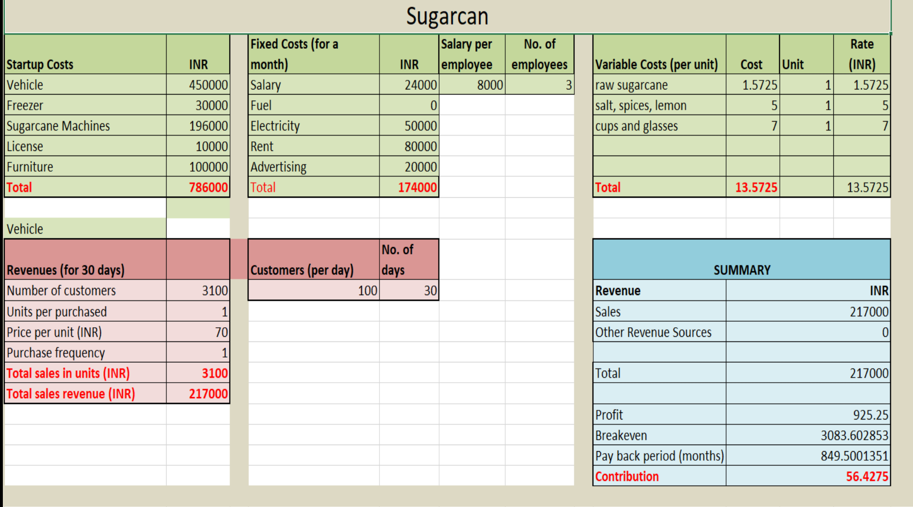
Financials

Slide 11
Milestones and Metrics
METRICS
Within 5 years of our operations starting from the year 2020 ,we aim to open three Sugarcan joint spaces in Delhi, Noida and Gurugram.
Online Sale –We expect a turnover of thirty five thousand bottles in a year, which means an average sale of hundred bottles in a day .

Slide 12
Legal Environment
Licenses Required
FSSAI License
Health/Trade License
Eating House License
Shop and Establishment Act
GST Registration

Slide 13
Vision
To be the preferred choice of customers when it comes to drinks, which is healthy as well as tasty.

Slide 14
*THANK YOU*

