Slide 1
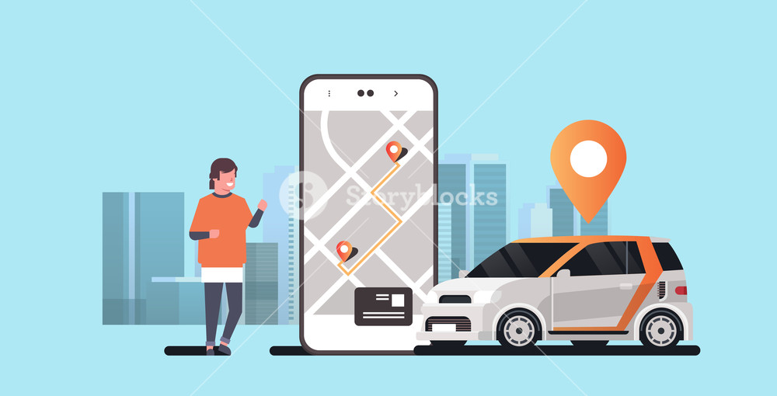
Auto-Pilot
Ghaadi Apki, Fikhar humari!
GROUP-8
Tanveer Ahmad (19DM225)
Surya Pratap Singh (19DM224)
Shubham Sureka (19DM242)
Ashish Dhand (19DM245)
Shubham Raj Devolia (19DM211)
Sai Charan Reddy (19DM232)

Slide 2


Purpose:
“Auto pilot aims at providing high quality, full range, personalized packages for servicing automobiles by offering high convenience and rapid service at the most economical price”.

Slide 3

Problem statement:
“Missed opportunities in providing coordinated and efficient service in the fragmented Automobile repair services market in India”.

Slide 4

What problem are we solving and why?
Problem-Servicing the automobiles
Over exploitation of customers
Poor transparency in the system
Chaotic, cumbersome, Inefficient and time taking process
Poor accessibility and awareness
Why Automobile service Industry?
Huge demand for automobile spare parts
Estimated 30 million cars in India, 7.5% of the overall GDP
Enormous number of stake holders
Hassle-free, fast, affordable and quality services.

Slide 5
Solution:
An online platform that will enable our customers the following:
Better awareness: Listings of local vendors
Superfluous process: Proper timelines from pickup to delivery
Personalized packages: Getting rid of customer exploitation
More transparency: CCTV footage of the automobile being serviced

Slide 6
Value proposition canvas:
Gain creators:
Skilled professionals
Door-step service
Car for car
Exclusive membership
Gains:
Quality service
Repair on site
Car replacement
Status symbol
Ease of service
Product & Services:
Exclusive club
Pick and drop
Car for car
Repair and maintenance
Customer Jobs:
Getting service done
On demand service
User interface
Pains:
Lack of time
Trust issues
Commute problem
Price exploitation
Lack of awareness
Pain resolver:
Online service
Quality assurance/Warranty
Pick up and drop service
Transparent pricing
Maximizing footprint of the brand.

Slide 7
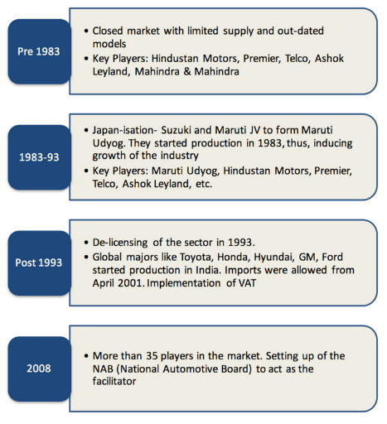
Evolution of the automobile industry:

Slide 8

Market Size:
India became the fourth largest auto market in 2018 with sales increasing 8.3 per cent year-on-year to 3.99 million units.
Total serviceable market: Approximately 30 million cars in India, Automobile service to grow from 20,000 Cr. to 33,000 Cr. By 2020
Serviceable available market: 18.66 Million cars (Delhi, Bengaluru, Chennai and Hyderabad)
Initial target market:
1.69 Million cars (Jaipur)

Slide 9

Competitor Analysis:
Company | Founders | Founded | Area | Core Business | Target Market | Revenue Stream | Platform | Spread/No of customers | Strength | Limitation | My Differentiating factor
Car Zippi | Suman Howlander | 2015 | Bangalore | Doorstep car care services | Urban Cities | Commission model | App/Web | Bangalore | Not disclosed | Expensive No real time problem solving Already existing solution. Highly competitive market | Real time problem solving Inexpensive High transparency Aggregator business model
MeriCAR.com | Rakesh Sidana | 2008 | Delhi NCR | Market place and Aggregator model | Urban Cities | Subscription models | App/Web | Delhi/NCR, Gurgaon and Noida | Not disclosed | No doorstep car care services offered Slow growth and expansion since inception Does not tie up with the local players and offer solutions but, just helps users identify nearby workshops | Doorstep care services offered. Planning to expand business on a large scale in short span of time. Tie ups with local players, customers are routed through our platform
Bookmycarservice.com | Raj Hasan Nagaraja | 2014 | Bangalore | Listing local players on its platform | Urban Cities | Fee per service | App/Web | Bangalore | Not disclosed | Almost like what we offer | Car for car service not available
AutoYaar | Bharat Ostwal, Sunil Gupta, Amisha Shah and Abhishek Gupta | 2015 | Ahmedabad | Aggregator platform | Urban Cities | Fee per service | App/Web | Ahmedabad | Not disclosed | Almost like what we offer | Car for car service not available

Slide 10

Product:
Vehicle broke down? No Problem. Find service centers nearby and book a service of your choice.
Online service
Repair on site
Car for Car
Let the customer’s book/schedule their service via the App in a superfluous manner.
Given your car for service? Rent a car for a day with the most economical price.

Slide 11

Segmentation Target Positioning:
Geographic: Urban cities
India
Demographic: Middle to high income group
Age Group: 25-40
Cities: Delhi, Mumbai, Chennai, Kolkata and cities with high income growth rate.
Young executives
Businessmen
Urban families
Lower middle income and middle income: Online Service and service on site
High income group: Car for car
Predominantly focused on mass market

Slide 12

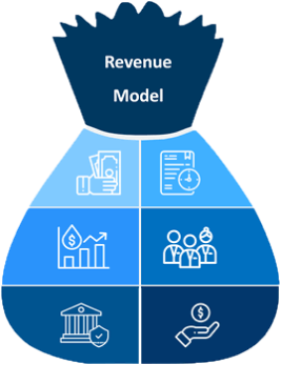
Pricing:
10% of the amount charged by mechanic
Recurring revenue Frequency:
600(client)*10%*30%(conversion)*5000
Estimated Yearly Revenue:
600(clients)*10%*5000(per client min bill)
Expected conversion rate:
30% of total customer
ARPU:
5000*10%
Lifetime value of customer:
25000(avg. purchase value)*2(avg. purchase frequency rate)

Slide 13
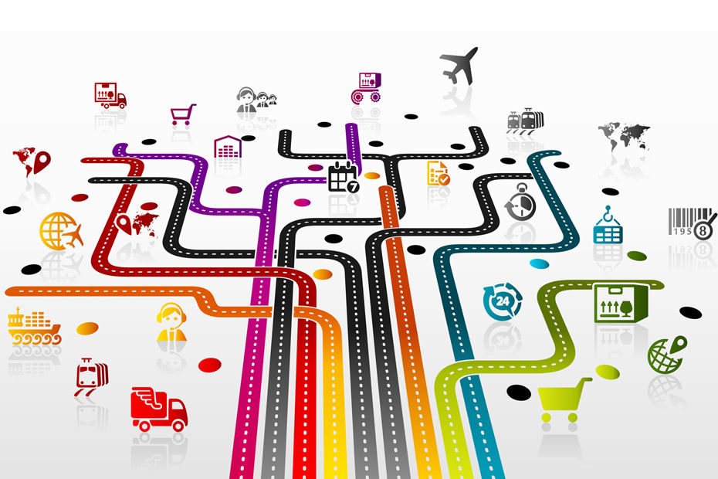





DISTRIBUTION
ONLINE APPLICATION
CUSTOMER
REPAIR SHOP

Slide 14





The Team
Tanveer Ahmad
Surya Pratap Singh
Sumit Pachisia
Sai Charan Reddy
Shubham Raj Devolia
Shubham Sureka
Ashish Dhand
Dr. Shalini Singh

Slide 15
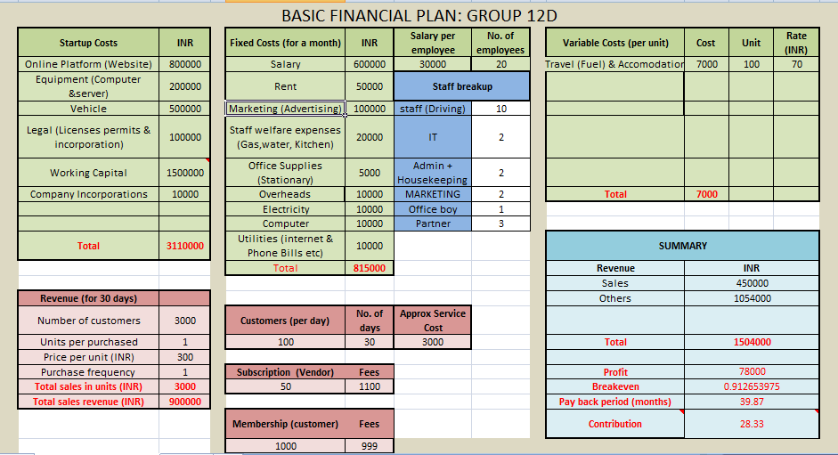
Financial Plan

Slide 16

Milestones and metrics:
Registration of local and authorized vendors in all the metropolitan cities by 2022
Become a national brand for automobile servicing by 2026
M1
M2
M3
M4
M5
Registration of all the local and authorized vendors in Jaipur by December 2021
Acquire 500000 Auto-Piloters by 2023
Become a national brand for automobile servicing by 2026

Slide 17

Risk evaluation and coping strategies
Online security
System reliability
Privacy issues
Customer disputes
Credit card fraud
Intellectual property
SEO
Taxation
Return of goods and services
Warehouse and logistics

Slide 18

Legal environment
Obtain municipal permits and licenses
Obtain state licenses and permits
Register for taxes
Purchase liability insurance
Apply for EIN
Create a business structure

Slide 19

“To become a national brand for automobile servicing”.

Slide 20
FIN.

