Slide 1
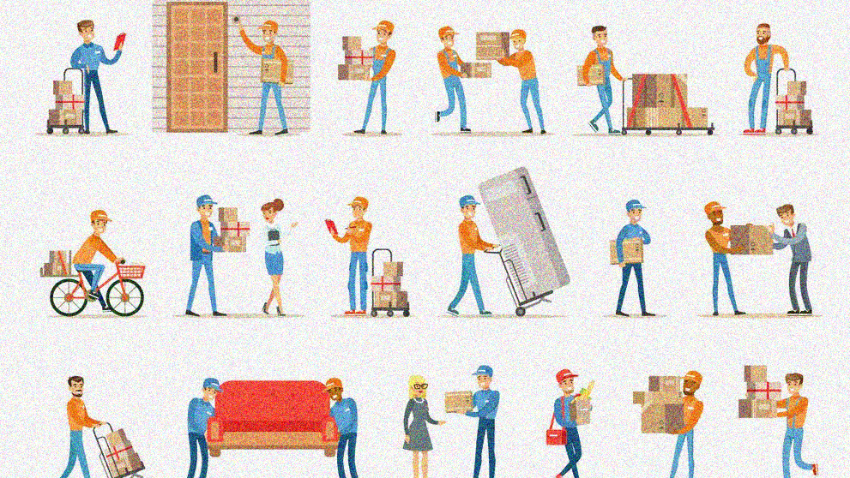

Slide 1
BY GROUP-7C

Slide 2
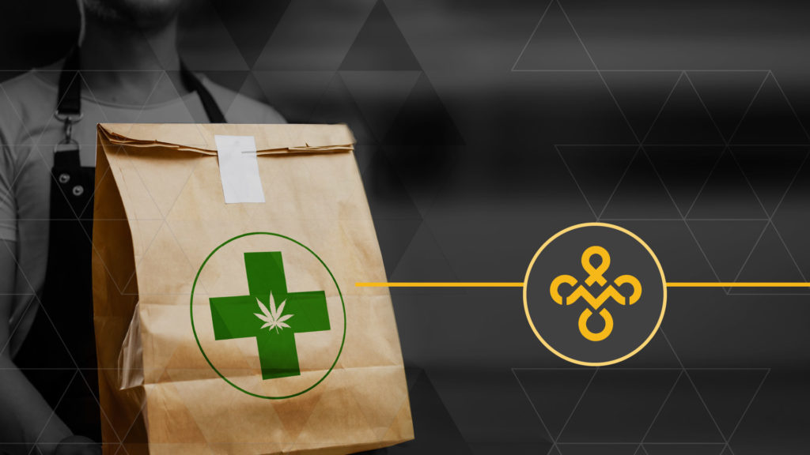
Slide 2
COMPANY PURPOSE
D(oor)livery is a delivery platform enabling customers to discover deals and offers at retail stores nearby.

Slide 3



PROBLEM
In some residential places which are at outskirts of the city, the markets are far-fetched.
Thereby causing inconvenience to residents, as each time they have to rush to the markets for nitty-gritty of day-to-day life.
When people have hectic schedule, they can’t go to the market due to time constraints.
Also due to lack of delivery system in tier 2 cities customers have to find time from their busy schedule to run errands or collect their order and purchases themselves.

Slide 4







SOLUTION
USE CASES
Customers can book services for delivery of various products at any point of time. Services include:
Food
Groceries
VALUE PROPOSITION
User – friendly application facilitating faster order processing and home delivery system, hence connecting people with the local market.
Providing customers deals, offers and attractive cashback schemes on frequent purchase of d(oor)livery services.
One App, Many Solutions: It is a single platform catering to different needs of customers.
Medicines
Pet Supplies
Order through app
On demand pick and drop from local vendors

Slide 5
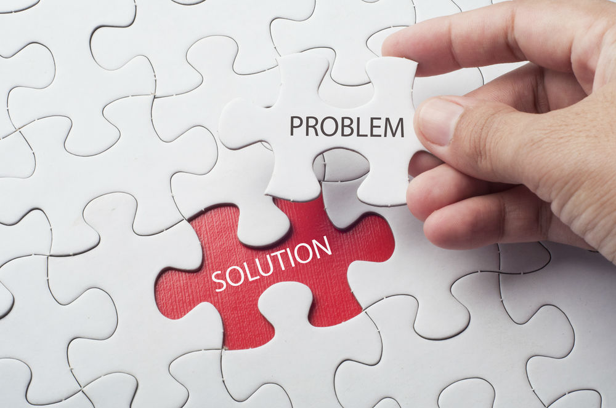
Slide 12
WHY NOW?
Surge of Internet
The sudden surge of Internet and location tracking devices have watered the plant of Hyperlocal Marketplace. Around August 2014, names like Swiggy, Zomato, Ubereats, and Foodpanda, etc. emerged, dropping another definition for eCommerce business. Hyperlocal is surely a promising dimension of eCommerce.
Need for Delivery Services
This way, hyperlocal businesses have given a push to traditional on-demand delivery services. The economy’s need for speed’ is satiated through this delivery model..
Government’s Support
The Government of India has been active in leveraging and embracing e-Commerce digital platforms to transform and organize traditional offline markets such as those of agricultural product. Over 120 million people are expected to shop online in 2021 and this number is expected to go up to 220 million by 2025. As a healthy growth in organized retail sector Indian e commerce market is expected to reach US $105 billion by 2021.

Slide 6

Slide 12
MARKET SIZE
INITIAL TARGET MARKET
ITM – What proportion of that market you want to initially capture? = 1.5 Lakh Customers
SERVICEABLE AVAILABLE MARKET
SAM – What proportion of that market fits you? = 69 crores (3% of TAM
TOTAL AVAILABLE MARKET
TAM – How big is the largest possible market? = ₹2306 Crore

Slide 7


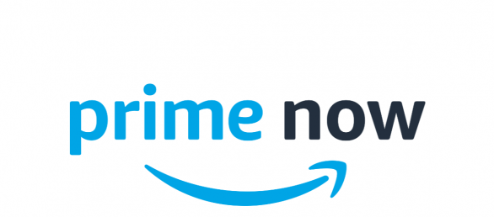







COMPETITION
More Convenient
More Expensive
Less Expensive
Less Convenient

Slide 8

Slide 3
COMPETITIVE ADVANTAGE
Operating in tier 2 cities
Indulging in additional segments like pick and drop from retail stores
Delivering various services through a single platform.
ADVANTAGE

Slide 9
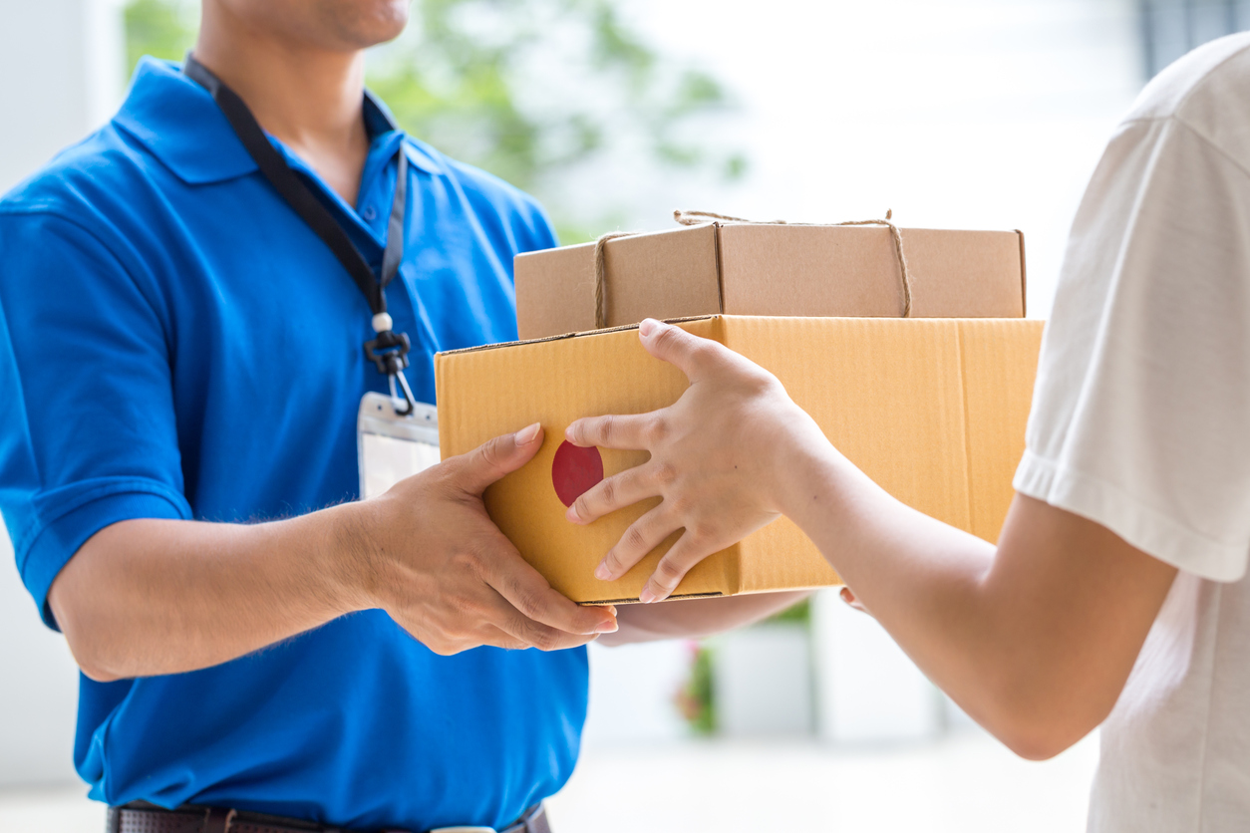

Slide 6
PRODUCT
OUR PREMIUM OFFERINGS
Application & Website
Feature: 2 types of accounts: Customer & Business account
Features for customers: monthly subscription or single use
Pick and drop/ place an order
Cashbacks and discounts
Payment options: Cash, Credit and Debit card, Net banking, e wallet: Paytm
GPS and locate the nearby store
Support Different languages
Customer support through email and chat

Slide 10

Timeline
2020
2020
2020
2020
2020
JANUARY-MARCH
APRIL-MAY
JUNE-JULY
SEPTEMBER
OCTOBER
PLANNING
APPROVAL
DEVELOPMENT & TESTING
HIRING
LAUNCHING

Slide 11

Business Model
2
PRICING MODEL
1
4
REVENUE MODEL
Price per delivery as per the distance covered (maximum 10 km radius)
Price per delivery (service fees) = ₹30 - ₹100
SALES & DIST CHANNEL
Service fees for pick and drop.
Order fees for online orders through app.
Advertising of local vendors.
Offline to Online Sales channel is used in hyperlocal ecommerce business.
3
Offline Retailers
Delivery Person
Customer
AVERAGE ACCOUNT SIZE
Assuming that a customer orders once in a week for average ticket earning of ₹40. therefore, considering repeat orders for 52 weeks in a year, average account size is (₹50*52 weeks) ₹2600 per account per year.

Slide 12


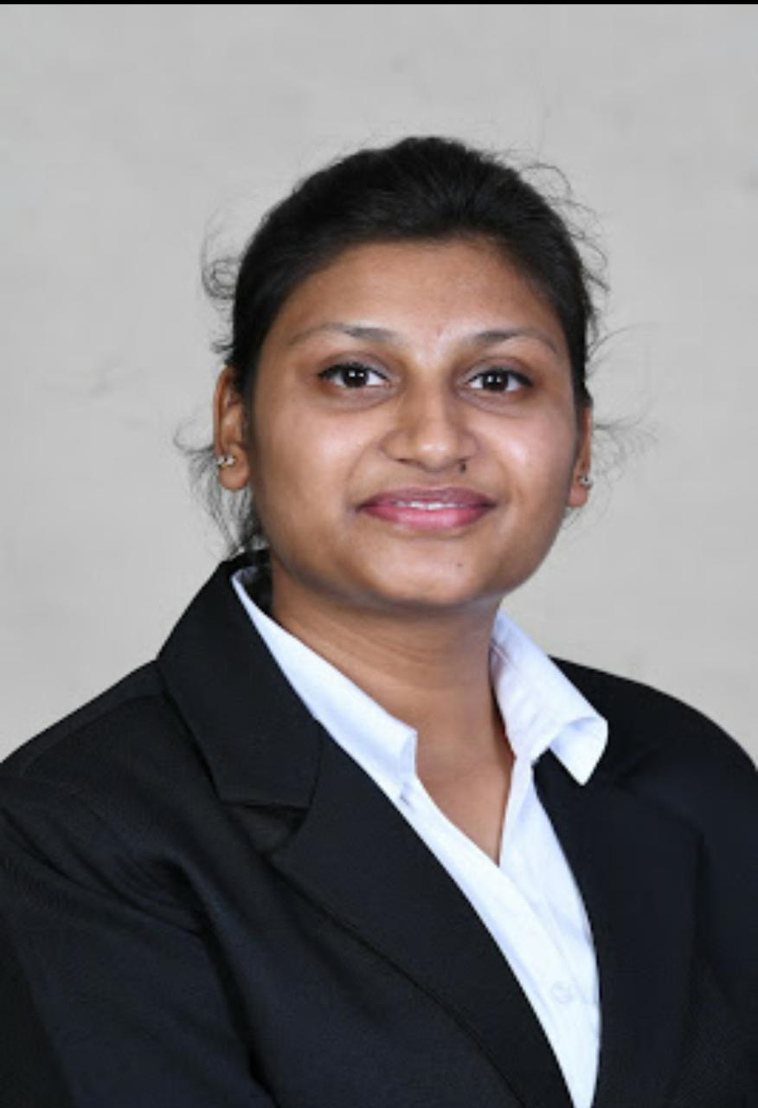


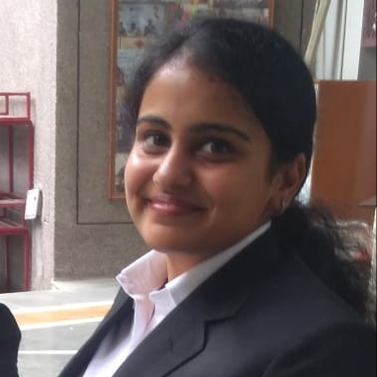
Slide 10
THE TEAM
FOUNDERS & MANAGEMENT
STRATEGIC MNG HEAD
OPERATIONS HEAD
MARKETING HEAD
FINANCE HEAD
HR HEAD
DOLLY GOYAL
SONALI JINDAL
SONAKSHI GUPTA
SHREYA GUPTA
RADHIKA AGARWAL

Slide 13

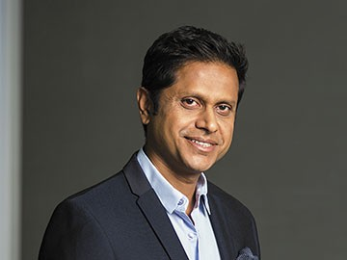
THE TEAM
BOARD OF ADVISORS
Mukul Arora
DIRECTOR
Mukesh Bansal
DIRECTOR

Slide 14
FINANCIALS
Start-up Costs | INR
Advertising & Marketing | 1,00,000
Mobile Application Development | 1,00,000
Company Registration | 1,00,000
Training Cost | 2,00,000
TOTAL | 5,00,000
Fixed Costs (for a month) | INR
Salary | 5,25,000
Fuel Cost Reimbursement | 60,000
Mobile App Maintenance | 15,000
Office Maintenance | 15,000
TOTAL | 6,15,000
Variable Costs (per unit) | Cost | Unit | Rate (INR)
Packaging | 5 | 1 | 5
Discounts and Offers | 10 | 1 | 10
TOTAL | 15
SUMMARY
Revenue | INR
Sales | 12,00,000
Others | 1,70,000
TOTAL | 13,70,000
PROFIT | 2,25,000
BREAKEVEN | 17571.43
PAYBACK PERIOD (months) | 2.22
CONTRIBUTION | 3500.00%
ASSUMPTIONS:
Revenue (for 30 days)
Number of customers | 6,000
Units per delivery | 1
Price per delivery (INR) | 50
Purchase frequency | 4
TOTAL SALES IN UNITS (INR) | 24,000
TOTAL SALES REVENUE (INR) | 12,00,000
Customers (per day) | days
200 | 30
Salary per employee | No. of employees
15,00 | 35
Other income includes Revenue Sharing, Advertising of local vendors & Commission earned

Slide 15
MILESTONES & METRICS
MILESTONES
KEY METRICS
Sales conversion rate
Average order value
Customer loyalty
Customer Lifetime Value
Customer Acquisition cost
Shopping Cart abandonment rate
We aim to be the biggest hyperlocal ecommerce portal in North India in the next 10 years, with a growth 15x in a period of 3 years.
In next 5 to 7 years D(oor)livery will be present in India’s top 10 cities.

Slide 16





Risk Evaluation & Coping Strategies
TECHNICAL RISK
OPERATIONAL RISK
Online security
System reliability
Privacy issues
Electronic payment processing risk
Intellectual Property
Customer related
  Product Return
  Non-Acceptance of Delivery
  False Claims
  Customer Disputes
Logistics/ Warehousing
  Damage during delivery
  Theft/ cheating by delivery person
MARKET RISK
FINANCIAL RISK
Existing Competition
New entrants
Noncooperation on the part of trading partners
Financial viability/ profitability
Credit risk
Price adjustment risk

Slide 17


Slide 6
LEGAL ENVIRONMENT
Ecommerce Registration in India (Legal Procedure)
Get Directors Identification Number (DIN)
Digital Signature Certificate
Filing application for Company Name to Registrar of Companies (ROC)
Company Registration
Apply for Goods and Service Tax (GST), Shops and Establishment License & Professional Tax (PT)
Apply for the Certification of Company’s Incorporation
Bank Account : Once the company is incorporated, one need to open a Current Bank Account in the name of the business with any bank. This acts as a proof of the Company’s Registration. Also, having company’s bank account is necessary to list the products on an ecommerce marketplace and/or to obtain payment gateway for a proprietary ecommerce website.
Payment Gateway for Ecommerce Business: Some documents to be submitted to the payment gateway provider: Bank account in the name of the business, PAN Card of the business, Certificate of Incorporation, Memorandum of Association.

Slide 18

Slide 2
“Our vision is to build a place where people can come to find and discover anything and everything they might want to buy and get delivered.“

Slide 19
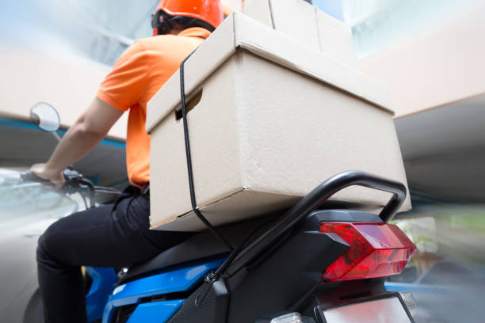


Thank You
Shreya Gupta 19DM205
Sonakshi Gupta 19DM217
Sonali Jindal 19DM220
Dolly Goyal 19DM068
Radhika Agarwal 19DM148
www.doorlivery.com

