Slide 1

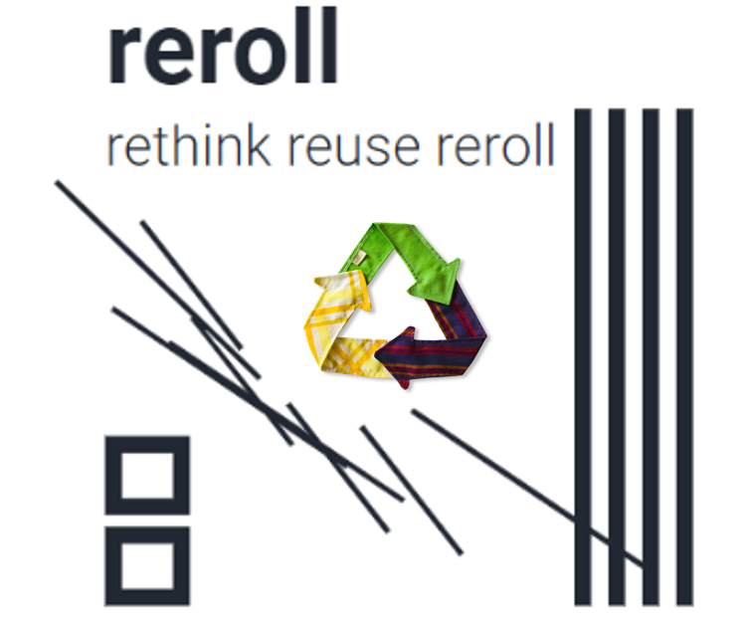
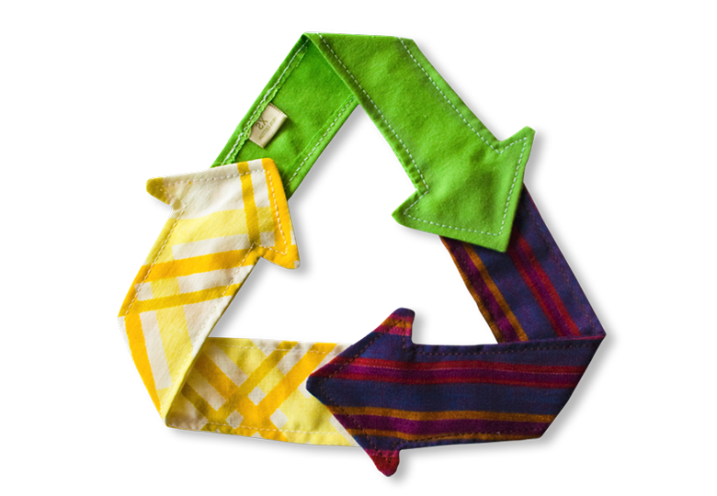
“We believe in personal touch, and so each creation is handmade, sourced from artisans across states in India. We curate unique collections that resonate with our philosophy of keeping ‘real things in life alive’
PITCH DECK

Slide 2
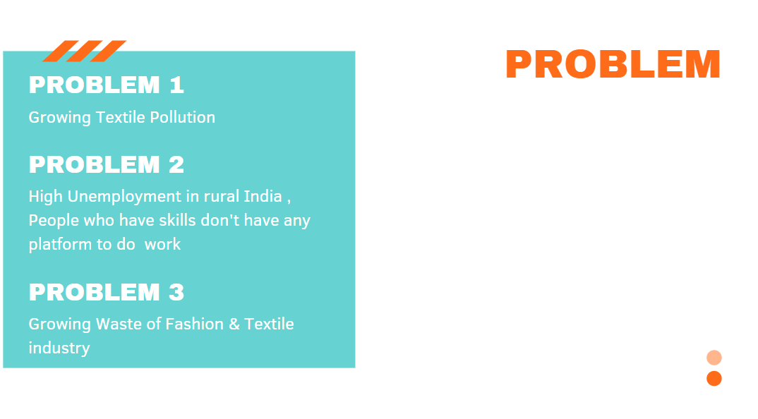
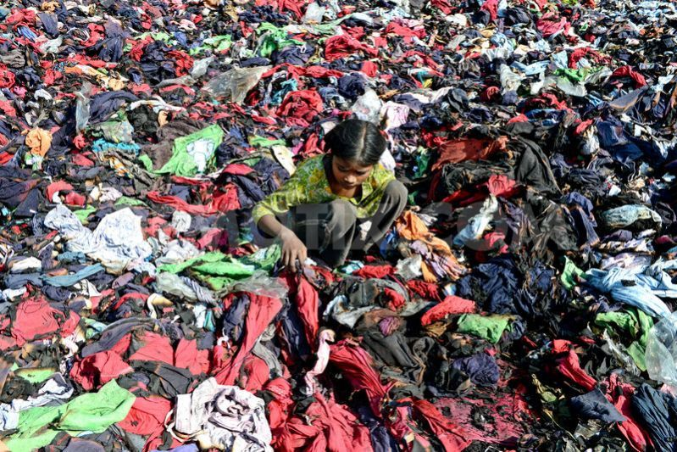


Slide 3

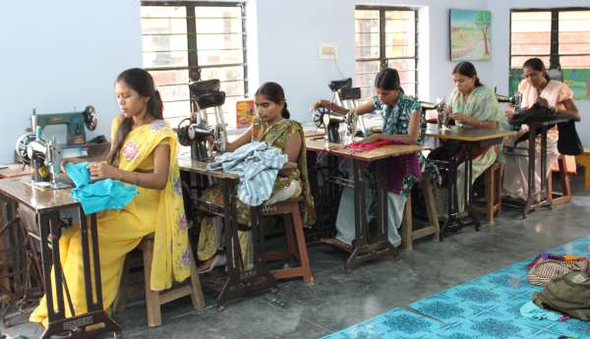
Reroll will Provide handcrafted products made by local villagers to tier one and two cities thereby generating business as well as employment in those areas
Reroll provides hand made products at low costs to consumers. The handmade products offer more variety and options to the consumers as compared to the mass produced goods available in the market.
Training Women to enhance the their stitching skills Educate them about how the things work in market Providing a platform so they can work & earn and can be self sufficient. Help them to convert their wasting time in to Investing

Slide 4

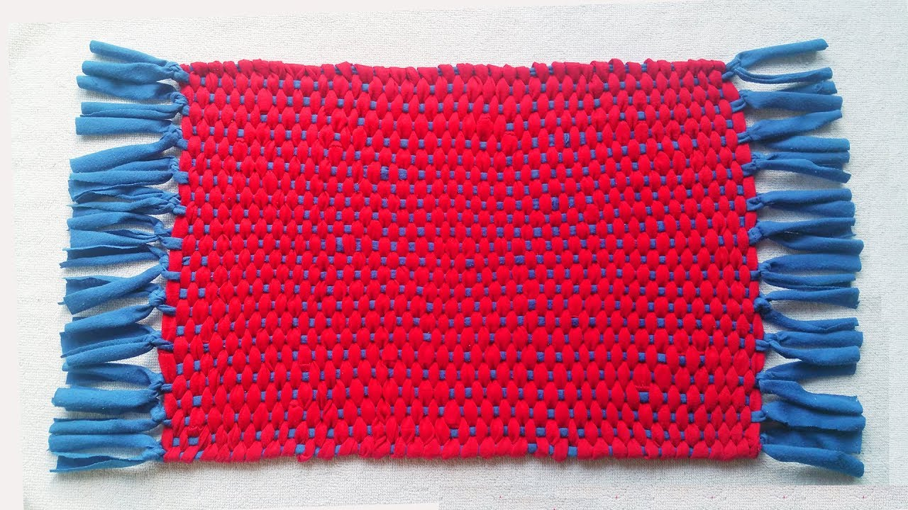
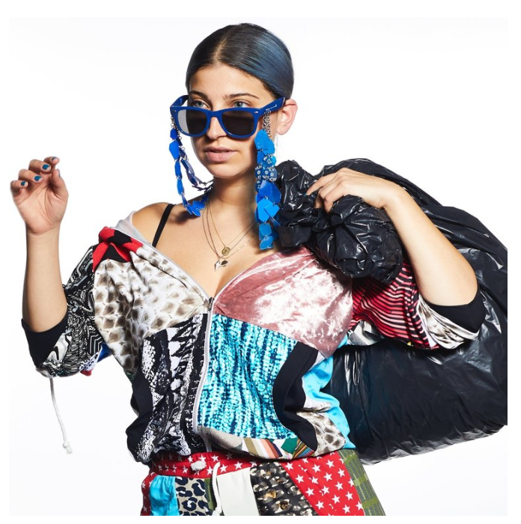
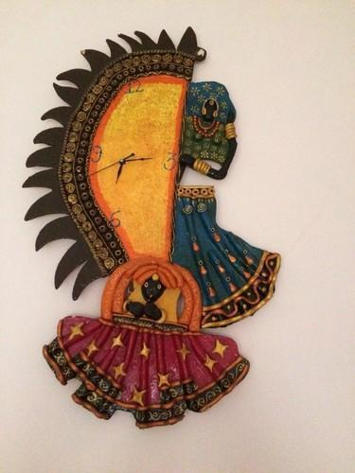
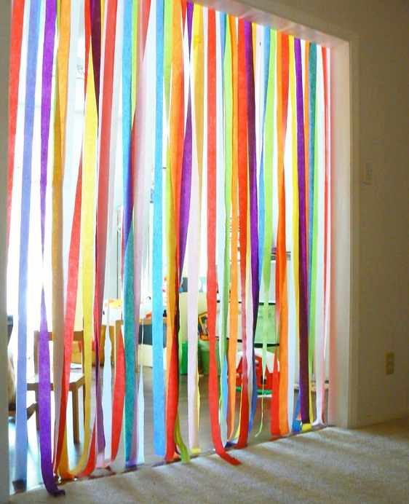
Handmade
Door mates
Handmade
Decorative item
Handmade
Blind Curtains
Handmade
fashion & regular Apparel

Slide 5
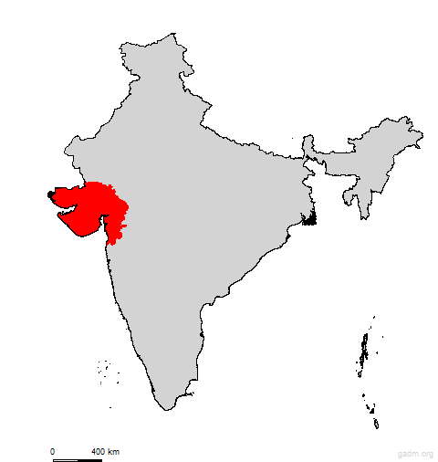
  TARGET MARKET
Total available market- Entire Global
India Serviceable available market- major metros and tier two cities
Initial target market- Ahmedabad,
Gandhinagar, Delhi

Slide 6

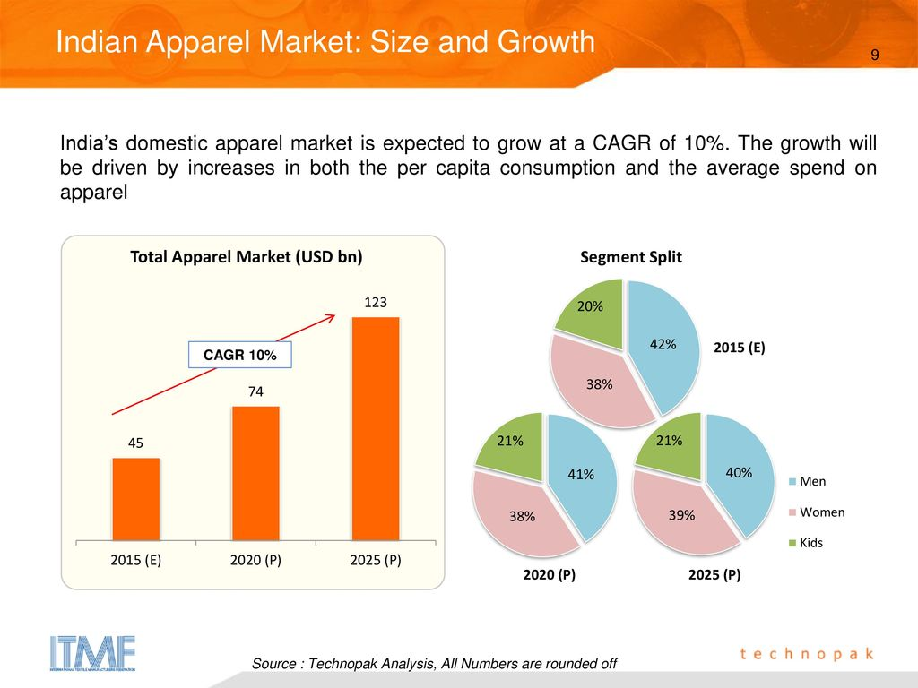
THE MARKET SIZE
1.9
BILLION
Total Available Market (TAM) Global
300 M
Serviceable Available Market (SAM) INDIA
5.6M
Serviceable Obtainable Market (SOM) Gujarat

Slide 7




DIRECT COMPETITORS
INDIRECT COMPETITORS
Voonik is a fashion Brand for women, with a focus on personalization.
Billioncrafts is an online start up to promote the Handicraft Industry of India to an International level.
Shiprocket Social as a platform that gives complete control over the way to sell online. Any one can now sell their products on your own free website without any commissions on sales.
FABSCRAP is your one-stop textile reuse and recycling resource

Slide 8

Reroll Side
Low Labor Cost
Low Raw Material
Low Fixed cost
Consumer Side
Batter Quality with low price
Emotions attachment with each product,
Green Products for Decoration, All products are handmade and only made by waste clothes
Varity of products
COMPETITIVE
ADVANTAGES

Slide 9

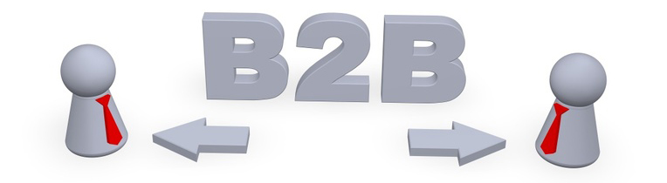


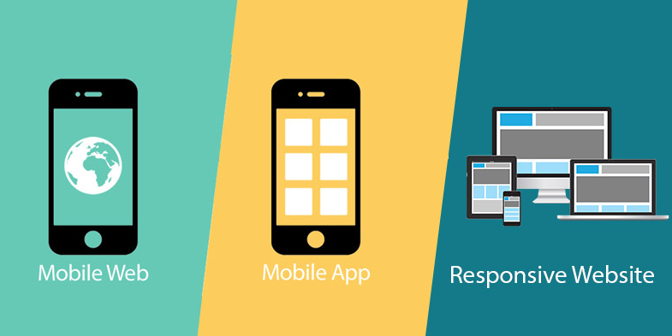
Upcycle the Waste
Source Waste and residue material from garment Industry and décor Home .Sort the material according to their length, Quality and Upcycle them in to sustainable and marketable designer product such as Bags, Cushions, Decor Items, Handicrafts & Gift Materials
Business Model

Slide 10
FUTURE ROADMAP
1
2
3
Acquiring significant market size in metros in one year
Expanding manufacturing locations across various parts of rural India within 14 months.
Break Even in first 4 month

Slide 11
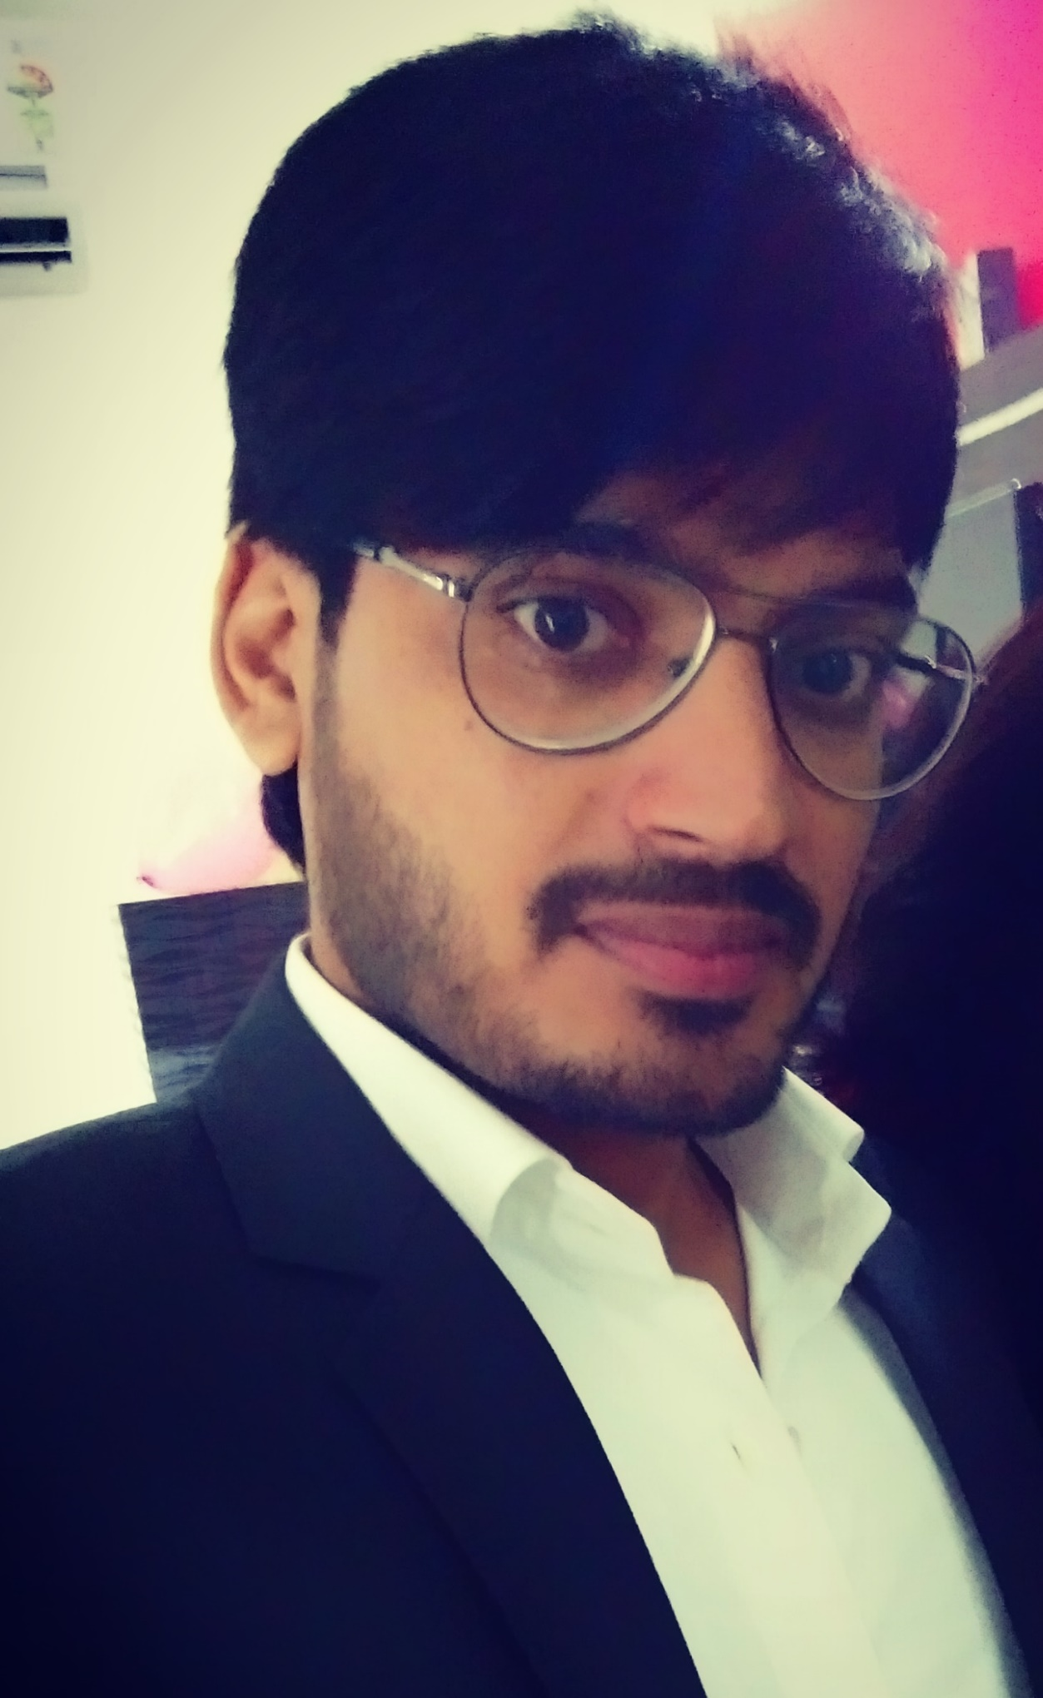
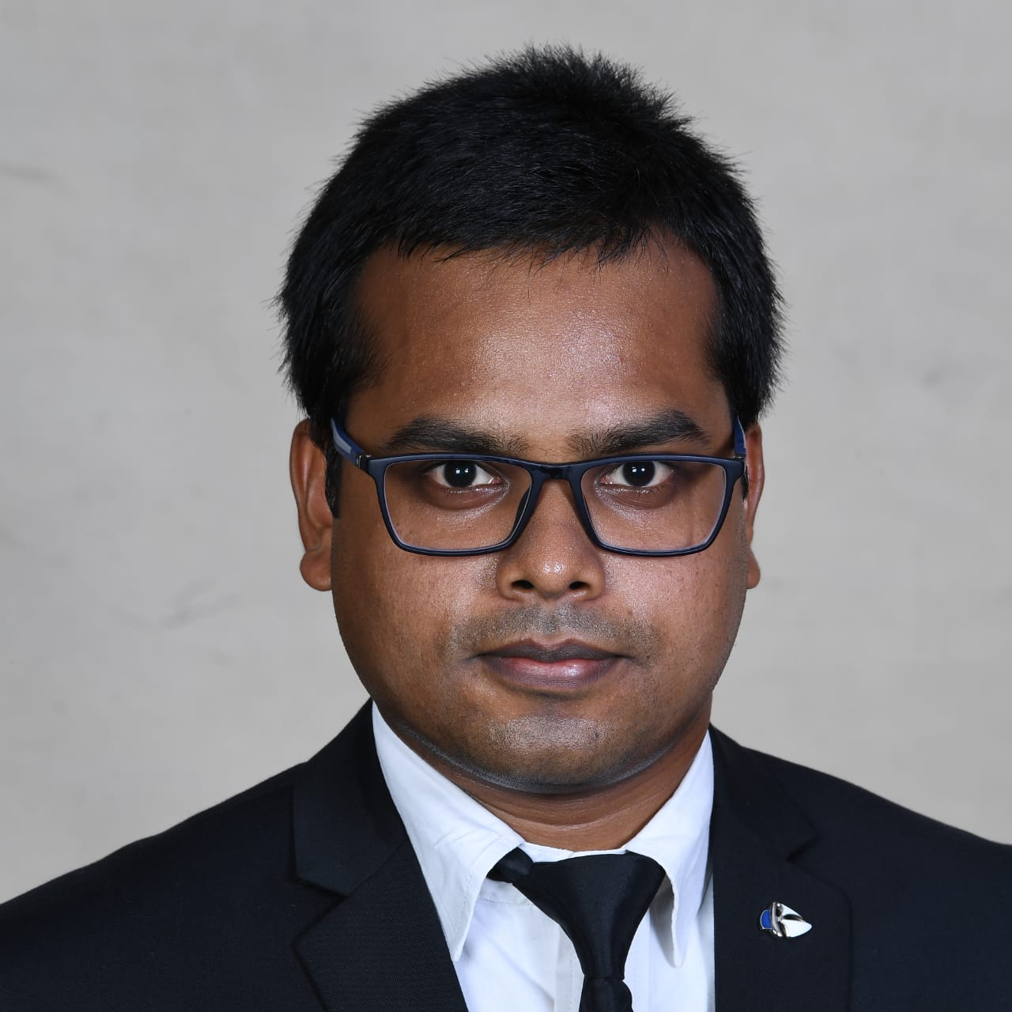
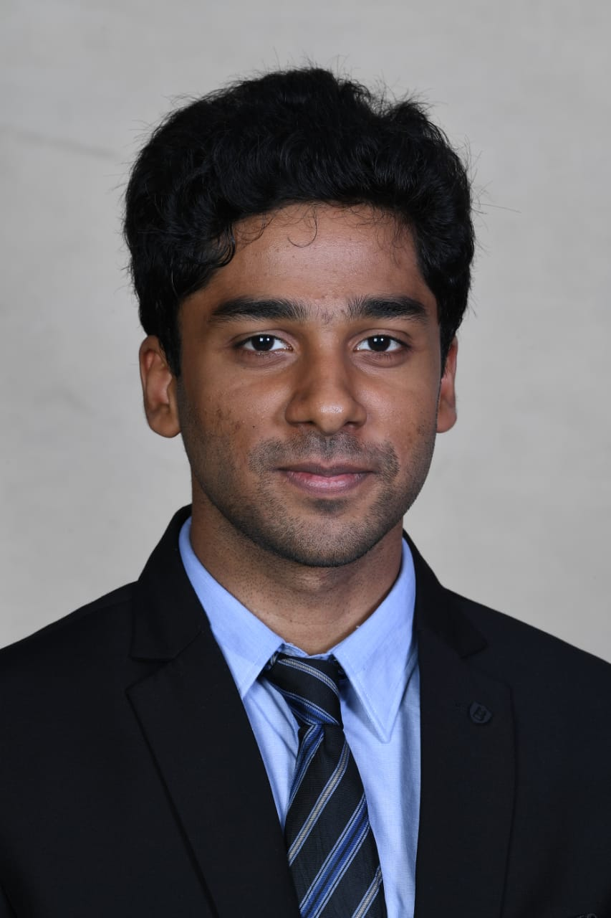
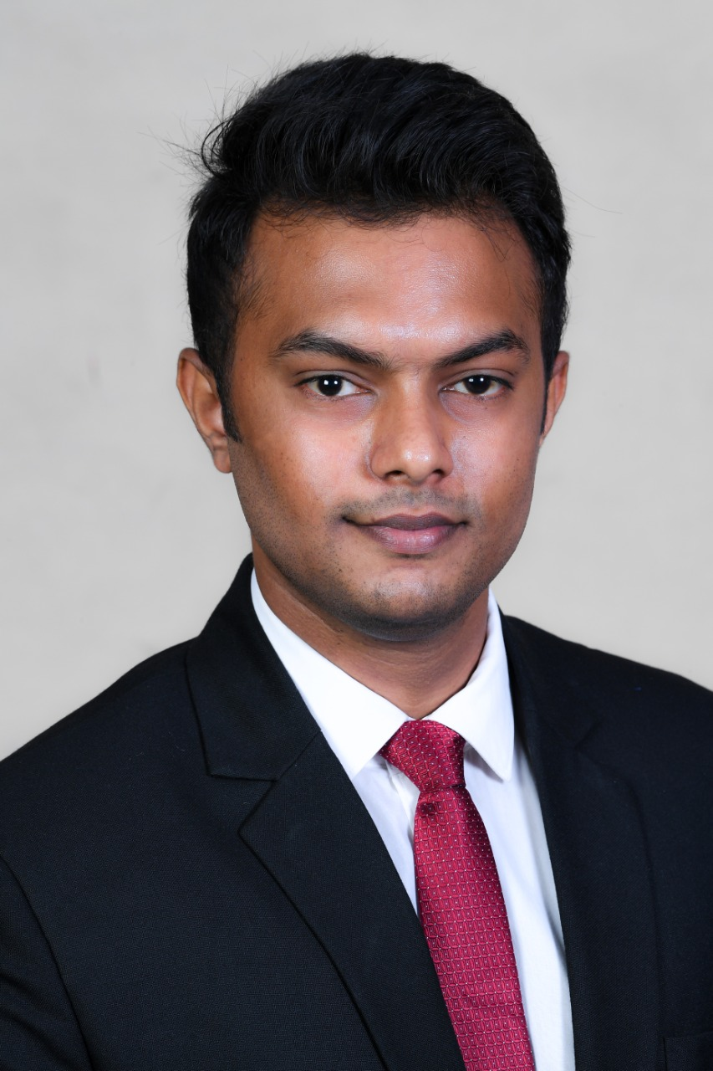
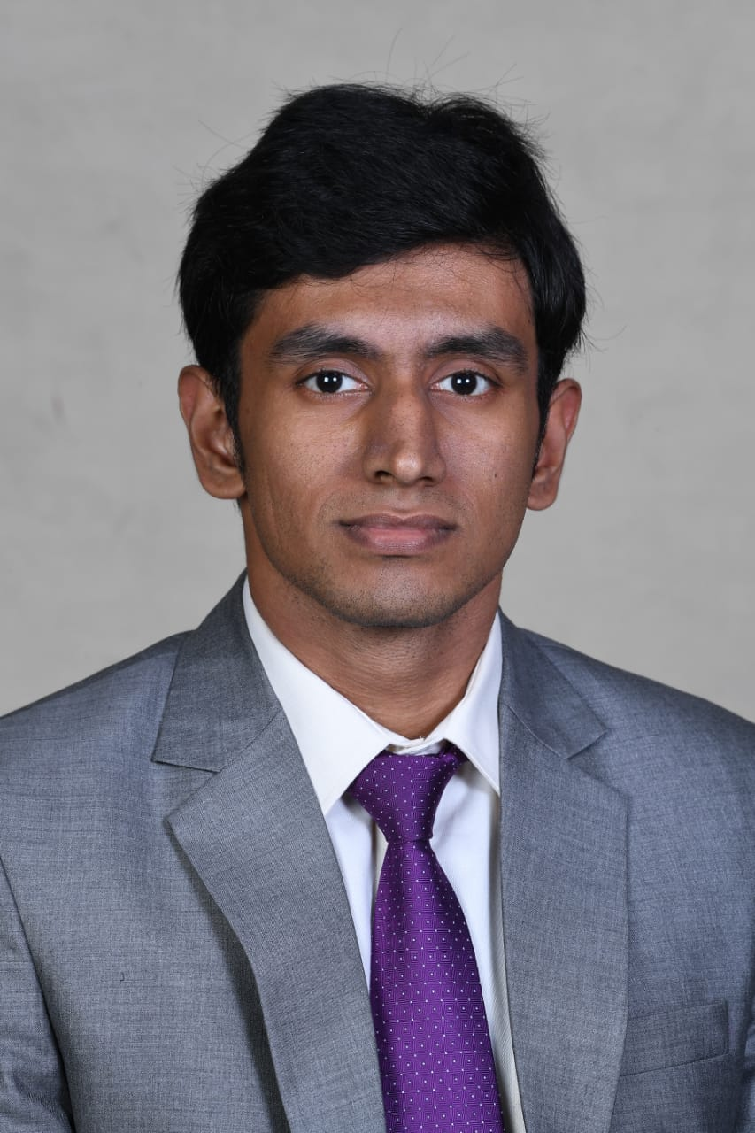
THE TEAM
Jeewesh Kumar
Jithin Mohan
Ananthan
Deepak Sunderrajan
Manjeet MN
Co-founder & Chief Operating Officer
Chief human resources officer
Chief financial
officer
Chief marketing officer
CEO & Founder

Slide 12
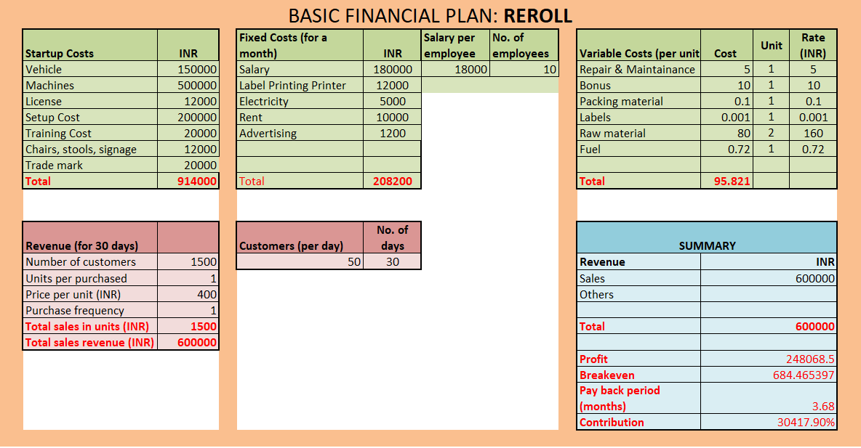
What We NEED

Slide 13
CONTACT US
Manjeet MN
+91-9910982224
mannjeetye@outlook.com
https://www.linkedin.com/in/imannjeet/

