Slide 1

BOOKEDIN
Group 6A
Aditya Sagar
Aditya Yadav
Aditya Singh Parihar
Alankrita Srivastava
Antara Bhattacharjee
Anuja Chatterjee
19DM018
19DM019
19DM020
19DM026
19DM038
19DM039

Slide 2

Company Purpose
Develop an online platform for book rentals and to connect local bookseller and book owners to the online buyers.

Slide 3
Problem
The books available online and offline are of high price.
Less availability of refurbished books.
Buyers are selling their old books in scrap.

Slide 4
Solution
Our product targets on renting and reselling market of used books and study materials on reasonable price.
Plethora of options for bookworms.
Our aim is to connect local bookseller and book owners to the online buyers.
The design for the user interface of our site/app would make it easier for buyers and sellers to engage in book shopping.
We provide rent before buy policy.

Slide 5
Why now
Historical Evolution of online book lending
Online library and rental company comes into presence since 2013 in India
Pioneers are Pustakkosh and Justbooks.
Recent trends that make our solution possible
Technological advancement
Availability of High speed net in lower price
Young population more comfortable with book renting rather buying
Space saving

Slide 6
Market Size
We are targeting on all age groups who love to read books and also for the student age group who need study materials at their doorstep at affordable pricing.
TAM = TOTAL NO. OF CUSTOMERS(BOOK READERS) * AVERAGE BOOK COST
= 500,000 * Rs.125 = Rs.62,500,000
SAM = CUSTOMERS(RENTED/PURCHASED) * AVERAGE BOOK COST
= 200,000 * Rs.125 = Rs.25,000,000
ITM = INITIAL CUSTOMERS * AVERAGE BOOK COST
= 1000 * Rs.125 = Rs.125,000
*Data based on Delhi NCR

Slide 7
Competition
Competitors
-MY PUSTAK
-PUSTAKOSH
-DOORSTEPBOOKS.COM
-PADHEGAINDIA.IN
Competitive Advantage
-Cheap Price Range
-Book available for exchange between customers
-Renting for short and long term

Slide 8
Product
Product line-up :
Form factor-Online website
Functionality- Online book rental
Features-Renting, selling, Exchange
Architecture- Request -> Receive -> Read -> Return /Buy

Slide 9
Product Development Roadmap
Executive Review
Release Candidate
Mar 10
Oct 1
Project start
Executive Decision
Beta Release
Final Release
Jan 25
Mar 21
Jun 30
Oct 20
2020
Jan
Feb
Mar
Apr
May
Jun
Jul
Aug
Sep
Oct
Nov
Dec
Assemble initial resources
Working Plans
Plan
Supplier selection
Website Planning
Planning Begin
Performance Validation
Test Complete
Monitoring
Phase Sync
Load Balance
Test
Integration I
Integration II
Integration III
Prototype
Model Build
Development Phase I
Develop
Development Phase II
Pilot Deployment
Development Begins
Launch
Website Launch
July 4, 2020
Making relevant changes
Public Review

Slide 10
Business Model
Revenue Model
Monthly and Annual Subscription
Security Deposit (Refundable)
Pricing
Subscription model
*Security deposits is Rs. 50 for each book
Category | Monthly | Yearly
Silver | Rs. 200 | Rs. 2000
5 books per month
Gold | Rs. 300 | Rs. 3200
10 books per month
Platinum | Rs. 400 | Rs. 4500
15 books per month

Slide 11
Average account size
Monthly membership around 15.
Yearly membership around 10.
Customer Lifetime Value= average purchase value × average purchase frequency rate
CLV = ₹125 * 10 customers * 1 book/day
      = 1250
Sales and Distribution Channel
Sales through official websites.
Delivery will be given by ourselves.

Slide 12
Customer Pipelines
Lead generation –through online advertisement, print ad, capturing existing customers from competitors, social media marketing.
Lead nurturing- online customer engagement and give them exciting offers.
Lead qualification – Find the target customers,
-Determining accessibility through mobile app and our official websites
-Making sure that the prospect have ability to purchase
Deal closing by taking payment.
Post Sale customer service by taking feedback, complain and overall engagement.

Slide 13


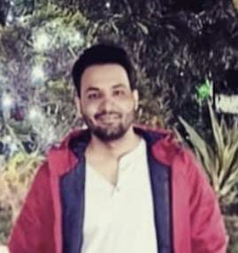
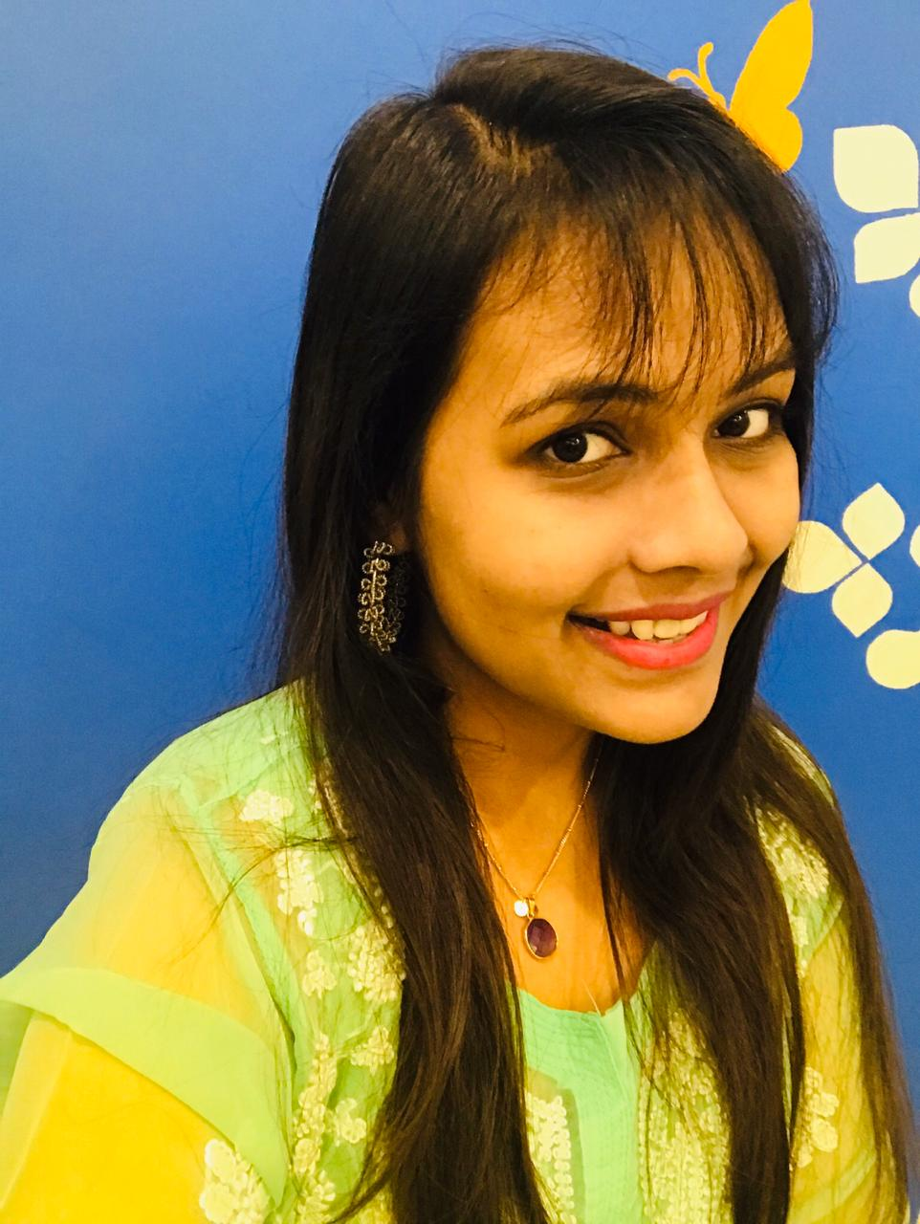

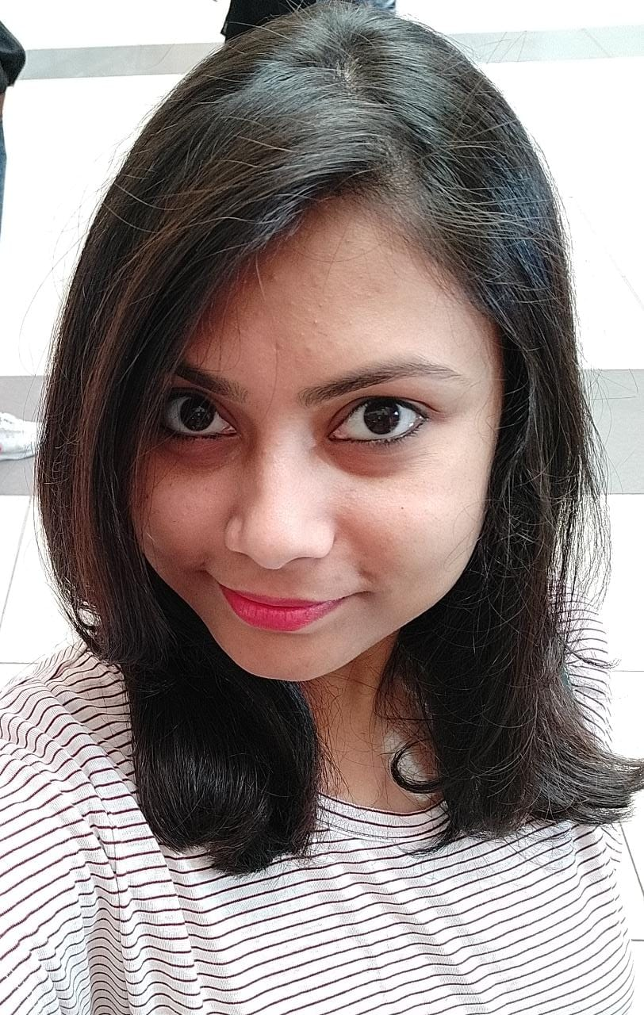
OUR TEAM SLIDE
Aditya Sagar
Aditya Singh Parihar
Aditya Yadav
CEO
CTO
Employee
Alankrita Srivastava
Antara Bhattacharjee
Anuja Chatterjee
Employee
Employee
Employee

Slide 14
BOOKEDIN
Startup Costs | INR |  | Fixed Costs (for a month) | INR | Salary per employee | No. of employees |  | Variable Costs (per unit) | Cost | Unit | Rate (INR)
Vehicle | 100000 |  | Salary | 36000 | 6000 | 6 |  | Packaging Material | 10 | 0.1 | 100
Employees's Equipment | 30000 |  | Fuel | 5000 |  |  |  |  | 5 | 0.05 | 100
Maintenance Cost | 20000 |  | Electricity | 2000 |  |  |  |  | 1.2 | 0.03 | 40
Website Development | 45000 |  | Rent | 7000 |  |  |  |  | 1
Office Supplies | 20000 |  | Advertising | 5000 |  |  |  |  | 0
Total | 215000 |  | Total | 55000 |  |  |  | Total | 17.2
Revenues (for 30 days) |  |  | Customers (per day) | No. of days |  |  |  | SUMMARY
Number of customers | 1000 |  | 10 | 30 |  |  |  | Revenue | INR
Units per purchased | 1 |  |  |  |  |  |  | Sales | 5000
Price per unit (INR) | 125 |  |  |  |  |  |  | Other Revenue Sources | 2000
Purchase frequency | 1
Total sales in units (INR) | 1000 |  |  |  |  |  |  | Total | 7000
Total sales revenue (INR) | 125000
 |  |  |  |  |  |  |  | Profit | 52800
 |  |  |  |  |  |  |  | Breakeven | 510.2040816
 |  |  |  |  |  |  |  | Pay back period (months) | 4.071969697
 |  |  |  |  |  |  |  | Contribution | 107.8

Slide 15
Milestones
#1: Profitable Business Model
#2: First Repeat Client
#3: Realistic, Scalable Marketing Strategy
#4: Hire and Train a Solid Team
#5: Gain Authority in Your Industry
#6: Reach a Significant Number of Sales

Slide 16
Key Metrics
1. Customer Acquisition Cost (CAC)
Lower the CAC the better depending on our business model and industry.
2. Retention Rate
Also known as churn rate, retention rate evaluates the percentage of customers that stay with you and the percentage that leave over a given time period.
3. Customer Lifetime Revenue (CLR)
4. Return on Advertising Spending (ROAS)
We will evaluate which of the channels are effective and start small and then figure out who is our targeted audience. Then expand.
5. Margin
Revenue must exceed our COGS and operating expenses.

Slide 17
Risk involved in starting the book rental site
E- commerce Online Security.
E- commerce Intellectual Property.
Customer Disputes and Chargebacks.
Product Warehousing and Logistics.
Customer Service.
E-commerce Taxation.
E-commerce Website SEO and Marketing.

Slide 18
Company Structure
This company is to be formed under the general partnership terms which is the simplest and least expensive co-owned business structure to create and maintain.
The following will be the terms and condition under the company structure: -
Personal Liability for All Owners.
Joint Authority over the company.
Joint Liability to be sued or required to pay any debt taken on behalf of the company.

Slide 19
Business Legal Environment: -
In the legal environment of a business, we are looking the key areas, particularly where law changes and how legal aspects affect businesses.
1. Organizational Law
2. Securities Law
3. Contract Law
4. Consumer Protection Laws: - a. Trade Description Act
b. Sale of Goods Act
5. Employees Protection Law: - Includes laws regarding health and safety at workplace.
6. Security against Haphazard Termination of employees.

Slide 20
Vision
If everything goes well, BookedIn will be an established name in the market.
We will not only a huge market share but also making huge profits.
Because of our business, book will be available at best price to every customers.
Variety of book genres will be large and old books will be exchanged to a great extent.

Slide 21

THANK YOU!

