Slide 1
EASYFILL
It’s not a choice. It’s a way of life

Slide 2
COMPANY PURPOSE
To make our users life more hassle-free and effortless; we want to get them rid of the mundane task of having to type the same information in various online forms, so that they could focus on what's relevant to them i.e. work towards their aspirations and dreams.

Slide 3
PROBLEM
Filling multiple forms in one-go is a strenuous and burdensome task
Information required to be filled differ from one form to the other along with certain common data.
Managing each & every document required is a bothersome task
Average time taken to fill a form ~ 20 - 30 mins.

Slide 4
SOLUTION
We will have an app/website where our users can update all their information regarding academics, extra curricular, co curricular, work experience, hobbies etc. along with uploading original certificates and mark-sheets for the same with a profile photo which will create a complete student profile similar to a resume.
Information from there can be used directly through a link to fill forms for various entrance examinations, forms for different academic institutions or while applying for a job.

Slide 5


WHY NOW?
Every year the number of people appearing for competitive exams or aspirants looking for their dream positions keep on increasing and there seems to be no sign of this trend slowing down in near future.
It’s high-time now for a product like ours to appear in the market. There are already some similar platforms available as ours but none provide the level of service or customer support like we will.

Slide 6
56 Crores
(online users in India)
32.4 Crores
(No. of people who fill forms annually)
7.1 Crore
(Students studying at coaching centres in India)
MARKET SIZE
TAM (TOTAL AVAILABLE MARKET)
PROFILE OF THE CUSTOMER WE TEND TO CATER:
SAM (SERVICEABLE AVAILABLE MARKET)
ITM (INITIAL TARGET MARKET)

Slide 7






COMPETITIVE ADVANTAGE
Product adaptability
Incorporation of NLP
Can store ‘n’ number and type of personal data under same identity
Automatically select and fills the required data with one click
Option to store the data only locally also
&
COMPETITION

Slide 8

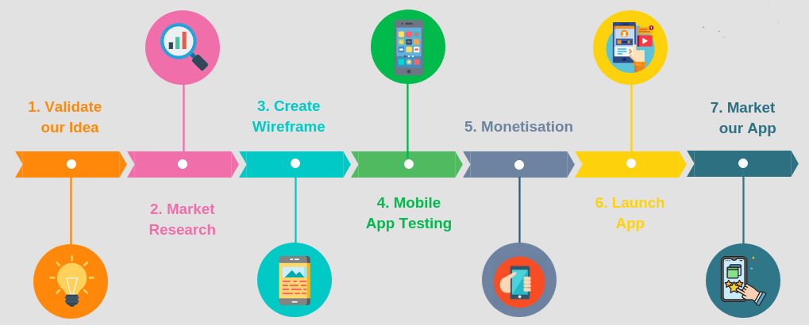
PRODUCT
Development Roadmap

Slide 9
User Flow
Create profile
Fill details and upload documents
Input the URL of the form
Press ‘EasyFill' Button
EasyFill Does the form filling
Purchase Flow
Goes to ‘Google’
Searches for ‘EasyFill’
Selects ‘EasyFill’ from the list
Selects Operating System
Download the software
Authenticate
Confirm Payment Details
Registration completes
Alerts and status updates
Setup Complete

Slide 10

BUSINESS MODEL
We would be using subscription business model. It is a business model in which a customer will pay a recurring price at regular intervals for access to our services.
Revenue model- Subscription Fee
Pricing- Yet to be finalize. It would be between Rs 1.5k to 2k p.a.
Average account size and Customer lifetime value- 1 to 3 year
Sales & distribution Channels – Educational Institute and website
Customer/pipeline list- Students and working professionals

Slide 11
TEAM
Founders & Management
CEO : SHRISHTY
TECHNICAL MANAGER : ANIRUDH
HR MANAGER : ANANYA
MARKETING AND CREATIVITY MANAGER : AYASMITA
OPERATIONS MANAGER : ANKITA
Board of Directors/Board of Advisors
It will consists of the founding members and our mentors.

Slide 12






FINANCIALS
Sources and Use of Funds : Investment through our funds and investors
Revenue by the Month – Rs 112425
Expenses by the Month – Rs 52750
Profit / Loss by the Month – Rs 59675
Breakeven – 35 months( 3 year)
Stable Economy and market
Not adjusted for inflation and TVM condition
Assumptions:

Slide 13

MILESTONES AND METRICS
1st Milestone : Successful result after testing our final product – both website and app
2nd Milestone: Launching our service
3rd Milestone: Reaching 1000 subscribers
4th Milestone: Penetrating international markets
KEY METRICS
Growth Rate
Number of subscribers

Slide 14
RISK EVALUATION AND COPING STRATEGIES
Technical Risks – Unforeseen glitches
Market Risk – May not have as high demand as predicted
Operational Risk –
  Computer hacking
  Internal/external fraud
  The failure to adhere to internal policies
Other -Risks arising from catastrophic events (e.g., hurricanes, floods, etc.)

Slide 15
LEGAL ENVIRONMENT
STRUCTURE
Our organization has a lean and organic structure. Since our company at beginning is employing less than 10 people. It won’t come under factory act at initial years of operation.
INTERPRETATION
The existing laws of India, even with the most compassionate and liberal interpretation could not be interpreted in the light of the emergency cyberspace
CYBER LAWS
In India, cyber laws are contained in IT Act, 2000 (“IT Act”)
ICA
The Indian Copyright Act is unable to protect the unauthorized distribution and use of work over internet. Infringement over internet and piracy posing a threat to creative works worldwide and thus the growth of the internet, the e-commerce and the digital economy.

Slide 16


VISION
“To facilitate people throughout the world to reach their full potential”

Slide 17
APPENDIX

Slide 18
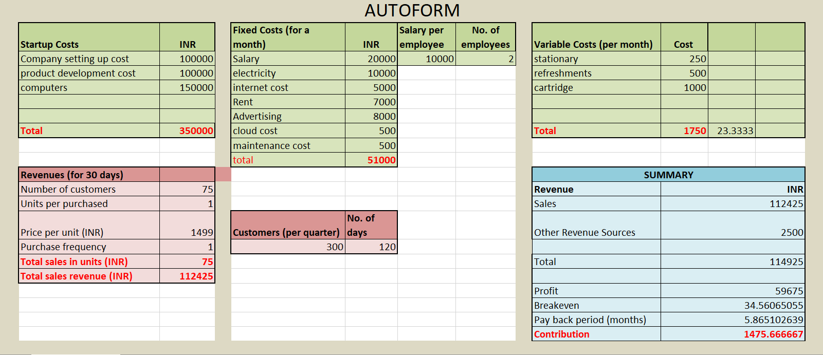
FINANCIAL ANALYSIS

Slide 19
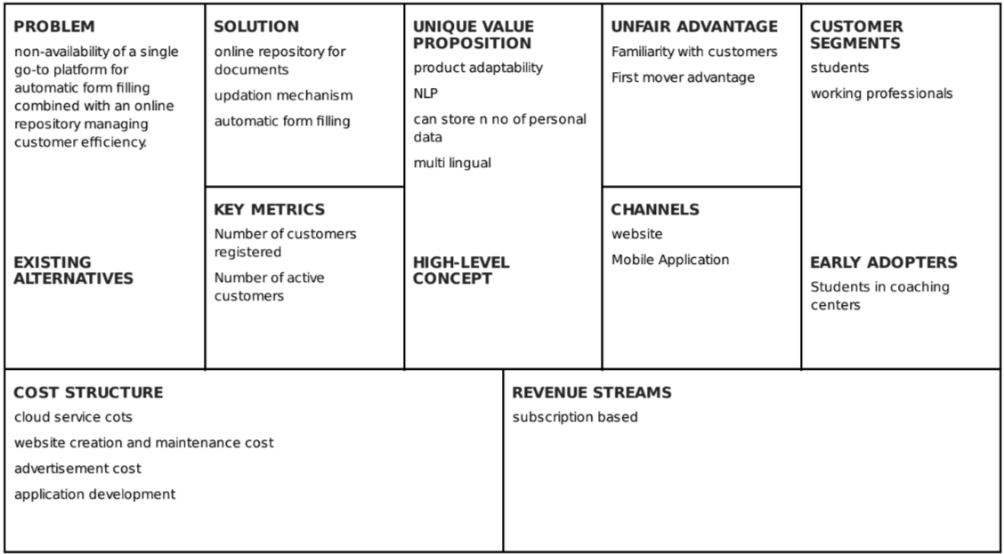
LEAN CANVAS

Slide 20
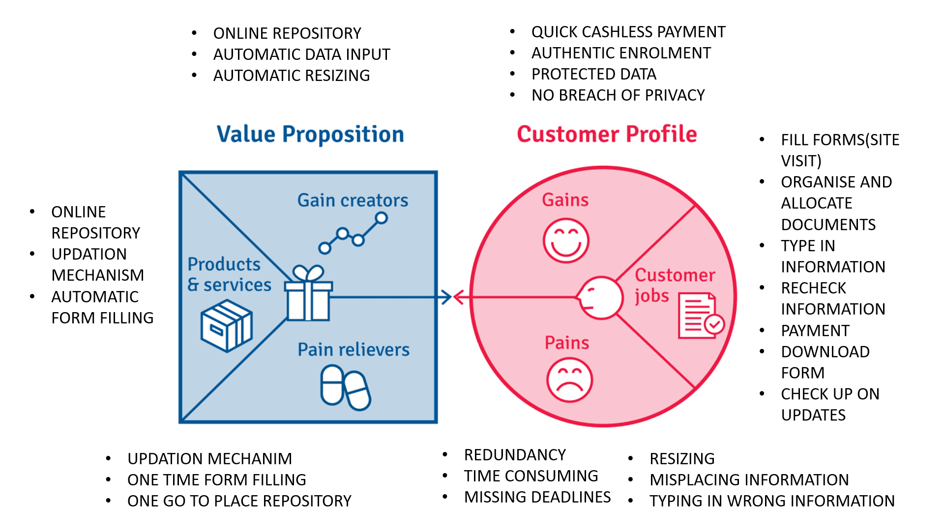
VALUE PROPOSITION

Slide 21

THANKS!
PRESENTED BY:
GROUP 5
ANANYA RAJAN : 19DM031
ANIRUDH KAKKAR : 19DM033
ANKITA JAIN : 19DM035
AYASMITA SEN : 19DM053
SHRISHTY KUMARI : 19DM207

