Slide 1
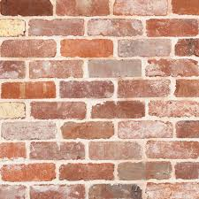
PLASTIC BRICKS

Slide 2

GROUP - 5
Shashank Tiwari 19DM192
Shivam Sharma 19DM199
Simran Ghanshyam Pandit 19DM214
Vidit Gupta 19DM233
Vivek Kumar Singh 19DM234
Himanshu Jain 19DM240

Slide 3
We are focused on creating a high quality product that will lead to a sustainable environment and will create maximum value addition for its customers
Purpose of the Company

Slide 4
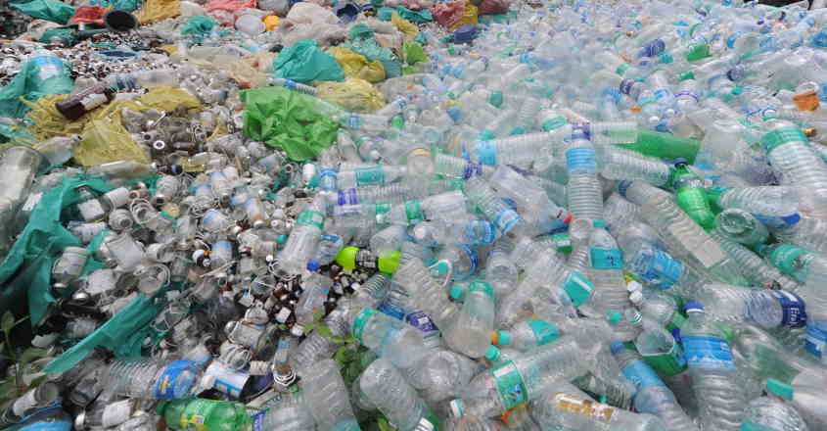
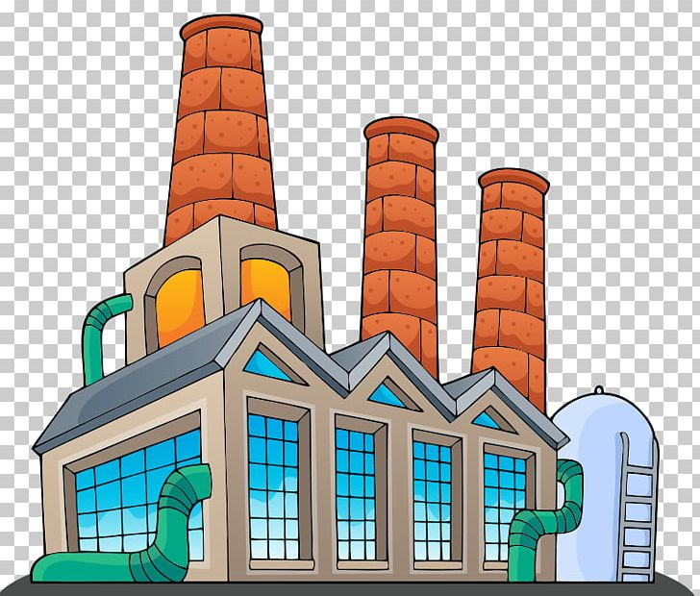
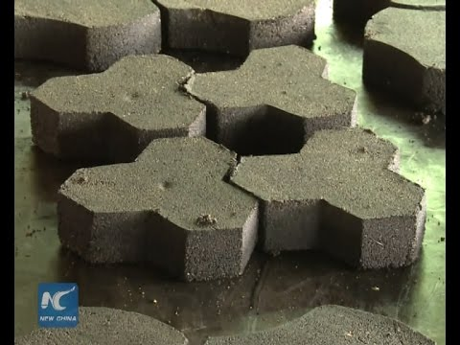
Problem Statement
Due to excessive use of plastic in most of the product, there is a rise in the plastic waste which is non biodegradable and has become a major problem in cities because of less availability of dumping ground.
Our Idea
So our idea is to produce brick, which is majorly made out of plastic.

Slide 5
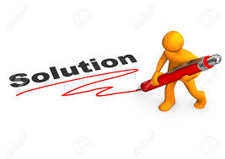
Solutions Our Product Provide
An Eco-friendly product.
More Durable than conventional bricks.
Comes in customizable sizes.
Better quality and strength as compared to conventional bricks.
Super heat insulating properties.

Slide 6
Why Now?
There is excessive use of plastic in our society, and because of it our mother nature is getting affected severely. So, there is a rise in the need to reduce these waste.
There is rise in for durable construction material, due to rise in climate change.
Technological advancement in the recent year has allowed us to convert recycled plastic into durable bricks.

Slide 7
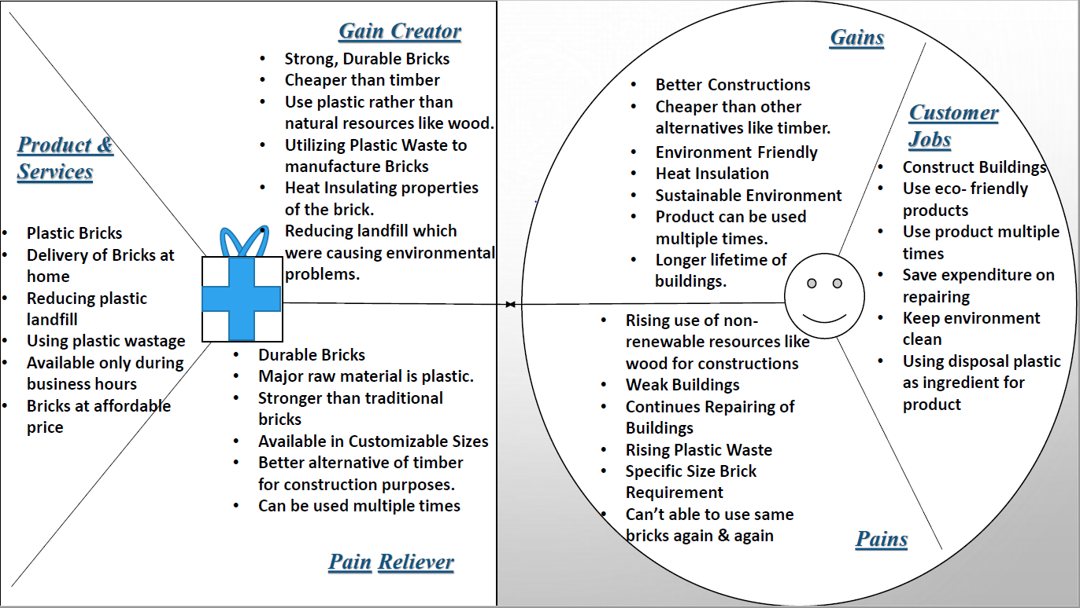
Value Proposition Canvas

Slide 8

Market Size
Construction Contractors.
TAM – All recognized contractors and also the local contractors
SAM – 43 recognized construction contractors
ITM – Top 10 recognized contractors like DLF, PNC Infratech, Brigade Enterprises, India Bulls, Prestige Group etc.

Slide 9

Competitor Analysis
Company | Area | Core Business | Target Market | Revenue Stream | Platform | Strength | Limitations | My Differentiating Factor
Wienerberger | Building Materials | Clay Bricks, Clay roof tiles, Ceramics and plastic pipes | Contractors and households | Sales of consignment | Online and distributors | Strong local presence, familiarizing with National norms and culture, combining innovation and tradition in our product | Target market quiet narrow | High quality products, high durable product, Customized product availability, environment friendly product.
Geetha Wood | Building Materials | Timber, pine wood, silver oak wood | Contractors and households | Sales of consignment | Online and distributors | Strong local presence, producing 100% eco friendly product | Producing good by using non renewable resource which overall effect the environment | High quality products, high durable product, Customized product availability, environment friendly product.

Slide 10
Our Product
Material Required:
Rubber Powder
Features:
Eco Friendly
Architecture
Building Houses
Roads
Plastic
Binding Materials
Chemicals ( for recycling)
Durable
Heat Resistance
Customisable
Customization for other construction purposes
Standard Size : (200*100*100)mm³

Slide 11
Product Line
Gathering plastic waste and other raw materials
Processing inputs in plastic bricks
Making customized bricks
Using these bricks for different construction purposes

Slide 12
MVP
User Flow:
People who are thinking of constructing new homes or building. People will search for construction materials out of which one is bricks. People will research for best, durable with customization bricks within the budget in the market. Building houses or any properties is huge investment. So, people think that it will long-lasting and they do not require to invest again & again. Since our product is more durable than other conventional products in the market and is also priced reasonably, user might choose our product. User can select our product from our distributers and partnered constructions material retailers. When cemented or clay bricks are used, if someone wants to modified their properties those bricks get damaged during process and they have to invest again on bricks but with our products these aspects are also be prevented. Finally for our ecosystem, it's everyone's responsibility to make it less harmful for our future generation. So, it's every user's responsibility that they involve in buying those products which are eco-friendly to our surrounding.

Slide 13
Business Model
KEY METRICS
Bricks Sale per Month
UNIQUE VALUE
PROPOSITION
Environmentally Sustainable
UNFAIR ADVANTAGE
Eco-Friendly Product
Different Customization
High Durable & Strength
High Lifetime
More Durable
More Strength
Cheaper than other plastic
Waste recycled products
Super Heat Insulating Properties
Customized Bricks
Revenue per Customer
Customer Interest
Average Transaction Size
Profit Margin per Brick
Customer Growth
Sales Growth
Revenue Growth

Slide 14
Continued…
COST STRUCTURE
Plastic Waste Cost
Other Raw Material, Machine Cost
REVENUE STREAMS
Partnerships with Construction Companies
Direct sales
Chemicals Cost
Coolants Cost
Tie Ups with Cement Retailers
Online sales
Electricity Cost
Rent/Factory Space & Warehouse
Transportation Cost
Wages/Salary for Employees & Labour
Travelling Cost (Related to Business Dealing)
Advertising Cost & Website Cost
Licensing our techniques
Renting our Warehouses

Slide 15
Team
Founders & Management
Board of Directors/Board of Advisors
Vivek Kumar Singh (CEO)
Vidit Gupta (MD)
Himanshu Jain( CFO)
Simran Ghanshyam Pandit(COO)
Shivam Sharma (HR Manager)
Shashank Tiwari (CMO)

Slide 16
Financials
Start-up Costs | INR
Land (1000 Sq. feet) | 75,00,000
Construction Materials | 10,00,000
Interiors | 5,00,000
Tools & Machinery | 25,00,000
Equipments | 1,00,000
License | 3,000
Transportation Vehicle | 12,00,000
Chairs, stools, signage | 50,000
Website Development | 30,000
Registration, Company Logo | 15,000
Total | 1,28,98,000
Since we plan to purchase a land rather than renting it, our start up cost is high.
As our start-up is too high so that we will difficulty in getting loans from banks.
We plan to approach foundations like Bill & Melinda Gates foundation and also other Angel Investors for our capital funding.
As our Pay back period is high, Investors would most likely be interested to invest in our company.
In order to keep the prices low as this is a competitive segment we are keeping our profit contribution margin to the bare minimum.

Slide 17
Fixed Costs (for a month) | INR
Salary | 1,11,500
Electricity | 27,500
Water | 250
Maintenance Cost of Machinery & Equipment's | 10,000
License Renewal | 100
Advertising Cost | 15,000
Maintenance Cost of website | 1,500
Broadband/Internet /Website Hosting Cost | 700
Insurance | 3,700
Property Tax | 150
Total | 1,70,400
Types of Employees | Number | Salary per each | Total
Supervisor | 2 | 12000 | 24000
Melting Process | 3 | 7000 | 21000
Cooling Process | 3 | 7000 | 21000
Distribution Channel | 2 | 6000 | 12000
Marketing | 2 | 10000 | 20000
Accounts Manager | 1 | 9000 | 9000
Security Guard | 1 | 4500 | 4500
Total | 14 |  | 111500
Electricity Cost
Cost per Unit (In Ghaziabad) | 5.5
No. of Units (Expected Using) | 5000
Total Electricity Cost per Month | 27500
Notes to Account:
Advertising cost include both online and offline promotion.
Insurance cost include warehouse, factory, employee, transportation insurance, etc.

Slide 18
Variable Costs (per unit) | Cost | Unit | Rate (INR)
Coal (per tonne) | 1,400 | 65 | 91,000
Fuels (per litre) | 66.05 | 1,100 | 72,655
Plastic Waste (per tonne) | 2,000 | 450 | 9,00,000
Bidding Materials (per tonne) | 2,500 | 75 | 1,87,500
Cooling Agents (per litre) | 250 | 2,000 | 5,00,000
Labour/day | 300 | 105 | 31,500
Chemicals (per litre) | 900 | 1,200 | 10,80,000
Total |  |  | 28,62,655
Notes to Account:
Biding material includes rubber, sand and cement.
It is estimated that the plant will be working at 60% of its total capacity.
Total Bricks Production/month | 150000
Production Cost (per brick) | 19.08

Slide 19
Revenues (for 30 days)
Number of customers | 36
Units per purchased | 8,000
Price per unit (INR) | 20.9924
Purchase frequency | 1
Total sales in units (INR) | 2,88,000
Total sales revenue (INR) | 60,45,811.2
SUMMARY
Revenue | INR
Sales | 60,45,811.2
Total | 60,45,811.2
Profit | 3,79,219.2
Breakeven | 89,289.45714
Pay back period (months) | 34.01199095
Contribution | 1.9084
Average Customers (per day) | No. of days
1.2 | 30
Notes to Account:
Only 10% profit margin on each unit of brick.

Slide 20
Development Road-Map
1st & 2nd Year – Research work
3rd & 4th Year – Construction Period with no significant profit
5th Year Onward – Generating Profit for further operation
10th Year- Enter into new markets and product lines
6th & 7th Year – Tie ups with Govt. for Rural Construction Project
8th & 9th Year- Finding new ways to create bricks

Slide 21
Risk Evaluation
TECHNICAL RISK
Control of harmful gases (during recycling process)
OPERATIONAL RISK
Health & Safety
MARKET RISK
Price Risk
Lack of skills/expertise.
Machinery Failure.
Interest Rate Risk
Equity Price Risk
Commodity Price Risk
Compliance with Regulations, laws etc.
Assets – Risk to buildings, assets from fire, flooding
Copyright theft
Bankruptcy of Suppliers or Clients
Client Attrition
Competition: Aggressive marketing.
Environment – Natural or Business Environment
Failure of Utilities e.g. Water, electricity
Supply Chain Failure/Delays
Technology – advances provide opportunity or threaten existing products
Transportation delay or damages
Cyber Risk & Data Security
Market Acceptance

Slide 22
Legal Framework
The regulatory areas that must be covered
Tax Laws
Securities Laws
Employment (Labour Legislations)
Environmental Laws
Indian Contract Act
Privacy Act
The Competition Act
Advertising, Commerce and Telecommunications
Intellectual Property
Financial Services and Insurance
The Consumer Protection Act
Companies Act
Information Technology Act

Slide 23
To provide construction materials for creating sustainable environment.
Vision of the Company

Slide 24


