Slide 1
E-LAB
Business Plan Presentation
“Project_esportz”
BY-
Group 5
Prateek Sharma 19DM140
Pravin Ojha 19DM142
Rajat Chauhan 19DM153
Rahul Singh 19DM246
Sartaj Singh 19DM185
Shubham Sharma 19DM210

Slide 2
COMPANY PURPOSE
Our idea is to provide Playgrounds for renting purpose.

Slide 3
PROBLEM
Pain of customers-
Shortage of play-grounds in Urban Cities.
Sports Enthusiast and organizers need affordable and quality play grounds
Community sports is lacking basic facilities for growth.
Customer addresses the issue today by-
Travelling far distance for getting a playground
Paying higher tarrifs

Slide 4
SOLUTION
Development of an app in which people/corporates can register themselves or their team and request for play ground.
Features of App :-
  Providing the list of grounds that are available nearby for rent at selected date
  Challenge other teams of the nearby societies
  Ranking of teams with player of month and team of the year
  Online stats of all the players

Slide 5
WHY NOW?
In urban areas, it’s difficult to find spaces to spend your weekends if you’re interested in playing sports. We met many people who were facing similar challenges as us and we initiated an on-ground research to understand the market. The research helped us understand that there were plenty of spaces available, but what was missing was an easy way to know about and access these facilities. Considering the popularity and efficiency of online space, and the evolving buying behaviour, we decided to take our business idea online through our app and website known as Project_esportz.

Slide 6
MARKET SIZE
Total Available Market-
People living in metropolitan cities
People living in societies and apartments
Corporates
Schools
Serviceable Available Market-
Metropolitan cities
Initial Target Market-
Metropolitan cities (New Delhi for now)

Slide 7
COMPETITION
Groundzilla.com (Delhi based), GWSPORTSAPP,CRICFARE etc
They connect players to ground –owner only for cricket while we are going to target players across all major sports.
The platform will work like a play-ground aggregator, players and ground-owners may interact with each other.
We will also standardized the service and quality of the offerings.

Slide 8
PRODUCT LINEUP
Purchase Flow
Goes to Esportz App
Select Sport, Date and Time.
Select Ground from the list
Select additional ground support facilities you need.
Checkout Cart
Choose convinent option to pay
Checkout Complete
Message alert for comfirmation on registered phone
Sports ground booked on scheduled date and time

Slide 9
BUSINESS MODEL
A user can simply come to our website and book the facility as per slot availability by paying online. Post-payment, the user will receive a confirmation through mail as well as call. It’s as simple as booking a movie ticket. To ensure that users are on the receiving end of premium quality sporting venues, our online platform provides relevant information on the sports infrastructure
Revenue Model – Renting of playgrounds, sports kits.
Pricing - Dynamic pricing based on market demand

Slide 10
TEAM
Founders :
Rajat Chauhan
Prateek Sharma
Pravin Ojha

Slide 11
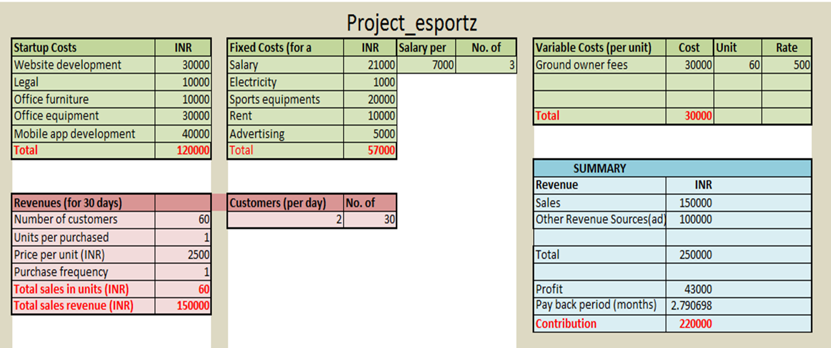
FINANCIALS

Slide 12
MILESTONES AND METRICS
Have created an overview of our idea, the various business model and financials and about to develop an app and website after that.

Slide 13
RISK EVALUATION AND COPING STRATEGIES
Technical risks-
Working of app
Condition of playground
Market risk –
Competitors providing grounds at lower price and with some added benefits and discounts.

Slide 14
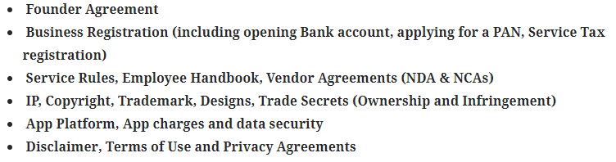
LEGAL ENVIRONMENT

Slide 15
VISION
Our vision is to provide sports playground for everyone and also to promote a culture of health and happiness through sports. Through our online platform, we want to be able to assist those who love to play sports but face multiple problems. The biggest issues we uncovered are firstly discovering grounds to play in, planning a tournament and locating like-minded sports partners to play with. Our mission at Project_esportz is to make playing and enjoying sports as easy as possible.

