Slide 1

CORPORATE SPORTS LEAGUE (CSL) kick away YOUR office blues….
PRESENTED BY: Group 4
Shivam Nagpal (19DM198)
Shreya Chopra (19DM204)
Shruti Gupta (19DM238)
Sonal Jain (19DM218)
Tanya Bhardwaj (19DM227)
Yash Khurana (19DM236)

Slide 2


COMPANY’s PURPOSE
We not only help organizations in keeping their employees motivated, refreshed and healthy but also help them in passing on important messages on effective communication and team work through fun and light hearted games and sports. We have come up with this idea, looking at the current problem of high stress rates that a lot of MNCs are facing as they are not able to keep their talent engaged, connected and happy at their work places.
Positioning Statement
‘For the corporates, who would want to kick away their office blues, CSL is the perfect fun and healthy gateway to lower your stress rates at an affordable price to increase your employee’s productivity and job satisfaction, creating a sustainable work-friendly environment’

Slide 3
PROBLEM STATEMENT
About two third of the employees today are tired and have a persistent feeling of fatigue, contributing to inefficiency and a downfall in the employee’s productivity.
Due to hectic schedule and unrealistic deadlines to be met, corporations aren’t able to organize powerful events in order to boost their employee’s morale.
It is imperative to organize few fun and healthy events while simultaneously making sure that the employees are fit and healthy to contribute towards the organizational goals.

Slide 4


SOLUTION
Third party vendor and service provider who organizes corporate sports events for various targeted companies
TAGLINE
WE PLAN, YOU PLAY!!!
Kick away your regular office blues, leave your hectic schedule behind and enjoy your day to the fullest.

Slide 5

WHY NOW?

Slide 6
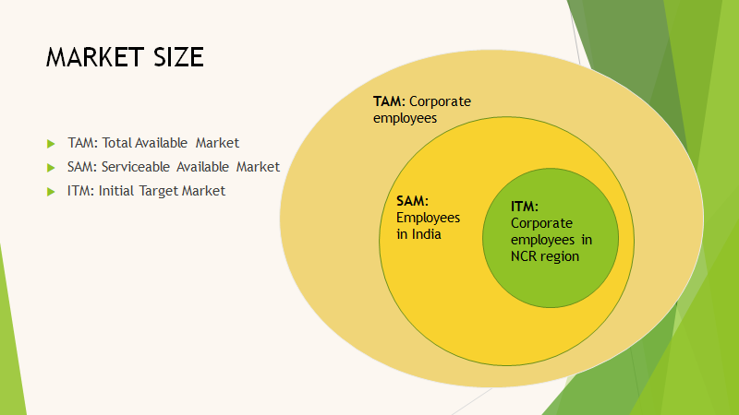
MARKET SIZE

Slide 7
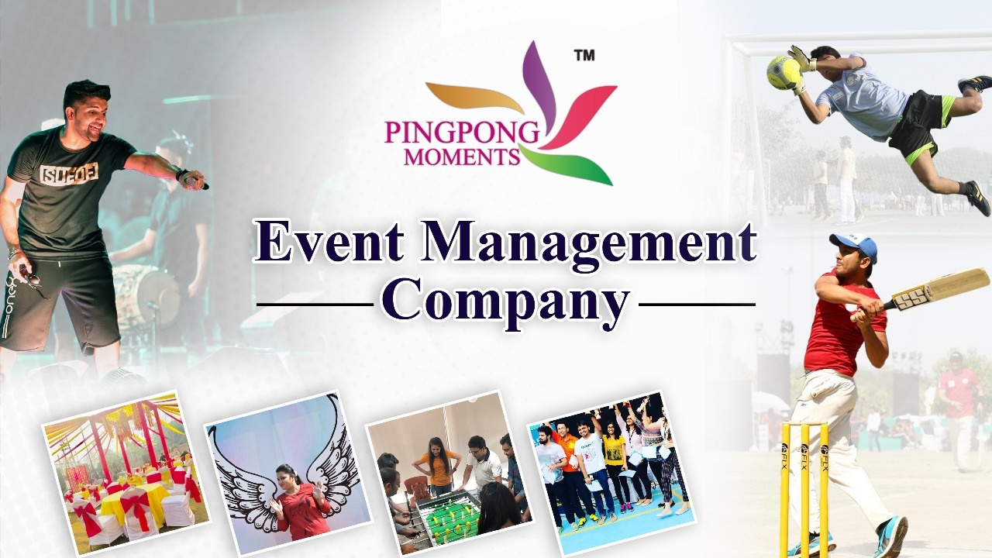

OUR Competitors
One of the fastest growing event management company
specializes in sports and corporate parties.
promote healthy lives, balanced and active communities
Started by Sachin Gupta, A cricket enthusiast & a visionary entrepreneur in 2010 with 16 teams
With objective of "Live your Cricket Dream like a Super Star" it recently finished its 8th season with 102 teams

Slide 8
Competitor Analysis
Company | Core Business | Target Market | Taglines | Strengths | Limitations
PINGPONG MOMENTS | Sports and corporate parties | Working professionals, Schools, clubs | There are few moments in life that remain unforgettable. We call them magical moments. | Wide customer base | Large number of players in the market
PRO CORPORATE LEAGUE | Corporate cricket league | Working professionals | "Live your Cricket Dream like a Super Star" | Fast growth rate | Niche market
CORPORATE SPORTS LEAGUE (Our Company) | Sports league for corporates | Working professionals | WE PLAN, YOU PLAY: Kick away your regular office blues, leave your hectic schedule behind and enjoy your day to the fullest. | Fresh concept | Niche market

Slide 9
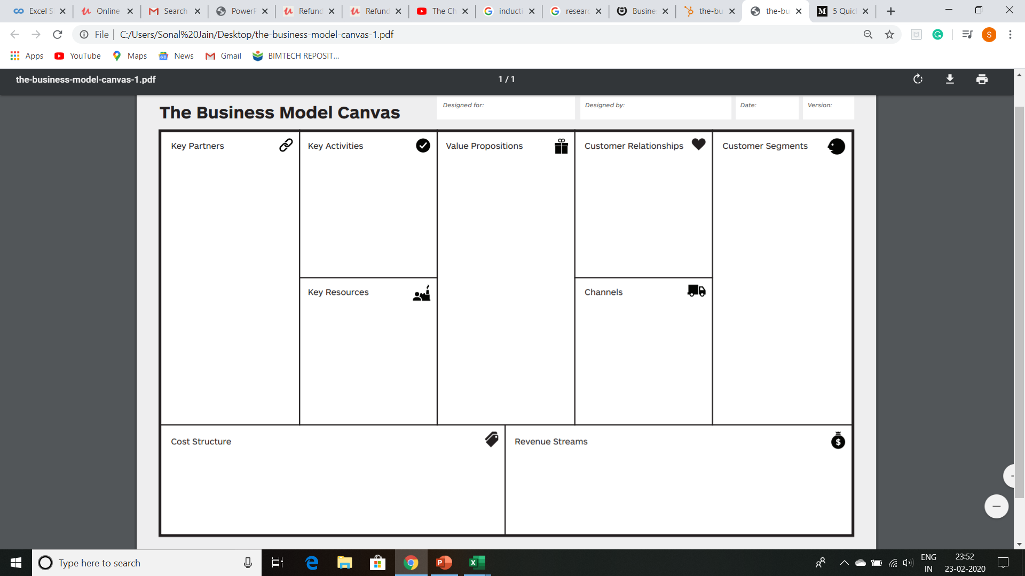
THE BUSINESS MODEL CANVAS
Corporates
CSL
2020
1.0
Sponsors
Ground Owners
Equipment Providers
Corporates
Act as a third party vendor to organize sports tournaments for various corporates across our target market
Organize extra-curricular and sports activities for corporates
Destress employees by holding refreshing events
Training employees on team work, effective communication etc. through management games.
Increased productivity of individuals
Lower turnover rates, as the employees have greater work satisfaction
Word of mouth
Customer Feedback and personal assistance
Social Media
Corporates in Delhi-NCR Region
Corporates
Media and Advertising
Playgrounds and their owners
Outreach Programs
Loyalty Programs
B2B Advertising
Channel Cost
General operations expenses
Advertising and promoting expenses
Equipment and purchase expenses
Ground booking fees
Fees income

Slide 10

MANAGEMENT TEAM
CHAIRMAN-SHIVAM NAGPAL
CHIEF FINANCIAL OFFICER -YASH KHURANA
TREASURER-SHRUTI GUPTA
VICE CHAIRMAN- SONAL JAIN
SECRETARY- SHREYA CHOPRA
CHIEF MARKETING OFFICER- TANYA BHARDWAJ

Slide 11
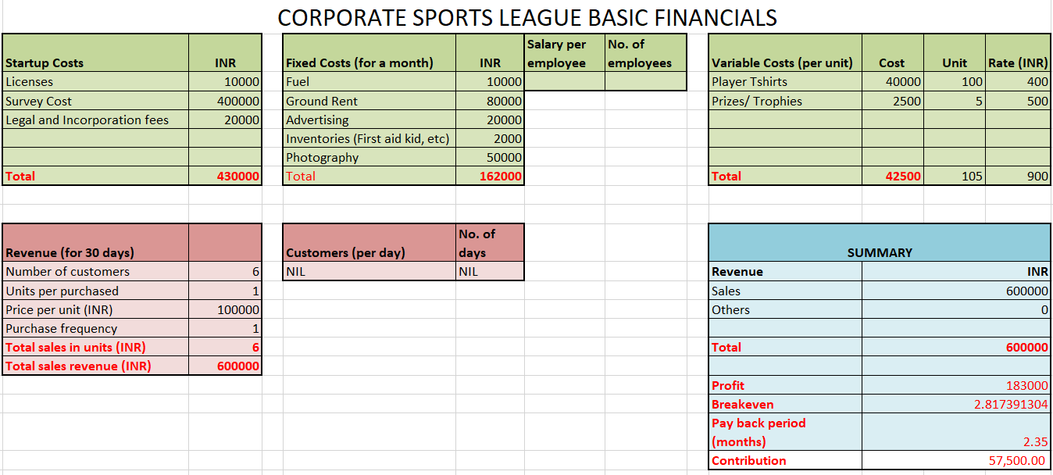
FINANCIAL PLAN

Slide 12





MILESTONES
(Projected)
Achieved its first million dollar project in 2025
Started in 2020
20 clients by 2022
Received funding from investors 2024
Achieved bench mark of organizing 100 successful events in 2022

Slide 13
RISK EVALUATION AND COPING STRATEGIES
We will use number of risk management strategies to prevent the emergence of adverse events for example -
Unstable and volatile environment where uncertainty dominates as well as related business risk (risk of failure, unforeseen losses)
Complexity of economic relations, political influence and different human behavior
Unlike uncertainty, risk represent the degree of stability of organization while achieving its goals
Unwanted damage, loss or pulling out from achieving the objective related to a specific business venture .
Emergency interventions( healthcare, evacuation of the injured, safe exit from the facility)
Planning the security guard system and attendants at the sports facility .

Slide 14

LEGAL ENVIRONMENT
Company Structure:
Partnership firm registered under ‘Indian Partnership Act’.
Registration under ‘Shops and Establishment Act’.
Number of members: 6
Licenses and Compliance:
Approval from signing authority to conduct the event
Budget approval from relevant departments
Approval from the ground authority
No objection certificate.
Public works department license

Slide 15

“To be one of the fastest growing events management company specializing in sports, public events, inaugurations and corporate parties by giving an opportunity to build strong businesses, thus promoting healthy lives, balanced and active communities.
Our primary motive is setting and achieving targets and moving beyond our limits in life, business and technology, enabling people to maintain a healthy work life balance through expertise, exclusivity and engagement.”

Slide 16

Sports contest
Brand partnership
Sharing content and photos
Sponsorship
By creating engaging contests

Slide 17
Marketing channels
website

Slide 18


Advertising channels
Powerful Invitations
Attractive Website
Pay-per click advertising
Handouts
Online-offline amalgamation
Word of mouth

Slide 19


