Slide 1

When you have Zomato for food, Uber for travel, then why step out to get your Car fixed?
Presenting
AUTO PILOT
“GAADI APKI, FIKAR HAMARI”
SUBMITTED BY:
Group 4 (SECTION C)
Sumit Pachisia 19DM223
Sonali Jain 19DM219
Ravleen Kaur 19DM157
Siddhartha Agarwal 19DM213
Anuvesh Sachdeva 19DM250
Rishabh Jain 19DM161

Slide 2




PAIN AREAS OF THE CUSTOMER
PROBLEMS
Poor Transparency in the System
Lack of Time
Trust Issues
Commute Problem
Price Exploitation

Slide 3




SOLUTION
Vehicle broke down? No Problem. Find service centers nearby and book a service of your choice.
Online service
Repair on site
Car for Car
Let the customer’s book/schedule their service via the App in a superfluous manner.
Given your car for service? Rent a car for a day with the most economical price.

Slide 4




The market research data states that only one third of the cars go back to dealer workshops post warranty and rest opt for local multi brand garages, which can provide reliable and cost effective service with closer home advantage.
Provide an online platform that allows users to search & schedule for car service and cleaning service.
We provide complete package for your car at your door step.
Want to bring quality car care to your doorstep & save time for better things in life.
Automated scheduling for our old customers which detects when service of their vehicle is due.
Multi Brand car servicing stations which provides cost effective and high quality repairs and is the future of car servicing industry in India.
WE PROVIDE

Slide 5
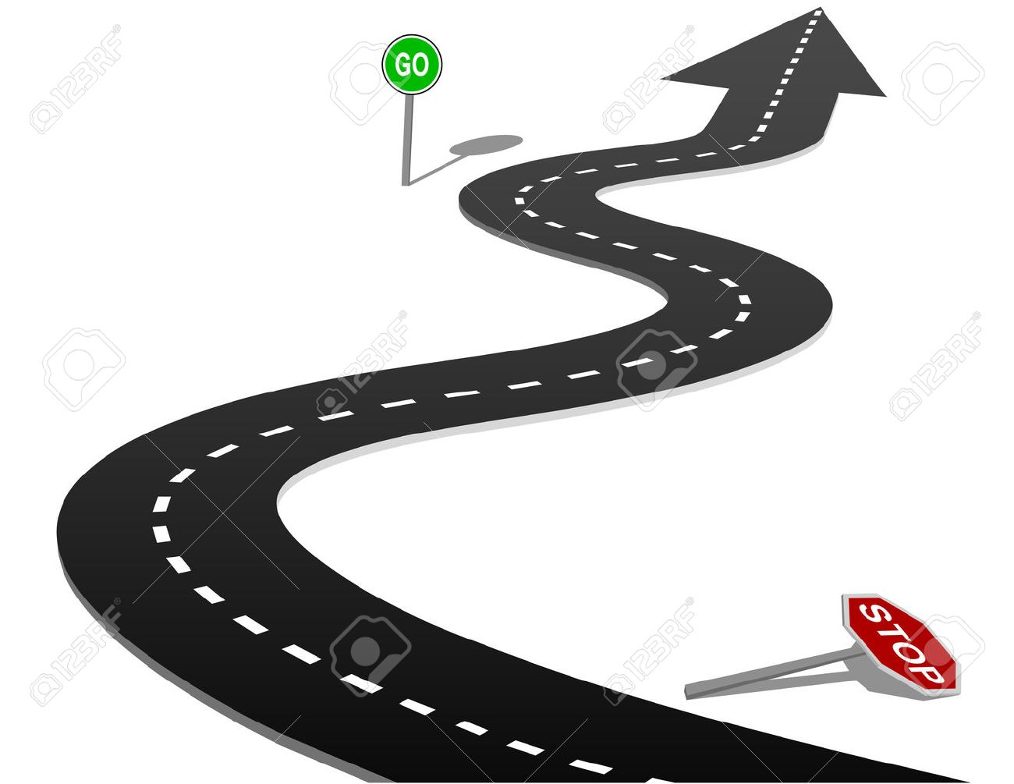

WHY NOW?
Online Auto Repair Marketplace Open bay Launches To Connect Car Owners With Local Mechanics
Battery problems are common all over the world during weather changes or negligence of customer using more electric power when car engine is switched off.
These reasons suggest that this industry has huge potential to grow in the upcoming time.
According to Market Research Analysts, Car Servicing Business in India is expected to grow exponentially in the near future.
In terms of revenue, car servicing industry is slated to be at ₹33,000 Crores by 2020, up from present ₹20,000 Cr.

Slide 6

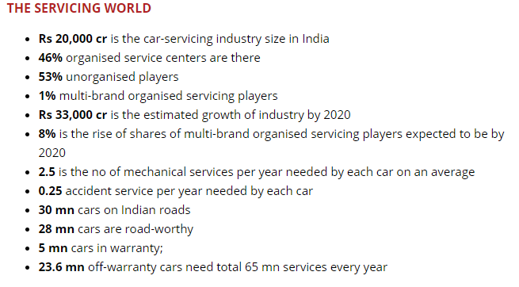

CONTINUED
“The auto servicing market, currently pegged at Rs. 20,000 crore, is expected to be worth Rs. 33,000-34,000 crore by 2020.”
-Colonel Y. S. Katoch
(Co-founder CarXpert)
With growing distrust in the after sales car service market, there exists a need for a new business model which can fill the void by providing Price Discovery and Quality Assurance, both at the same time.

Slide 7
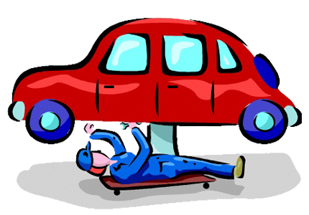
STP
S
T
P
Geographic: Urban cities of India
Demographic: Middle to high income group
Age Group: 25-40 Years
Cities: Delhi, Mumbai, Chennai, Kolkata and cities with high income growth rate.
Young executives
Businessmen
Urban families
Lower middle income and middle income: Online Service and service on site
High income group: Car for car
Predominantly focused on mass market

Slide 8
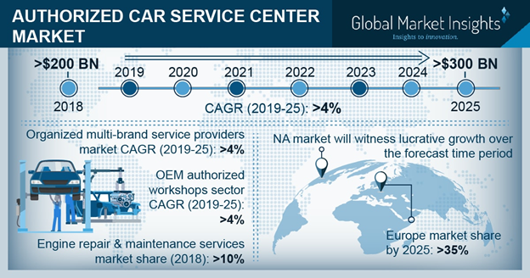
MARKET SIZE
INDUSTRY TRENDS
Authorized Car Service Center Market size valued at USD 200 billion in 2018 and is estimated to exhibit over 4% CAGR between 2019 and 2025.
As per Global surveys, 62.69% complaints are that engine is not starting. The figure could be same or around in India. Battery problems are common all over the world during weather changes or negligence of customer using more electric power when car engine is switched off. 19.40% complaints are with tyres and wheel issues. Rest problems are with mechanical.

Slide 9
COMPETITOR ANALYSIS
Company | Founders | Founded | Area | Core Business | Target Market | Revenue Stream | Platform | Spread/No of customers | Strength | Limitation | My Differentiating factor
Car Zippi | Suman Howlander | 2015 | Bangalore | Doorstep car care services | Urban Cities | Commission model | App/Web | Bangalore | Not disclosed | Expensive No real time problem solving Already existing solution. Highly competitive market | Real time problem solving Inexpensive High transparency Aggregator business model
MeriCAR.com | Rakesh Sidana | 2008 | Delhi NCR | Market place and Aggregator model | Urban Cities | Subscription models | App/Web | Delhi/NCR, Gurgaon and Noida | Not disclosed | No doorstep car care services offered Slow growth and expansion since inception Does not tie up with the local players and offer solutions but, just helps users identify nearby workshops | Doorstep care services offered. Planning to expand business on a large scale in short span of time. Tie ups with local players, customers are routed through our platform
Bookmycarservice.com | Raj Hasan Nagaraja | 2014 | Bangalore | Listing local players on its platform | Urban Cities | Fee per service | App/Web | Bangalore | Not disclosed | Almost like what we offer | Car for car service not available
Auto Yaar | Bharat Ostwal, Sunil Gupta, Amisha Shah and Abhishek Gupta | 2015 | Ahmedabad | Aggregator platform | Urban Cities | Fee per service | App/Web | Ahmedabad | Not disclosed | Almost like what we offer | Car for car service not available

Slide 10
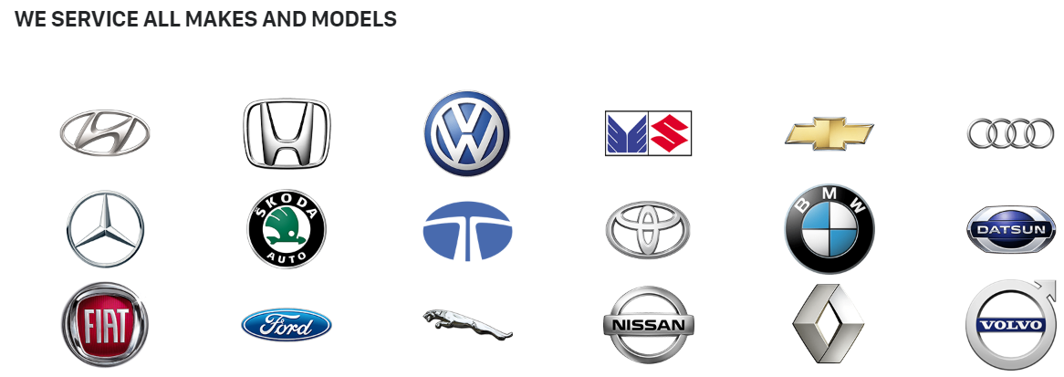
COMPETITIVE ADVANTAGE

Slide 11
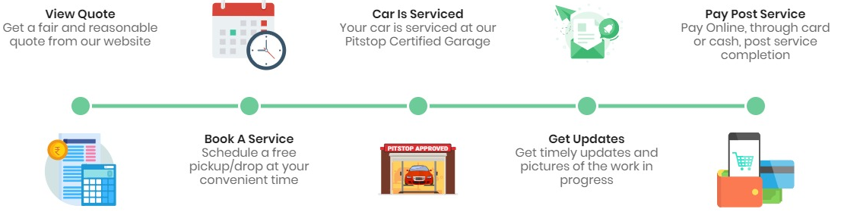
PRODUCT FUNCTIONALITY

Slide 12
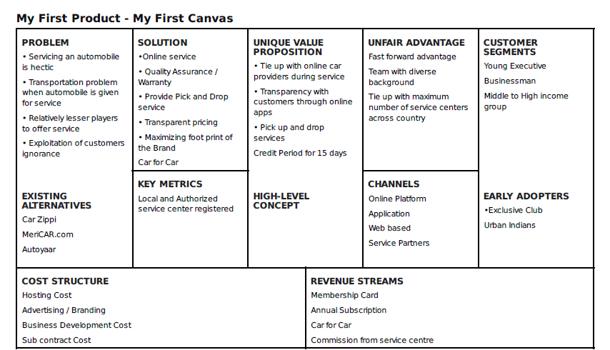
PRODUCT CANVAS

Slide 13
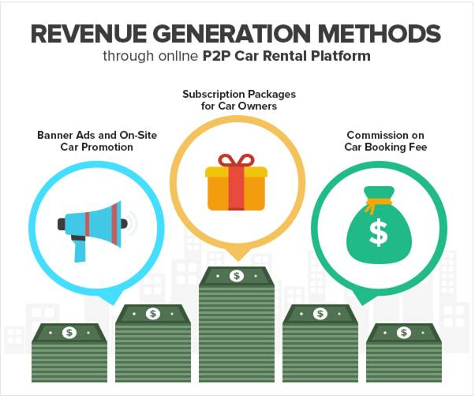

REVENUE MODEL
FUTURE PERSPECTIVE
1) Sales Commission – service based Commission
2) Small Fee from vendors to use technology platform
3) More commission on achieving daily target
4) Corporate retainer Tie-ups
5) Bonus of pull spare parts from Suppliers
REVENUE STREAM

Slide 14
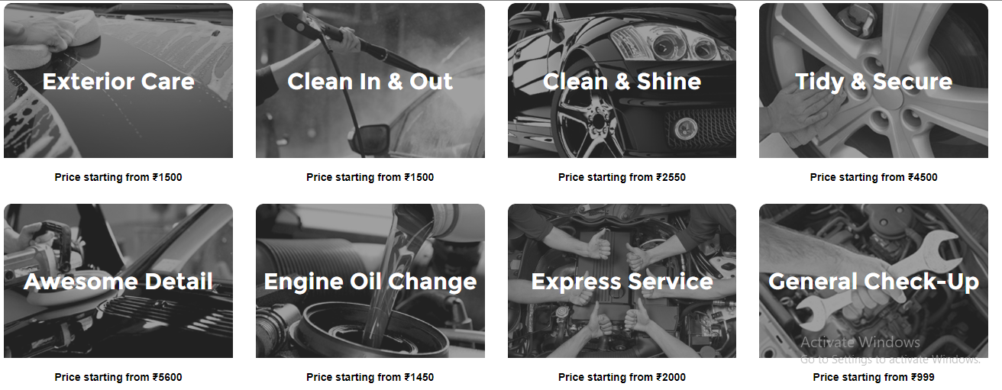
PRICING MODEL

Slide 15
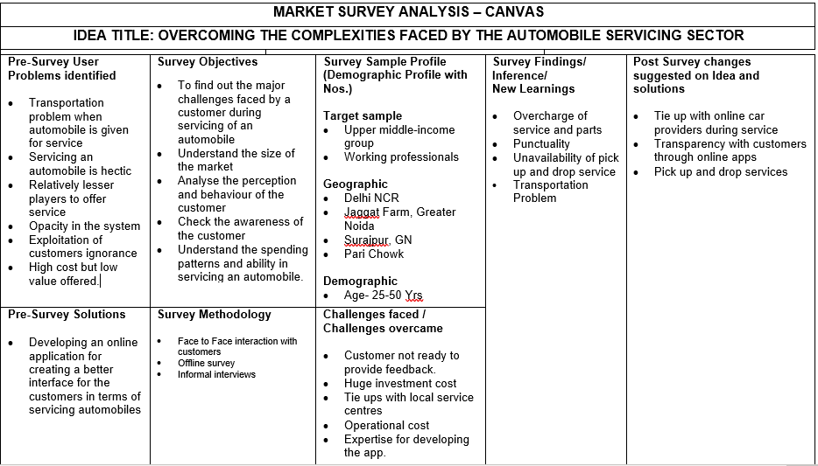
MARKET SURVEY ANALYSIS

Slide 16

BUILDING CUSTOMER RELATIONSHIP
1-Referrals credit point
2- Offers on First Service
3-Credit point in delay in Service
4-Promotion & Offer
5-Always ask for Customer Feedback to improve the experience

Slide 17
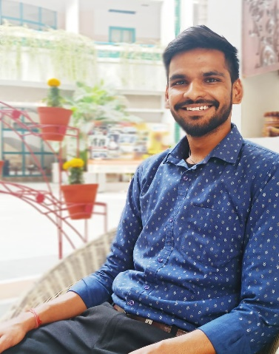


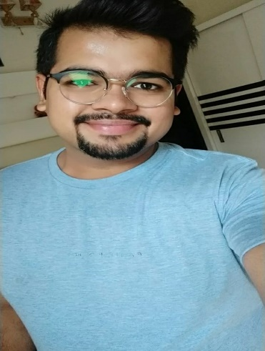
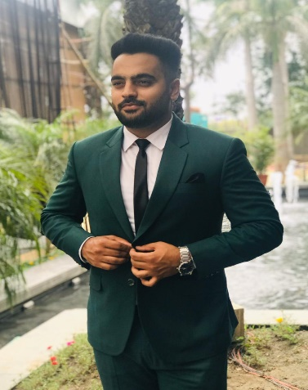
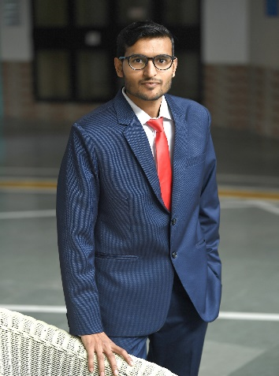
FOUNDERS AND MANAGEMENT
SUMIT PACHISIA
Founder
SONALI JAIN
Co- Founder
RAVLEEN KAUR
Head- Strategy
RISHABH JAIN
Head- Finance
ANUVESH SACHDEVA
Head- Operations
SIDDHARTHA AGARWAL
Head- Marketing

Slide 18
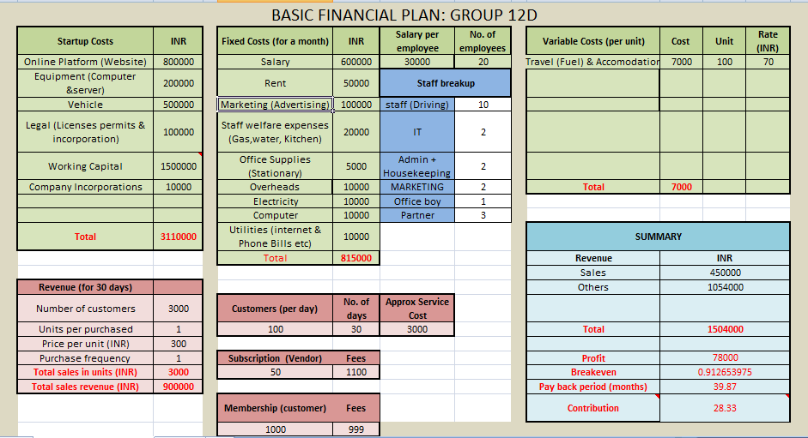
FINANCIAL PLAN

Slide 19


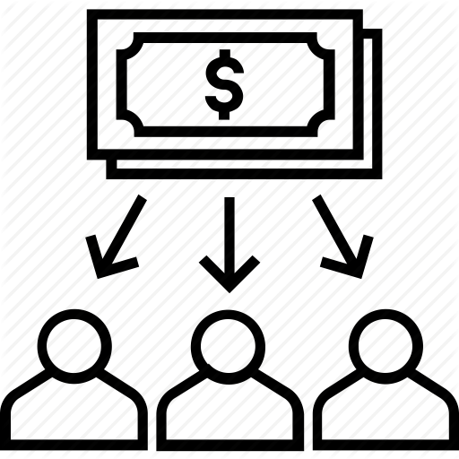




COST STRUCTURE
Marketing, branding & promotion deals
Technical & non technical infrastructure
Office space & office resources
Staff salaries, commission, utility & other regular expenses
Legal costs

Slide 20



We are hoping to become Pan-India by 2025.
The Startup is also working on pilots to get into vehicle insurance, road-side assistance, and auto-parts and accessories sectors.
By the end we will be targeting 3 major car parking lots in Delhi, where we are expecting to serve 20 cars per day from each parking lot.
This will give us access to 5000 cars on daily basis where we can promote car service business.
The number of workshop signed will increase to 50 as we would cover more car brands and locations in Delhi.

Slide 21


