Slide 1
BUSINESS PLAN DOCUMENT
Documented By:
Pooja Rawat 19DM133
Shinjini Ghosh 19DM195
Shireen Ahmed 19dm196
Shubhali Singh 19DM208
Shubham 19DM209
Tuhina priya 19DM229
Mentored By:
Dr. Shalini Singh

Slide 2
Company Purpose
“ We provide you ease of dressing with premium lineups, easy rentals, return and long term ownership ”

Slide 3
PROBLEM
Keeping up with the new age lifestyle of slaying at personal looks while being in the limit of budgeted monetary constraint.
To deal with the issue people buy clothes or borrow from roommates or all together do not do anything about it if the money value is too high

Slide 4
Solution
ØWe give you latest fashion wardrobe at affordable price at rent, so that when you are bored of the looks you can get new ones.
ØWith same budget for three months you get bigger wardrobe.
ØDon’t spend large amount of your money on dress you are going to wear only once, just select the dress and rent it from us.
You can get our products at our store or at online website

Slide 5
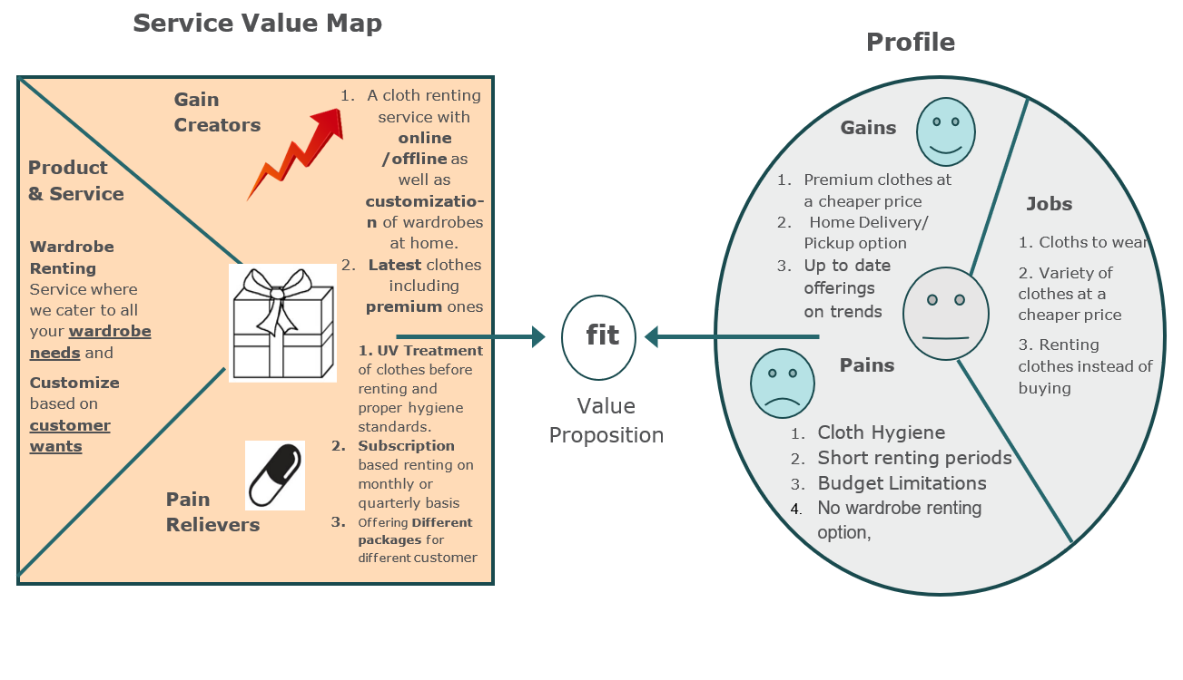
Value Proposition

Slide 6
Why now
According to research done by Mckinsey rental business models are extremely relevant in 2020 as cost of ownership increases and trends are short-lived.
This trend is partly driven by the young generation’s hunger for newness, while embracing sustainability. Research shows that average consumers today buy 60 percent more items of clothing than they did 15 years ago. But consumers keep that clothing for only half as long as they used to. For example, a survey done in Britain found that one in three young women consider clothes “old” after wearing them once or twice. One in seven consider it a fashion faux pas to be photographed in an outfit twice. Simply put, young people today crave newness, and these cohorts are much more likely to embrace churn in their wardrobes. At the same time, younger generations are more interested in sustainable clothing than older consumers. Rental, resale, and refurbishment models lengthen the product life cycle while offering the newness consumers desire.

Slide 7
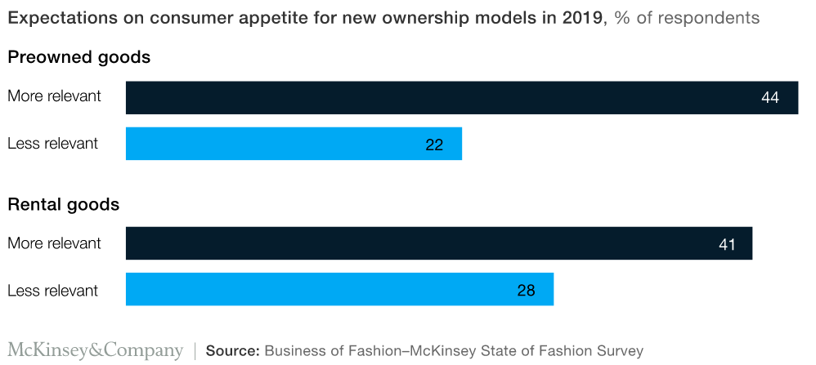
Why now

Slide 8
Market size
TAM
People enthusiast for stylish and on the point presentation targets metropolitan cities with a gross population of 52,950208 in cities like Delhi, Mumbai, Bangalore , Hyderabad, Chennai, Kolkata, Ahmadabad
SAM
College Students, Corporate Employees, People working in fashion industry, Mid income groups consists of 18003070 people that can be served with our rental model
ITM
There are about 500,000 university students in Delhi NCR attending around more than 165 universities and colleges of which we need to reach at least 3% at 14600 young enthusiasts.

Slide 9
Competition
Competitors and their competitive advantages
Stylobe- 200+ outfits available at store
flyrobe - Large collection of party dresses with attractive rental options, free delivery and pickup
Stage 3 -Free home trials and personalized styling assistance, plus size selection
Notes:
Yaha competitors analysis se daal dena shubham..mere me select in ho raha wo part

Slide 10
Product
Platforms- Rent-O-Robe store, Online and App Support.
Service- Stores and website for wardrobe selection and delivery.
Type- Mobile Focused, Personalization, long term rentals, focused on regular lifestyle, Customizable wardrobe at an affordable price.
Product-
A selection of wardrobe items catering to current trends as well as business formals for rent. The items can be customized as a pizza can be with the dressing of your choice or our recommendation.

Slide 11
Business Model
Revenue model- A subscription rental model to grant customers access to an array of clothing and accessories free of additional charges. Customers that like a particular piece have the option to buy it outright.
Pricing- 3599 per unit for 3 months(A unit has multiple items including accessories)
Average account size and Customer lifetime value- 60 customers per month averaging 2 customers a day with a customer life time value as 16882.86
Sales & distribution Channels- Stores, online access and mobile application for sales
Warehouse as a central distribution point for sales channel
Customer/pipeline list- 60 customers per day

Slide 12
Team
Founders – Shubhali Singh and Shubham
Management- CEO- Shubhali Singh
COO- Shubham
CMO- Pooja Rawat
CTO- Tuhina Priya
CPO- Shireen Ahmad
CSO- Shinginie Ghosh
Board of Directors/Board of Advisors-
Manish Malhotra
Savya Sanchi

Slide 13
Financials
Costs and Expenses-
Startup costs- 106500 RS.
Fixed cost- 97125 RS.
Variable cost- 10800 RS.
Revenue by the Month - 215940 RS. Projections for one year – 2915190 RS. (near 13.5 months)
Expenses by the Month - 107925 RS. Projection for the year – 1300000 RS.
Profit / Loss by the Month – 108015 RS. Projections for one year- 1615190 RS.
Breakeven 62 units in 1.2 month optimistic or 2.5 months pessimistic
Assumptions- sales of 60 units within a month
Sources and Use of Funds- 100000 RS. As investment from venture capitalists for startup and running cost

Slide 14
Milestones and Metrics
In 12 to 18 months we expect have offline presence in all the metro cities and online presence in all nearby cities of offline stores.
We expect to be well trusted brand for our customers, and we plan to customer retention as the metrics of success.
To measure the success of our company we will measure growth rate of number of customers in every month and quarter (seasonal change)
Reusability of products is also metrics for growth.
Cost Of Acquiring customers will be 10500 RS. Based on conversion rate of 5% at 730 customers from a reach of 14600 potential customers with a retention period of 4.3 months

Slide 15
Risk Evaluation and Coping Strategies
As the idea is very new, might fail so we plan to have test market.
Higher than expected expenses so we are keeping a range of products available i.e. high end to low end
Unable to find good location is a high risk in metro cities so we plan to have more powerful and interactive online setup
Customer returning damaged clothes is also a high risk situation for which we decided to keep staff for specific purpose of checking and having contract with customer to deal with such issues.
Getting the product to customer and dealing with the delay in service is our priority but is for any reason that fail then the customer will get continuous update of the reason of failure and redeemable points for next purchase

Slide 16
Legal Environment
Incorrect Legal structure of the new business
Absence of a founder’s agreement
Not having proper licences
Ignorance of applicable tax laws
Secure bank account with transparency
No legal protection for Intellectual Property Rights
Employment Contracts

Slide 17
Vision
If all goes well, In next five years –
We will be well known and trusted brand
We will have tie ups with all big clothes retail chains
We will be connected through most of the ecommerce websites
We will have atleast 50 offline designing and clothing stores all across India
We will be coordinating with big fashion designers
We expect to have sales force of about 1000 people.

