Slide 1
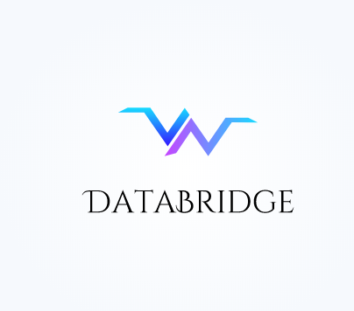

Slide 2
Company purpose
Our company will provide the quality data required to train the machine learning algorithms.

Slide 3
Problem
To gather data, a company that builds machine learning algorithm needs to set up a separate department which is time and cost consuming. They require data in huge amount without which their algorithms cannot be trained.

Slide 4
Solution
To solve the problem, the companies that require the data to training their algorithms can outsource their requirement to us which will be very cost effective when compared to setting up their own department.We will provide them the quality training data that they require in a specified period of time.
We will provide hard to obtain data at scale for companies where access to new data is critical or where data can create a competitive advantage in their data models.

Slide 5
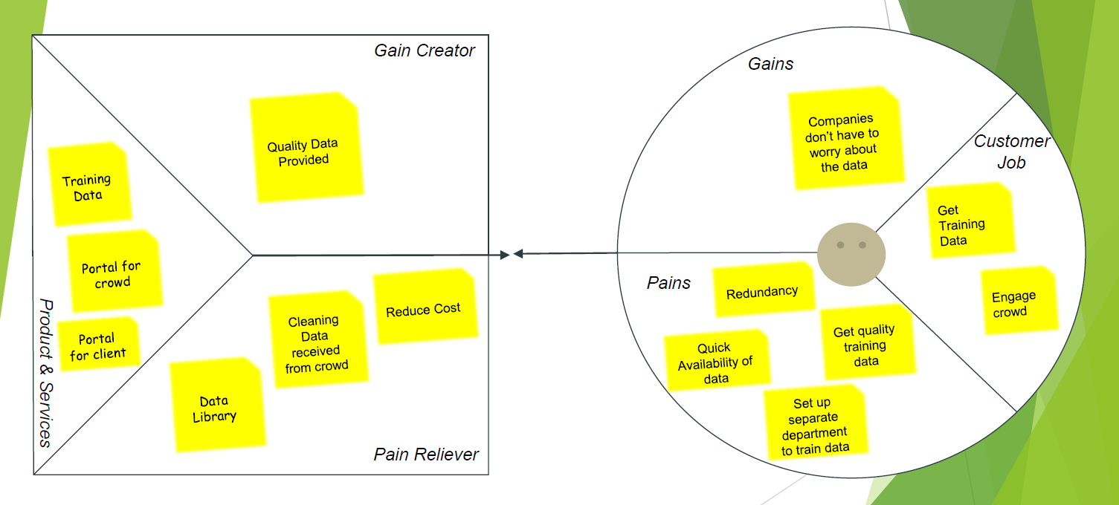
Value proposition

Slide 6
Use Cases
Computer Vision - From spatial data and object recognition, to semantic understanding and 3D point cloud annotations, we bring a greater understanding of the visual world with detailed, accurately tagged images and datasets to improve the user experience.
NLP - Accurately tag and annotate images and videos, train sentiment, semantic, syntax, and context analysis, and categorize and process statements, all to prepare datasets for smarter natural language processing algorithms across the automation ecosystem.
Transcription - Save time and money by efficiently and accurately transcribing detail and leveraging optical character recognition from a host documents as well as image, video, and audio so core business processes can be executed rapidly. Additionally, datasets can be leveraged to gain key insights and metrics for more actionable, real-time reporting, allowing you to focus your valuable time elsewhere.

Slide 7
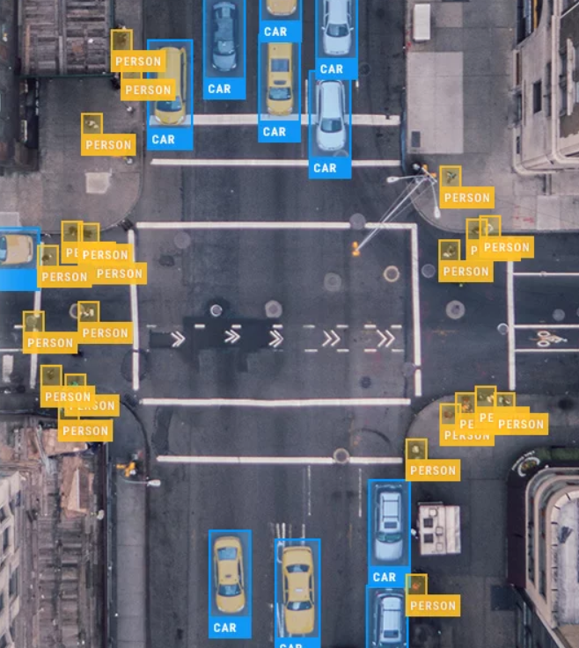
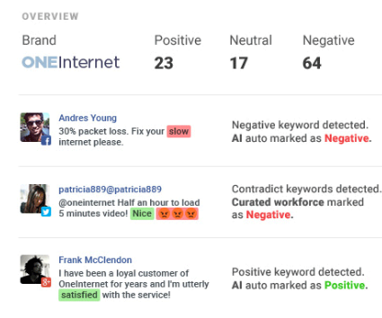
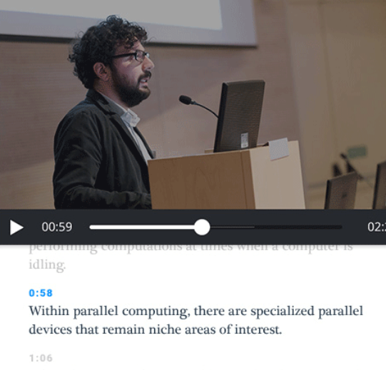
Use Cases
Computer Vision
NLP
Transcription

Slide 8
Target Market
Data labelling companies
Text analysis companies
Research students building data models

Slide 9
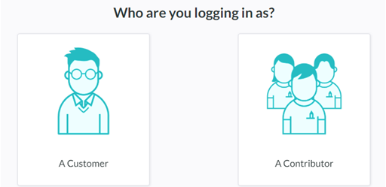
Competition
Our biggest competitors in India are Playment (2015) & Bridged AI (2018)
Our Advantage over them will be that we are adding value to our crowd also, where as our existing competitors don’t have means to engage crowd.

Slide 10
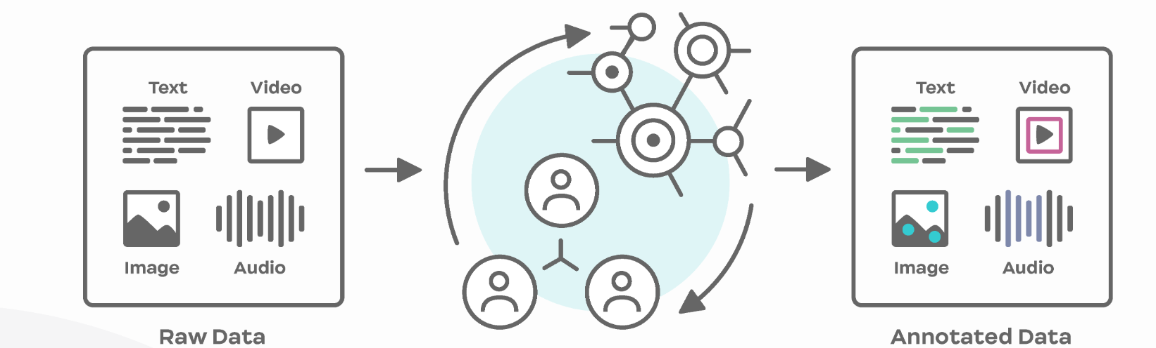
How?
Our platform
If a company need labels and annotations for their machine learning project, we can help. They just need to upload their unlabeled data, with the rules they need for their machine learning project, and launch. We use a distributed network of human annotators and cutting edge machine learning models to annotate that data at enterprise scale.

Slide 11
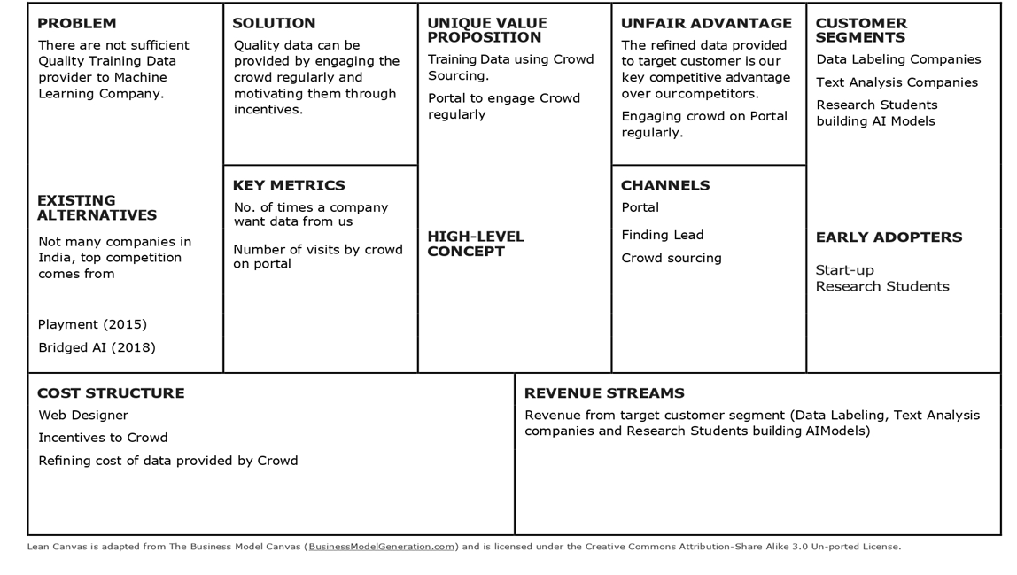
Business Canvas

Slide 12
Team
Radhika Garg - CEO
Rushabh R Parate - COO
Sahil Kumar - CFO
Priyal Vijaywargia - BoD
Sai Arpita Das - BoD
Saket Mahawar - BoD

Slide 13
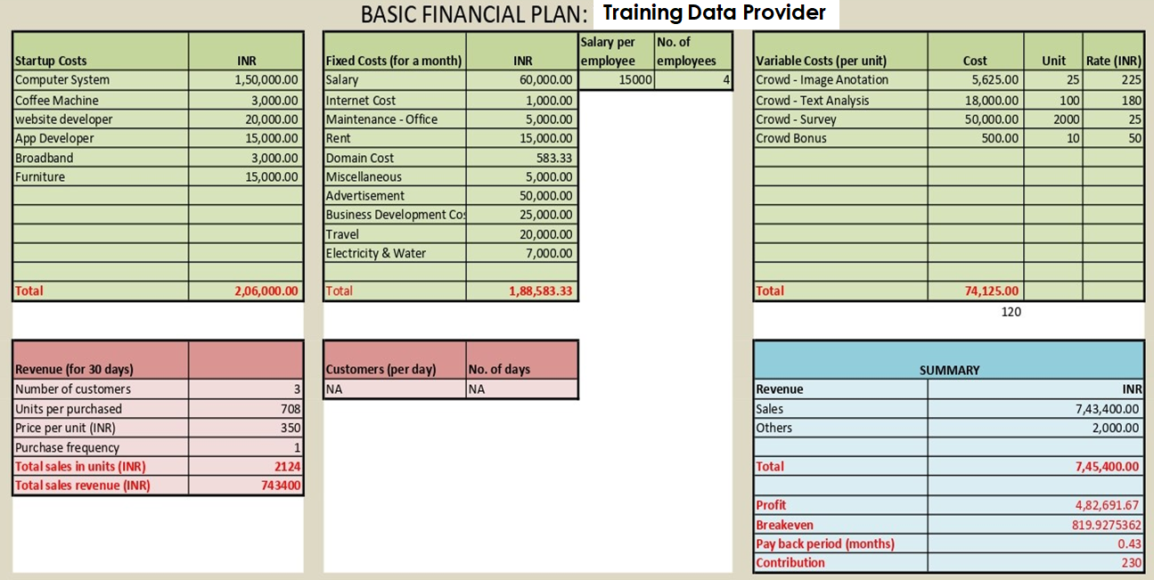
Financials

Slide 14
Our Mission
In a world where data is a powerful resource, we provide it at scale. Using a combination of trending technology and talented workforce, we intend to save you from the burden of creating data, while you focus on its involvement in your operation.
Our mission is to help companies accelerate their AI development by providing core data related solutions, significantly reducing the time to market.

