Slide 1

GPS & Geo-Tagging Enabled Shopping
GROUP:3
Deepa Raghuwanshi (19DM065)
Malay Pant (19DM100)
Manikant Jaiswal (19DM102)
Manvi Garg (19DM105)
Mariya Ali (19DM109)
Mohd Sahil Zaidi (19DM113)
1

Slide 2


Company Purpose
To provide a solution for the daily shopping needs of the people through reminder based application by using GPS
We aim to provide best offers and a wide variety of products at tip of your finger.

Slide 3
Problem
People forget:
A person wants to buy a commodity but in the fast paced life, people tend to forget or get distracted by the situations, hence the app would work as a reminder for the customer.
Search assistance:
People like to explore and hustle.
The demand of the buyer can be met at more than one place in todays time.
Due to a garland of choices to the buyer, they avoid taking instant decision.
Vast pool of choices:
Most of the time, we are confused about what to buy and what not to buy because we have so many choices. This leads to delay in purchasing.

Slide 4
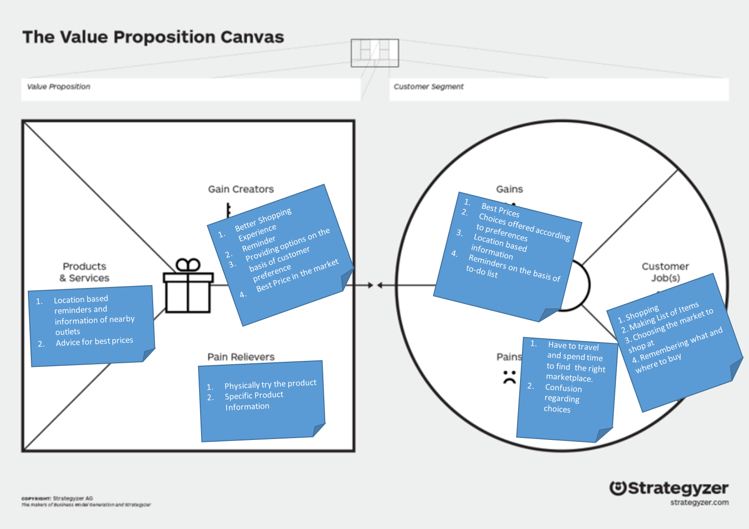
Solution

Slide 5
Solution
When you are travelling/moved to a new city and oblivious of the options available.
Acts as reminding app for the people who are on constant move.
People who thrive for offers.
The users can follow specific stores to avail the early bird offers and get notified about latest introductions

Slide 6
Why Now
Set-up the historical evolution of your category
Retail search and discovery service
Define Industry / recent trends that make your solution possible
Inc. in Telematics
Driving behavior monitor
Integration
Photo & Video Recording
Vehicle Maintenance

Slide 7
Market Size
TAM (Total Available Market):
Delhi, Bangalore (2.85 crore)
SAM (Serviceable Available Market):
Delhi-NCR (2crore)
ITM (Initial Target Market):
Delhi-NCR (90 lakh)

Slide 8
Market Size
Type of Segmentation | Segmentation Criteria | Target Customer
Geographic | Region | India (Currently)
 | Density | Urban
Demography | Age | Anyone above 18 years
 | Gender | Males & Female
 | Occupation | Students, Employees, Professionals etc.
Behavioural | Benefits sought | Finding Information, Reminder
 | Personality | Experimenting, Exploring, Easy-going
Psychographic | Social Class | Lower, Working, Middle & Upper Class
 | Lifestyle | Explorer

Slide 9
Competition
Company | Founders | Year Founded | Area | Core Business | Target Market | Revenue Stream | Platform | Spread/ No. of Customer | Strength | Limitations | My differentiating factor | Remarks/Reason for Failure
Google Maps | Lars Rasmussen, Jens Eilstrup Rasmussen | February 8,2005 | Maps and location using GPS | Web Mapping | Local Audience | Google AdWords | PC(Windows/MacOS), Application based(Android/iOS) | 1Bilion+ | Sound, Compass, Quick Search | no reminder feature, will advice you only when you search for the commodity | more accurate & efficient | _
Apple Maps | Apple Inc. | June 11,2012 | Maps and location using GPS | Web Mapping | Local Audience | Non Profit | iOS, MacOS | 85.8 Million+ | Higher numebr of icons, | no reminder feature, will advice you only when you search for the commodity | more icons | _
Evernote | Ian Small | June 24,2008 | Note Keeping | Organisation | Local Audience | Premium Service | PC(Windows/MacOS), Application based(Android/iOS) | 150million | note taking, organizing, task lists, archiving | features limited for free user | large number of feautres | _

Slide 10
Product
We are provide a service
It will be an website and application based product available on any mobile platform
Features include location tracking using GPS, reminder services, latest offers from our partners, and ideas of preferred products using inbuilt features

Slide 11
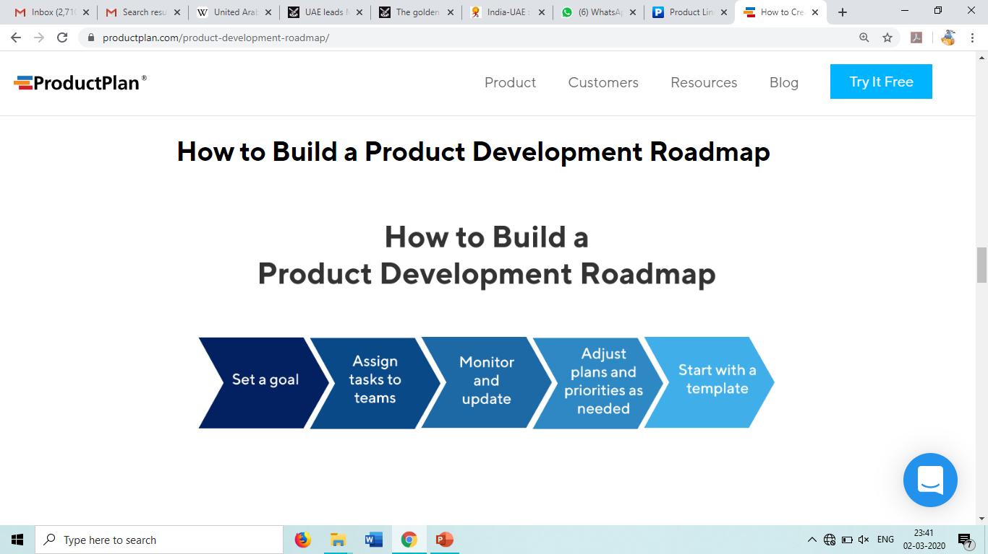
Design of Website & App
Collaboration with stores as partners
Monitoring performance of website
Lead generation and follow up by salesforce
Lead Conversion

Slide 12
Business Model
Revenue model: Subscription Based Business Model with commissions from stores.
Pricing: Penetration Pricing to gain Market Share
Customer lifetime value:Customer lifetime value is the metric that indicates the total revenue a business can reasonably expect from a single customer account. So, in our case we charge Rs. 39/- per month and the lifetime value is around 6 months
Sales & Distribution Channel: Online sales & distribution through Play store and App store and market the product on social media platforms.
12

Slide 13
Team
Founders & Management:
CEO: Malay Pant
COO: Mohd Sahil Zaidi
CMO: Manikant Jaiswal
CFO: Manvi Garg
HR: Mariya Ali
PR: Deepa
13

Slide 14
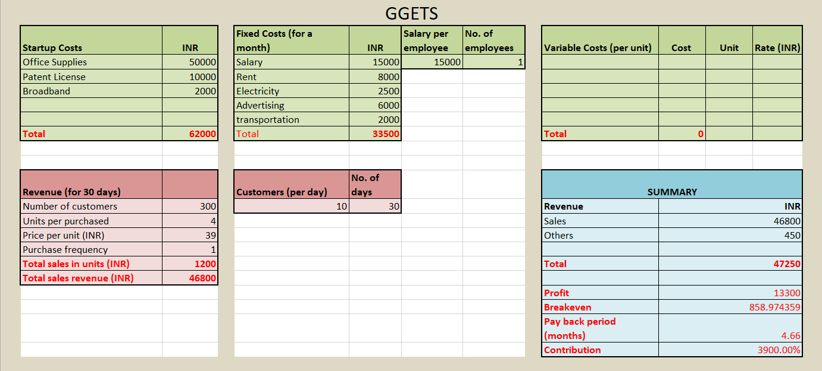
Financials
12

Slide 15

Milestones and Metrics
Milestones
To reach the Total available market (2 crore) in next 5 years.
To collaborate with all the major retail outlets in Delhi NCR within next 3 years
Key Metrics:
Traffic on app/website
Number of downloads from play store/apple store
Number of paid customers
Number of store collaborated with
12

Slide 16

Risk Evaluation and Coping Strategies
Technical Risks
Security breach
Dependence of third party servers
App becoming outdated due to changing technology
Market Risks
Customers changing preference
Competition introducing a replica at lower costs
Customer does not have enough purchasing power
12

Slide 17
Legal Environment
Details on Company Structure:
The company will be Private Limited
Details of Compliances, licences, trademarks or any kind of IP requirements:
Licence is required from The Wireless Planning & Coordination(WPS) Wing of the Ministry of Communication & IT for making GPS operational
12

Slide 18
Vision
If all goes well, what will you have built in five years?
To become the No. 1 company in the industry known for their services, catering to its customers in best possible way by providing excellent services at affordable prices.
12

