Slide 1
E-LAB
BUSINESS IDEA- “AUTOFORM”
Submitted By-
Group 2C
ABHINANDAN SINGLA 19DM007
ABHINAV GUPTA 19DM008
ABHISHEK SUMAN 19DM013
ANIKA MITTAL 19DM032
BHAGYASHRI SATHE 19DM058
BADAL WADHWANI 19DM056
PGDM (2019-21)
SECTION- C

Slide 2
Company purpose
Providing an app that can be used directly to create a repository and fill forms (examination forms and job applications) directly through a link.

Slide 3
Problem
Filling forms is always a headache.
Different forms requires different information.
Ever ran around looking for documents ?
It takes an average time of 20 - 30 minutes to fill a form.
Ever thought if someone else was there to do that job for you ?
Personally faced the same problem while registering for various entrance examinations and applying for various colleges in under-graduation and post-graduation.

Slide 4
Solution
We will have an app/website where students can update all their information regarding academics, extra curriculars, co curriculars, work experience, hobbies etc. along with uploading original certificates and marksheets for the same with a profile photo which will create a complete student profile similar to a resume.
Information from there can be used directly through a link for form filling for various entrance examinations, forms for different academic institutions or while applying for a job.

Slide 5
Why now?
Students need a platform to fill repetitive data in multiple forms
Time Saving
Cost Effectiveness
Enhanced Efficiencies
Can fill more forms in less time

Slide 6
Market survey
81% people felt it stressful to fill an application form
People are really looking for a ONE CLICK solution
Concern for security of data
Could be provided to customers on subscription basis
Incorporation of B2B model
Target segment
Students- school, under graduates, post graduates
Job applicants
Employees

Slide 7
MARKET SIZE
TAM (Total Available Market) –
  Total enrolment in higher education has been estimated to be 34.6 million.
  Girls constitute 46.2% of the total enrolment.
  79.3% of 34.6 million enrolled in Undergraduates = 27.4 million
SAM (Serviceable Available Market)
  17% of 34.6 million in through higher education + 17 % of 27.4 million Undergraduates = 10.54 million
ITM ( Initial Target Market)
  1% of above total = 0.1 million

Slide 8






Competition

Slide 9
Features
Product Adaptability
Automatically select and fills the required data
Security: E signing for authentication
Online Repository
Updates about deadlines
How are we unique?
1 GB of free space to securely store resident information
Customization
Incorporation of NLP
Can store ‘n’ number of personal data
Automatically select and fills the required data

Slide 10
Business model
Revenue model- subscription based
Average account size and Customer lifetime value – Average revenue per year per account =1499
Sales & distribution Channels- online
Customer/pipeline list- Consult with educational institutions and business organizations to convert prospective users into subscribed users.

Slide 11
team
Abhishek Suman
Founding Chairman
Abhinandan Singla
Managing Director
Abhinav Gupta
CEO
Bhagyashri Sathe
COO
Badal Wadhwani
Director
Anika Mittal
Director

Slide 12
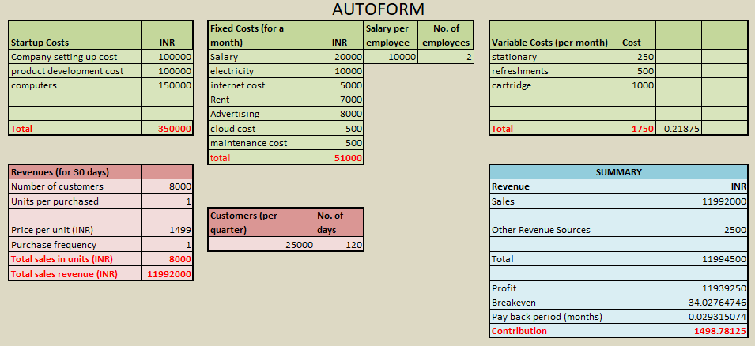
financials

Slide 13
Milestones and metrics
Aim to complete 100,000 active subscription based users/students/employees by end of 2020.
To achieve break-even point by receiving minimum 34 subscriptions.
Collaborate with 20+ organisations(colleges, businesses) in the next 6 months to provide services to their employees/students.
Setup indigenous cloud storage infrastructure within 3 years of operations.

Slide 14
Risk Evaluation and Coping Strategies
Technical risks
Managing the huge database on cloud
Privacy of data
Market risk
Availability of similar products in market
Market penetration
Operational risk
Database management
NLP maintenance
Solution
Cloud storage with uninterrupted internet
Antivirus and Firewall
Solution
Heavy marketing during form filling seasons
Marketing the NLP aspect
Solution
NLP continuous improvement

Slide 15
Legal environment
Company Structure
Management
Planning
Compliance
Operational
Execution
Marketing

Slide 16
Legal environment
Implementing a privacy policy for the data being collected mentioning
  What specific information you plan to collect and store
  How you intend to use the data
  How the data may be shared with external parties
Legally be required to incorporate descriptions of:
  How customers may opt-out of certain collection or sharing
  How users may access or remove their data
  How users can find out when policies change
Protection of data according to the IT Act of India.

Slide 17
Vision statement
We encourage innovation to meet challenges of readily available cloud storage at an affordable cost to cater to the need of fastly transforming digital India.

Slide 18
THANK YOU

