Slide 1

PRESENTED BY:
GROUP 1
Ayush Bedi 19DM006
Kamal Taliyan 19DM087
Kasturi M Ranga 19DM093
Kiran Kumar M 19DM095
Prashant Chauhan 19DM138
Sai Kiran Ambarapu 19DM175

Slide 2
1
2
3
Procure raw material: Oil Seeds
Extract Bio-Diesel by filtration and distillation
Market and Advertisement of the product
6
5
4
Services and Benefits addressing
Sales and distribution management
Service and Process improvement

Slide 3
Company Purpose
Help fuel the business with something renewable, economical and sustainable – Choose Bio-Diesel

Slide 4





Problem
Reliance on conventional sources of energy in agricultural sector.
Need to shift towards environment friendly fuel sources.
Lack of resources to generate bio-fuels.
Lack of awareness among farmers that production of biofuel can be a source of income.
Non-utilization of farm lands.

Slide 5

Solutions:
Create awareness among farmers to use their small pieces of unused agricultural lands to grow bio-fuel plants.
Introduce the concept of cooperative farming to ensure economies of scale.
Setup oil extraction plant to extract oil from seeds and filter to obtain bio-fuel.

Slide 6
Why Now ?
Growing need for conventional fuel and stress in diesel demand and prices.
Encouragement for renewable sources from Indian Government to reduce the carbon footprint.
Nearly 80% dependency of India on oil exports

Slide 7
Market Size
Market size will be very small since the target customers would be mostly businesses and domestic and commercial residencies using generators for power back-up.
Estimated customers are in the range of 1000 to 1500

Slide 8
Competition
Major Competitors
Adi Biotech Pvt. Ltd.
Muenzer Bharat Pvt. Ltd.
Advantages Over competitors:
Providing superior quality product and services at competitive prices
Committed to total customer satisfaction.
Highly adaptable to changes in the biodiesel market.

Slide 9
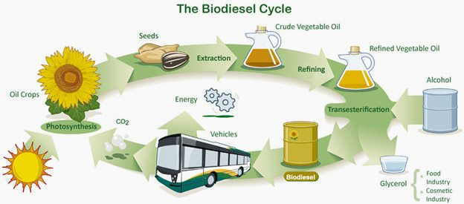
Product

Slide 10
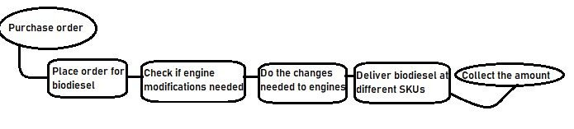
Business Model
Revenue model: Sales based on credit or cash
Pricing: Lesser than conventional diesel ie at Rs ~50 per litre
Customer lifetime can be estimated as a longer one once dependency is created.
Sales and distribution: On a door-step delivery basis or availability at newly opened distribution centres.
Service Flow

Slide 11
Team
Ayush Bedi Founder/Production Head
Kamal Taliyan Founder/Marketing Head
Kasturi M Ranga Founder/Finance Head
Kiran Kumar M Founder/Admin Head
Prashant Chauhan Founder/Operations Head
Sai Kiran Ambarapu Founder/Sales & Distribution Head

Slide 12
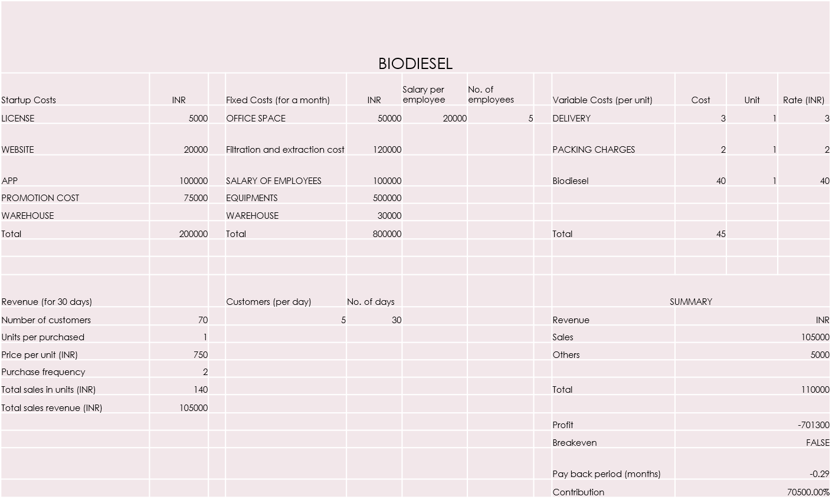
Financials

Slide 13
Risk and Remedy
Risks:
Storage of Bio-diesel.
Usability in diesel generators
Availability of oil seeds for year-round productions
Remedy:
Pull based production facility – flexibility in production
Engine modifications and regular servicing
Storage of oil seeds in silos and vast spread seed procurement methods

