Slide 1

CHEERY PAWS
LOOKING OUTSIDE OF THE PET BOX
GROUP 1A- AARUSHI SETHI, AARUSHI NARANG, AKSHIT VARMA, ANJANI SHARMA, VANSHIKA CHAUHAN

Slide 2

COMPANY PURPOSE
To provide pet services at the convenience of the customers.

Slide 3




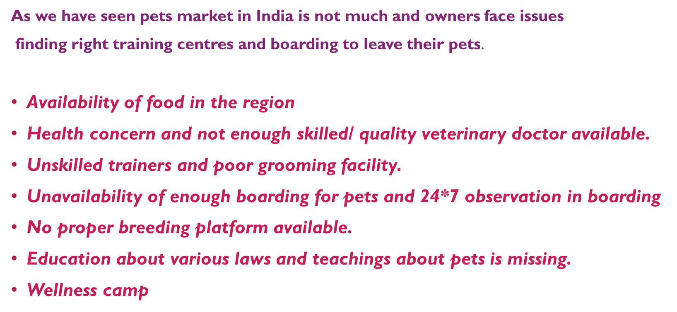

Slide 4
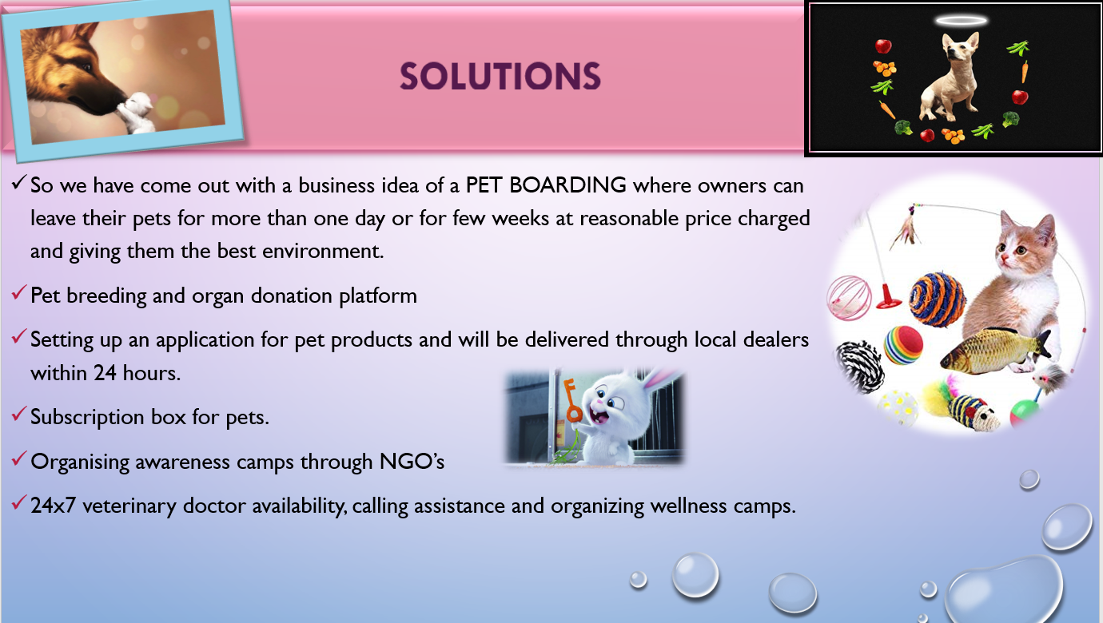

Slide 5

WHY NOW?
Owning a pet is a huge responsibility. You have to make sure it is regularly trained, fed, hydrated, and cleaned up after. You also have to make sure your four-legged friend is in good health. Proper pet care, which includes vaccinations, flea treatment, and grooming, is crucial to keeping your animal healthy and happy.

Slide 6
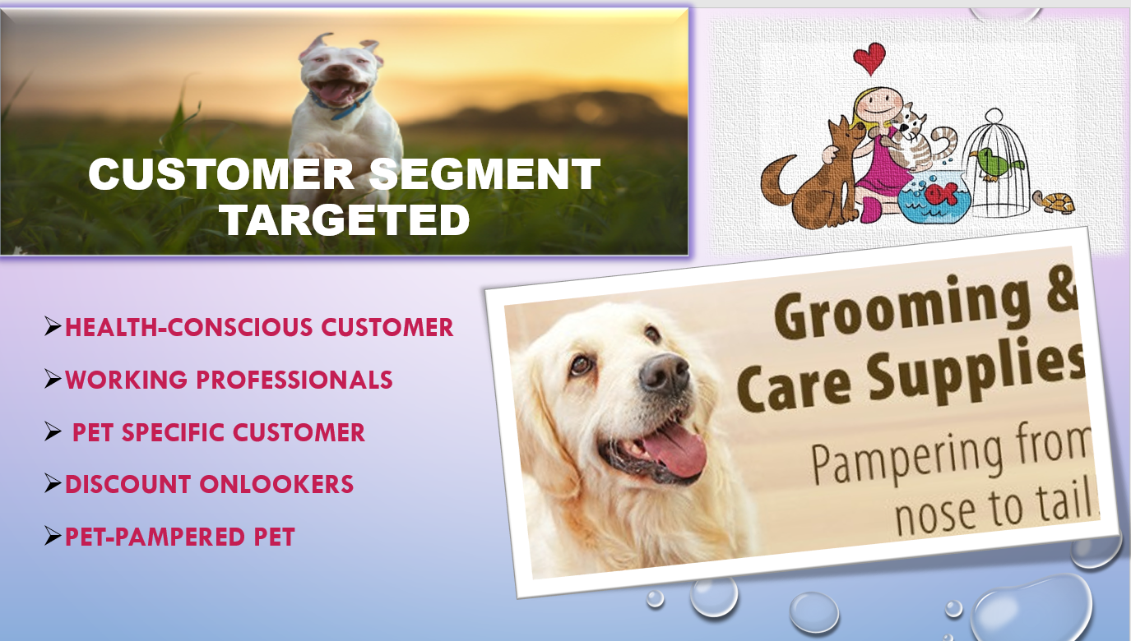

Slide 7
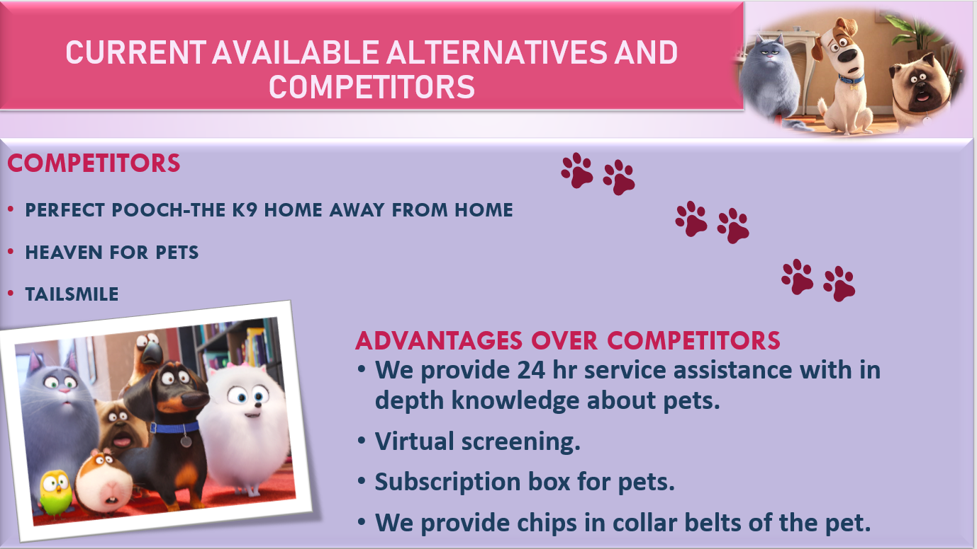

Slide 8
PRODUCT
Owners of breeds that require regular grooming. Many owners will have neither the necessary skills nor the time to groom their pets regularly and so prefer to have a professional do it for them
Professionals and enthusiasts who breed and show animals - particularly dogs and cats
Owners who are not physically able to groom their own pets - perhaps because they are elderly or because they have a disability
Owners of animals that need flea or other parasite treatments, or which need an identity microchip implanted (if we offer this service)
Proprietors of animal boarding kennels and pet shops that offer a grooming service to their customers but are not able to do the grooming themselves
Owners of animals that have been referred to you for grooming by a vet

Slide 9
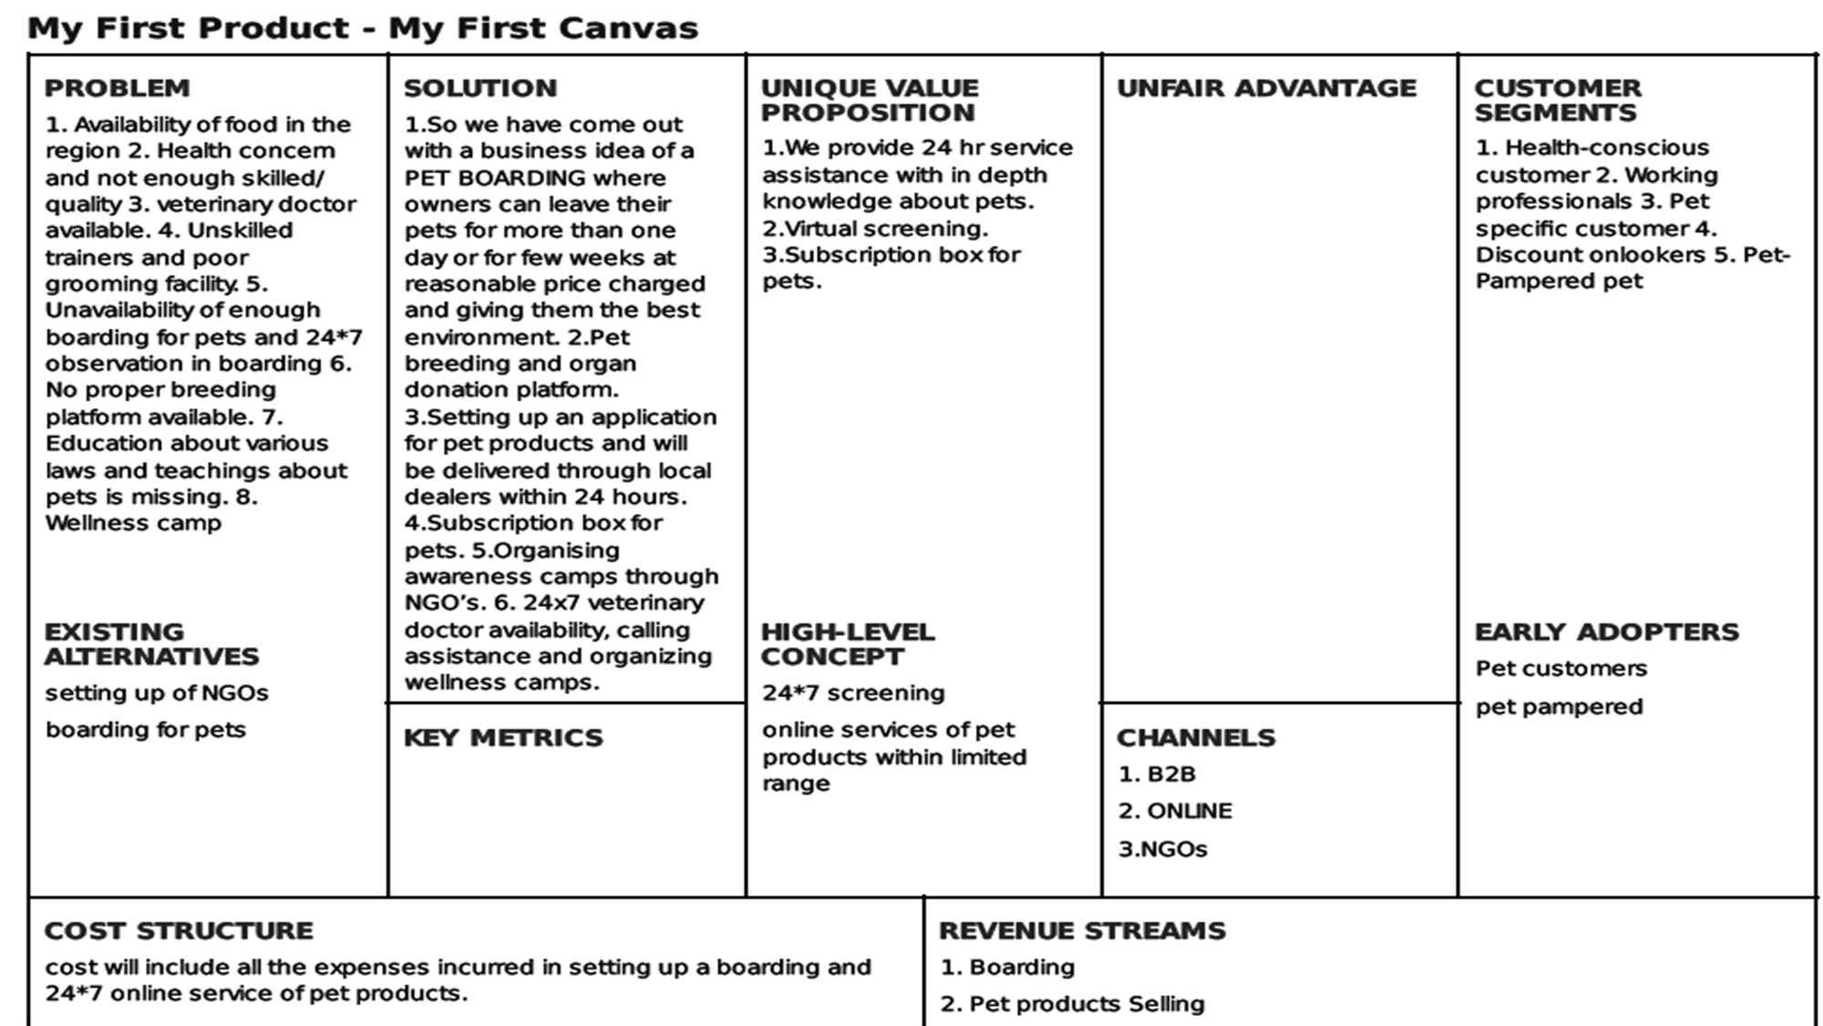

Slide 10
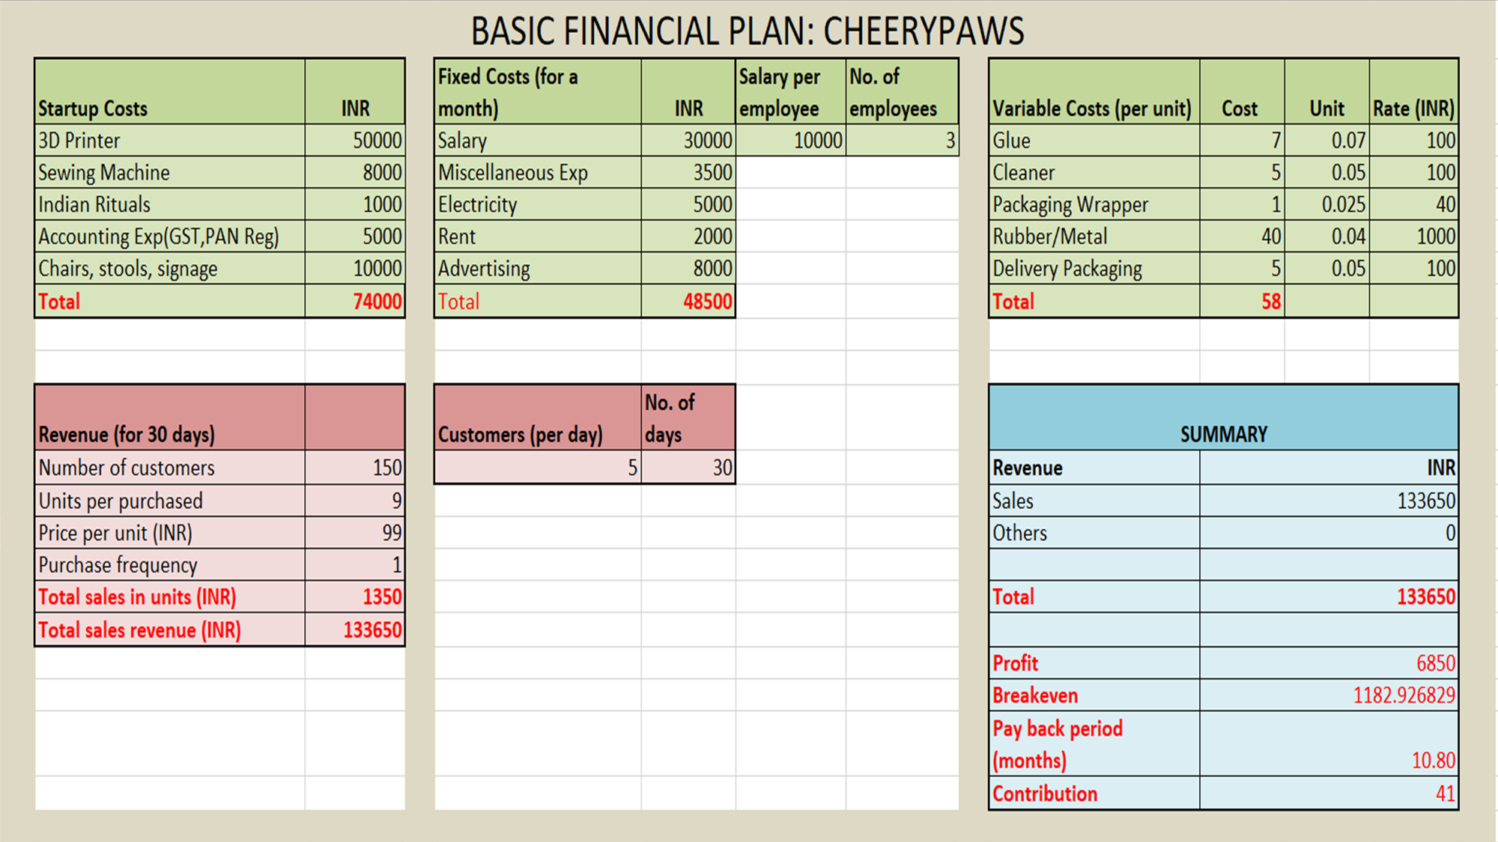

Slide 11
MILESTONES
Establish legal entity (c-corp, s-corp, llc, etc.)
Launch website
Establish market validation aka sign up a few paying customers
Commit to great customer service
Focus on daily and monthly growth rates (get to 10K, 100K, 1M, 10M users)
study start-up marketing strategy
Grow email list with interested customers
Earn mentions on high profile start-up blogs
Develop brand partnerships
Show growth trends
Hire key people (e.g. awesome marketing person)

Slide 12
METRICS
Marketing: CPC (Cost-per-Click) and CPA (Cost-per-Acquisition)
Human Resources: Absenteeism Rate
Sales: Lead-to-Opportunity Ratio and Lead Conversion Ratio
Logistics: Transportation Costs and Delivery Time

Slide 13
RISK EVALUATION AND COPING STRATEGIES
Technical Risks
Battery life- Terrain unfavorable to GPS signals takes longer to establish a location leading to shorter battery life
Solution-Batteries with high life
Market Risks- Entry of new competitors
Solution- Better service with low prices
Operational Risks- Pets might get infection or bite somebody
Solution- Proper monitoring of pets with hygienic environment

Slide 14
LEGAL ENVIRONMENT
Company Structure: It is a known fact that the success of any business is to a larger extent dependent on the business structure of the organization and the people who occupy the available role. The fact that we want to become one of the leading dog boarding services business brand in the industry, we have decided to hire qualified and competent hands to occupy the following positions:
Principal Partner / Chief Executive Officer
Vet Doctor
Dog Handlers / Pet Trainers for Various Skill Sets
Accountant
Marketing and Sales Executive
Client Service Executive
Pet Licensing In India- It is issued by Municipal Corporation authority under section 14, rule number 22(a) sub-claws 386 under Maharashtra Municipal Provincial Act. Average fees for getting license is Rs. 35000.

Slide 15
VISION
We believe that all pets deserve to be happy, healthy and loved. While pets are the cornerstone of our business, our two-legged customers are paramount to our success. We certainly sell all the necessities and frivolities for your pets but we are also Berkeley’s original community resource and gathering space for pet lovers. Simply put, we offer extraordinary service, valuable knowledge and are invitingly priced.

Slide 16


